Slide 1
Entity Resolution Algorithms
Group 13
By
Boxuan Zhao
Zixuan Guan
Zheren Tang
Jihan Wei
Yingxin Zhang
ALLPPT.com _ Free PowerPoint Templates, Diagrams and Charts

Slide 2
Outline
Introduction to Algorithms
Our Evaluations Methods
Result
Questions

Slide 3
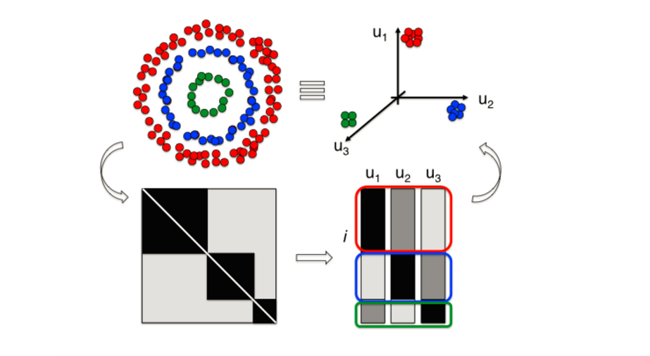
Spectral Clustering Using QR Decomposition

Slide 4
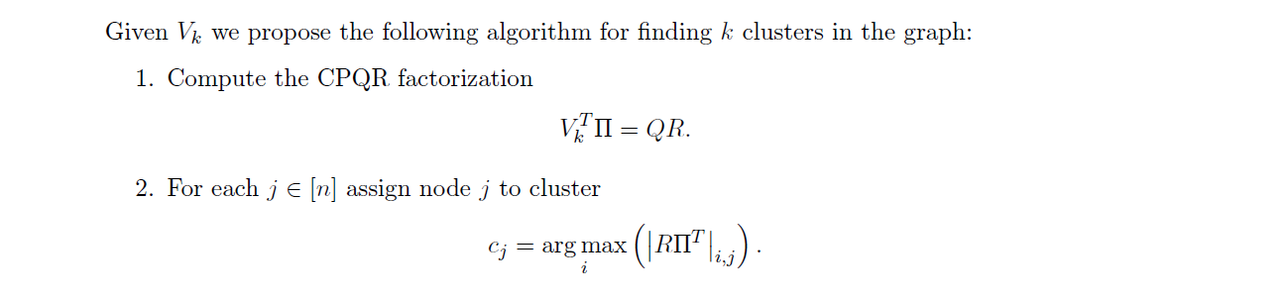
Spectral Clustering Using QR Decomposition

Slide 5
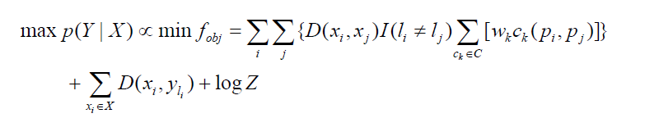
A Constraint-Based Probabilistic Framework approach
An EM algorithm who aims to minimize
My team focus on the c2 criterion(whether two citation vectors have the same
coauthor)
Iterates until convergence criterion (i.e.. There is no change of cluster
assignment) has been satisfied
Have to tune the weight parameter Wk
Have to initialize cluster assignment L for each citation vector
Have to initialize a parameter matrix A for distance calculation
Think about the idea that you want to find cluster assignment that not only
minimize the distance between each point and its center, but also satisfies the
c2 criterion.

Slide 6
A Constraint-Based Probabilistic Framework approach
We initialize our cluster assignment based on C2 constraint, namely
the two citation vectors that have the same coauthor will have the same
cluster assignment
If number of the resulting cluster is greater than our known cluster K,
we cluster the nearest group until K groups left. Otherwise, we randomly sample perturbations of the global centroid to make it up.
Then, based on he current cluster assignment, we reassign each paper by
maximizing p(Y|X), and the cluster centers are also re-estimated from
the assignment, with the same objective to maximize the p(Y|X), with the
distance measure is also updated.
We can finally stop the algorithm when there is no further changes in
cluster assignment.

Slide 7
Evaluation Method
We evaluate the two algorithms using gold standard clusters
The evaluations are carried out using the following two types of features: 1. Tf-idf matrix using all features
2. Tf-idf matrix using individual features
Particularly for paper 6, we have also conducted

Slide 8
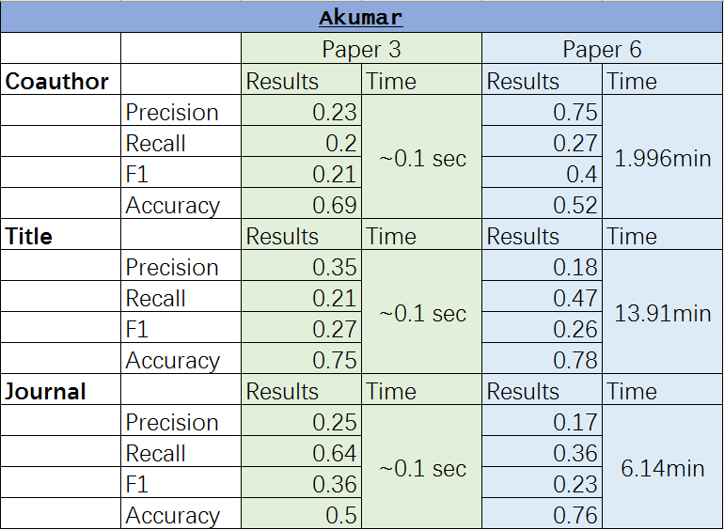
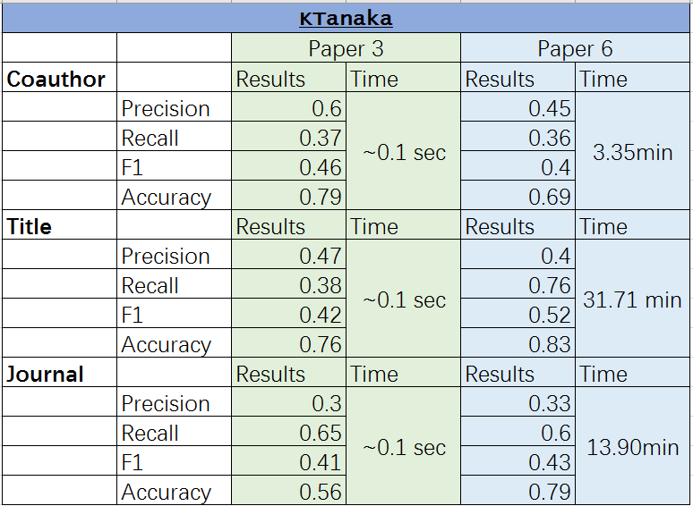
Our Results

Slide 9
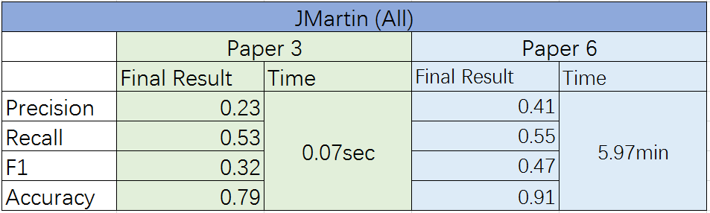
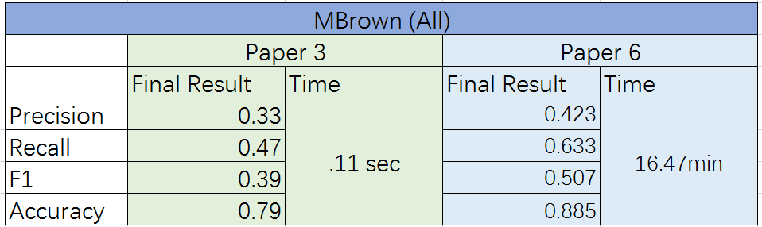
Our Results

Slide 10
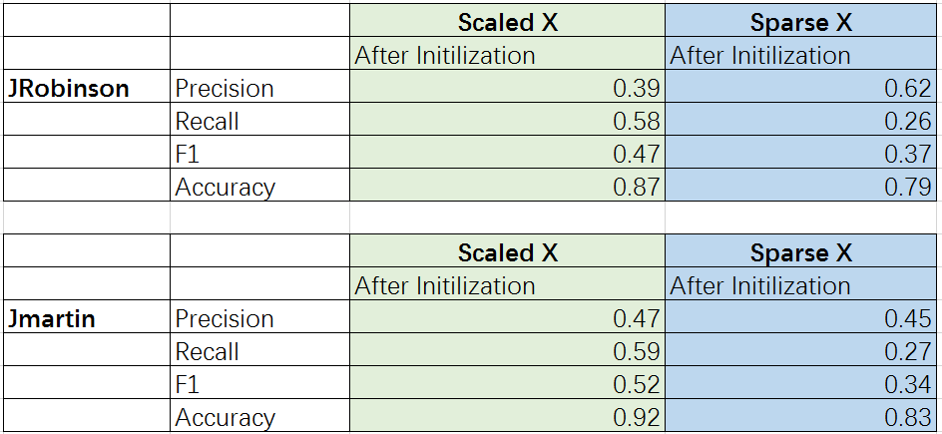
Our Results

Slide 11
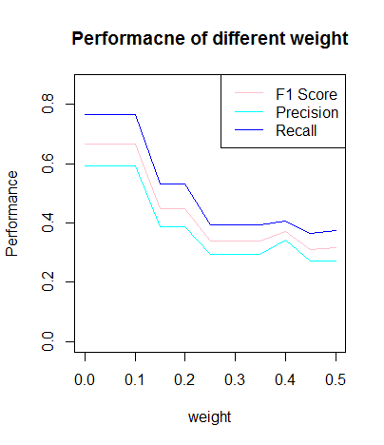
Our Results

Slide 12
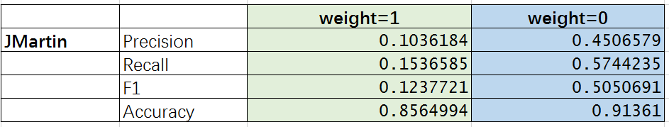
Our Results

Slide 13
Conclusion

Slide 14
Any Questions?

Slide 15
Thanks!
ALLPPT.com _ Free PowerPoint Templates, Diagrams and Charts

