Slide 1
ADS Project 5
Group 3
Yue Gao, Mengchen li, jingwen yin,
chenyun zhu, hongyi zhu

Slide 2
Fragile Families Challenge
A scientific mass collaboration combining:
predictive modeling
causal inference
and qualitative interviews
to improve the lives of disadvantaged children in the US.
Key research question: What can be done to improve the life chances of disadvantaged children?
Social Scientists ←→ Data Scientists

Slide 3
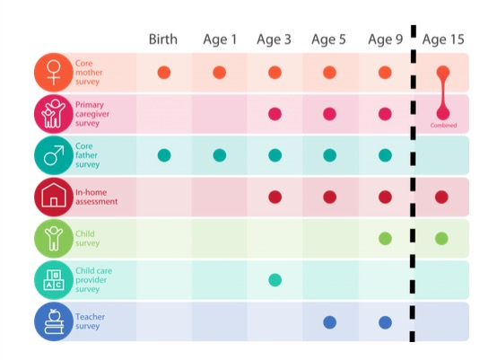
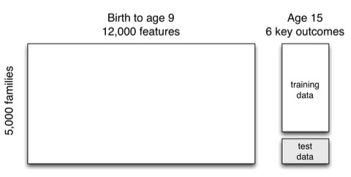
Data Cleansing
Assumption:
Age 9 data has already included all the information from age 0-5
Continuous outcomes:
GPA, Grit, Material hardship
Binary outcomes:
Housing eviction,
Layoff of a caregiver,
Job training for a caregiver

Slide 4
Missing data
Several missing value codes:
-9 Not in wave
-6 Valid skip
-2 Dont know
-1 Refuse
NA also used occasionally
Categorical feature:
Make NA a special level
Continuous feature:
Create a dummy variable indicating the missing situation of the feature
Impute the missing value with median (library: Hmisc)

Slide 5
Feature Selection
Boruta package
Feature results:
Firstly, it adds randomness to the given data set by creating shuffled copies of all features.
Then, it trains a random forest classifier on the extended data set and applies a feature importance measure to evaluate the importance of each feature where higher means more important.
At every iteration, it checks whether a real feature has a higher importance than the best of its shadow features and constantly removes features which are deemed highly unimportant.
Finally, the algorithm stops either when all features gets confirmed or rejected or it reaches a specified limit of random forest runs.
Feature | Selected Number
Eviction | 36
Layoff | 20
Job Training | 20
Material Hardship | 46
GPA | 63
Grit | 21

Slide 6
Prediction
Tried Methods: Linear Regression, Full tree, Pruned tree, Random Forest, Conditional inference trees, gamboostLSS, Gradient Boosting, Support Vector Machine, LM+RF, SVM+RF

Slide 7
Q&A
Final RESULT:
THANK YOU!

