Slide 1
Project 3: Dogs, Fried Chicken or Blueberry Muffins?
Group 10 Members:
Wenyuan Gu
Wenshan Wang
Yiyi Zhang
Xinlei Cao

Slide 2
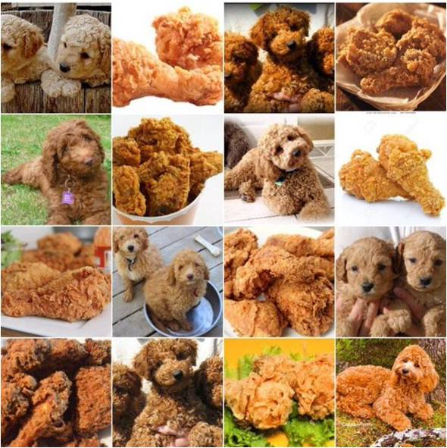
Introduction
In this project, we have created a classification engine for images of poodles, fried chicken and blueberry muffins. Our goal is to improve the prediction accuracy from the baseline model (GBM with decision stumps on 2000 SIFT features) and to enhance computational efficiency in terms of running time, storage and memory cost.

Slide 3
Outline
1
Feature Extraction
2
Model Training
3
Model Selection
4
Outcome

Slide 4
1
Feature Extraction
PART

Slide 5
Feature extraction
SIFT
Baseline
A classical approach, local descriptor
Rotation and scale invariant
HOG
Histogram of Oriented Gradients
Global descriptor
LBP
Local Binary Patterns

Slide 6
2
Model Training
PART

Slide 7
1
Gradient Boosting Model (baseline)
Models
2
Support Vector Machine (SVM)
3
Random Forest (RF)
4
Logistic Regression
5
Xgboost
6
Convolutional Neural Networks(CNN)

Slide 8
3
Model selection
PART

Slide 9


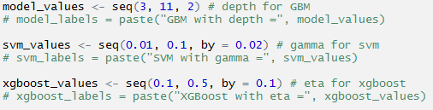
Tune parameter

Slide 10


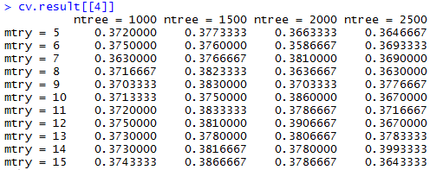
Tune parameter

Slide 11
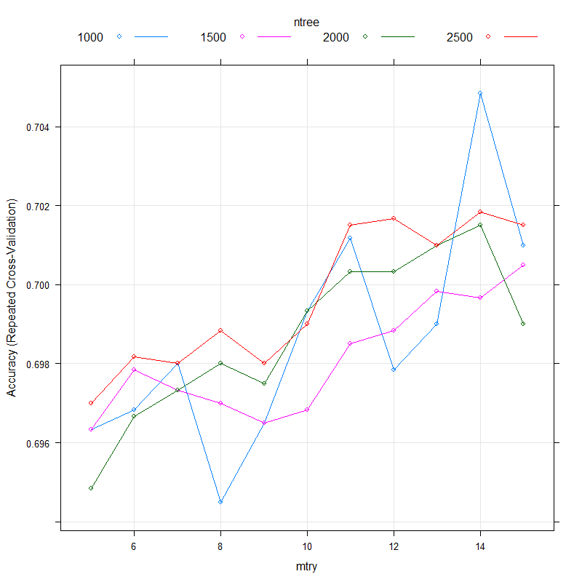
Tune parameter
Visualize cross-validation results

Slide 12
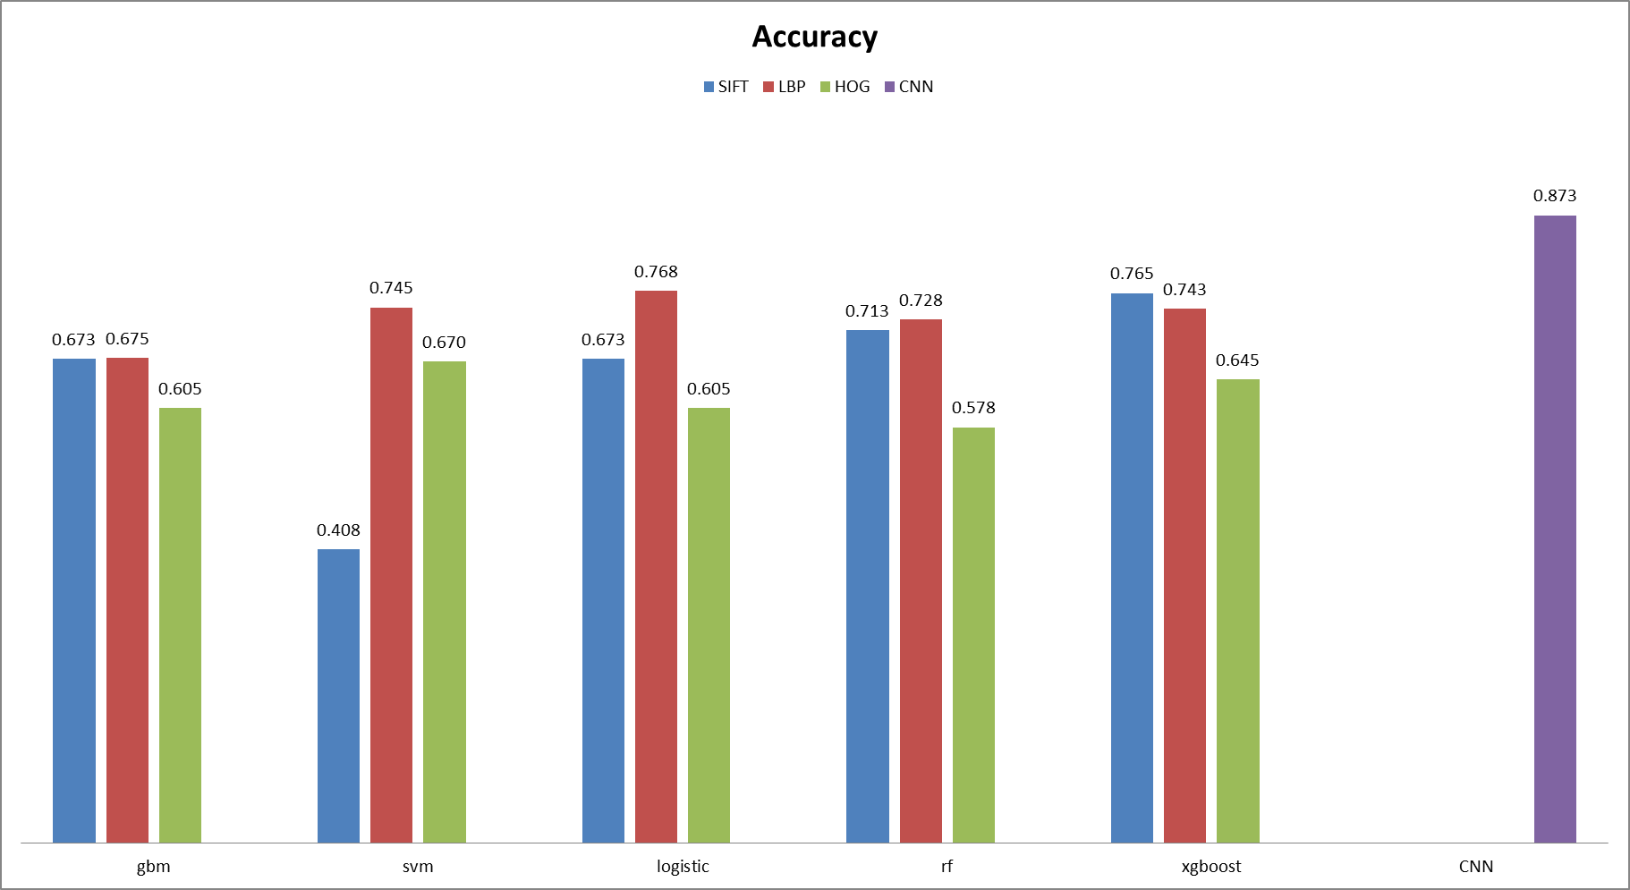
Model selection

Slide 13
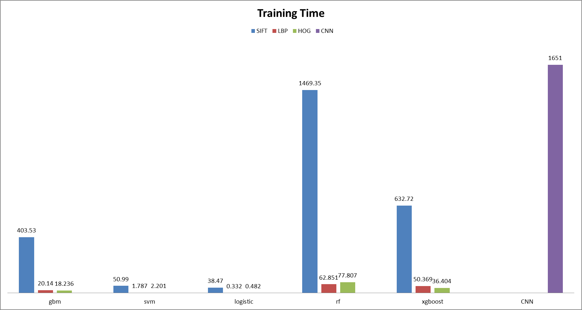
Model selection

Slide 14
4
Outcome
PART

Slide 15
Our Best Model
Local Binary Patterns
+ Logistic Regression
 | Accuracy | Training Time
Baseline(SIFT+GBM) | 67.3% | 403.53s
Improved(LBP+Logistic) | 76.8% | 0.33s

Slide 16
THANKS

