Slide 1
Project 3: Dogs, Fried Chicken or Blueberry Muffins?
Group 6 members:
Wenyuan gu
Wenshan wang
Yiyi zhang
Xinlei cao

Slide 2
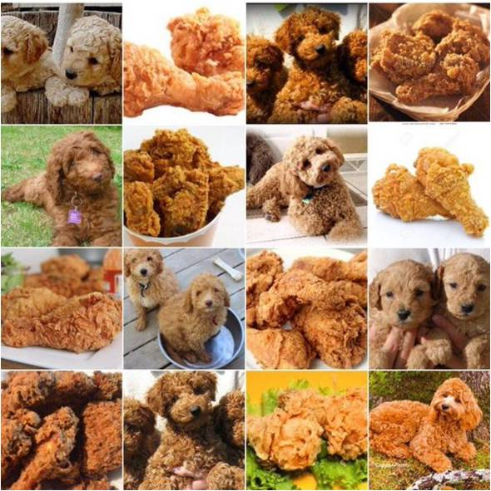
Introduction
In this project, our goal is to classify whether an image is dog, fried chicken or blueberry muffin. We have been given 3,000 images to train our baseline and proposed models, and will run the test on the test images.

Slide 3
Outline
1
Feature extraction
2
Model training
3
Model selection
4
Outcome

Slide 4
1
Feature extraction
PART

Slide 5
Feature extraction
SIFT
Baseline
A classical approach, local descriptor
Rotation and scale invariant
HOG
Histogram of oriented gradients
Global descriptor
LBP
Local binary patterns

Slide 6
2
Model training
PART

Slide 7
1
Gradient Boosting Model(baseline)
Models
2
SVM – Support Vector Machine
3
RF—Random Forest
4
Logistic regression
5
Xgboost

Slide 8
3
Model selection
PART

Slide 9


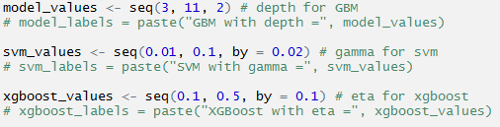
Tune parameter

Slide 10


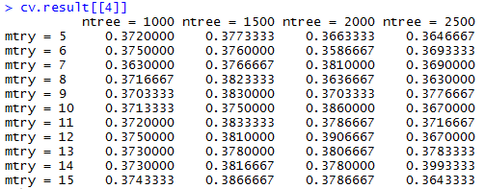
Tune parameter

Slide 11
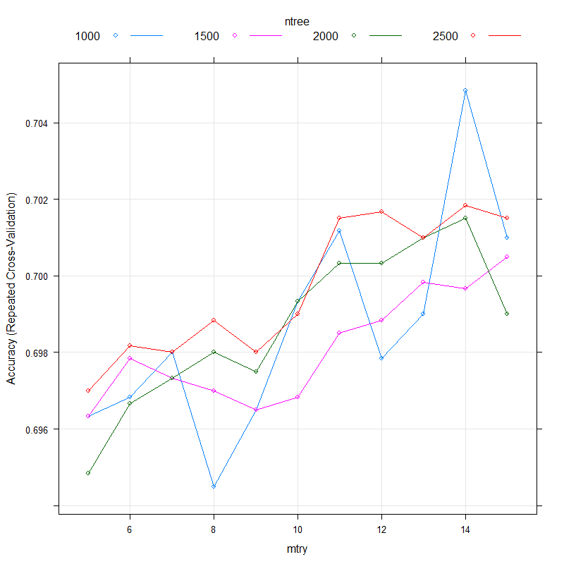
Tune parameter
Visualize cross-validation results

Slide 12
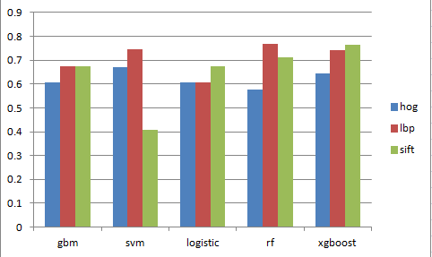
Model selection
Accuracy

Slide 13
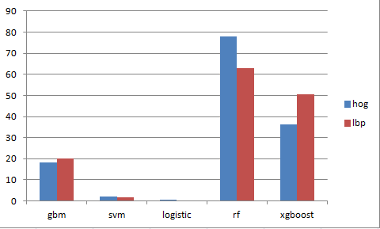
Model selection
Training time

Slide 14
4
Outcome
PART

Slide 15
Our best model
Local binary patterns
+ Random forest

Slide 16
THANKS

