Slide 1
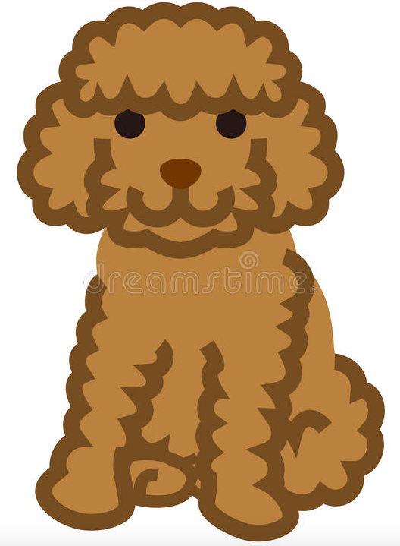
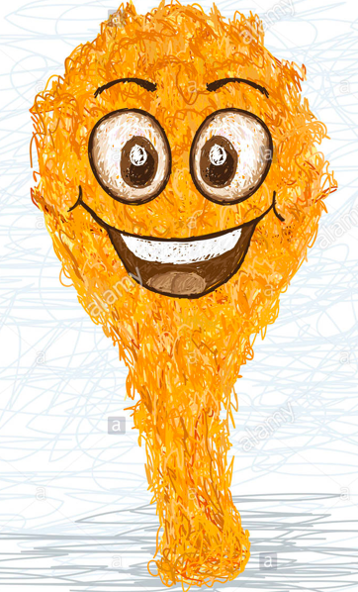
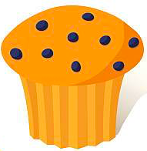
Dog or Fried Chicken or Muffins?
Model evaluation and selection using Predictive Analytics
Group 7: Anshuma Chandak, Yuexuan Huang, Xinrou Li, Fangbing Liu, Xiuruo Yan
Group 7: Anshuma Chandak, Yuexuan Huang, Xinrou Li, Fangbing Liu, Xiuruo Yan
Group 7: Anshuma Chandak, Yuexuan Huang, Xinrou Li, Fangbing Liu, Xiuruo Yan

Slide 2
Agenda
Discuss Project Goals
Model Selection
Final Model Proposal
Test Data Results

Slide 3
Project Goals
1

Slide 4
Propose a feasible improvement in client’s current practice to distinguish pictures of dogs (poodles and Chihuahuas), fried chicken and blueberry muffins.
In terms of ?
Storage, Memory cost
Computational Efficiency – Running time cost on Test data
Predictive Power - Accuracy and Error rates

Slide 5
Model Selection
2

Slide 6
Model selection is the task of selecting a statistical model from a set of candidate models
Methodology:
Select a varied set of classifiers
Select a varied set of feature extraction methods
Build different models by combining different classifiers and features
Test each model with respect to –
Accuracy – Train & Test Error
Running Time

Slide 7
We used a combination of the following classifiers and feature extraction methods:
Classifiers
XG Boost
GBM
SVM Linear
SVM RBF Kernel
Random Forest
Logistic
AdaBoost
Feature Extraction | No. of features
SIFT | 2000
SIFT + PCA | 100
Histogram of oriented gradients (HOG) | 54
Gray | 250
Color | 2000

Slide 8
Overview of Terminology
Feature : Piece of information that describes a part of image or whole image. These features could be corners, edges, lines, color, etc.
Feature Extraction: Transforming the input data into the set of features. It is a form of dimensionality reduction.
Properties of good features:
Repeatability
Saliency (descriptiveness)
Compactness

Slide 9
Baseline: GBM + SIFT
Client is currently using Boosted Decision Stumps on SIFT Features yield the following summary findings, based on data of 3000 images.
Test Error Rate: 28.89%
Train Error Rate: 2.19 %
Running Time (on test data) : 0.805 seconds

Slide 10
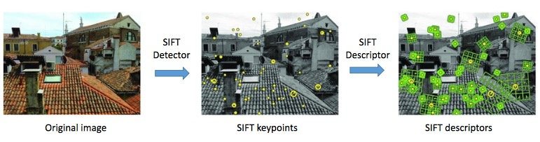
Feature: SIFT
Image: matlab SIFT tutorial

Slide 11
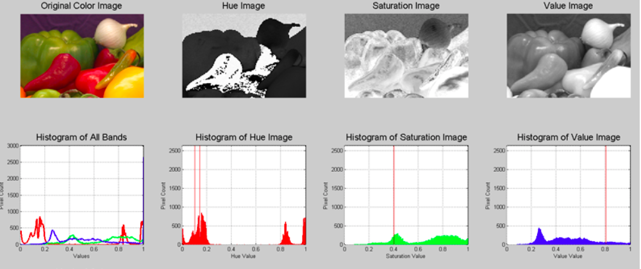
Feature: Color (RGB + HSV)
Image: mathworks website

Slide 12
Model Selection on SIFT features
Model | GBM | XG Boost | AdaBoost | SVM (linear) | SVM ( RBF Kernel) | Logistic | Random Forest
Error Rate | 28.89 | 28.44 | 34.53 | 29.03 | 26.36 | 26.53 | 31.3
Running Time | 0.805 | 38.03 | 12.82 | 2.987 | 2.88 | 0.225 | 0.15

Slide 13
Model Selection on SIFT + PCA features
Model | GBM | XG Boost | AdaBoost | SVM (linear) | SVM ( RBF Kernel) | Logistic | Random Forest
Error Rate | 26.11 | 40 | 31.33333 | 32.4 | 29.47 | 30.9 | 29.1
Running Time | 0.029 | 4.05 | 0.262198 | 0.174 | 0.303 | 0.008 | 0.04

Slide 14
Model Selection on HOG features
Model | GBM | XG Boost | AdaBoost | SVM (linear) | SVM ( RBF Kernel) | Logistic | Random Forest
Error Rate | 24 | 25 | 29.2 | 29.16 | 24.37 | 30 | 24.1
Running Time | 0.035 | 2.63 | 0.12 | 0.125 | 0.125 | 0.004 | 0.03

Slide 15
Model Selection on GRAY features
Model | GBM | XG Boost | SVM (linear) | SVM ( RBF Kernel) | Logistic | Random Forest
Error Rate | 44.56 | 45.89 | 52.06 | 47.01 | 42.8 | 41.6
Running Time | 0.034 | 9.68 | 0.612 | 0.676 | 0.202 | 0.03

Slide 16
Model Selection on Color (RGB + HSV) features
Model | GBM | XG Boost | AdaBoost | SVM (linear) | SVM ( RBF Kernel) | Logistic | Random Forest
Error Rate | 13 | 15 | 18 | 29.69 | 27.56 | 29.46 | 13.5
Running Time | 0.86 | 33 | 6.88 | 2.624 | 2.683 | 0.202 | 0.14

Slide 17
Comparative Analysis – SIFT V/S COLOR

Slide 18
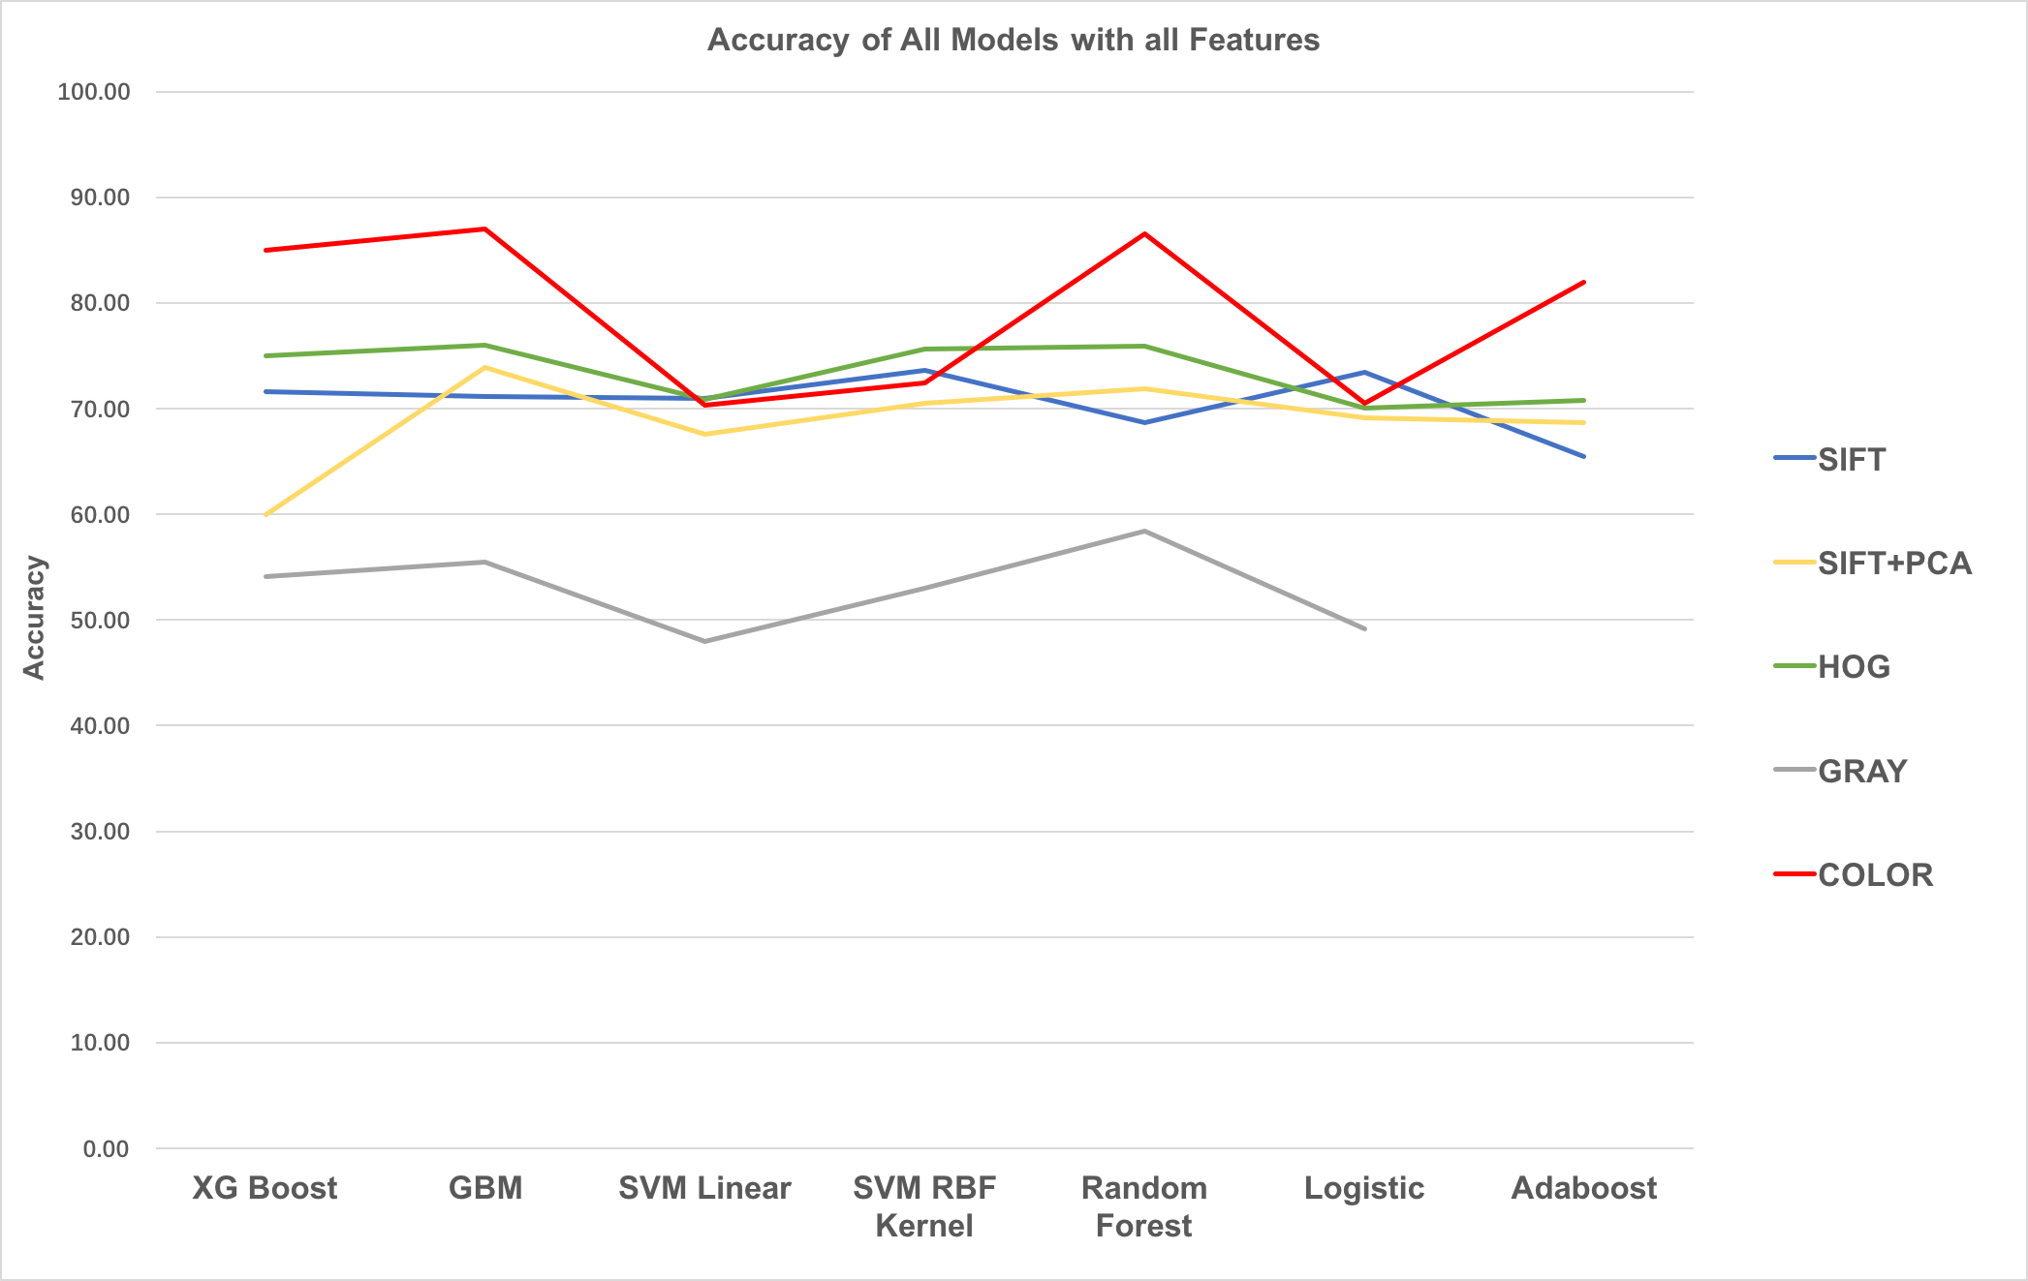
Comparative Analysis – Models with different features

Slide 19
Final Model
3

Slide 20
After comparing several classifiers with different feature extraction methods, we propose our final model- Gradient Boosting Machine with Color Feature.
Parameters | Accuracy rate | Training Error rate | Test Error rate | Running time (in sec)
distribution = "multinomial", n.trees = 441, shrinkage = .1 | 87 | 3.62 | 13 | 0.86
Notes:
10 fold CV : seq(1,500) ; shrinkage: 0.1
30 percent: test set

Slide 21
Test Data Results
4

Slide 22
Given the new testing data of 3000 images, the results of our proposed Final Model are below.
Accuracy:
Running Time:

Slide 23
Thanks!

