Slide 1

Collaborative Filtering Algorithms
Group 10
Yiyi Zhang; Hanying Ji; Jiaqi Dong; Mingming Liu

Slide 2

Data Set
Memory-Based Model
Model-Based Model
Comparison
Conclusion

Slide 3

Part 1
Data Set

Slide 4



Data Set
Microsoft Web Data
EachMovie
61265 users entered a total of 2811983 numeric ratings on 1623 movies, i.e. about 2.4% entries are rated by zero-to-five stars.
The data records the use of www.microsoft.com by 38000 anonymous, randomly-selected users.
implicit
explicit
1 for visit
Score from 1 to 6
0 for no visited
NA for no rated
Use Ranked Score to evaluate
Use MAE to evaluate

Slide 5
Assignment
Algorithm | Component | Variants | Data
Memory-based Algorithm | Similarity Weight | Pearson | 1,2
 |  | Spearman | 1,2
 |  | SimRank | 1
 | Variance Weighting | No | 1,2
 |  | Yes | 1,2
 | Selecting Neighbors | Weight Threshold | 1,2
Model-based Algorithm | Cluster Models |  | 2
01
02
03
发展趋势
形势倒逼
内在需求

Slide 6
Part 2
Memory-Based Algorithm

Slide 7


Memory-Based Algorithm
PPT模板下载：www.1ppt.com/moban/ 行业PPT模板：www.1ppt.com/hangye/
节日PPT模板：www.1ppt.com/jieri/ PPT素材下载：www.1ppt.com/sucai/
PPT背景图片：www.1ppt.com/beijing/ PPT图表下载：www.1ppt.com/tubiao/
优秀PPT下载：www.1ppt.com/xiazai/ PPT教程： www.1ppt.com/powerpoint/
Word教程： www.1ppt.com/word/ Excel教程：www.1ppt.com/excel/
资料下载：www.1ppt.com/ziliao/ PPT课件下载：www.1ppt.com/kejian/
范文下载：www.1ppt.com/fanwen/ 试卷下载：www.1ppt.com/shiti/
教案下载：www.1ppt.com/jiaoan/
字体下载：www.1ppt.com/ziti/

Slide 8
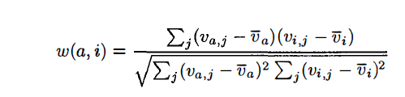

Similarity Weighting
Pearson Correlation
Spearman Correlation
PPT模板下载：www.1ppt.com/moban/ 行业PPT模板：www.1ppt.com/hangye/
节日PPT模板：www.1ppt.com/jieri/ PPT素材下载：www.1ppt.com/sucai/
PPT背景图片：www.1ppt.com/beijing/ PPT图表下载：www.1ppt.com/tubiao/
优秀PPT下载：www.1ppt.com/xiazai/ PPT教程： www.1ppt.com/powerpoint/
Word教程： www.1ppt.com/word/ Excel教程：www.1ppt.com/excel/
资料下载：www.1ppt.com/ziliao/ PPT课件下载：www.1ppt.com/kejian/
范文下载：www.1ppt.com/fanwen/ 试卷下载：www.1ppt.com/shiti/
教案下载：www.1ppt.com/jiaoan/
字体下载：www.1ppt.com/ziti/

Slide 9
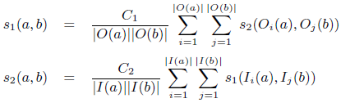
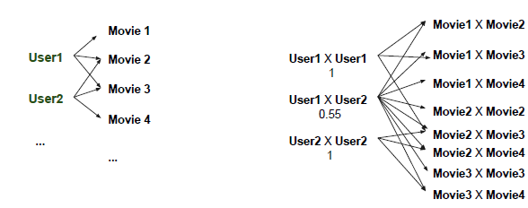
Similarity Weighting
Simrank
web1
web1
web2
web2
web1
web3
web3
web1
web4
web4
web2
web2
web2
web3
web2
web4
web3
web3
web3
web4
PPT模板下载：www.1ppt.com/moban/ 行业PPT模板：www.1ppt.com/hangye/
节日PPT模板：www.1ppt.com/jieri/ PPT素材下载：www.1ppt.com/sucai/
PPT背景图片：www.1ppt.com/beijing/ PPT图表下载：www.1ppt.com/tubiao/
优秀PPT下载：www.1ppt.com/xiazai/ PPT教程： www.1ppt.com/powerpoint/
Word教程： www.1ppt.com/word/ Excel教程：www.1ppt.com/excel/
资料下载：www.1ppt.com/ziliao/ PPT课件下载：www.1ppt.com/kejian/
范文下载：www.1ppt.com/fanwen/ 试卷下载：www.1ppt.com/shiti/
教案下载：www.1ppt.com/jiaoan/
字体下载：www.1ppt.com/ziti/

Slide 10


Similarity Weighting
Simrank
PPT模板下载：www.1ppt.com/moban/ 行业PPT模板：www.1ppt.com/hangye/
节日PPT模板：www.1ppt.com/jieri/ PPT素材下载：www.1ppt.com/sucai/
PPT背景图片：www.1ppt.com/beijing/ PPT图表下载：www.1ppt.com/tubiao/
优秀PPT下载：www.1ppt.com/xiazai/ PPT教程： www.1ppt.com/powerpoint/
Word教程： www.1ppt.com/word/ Excel教程：www.1ppt.com/excel/
资料下载：www.1ppt.com/ziliao/ PPT课件下载：www.1ppt.com/kejian/
范文下载：www.1ppt.com/fanwen/ 试卷下载：www.1ppt.com/shiti/
教案下载：www.1ppt.com/jiaoan/
字体下载：www.1ppt.com/ziti/

Slide 11

Variance Weighting
Vairance Weighting
(Pearson Correlation)
PPT模板下载：www.1ppt.com/moban/ 行业PPT模板：www.1ppt.com/hangye/
节日PPT模板：www.1ppt.com/jieri/ PPT素材下载：www.1ppt.com/sucai/
PPT背景图片：www.1ppt.com/beijing/ PPT图表下载：www.1ppt.com/tubiao/
优秀PPT下载：www.1ppt.com/xiazai/ PPT教程： www.1ppt.com/powerpoint/
Word教程： www.1ppt.com/word/ Excel教程：www.1ppt.com/excel/
资料下载：www.1ppt.com/ziliao/ PPT课件下载：www.1ppt.com/kejian/
范文下载：www.1ppt.com/fanwen/ 试卷下载：www.1ppt.com/shiti/
教案下载：www.1ppt.com/jiaoan/
字体下载：www.1ppt.com/ziti/

Slide 12
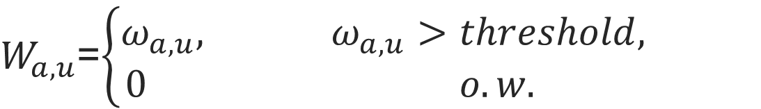
Selecting neighbors
Selecting neighbors
(Weight Threshold)
$W_{a,u}$=$\left\{\begin{aligned}ω_{a,u}, ω_{a,u}>threshold, \\ 0 o.w. \end{aligned}\right.$
PPT模板下载：www.1ppt.com/moban/ 行业PPT模板：www.1ppt.com/hangye/
节日PPT模板：www.1ppt.com/jieri/ PPT素材下载：www.1ppt.com/sucai/
PPT背景图片：www.1ppt.com/beijing/ PPT图表下载：www.1ppt.com/tubiao/
优秀PPT下载：www.1ppt.com/xiazai/ PPT教程： www.1ppt.com/powerpoint/
Word教程： www.1ppt.com/word/ Excel教程：www.1ppt.com/excel/
资料下载：www.1ppt.com/ziliao/ PPT课件下载：www.1ppt.com/kejian/
范文下载：www.1ppt.com/fanwen/ 试卷下载：www.1ppt.com/shiti/
教案下载：www.1ppt.com/jiaoan/
字体下载：www.1ppt.com/ziti/

Slide 13
Result – Data1
Rank Score | Z-Score |  |  |  |  | Deviation for Mean
 |  | Variance=OFF |  | Variance=ON |  | Variance=OFF |  | Variance=ON
 |  | Pearson | Spearman | Pearson | SimRank | Pearson | Spearman | Pearson | SimRank
Weight Threshold | 0 | 39.86163 (100%) | 39.86163 (100%) | 39.922428 (100%) | 40.77057 | 39.784768 (100%) | 39.784768 (100%) | 39.849374 (100%) | 40.77628
 | 0.2 | 39.364175 (52.42%) | 39.364175 (52.42%) | 39.977511 (50.15%) |  | 39.459138 (52.42%) | 39.459138 (52.42%) | 39.959964 (50.15%)
 | 0.3 | 38.077085 (29.03%) | 38.077087 (29.02%) | 39.145602 (34.91%) |  | 38.171786 (29.03%) | 38.171798 (29.02%) | 39.233054 (34.91%)
 | 0.4 | 5.820478 (15.14%) | 5.820477 (15.14%) | 38.091526 (21.31%) |  | 5.857705 (15.14%) | 5.857706 (15.14%) | 38.232782 (21.31%)
 | 0.5 | 1.835299 (5.76%) | 1.837463 (5.77%) | 5.856577 (11.02%) |  | 1.8487 (5.76%) | 1.846338 (5.77%) | 5.871136 (11.02%)
PPT模板下载：www.1ppt.com/moban/ 行业PPT模板：www.1ppt.com/hangye/
节日PPT模板：www.1ppt.com/jieri/ PPT素材下载：www.1ppt.com/sucai/
PPT背景图片：www.1ppt.com/beijing/ PPT图表下载：www.1ppt.com/tubiao/
优秀PPT下载：www.1ppt.com/xiazai/ PPT教程： www.1ppt.com/powerpoint/
Word教程： www.1ppt.com/word/ Excel教程：www.1ppt.com/excel/
资料下载：www.1ppt.com/ziliao/ PPT课件下载：www.1ppt.com/kejian/
范文下载：www.1ppt.com/fanwen/ 试卷下载：www.1ppt.com/shiti/
教案下载：www.1ppt.com/jiaoan/
字体下载：www.1ppt.com/ziti/

Slide 14
Result – Data2
MAE | Z-Score |  |  |  | Deviation for Mean
 |  | Variance=OFF |  | Variance=ON | Variance=OFF |  | Variance=ON
 |  | Pearson | Spearman | Pearson | Pearson | Spearman | Pearson
Weight Threshold | 0 | 1.428475 (100%) | 1.593824 (100%) | 1.88334 (100%) | 1.336934 (100%) | 1.319426 (100%) | 1.69374 (100%)
 | 0.2 | 1.137397 (57.83%) | 1.137854 (57.81%) | 1.145734 (50.10%) | 1.135716 (57.83%) | 1.136039 (57.81%) | 1.139967 (50.18%)
 | 0.3 | 1.147375 (40.65%) | 1.149654 (39.92%) | 1.159057 (34.82%) | 1.140594 (40.64%) | 1.142161 (39.92%) | 1.140594 (40.64%)
 | 0.4 | 1.16645 (24.28%) | 1.171506 (23.15%) | 1.182244 (21.21%) | 1.149662 (24.28%) | 1.1532 (23.15%) | 1.149662 (24.28%)
 | 0.5 | 1.202854 (11.80%) | 1.210711 (10.82%) | 1.216701 (10.93%) | 1.169631 (11.80%) | 1.174899 (10.82%) | 1.169631 (11.81%)
PPT模板下载：www.1ppt.com/moban/ 行业PPT模板：www.1ppt.com/hangye/
节日PPT模板：www.1ppt.com/jieri/ PPT素材下载：www.1ppt.com/sucai/
PPT背景图片：www.1ppt.com/beijing/ PPT图表下载：www.1ppt.com/tubiao/
优秀PPT下载：www.1ppt.com/xiazai/ PPT教程： www.1ppt.com/powerpoint/
Word教程： www.1ppt.com/word/ Excel教程：www.1ppt.com/excel/
资料下载：www.1ppt.com/ziliao/ PPT课件下载：www.1ppt.com/kejian/
范文下载：www.1ppt.com/fanwen/ 试卷下载：www.1ppt.com/shiti/
教案下载：www.1ppt.com/jiaoan/
字体下载：www.1ppt.com/ziti/

Slide 15
Part 3
Model-Based Algorithm

Slide 16


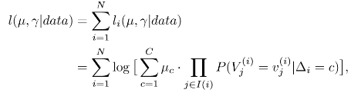
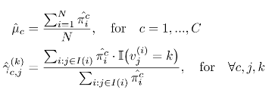

Model-Based Algorithm
Score Estimation
Log-likelihood Function
EM Algorithm
PPT模板下载：www.1ppt.com/moban/ 行业PPT模板：www.1ppt.com/hangye/
节日PPT模板：www.1ppt.com/jieri/ PPT素材下载：www.1ppt.com/sucai/
PPT背景图片：www.1ppt.com/beijing/ PPT图表下载：www.1ppt.com/tubiao/
优秀PPT下载：www.1ppt.com/xiazai/ PPT教程： www.1ppt.com/powerpoint/
Word教程： www.1ppt.com/word/ Excel教程：www.1ppt.com/excel/
资料下载：www.1ppt.com/ziliao/ PPT课件下载：www.1ppt.com/kejian/
范文下载：www.1ppt.com/fanwen/ 试卷下载：www.1ppt.com/shiti/
教案下载：www.1ppt.com/jiaoan/
字体下载：www.1ppt.com/ziti/

Slide 17
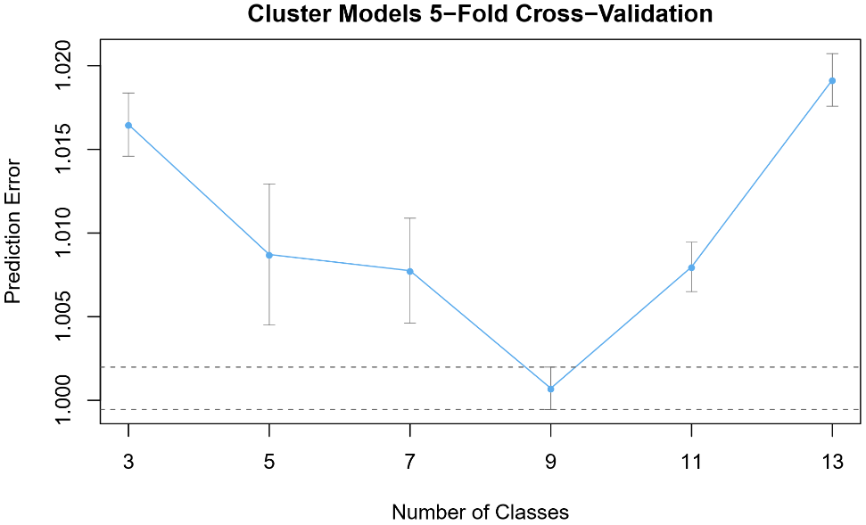
Cross-Validation
MAE for test set: 1.360271
PPT模板下载：www.1ppt.com/moban/ 行业PPT模板：www.1ppt.com/hangye/
节日PPT模板：www.1ppt.com/jieri/ PPT素材下载：www.1ppt.com/sucai/
PPT背景图片：www.1ppt.com/beijing/ PPT图表下载：www.1ppt.com/tubiao/
优秀PPT下载：www.1ppt.com/xiazai/ PPT教程： www.1ppt.com/powerpoint/
Word教程： www.1ppt.com/word/ Excel教程：www.1ppt.com/excel/
资料下载：www.1ppt.com/ziliao/ PPT课件下载：www.1ppt.com/kejian/
范文下载：www.1ppt.com/fanwen/ 试卷下载：www.1ppt.com/shiti/
教案下载：www.1ppt.com/jiaoan/
字体下载：www.1ppt.com/ziti/

Slide 18
Comparison —— Data 2
 | MAE
Cluster Model | 1.360271
Memory-Based Model ( Corrleation = Pearson Variance = No Threshold =0.2) | 1.135716

Slide 19
Conclusion
For data1,
Simrank correlation is better than other correlation
For data2,
Memory-Based Model (pearson, threshold=0.2) is better than Cluster Model
1
4
Conclusion
2
Variance Weighting improves the performance for data1, while lowers the performance for data2
The best threshold is 0.2 for both data sets
3

Slide 20
Thank You!
Group 10
Yiyi Zhang; Hanying Ji; Jiaqi Dong; Mingming Liu

