Slide 1
Group 4
Collaborative Filtering
Algorithms
Group Member: Du Guo
Yu Tong
Xiuruo Yan
Lan Wen
Yuhan Zha

Slide 2

CONTENTS
1
Data Sets
2
Memory Based Algorithm
3
Model Based Algorithm
4
Evaluation
5
Result Analysis

Slide 3
Data Set Info
Data Set 1: Anonymous Microsoft Web Data
Data Set 2: Movies Grading Data
Binary (0 for not visited & 1 for visited)
User: User indices range from 10010 to 42708
Feature (web): Site indices ranging from 1000 to 1295
Train: 4151* 85
Test: 665 * 85
6 Categories ( movie rating from 1 to 6)
User: User indices range from 1 to 74418
Feature(Movie):Movie indices range from 1 to 1648
Train: 5055 * 1619
Test: 5055 * 1597

Slide 4
Implementation: Variants being tested
Algorithm | Component | Variants | Data
Memory-based Algorithm | Similarity Weight | Pearson Correlation | 1,2
 |  | Mean Square Difference | 1,2
 |  | SimRank | 1
 | Variance Weighting | No | 1,2
 | Selecting Neighbors | Weight Threshold | 1,2
 |  | Best-n-estimator | 1,2
 |  | Combined | 1,2
 | Rating Normalization | Deviation for Mean | 1,2
 |  | Z-score | 1,2
Model-based Algorithm | Cluster Models |  | 1

Slide 5

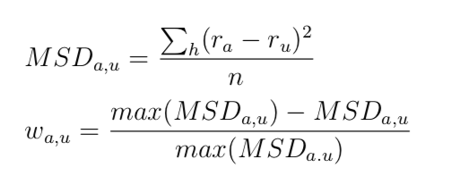
Weight all users with respect to similarity with the active user:
Similarity Weight:
Pearson Correlation
Measures the degree to which a linear relationship exists between two variables
Mean Square Difference

Slide 6

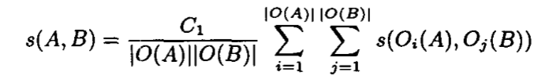
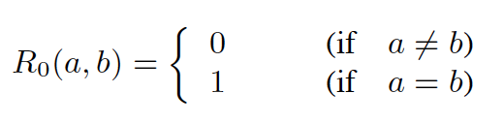
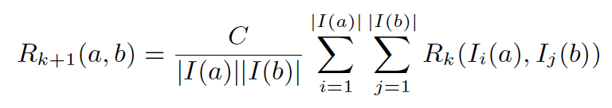
SimRank
For the algorithm of SimRank, we mainly implement these two equations below
The way to compute SimRank is the naïve method:

Slide 7
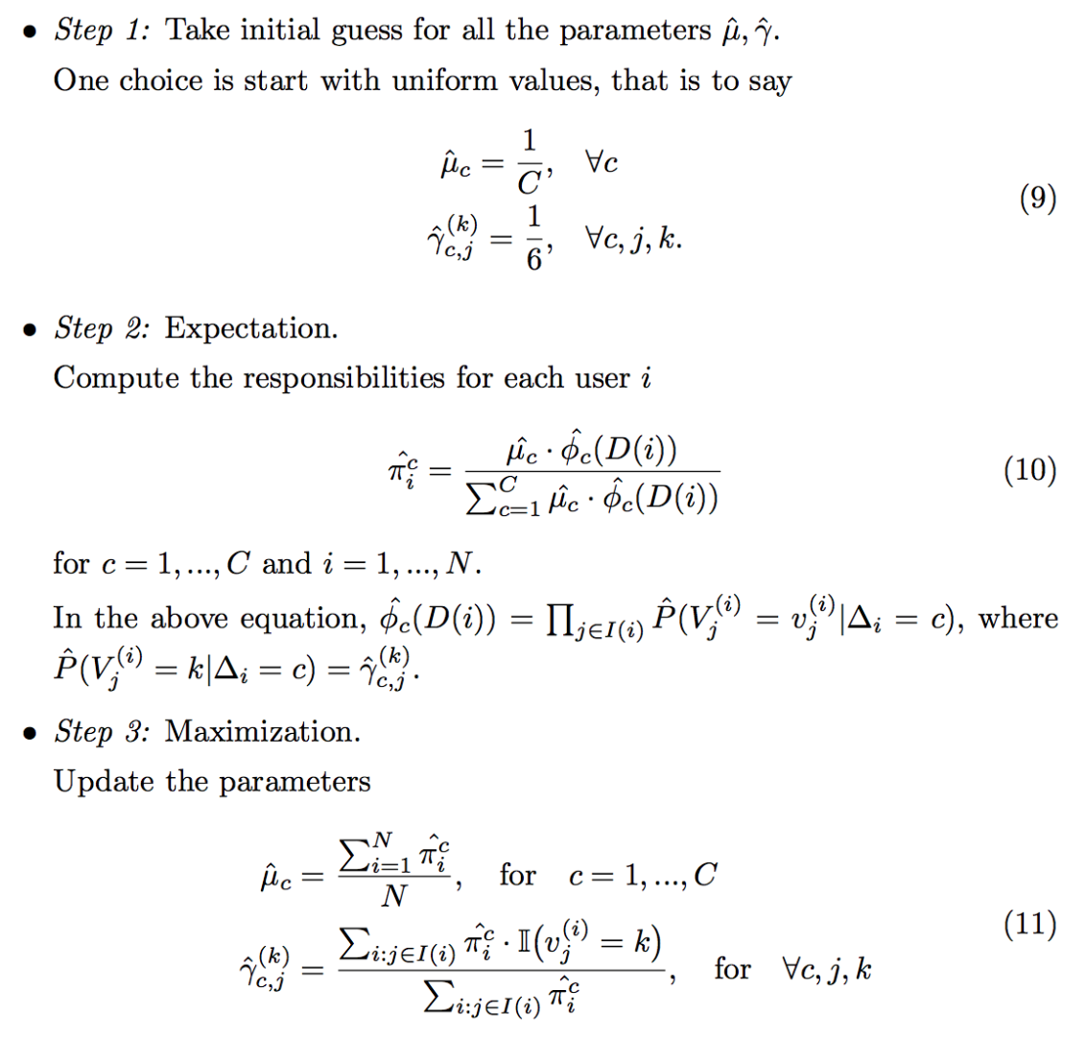
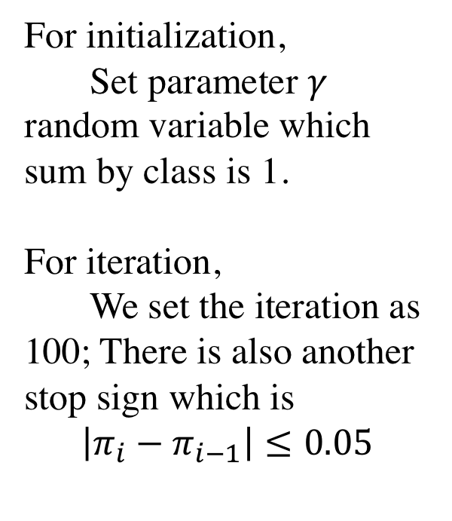
Model Based Algorithm – Cluster Model
For initialization,
Set parameter $γ$ random variable which sum by class is 1.
For iteration,
We set the iteration as 100; There is also another stop sign which is
$$\left|π_{i}−π_{i−1}\right|≤0.05$$

Slide 9

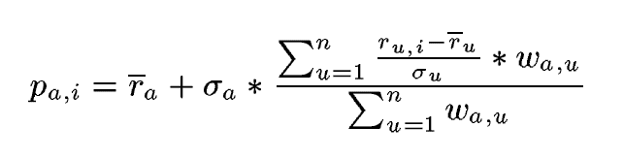
Rating Normalization
Deviation for mean
Z-score:
Notes:
z-score is a normalization
For some users, they may be very strict. They prefer to give low scores even for some good movies. Z-score can prevent this kind of situation

Slide 10
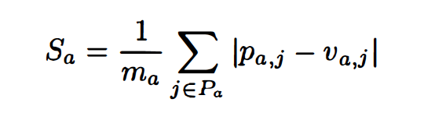
Evaluation
For this part, we applied three evaluation methods to compare the results:
For dataset 1 – Rank Score
- Rank Score
It measures the expected utility of a ranked recommendation list Ra and normalized by the maximum achievable utility Ra_max.
The expected utility of a list is simply the probability of viewing a recommanded item times its utility.
For dataset 2 – MAE
- MAE
MAE is simply to calculate the average absolute deviation for a user :

Slide 11
Results Analysis
Dataset 1: Ranked Scoring
Selecting Nbors Similarity Weight | Weight Threshold |  | Best-N-Estimator |  | Combined
 | 0.05 | 0.2 | 20 | 40 | 0.05 + 40
Pearson Correlation | 45.7274 | 44.05147 | 32.68916 | 34.62473 | 33.7009
Mean-Squared-Difference | 47.77998 | 47.77998 | 33.38771 | 35.12559 | 35.04042
SimRank | 45.985 | 32.1453 | 32.3775 | 33.39524 | 35.0523

Slide 12
Dataset 2: MAE
Selecting Nbors Similarity Weight | Weight Threshold |  | Best-N-Estimator |  | Combined
 | 0.05 | 0.2 | 20 | 40 | 0.05 + 40
Pearson Correlation | 1.187658 | 1.185793 | 1.167949 | 1.167326 | 1.183761
Mean-Squared-Difference | 1.168654 | 1.168654 | 1.170718 | 1.169313 | 1.166298

Slide 13
THANK YOU

