Slide 1
Collaborative Filtering Algorithm
Group Member: Wenyuan Gu
Yuehan Kong
Keran Li
Wenyi Tao
Jingtian Yao
Group 5

Slide 2
Agenda
Data Processing
Algorithm
Evaluation
Main Results

Slide 3
Data Processing
MS
Rearrange the dataset 1 by setting row to users and column to the website and assigning 0 to users who do not click the website.
Dataset
Movie
Rearrange the dataset 2 by setting row to users and column to each movie and assigning NA to users who do not rate the movie.

Slide 4
Memory Based Algorithm
Similarity Weight
Pearson Correlation
Spearman Correlation
SimRank
Variance Weighting
No
Yes
Selecting Neighbors
Weight Threshold
Rating Normalization
Deviation from Mean

Slide 5



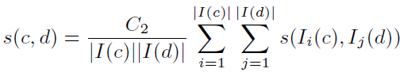
Similarity Weight
Pearson Correlation
Measures the degree to which a linear relationship exists between two variables.
Spearman Correlation
Similar to Pearson but does not rely on model assumptions.
Computes a measure of correlation between ranks instead of rating values.
SimRank
Suppose A, B are two users, the similarity between A and B is
Suppose c, d are two movies, the similarity between c and d is
If A = B, s(A,B) = 1; if c = d, s(c,d) = 1.

Slide 6
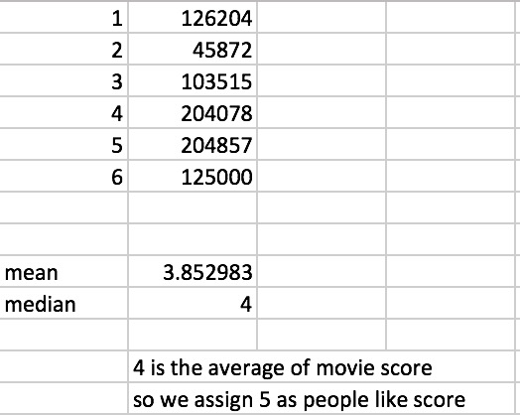
Sim Rank
Assign 1 for the score greater than or equal to 5 and 0 for the score less than 5.

Slide 7


Variance Weighting
The Pearson correlation can be represented as the covariance of two users’ ratings, after the ratings have been scaled to z-scores. (mean 0, standard deviation 1)
By incorporating a variance weight term, we will increase the influence of items with high variance in rating and decrease the influence of items with low variance.

Slide 8
Selecting Neighbors
Weight Threshold
Set an absolute correlation threshold, where all neighbors with absolute correlations greater than a given threshold are selected.
Suggested by Breese is that high correlates (such as those with correlations greater than 0.5) can be exceptionally more valuable as predictors than those with lower correlations.
For SimRank on Movie dataset, weightings are small so we set threshold to 0.006 and for all other methods we set it to 0.5

Slide 9

Rating Normalization
Deviation from Mean
Compute the average deviation of a neighbor’s rating from that neighbor’s mean rating.

Slide 10
Model Based Algorithm-Cluster Model
Input
A sparse matrix, columns are the number of website, rows are users. If the user visited a website, the value is 1 else 0.
Output
Return a recommended list of websites for every user.
Evaluation Criteria: Rank Score
Result
Around 47%-50% (on the test data)

Slide 11

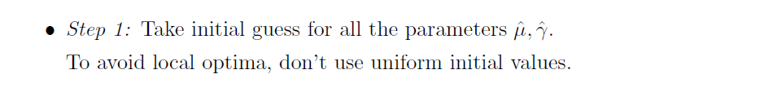
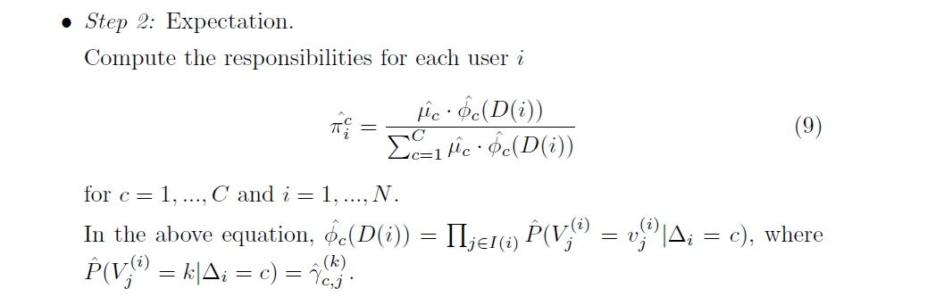
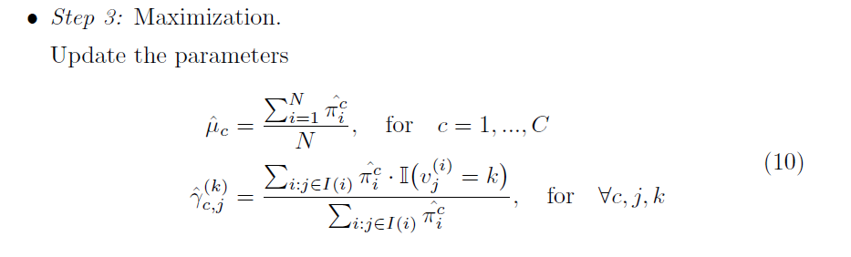

Cluster Model Intuition
A type of naïve Bayesian clustering, all the click events are conditionally independent given a group.
Implement EM algorithm for estimating the parameter.
Draw samples from Dirichlet distribution for the initial value of parameters.
The magnitude is well handled by R, so don’t need particular logarithm process.
These are the MLE estimator from the likelihood function. (closed form since our model are exponential family)
We choose the threshold to be sum(|gamma(i)-gamma(i+1)|)<10

Slide 12
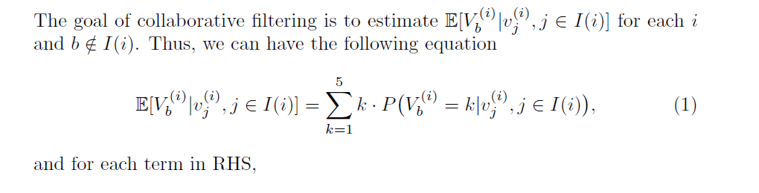
Cluster Model Predicted Scoring
We return a list of all movies with the decreasing order of the score for each user.

Slide 13
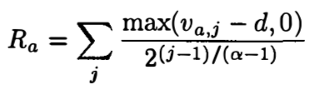

Evaluation
MS Dataset – Rank Score
It estimates the expected utility of a particular ranked list to a user.
The expected utility of a list is simply the probability of viewing a recommended item times its utility.
Movie Dataset – MAE (Mean Absolute Error)
Evaluate the accuracy of a filtering system by comparing the numerical prediction values against user ratings for the items that have both predictions and ratings.

Slide 14
Main Results
Movie Dataset
MAE | Pearson | Spearman | SimRank
None | 1.083907 | 1.074416 | 1.043124
Variance | 1.068813 | 1.069592 | 1.141436
MS Dataset
Rank Score | Pearson | Spearman
None | 35.74765 | 35.73527
Variance | 42.65232 | 42.652

Slide 15
Main Results
Cluster Model
We have tried K=3, 4, 5 to tune the parameter of cluster number.
The best prediction is 47.7 rank score with the corresponding K = 3.
K | Rank Score
3 | 47.7
4 | 42.57
5 | 46.04

Slide 16
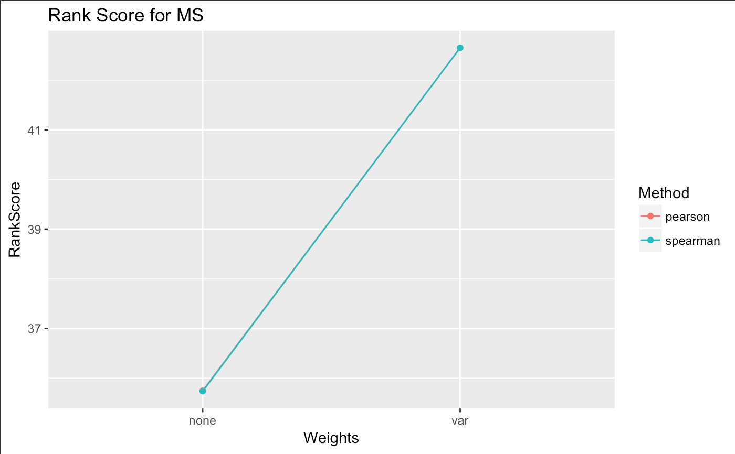
Main Results
Pearson correlation and spearman correlation perform similar.
Both improved after variance adjustment.

Slide 17
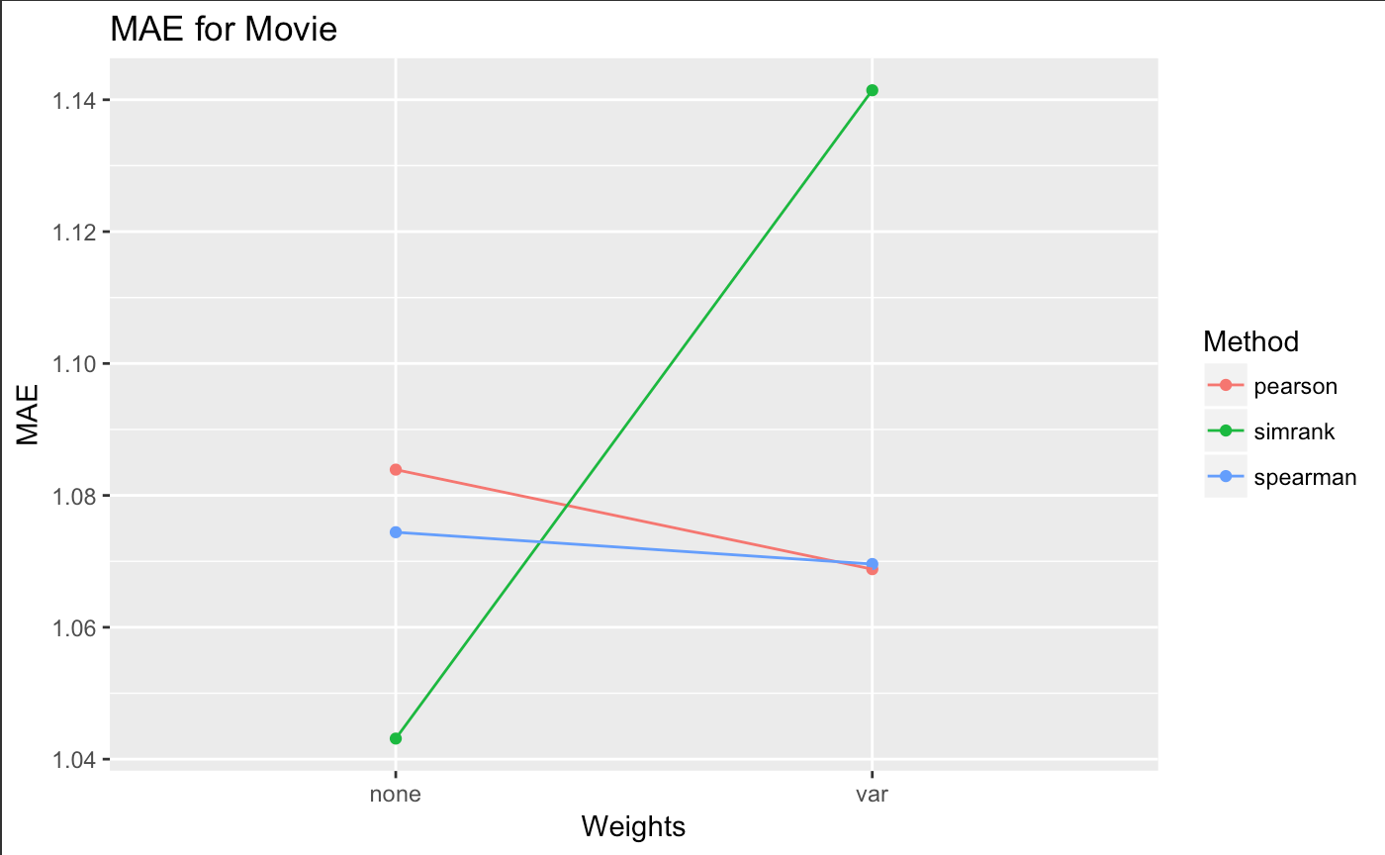
Main Results
SimRank performs better without variance adjustment but pearson correlation and spearman correlation perform better with variance adjustment.

Slide 18
Thank you!

