Slide 1
Project4
Collaborative Filtering
PRESENTED BY Group 7
Ding, Xueying,
Fan, Xiaochen,
Guo, Tao,
Jiang, Chenfei,
Yu, Linna

Slide 2
Contents
Data
Evaluation
Memory-based Algorithm
Model-based Algorithm
Result

Slide 3
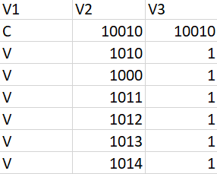
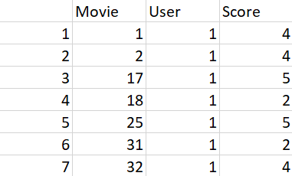
DATA
MS
Movie

Slide 4
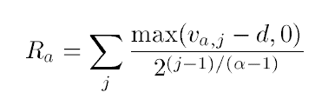

Evaluation
For MS:
Rank Score
For Movie:
MAE: mean absolute error
ROC: true positive rate ~ false positive rate

Slide 5
Selecting Neighbor
Similarity
Weight
Prediction
Memory-based Algorithm

Slide 6
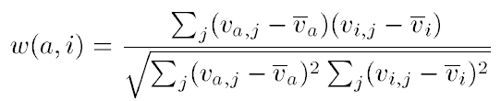



Similarity Weight
Pearson Correlation ——
Vector Similarity ——
SimRank (only for Movie data set) ——

Slide 7

Selecting Neighbors
Weight Threshold:-- parameter: p
Best-n-estimator-- parameter: n
Combined-- parameter: n,p
Selecting Neighbors
& Prediction
Prediction
Prediction :

Slide 8

Model-based Algorithm
Cluster Model (only for MS data set)
EM algorithm
E-step: guess labels
M-step: estimate parameters
2 steps are iterated repeatedly

Slide 9
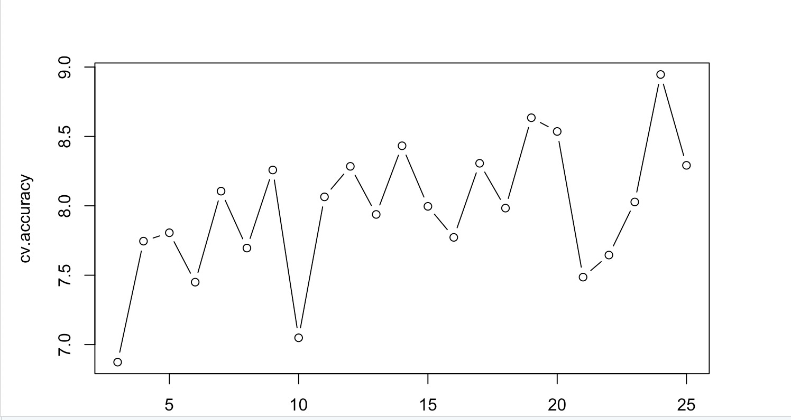
Cross-Validation
Choosing C
All but 1: In validation data, we withhold a single randomly selected vote for each user and try to predict its value given all other votes the user has voted on.
So, based on our output , C=24 has the highest ranking score.

Slide 10
MS data results
Ranking Score
Variance Weighting = F |  | Selecting Neighbors
 |  | Weight Threshold | Best-n-estimator | Combined
Similarity Weight | Pearson Correlation | 7.57351 | 7.94754 | 7.96865
 | Vector Similarity | 7.55442 | 7.95246 | 7.98182
Cluster (C = 24) |  | 39.33172
Cluster (C = 19) |  | 39.11221
Cluster (C = 14) |  | 38.61513
Based on Rank Score: (We choose d = 0)
Cluster performs the best

Slide 11
Movie data results
Based on MAE: Pearson + Best-n-estimator
Variance Weighting = F |  | Selecting Neighbors
 |  | Weight Threshold | Best-n-estimator | Combined
Similarity Weight | Pearson Correlation | 1.181029 | 0.9605008 | 1.443416
 | Vector Similarity | 1.154001 | 1.13852 | 1.156417
 | SimRank | 1.097066 | 1.090524 | 1.097066
Based on ROC: Vector Similarity + Best-n-estimator
Variance Weighting = F |  | Selecting Neighbors
 |  | Weight Threshold | Best-n-estimator | Combined
Similarity Weight | Pearson Correlation | 0.6708 | 0.6711 | 0.6683
 | Vector Similarity | 0.6639 | 0.6699 | 0.6619
 | SimRank | 0.6461 | 0.6453 | 0.6461

