Slide 1
2018 FIFA World Cup Prediction
ADS Project 5 Group 6

Slide 2
Motivation
Soccer is a game of 11 players in each team
Use the stats of players in the past to predict match results
Further, to predict the winner of 2018 World Cup
Notes:
Match results depend on players’ performance, combine the stats of players

Slide 3
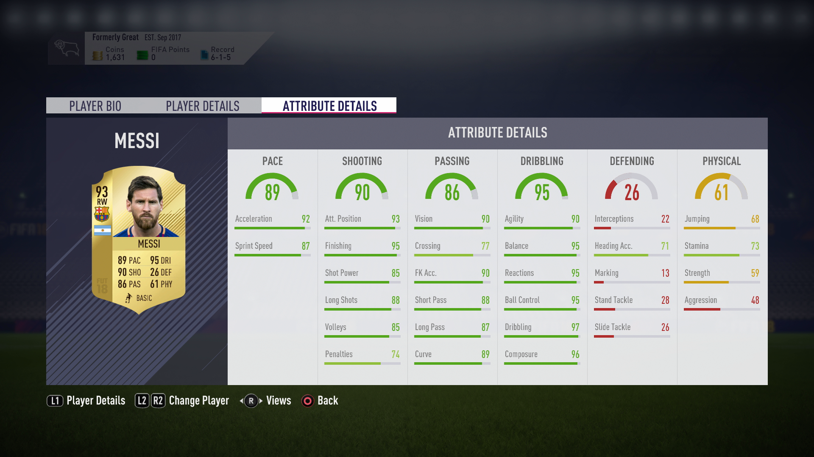
Player Data
Player Ratings in FIFA 18:
Based on Stats from Real Games
35 Attributes for each player
20 top players chosen from each team
Represents a Team using 17 selected features

Slide 4

Match Data
2017-2018 European “Big Five” Soccer Leagues
1200+ matches results as training set
92 Teams

Slide 5
Data Manipulation
Training Set & Test Set
92 clubs from 5 European Soccer Leagues
Use attributes of top 20 players in each team to calculate 17-feature Team Ratings
For each match, find the difference of Team Ratings between two teams and use them as predictors
Use the match result(Home Win/Loss) as response
Prediction Set
Same Process to National Teams

Slide 6
Model

Slide 7
Model Comparison

Slide 8
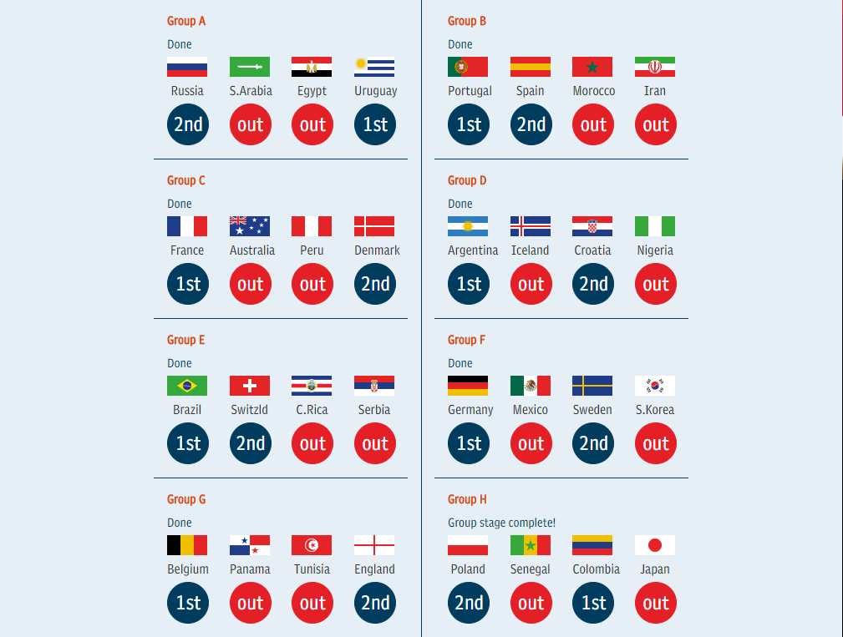
Prediction
Group Stage:
Choose 16 teams from 32
Based on Experience and Bet Odds

Slide 9
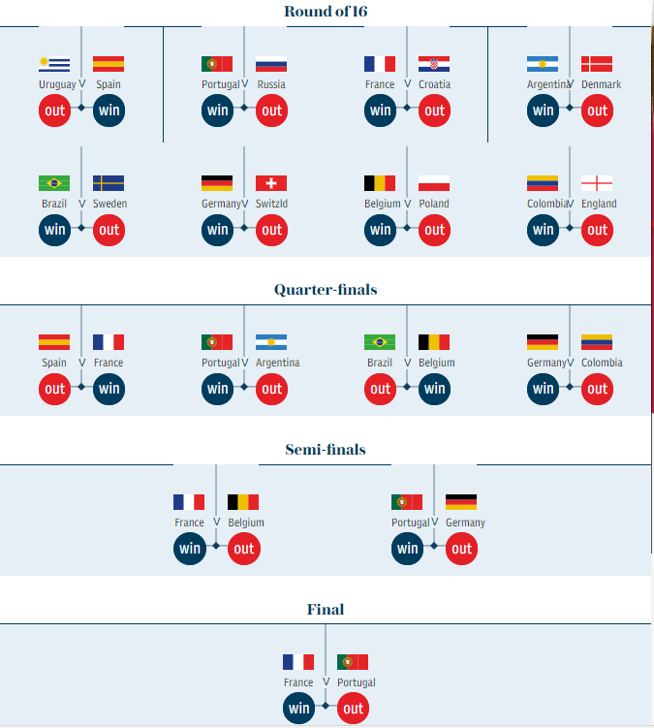
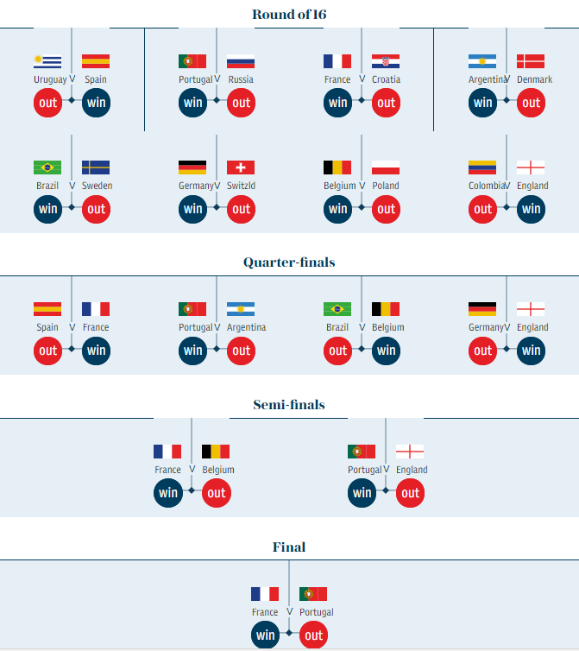
SVM and NNW Result Comparison
SVM Nonlinear Prediction
Neural Network Prediction

Slide 10
Thank you!
Important:
You are welcome to bet using our result.
BUT YOU ARE ON YOUR OWN RISKS!!!

