Slide 1
Default of credit card modeling and visualization
Group 8 :
Jingtian Yao
Chenfei Jiang
Michael Utomo

Slide 2
Category
1. Problem Description
2 Data Preprocessing
3. Model Selection
4. Visualization

Slide 3
Problem Description
The accuracy of the result of customers’ credit card default payment is essential from the perspective of risk management.
We aimed at predicting customers’ default payments status next month and compares the predictive accuracy among different algorithms.
We also built a Shiny App for the bank to help them with better risk management.

Slide 4
Data preprocessing
Data Source : https://archive.ics.uci.edu/ml/datasets/default+of+credit+card+clients
23 attributes
Amount of given credit
Gender
Education
Marital Status
Age
History of past payment (last 6 months)
Amount of bill statement (last 6 months)
Amount of previous payment (last 6 months)
Divide data into training set (24,000 observations) and test et (6,000 observations)

Slide 5
Model Selection
1. SVM (radial basis function kernel)
Tunning parameters: cost & gamma
range of cost: 10^(-6:2)
range of gamma: 10^(-4:4)
Best parameters: cost = 10, gamma = 0.001
For each algorithm, use 5-folds cross validation to choose the best parameter.

Slide 6
Model Selection
2. Random Forest
Tunning parameters : mtry & ntree
range of mtry : 1,2,3,4
range of ntree : 100, 200, 300, …, 1000
Best parameters: mtry = 2, ntree = 600
For each algorithm, use 5-folds cross validation to choose the best parameter.

Slide 7
Model Selection
3. Xgboost
Tunning parameters : eta & gamma & max depth
range of eta : 0.3, 0.5, 0.7
range of gamma : 0, 0.5, 1
range of max depth : 2, 3, 4, …, 10
Best parameters: eta = 0.5, gamma = 0.5, max depth = 4
For each algorithm, use 5-folds cross validation to choose the best parameter.

Slide 8
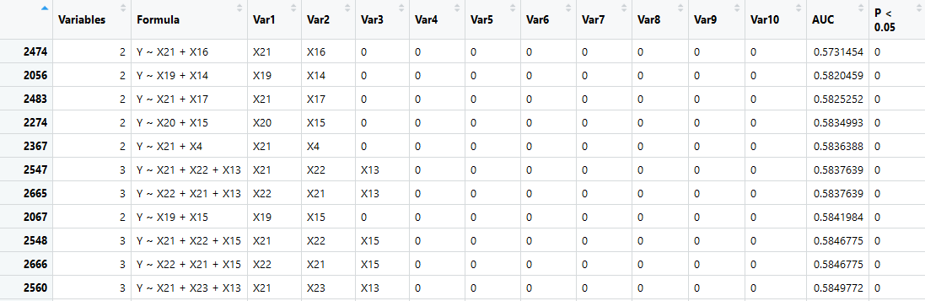
Model Selection
4. Logistic Regression
AUC: Area under the ROC curve - assessing discrimination in logistic regression
For each algorithm, use 5-folds cross validation to choose the best parameter.

Slide 9
Model Selection
5. Neural Network
Size : Number of units in the hidden layer (Choose 2 from 1 to 5)
Decay : parameter for weight decay (0.1)
Maxit: maximum number of iterations (200)
For each algorithm, use 5-folds cross validation to choose the best parameter.

Slide 10
Model Selection
Algorithm | Test Accuracy | Prediction Time (6000 observations)
SVM | 0.779 | 28.75s
Random Forest | 0.815 | 3.07s
Xgboost | 0.878 | 0.05s
Logistic Regression | 0.808 | 0.10s
Neural Network | 0.779 | 4.41s
According to the test accuracy, Xgboost algorithm performs the best.

Slide 11
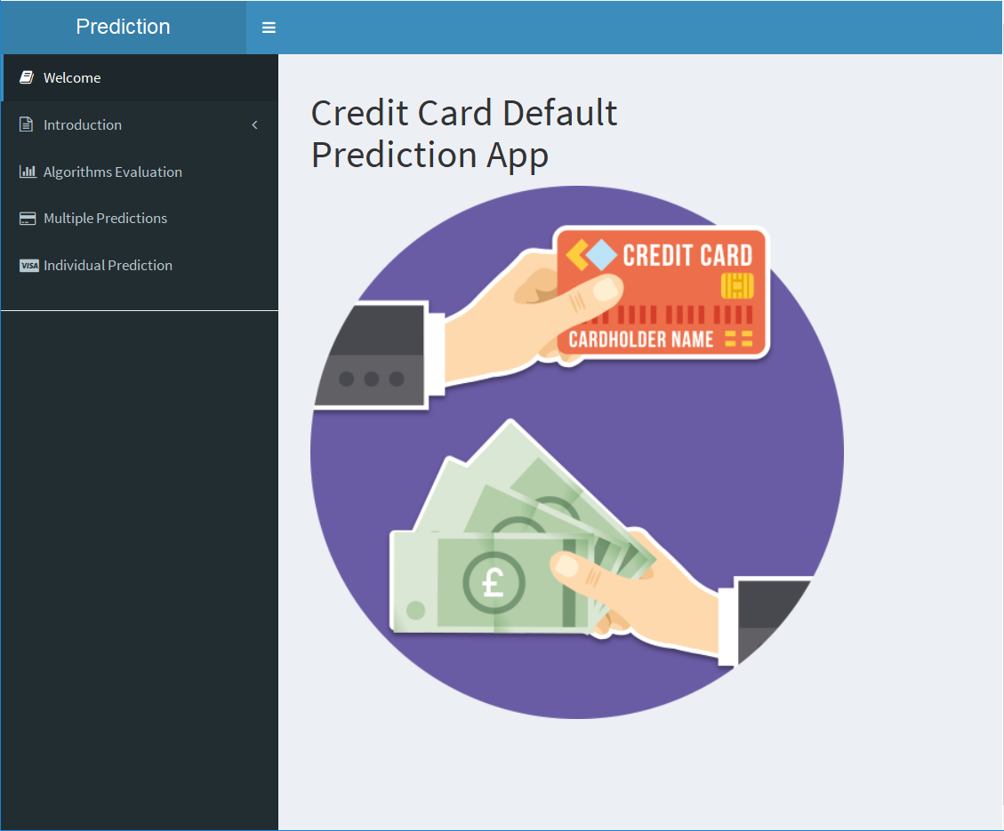
Visualization
The homepage of our app.
The app includes 5 parts:
Welcome
Introduction
Algorithm Evaluation
Multiple Predictions
Individual Prediction

Slide 12
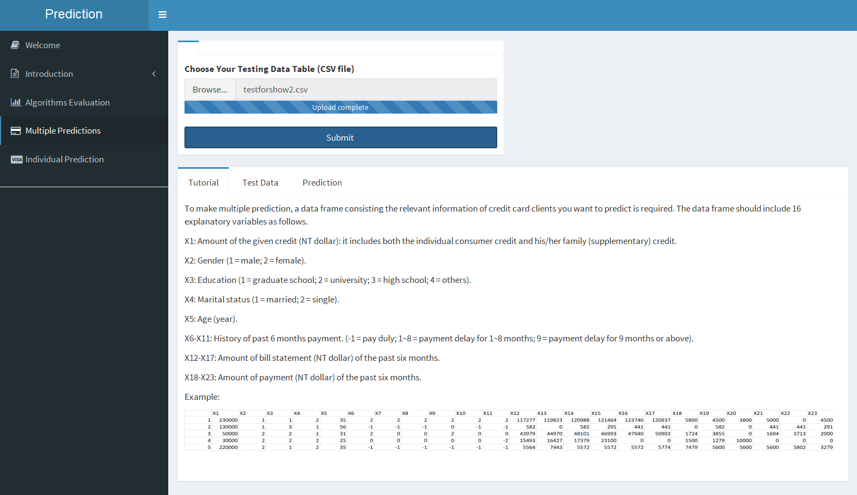
Visualization

Slide 13
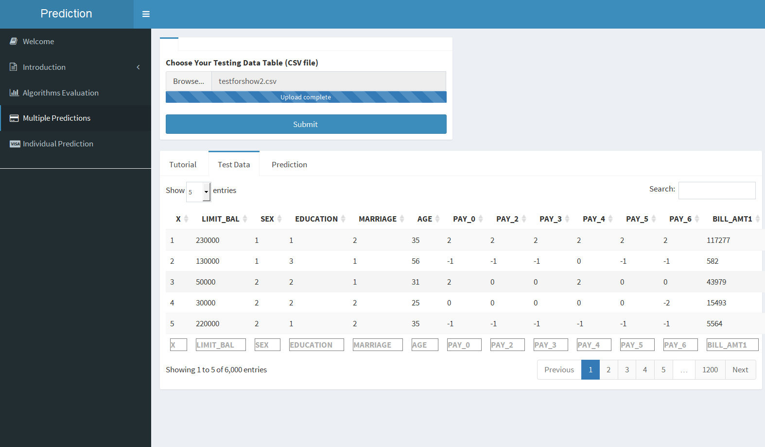
Visualization

Slide 14
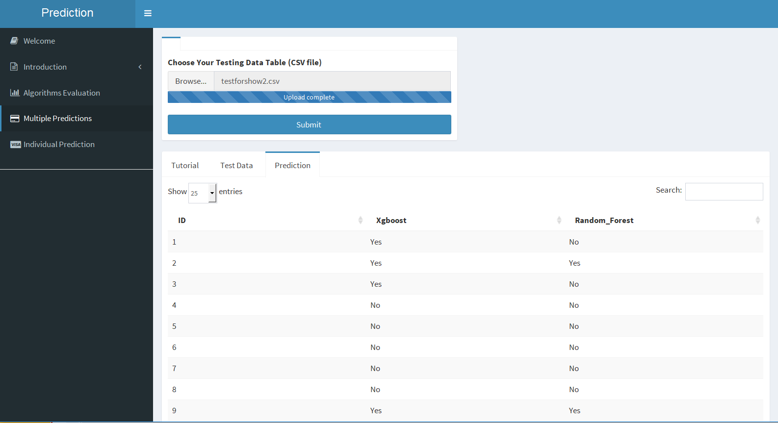
Visualization

Slide 15
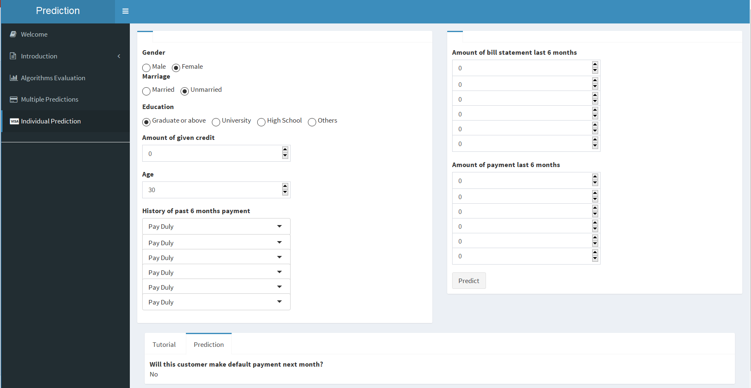
Visualization
https://lanceyjtcolumbia.shinyapps.io/default_payment/

Slide 16
Future plan
Add “Model Training” feature in our app.
Idea: Allow user to upload their own training dataset, and we can train a new model for the user based on the data user given.

Slide 17
Q & A

Slide 18
Thank you

