Slide 1
Project: OCR (Optical Character Recognition)
Group 10
-Seungwook Han -Hongye Jiang -Jingyue Li
-Xinzhu Wang -Xiaoxi Zhao

Slide 2
Overview
Project Goals
Focus on post-processing of Optical character recognition (OCR) process
Error Detection
Error Correction
Evaluation

Slide 3
Error Detection
Preparation
1. Extract several features of each word
2. Marked each word as an error or not
Classification
1. Cross-validation
2. Apply SVM on the training set
3. Predict errors of the test set

Slide 4
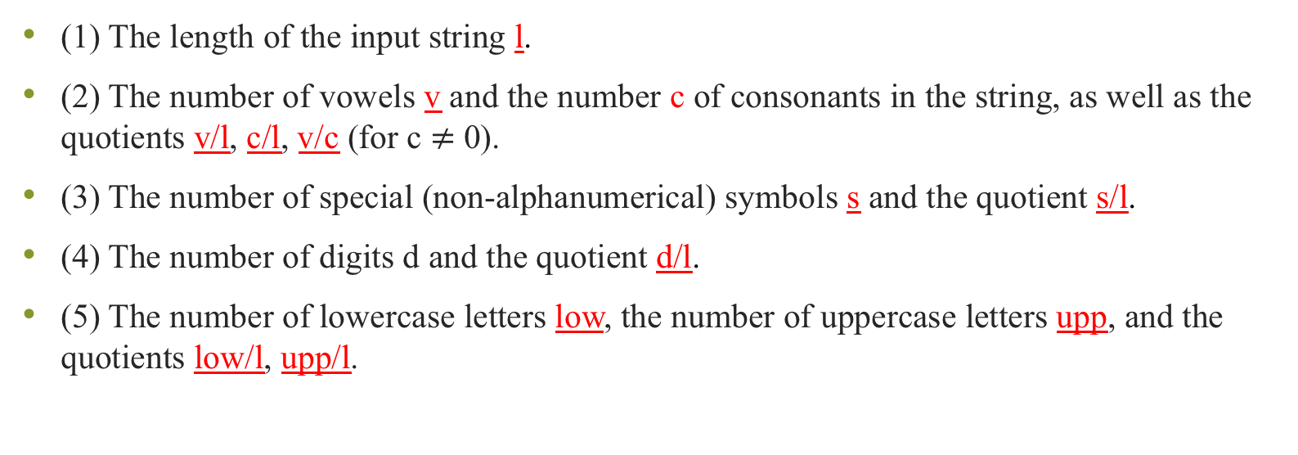
Features
(1) The length of the input string l.
(2) The number of vowels v and the number c of consonants in the string, as well as the quotients v/l, c/l, v/c (for c $≠$0).
(3) The number of special (non-alphanumerical) symbols s and the quotient s/l.
(4) The number of digits d and the quotient d/l.
(5) The number of lowercase letters low, the number of uppercase letters upp, and the quotients low/l, upp/l.

Slide 5
Features
(6) The length of the maximal sequence of identical letters a. If a>2 , the value of feature is a/l, otherwise it’s 0.
(7) The number of all alpha-numerical symbols lα, and the number of other symbols k. if k > lα, the value of feature is 1, otherwise it’s 0.
(8) The length of subsequence of directly consecutive consonants c. if c≥ 6, the value of feature is 1, otherwise it’s 0.
(9) The length of non- alpha-numerical symbols f after deleting the first and last symbol of the input string. If f > 1, the value of feature is 1, otherwise it’s 0.

Slide 6
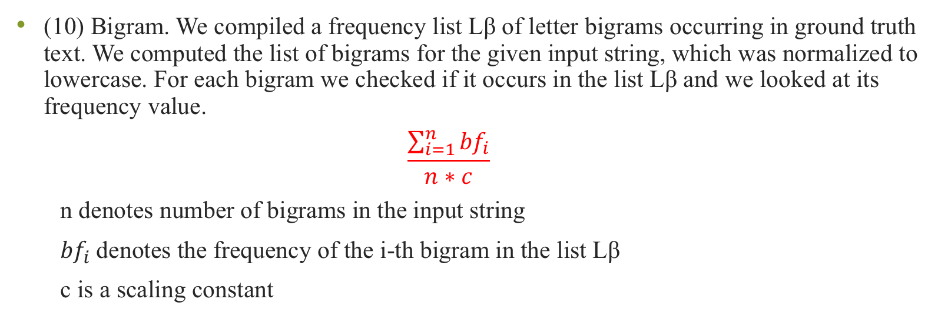
Features
(10) Bigram. We compiled a frequency list Lβ of letter bigrams occurring in ground truth text. We computed the list of bigrams for the given input string, which was normalized to lowercase. For each bigram we checked if it occurs in the list Lβ and we looked at its frequency value.
$$\frac{\sum_{i=1}^{n}{{bf}_{i}}}{n∗c}$$
n denotes number of bigrams in the input string
${bf}_{i}$denotes the frequency of the i-th bigram in the list Lβ
c is a scaling constant

Slide 7

Features
(11) Most frequent symbol. The number of occurrences of the most frequent symbol i of the input string of length $l$. The value of feature is i/$l$if i≥3, otherwise 0.
(12) Non-alphabetical symbols. The number of occurrences of alphabetical symbols $l1$ in the input string, $l2$ = $l$ − $l1$, the value of feature is $l2$/$l1$. If $l1 or l2$ is 0, then value is 0.

Slide 8
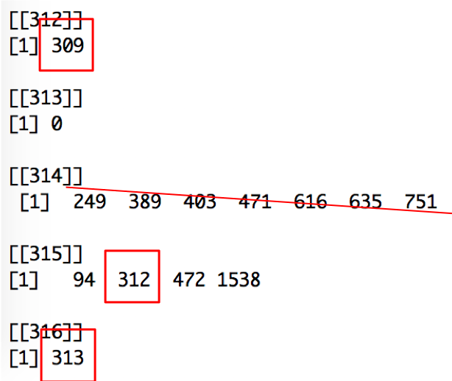

Separation of classes
Return the position index of corresponding correct word in ground truth text if possible for each word in each file. If it returns 0, it’s an error. Otherwise it’s correct.
For example, for the same article, the 312th word in OCR output matches the 309th word in the ground truth text. Then it is a correct word. But the 313th word is not correct.

Slide 9
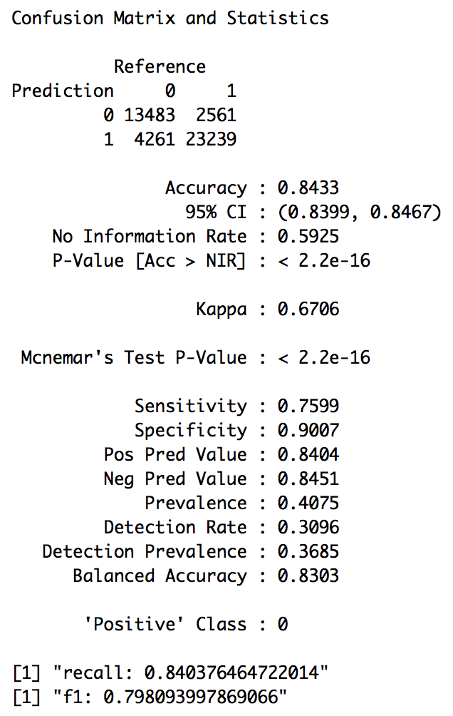
SVM Performance

Slide 10
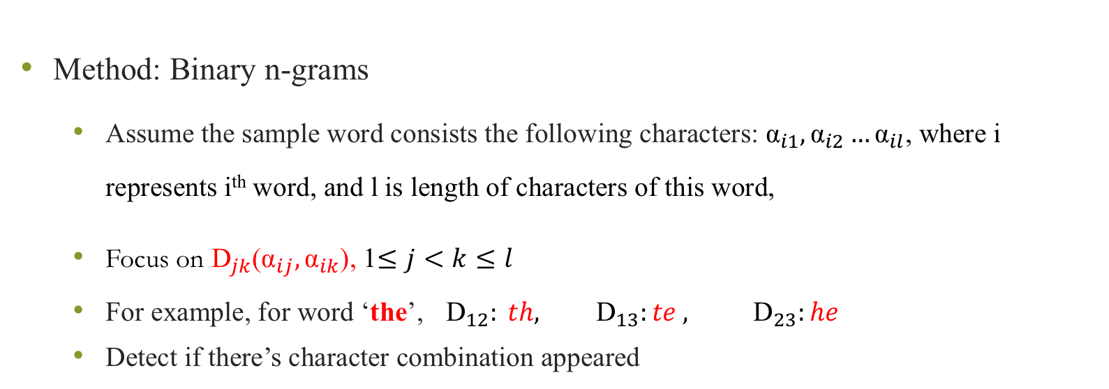
Error Correction
Method: Binary n-grams
Assume the sample word consists the following characters: ${\text{α}}_{i1},{\text{α}}_{i2}…{\text{α}}_{il}$, where i represents i^{th} word, and l is length of characters of this word,
Focus on ${\text{D}}_{jk}$(${\text{α}}_{ij},{\text{α}}_{ik}$), 1$≤j<k≤l$
For example, for word ‘the’, ${\text{D}}_{12}: th,$ ${\text{D}}_{13}:te ,$ ${\text{D}}_{23}:he$
Detect if there’s character combination appeared

Slide 11
Error Correction
Three steps
1. create a dictionary by extracting structural information of ground truth text
2. for each error, detect the position of wrong character (may be 1 or 2).
3. find the most suitable character to replace the wrong one.

Slide 12
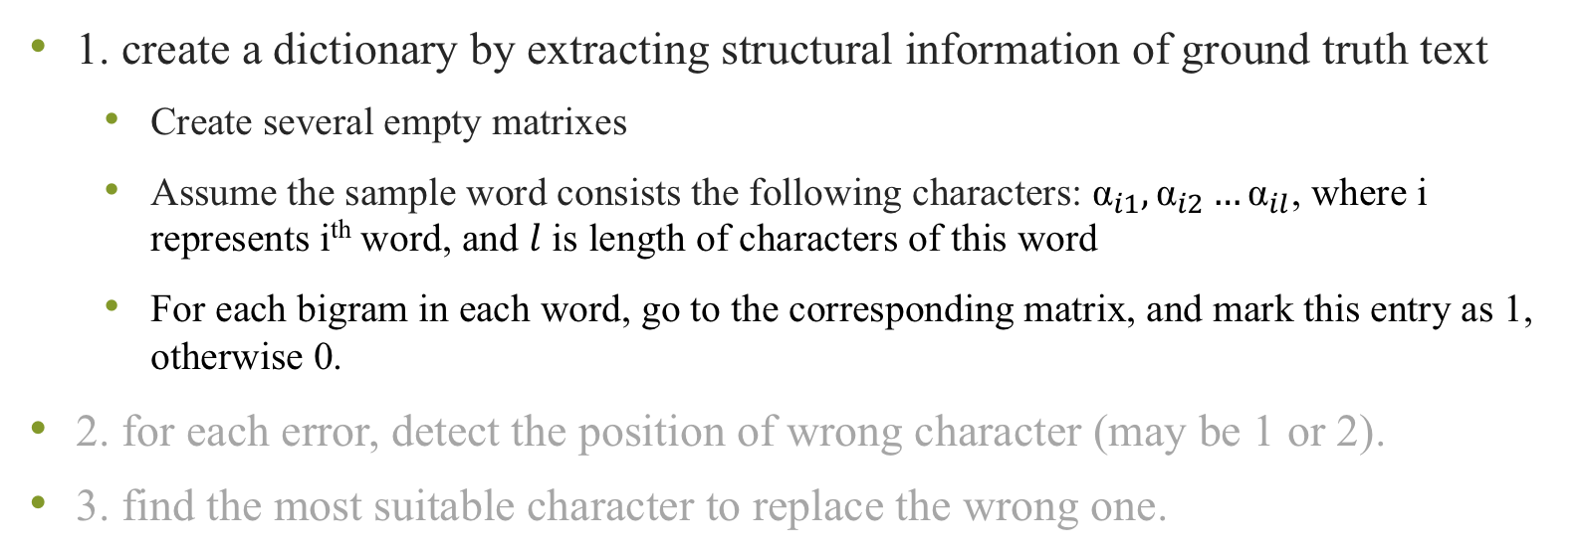
Error Correction Steps
1. create a dictionary by extracting structural information of ground truth text
Create several empty matrixes
Assume the sample word consists the following characters: ${\text{α}}_{i1},{\text{α}}_{i2}…{\text{α}}_{il}$, where i represents i^{th} word, and $l$ is length of characters of this word
For each bigram in each word, go to the corresponding matrix, and mark this entry as 1, otherwise 0.
2. for each error, detect the position of wrong character (may be 1 or 2).
3. find the most suitable character to replace the wrong one.

Slide 13
Error Correction
Ground
Truth
Text
(of the training set)
Length of characters(l)
2
3
Characters combination
4
…
$$D_{12}$$
𝐷_12
$$D_{13}$$
𝐷_13
$$\frac{l∗(l−1)}{2}$$
combinations
(𝑙∗(𝑙−1))/2
combinations
$$D_{23}$$
𝐷_23
A 26*26 matrix
A 26*26 matrix
A 26*26 matrix
$\frac{4∗3}{2}$= 6 combinations
(4∗3)/2= 6 combinations
Six 26*26
matrixes
$\frac{l∗(l−1)}{2}$ 26*26 matrixes
(𝑙∗(𝑙−1))/2 26*26 matrixes

Slide 14
Error Correction Steps
1. create a dictionary by extracting structural information of ground truth text
2. for each error, detect the position of wrong character (may be 1 or 2).
Find out those nonexistent pairs of characters by comparing with the dictionary.
Sort the frequency of the positions in all nonexistent pairs from high to low
We will correct characters in first two position, if the second and third frequency are equal, we just correct the character in first one position.
3. find the most suitable character to replace the wrong one.

Slide 15
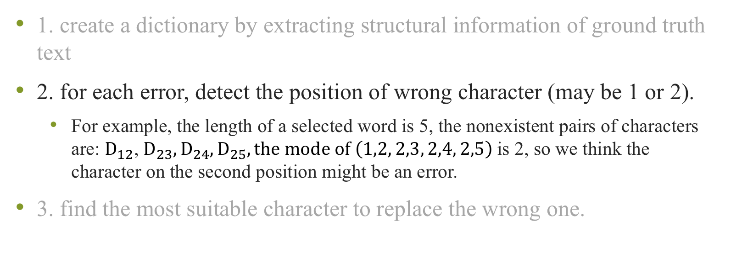
Error Correction Steps
1. create a dictionary by extracting structural information of ground truth text
2. for each error, detect the position of wrong character (may be 1 or 2).
For example, the length of a selected word is 5, the nonexistent pairs of characters are: ${\text{D}}_{12}$, ${\text{D}}_{23},{\text{D}}_{24},{\text{D}}_{25}, the mode of \left(1,2, 2,3, 2,4, 2,5\right)$is 2, so we think the character on the second position might be an error.
3. find the most suitable character to replace the wrong one.

Slide 16
Error Correction Steps
1. create a dictionary by extracting structural information of ground truth text
2. for each error, detect the position of wrong character (may be 1 or 2).
3. find the most suitable character to replace the wrong one.
Try to replace a-z to the wrong letter, and check all bigram sequences related to this new letter. Choose the one with the lowest nonexistent pairs

Slide 17
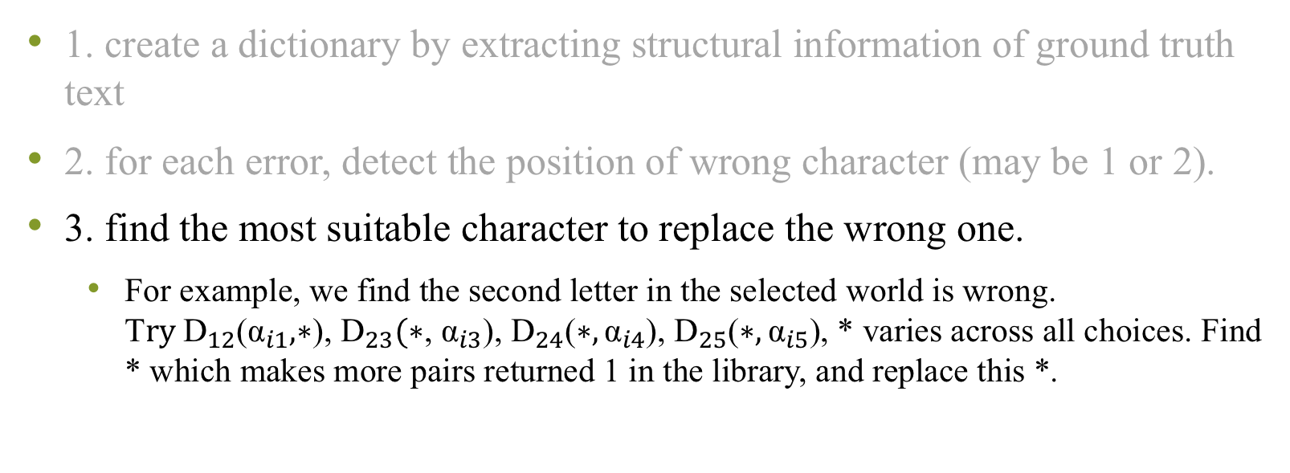
Error Correction Steps
1. create a dictionary by extracting structural information of ground truth text
2. for each error, detect the position of wrong character (may be 1 or 2).
3. find the most suitable character to replace the wrong one.
For example, we find the second letter in the selected world is wrong. T$ry {\text{D}}_{12}$(${\text{α}}_{i1},∗$), ${\text{D}}_{23}(∗$, ${\text{α}}_{i3}$), ${\text{D}}_{24}$($∗,{\text{α}}_{i4}$), ${\text{D}}_{25}$($∗,{\text{α}}_{i5}$), * varies across all choices. Find * which makes more pairs returned 1 in the library, and replace this *.

Slide 18
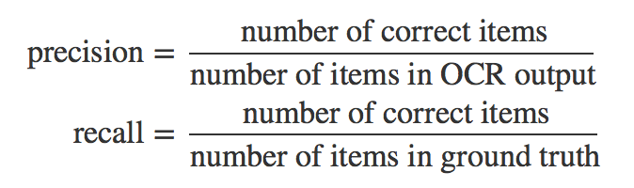
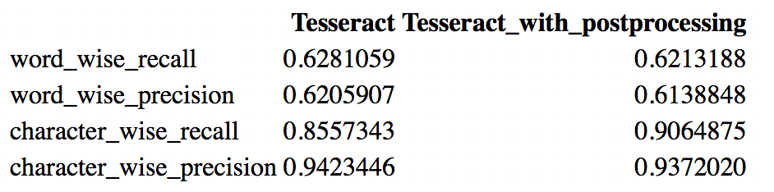
Evaluation

