Slide 1
Algorithms Implementation and Evaluation
Group 11
Presenter: SIWEI LIU

Slide 2
PAPER: D1 + C4
I. Error Detection
II. Error Correction
III. Evaluation

Slide 3
ERROR DETECTION

Slide 4
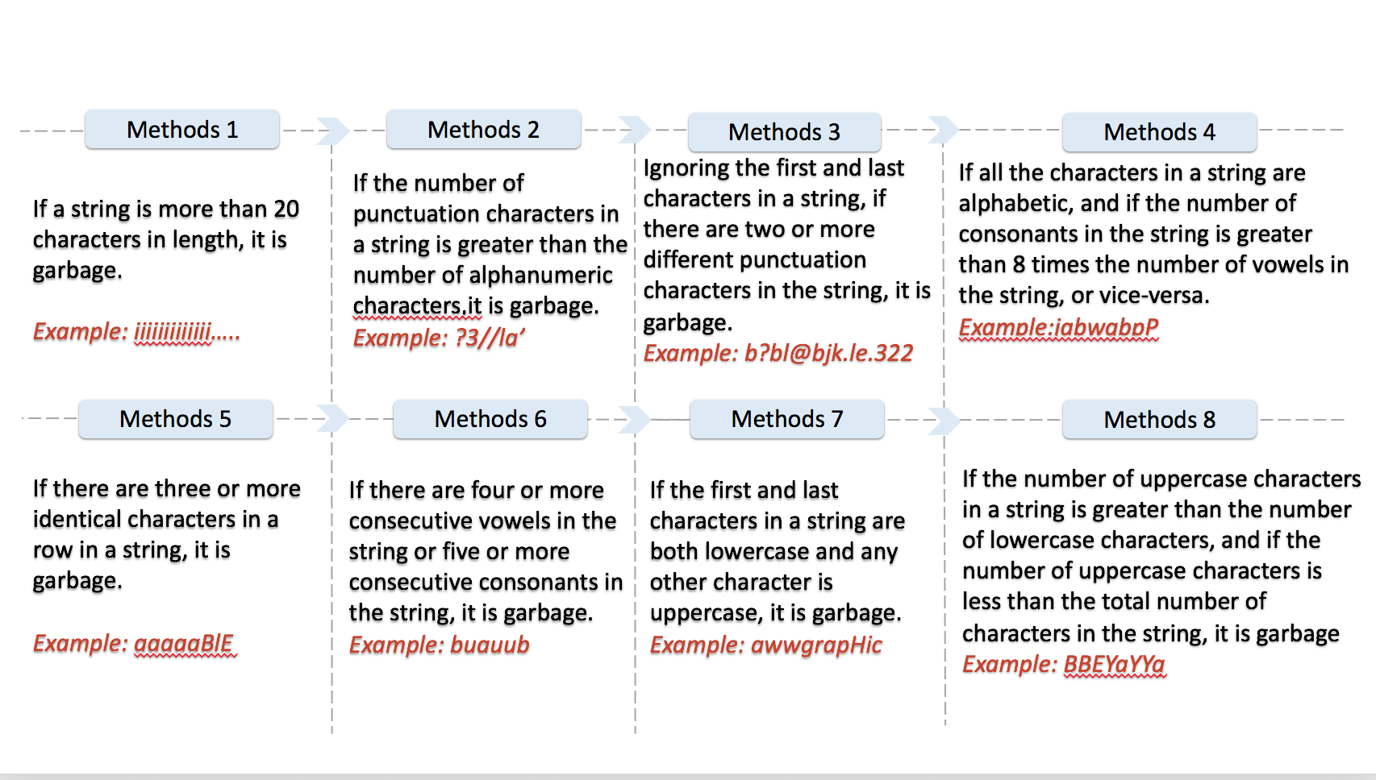

Slide 5
ERROR CORRECTION

Slide 6
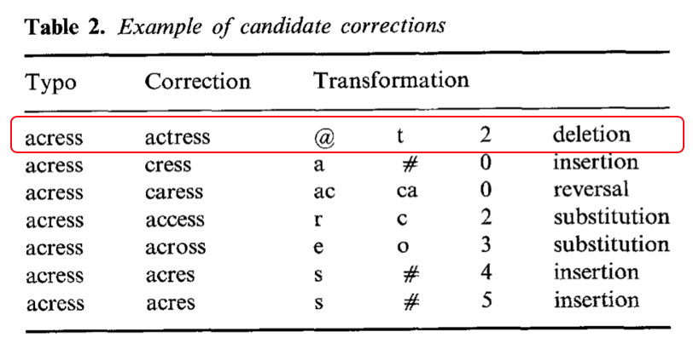
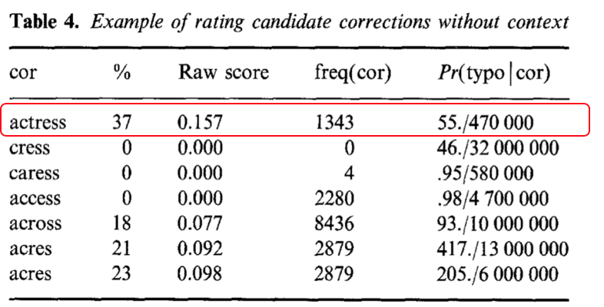
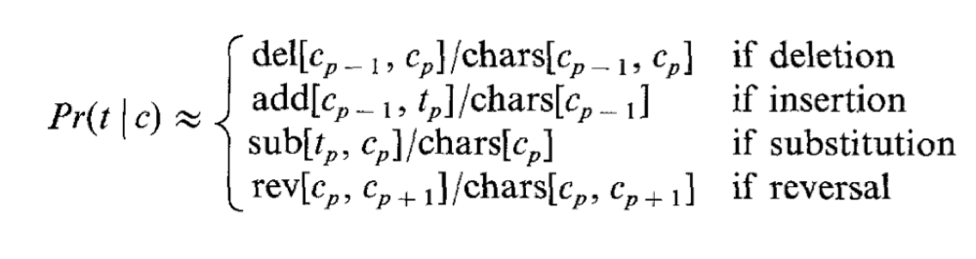

Slide 7
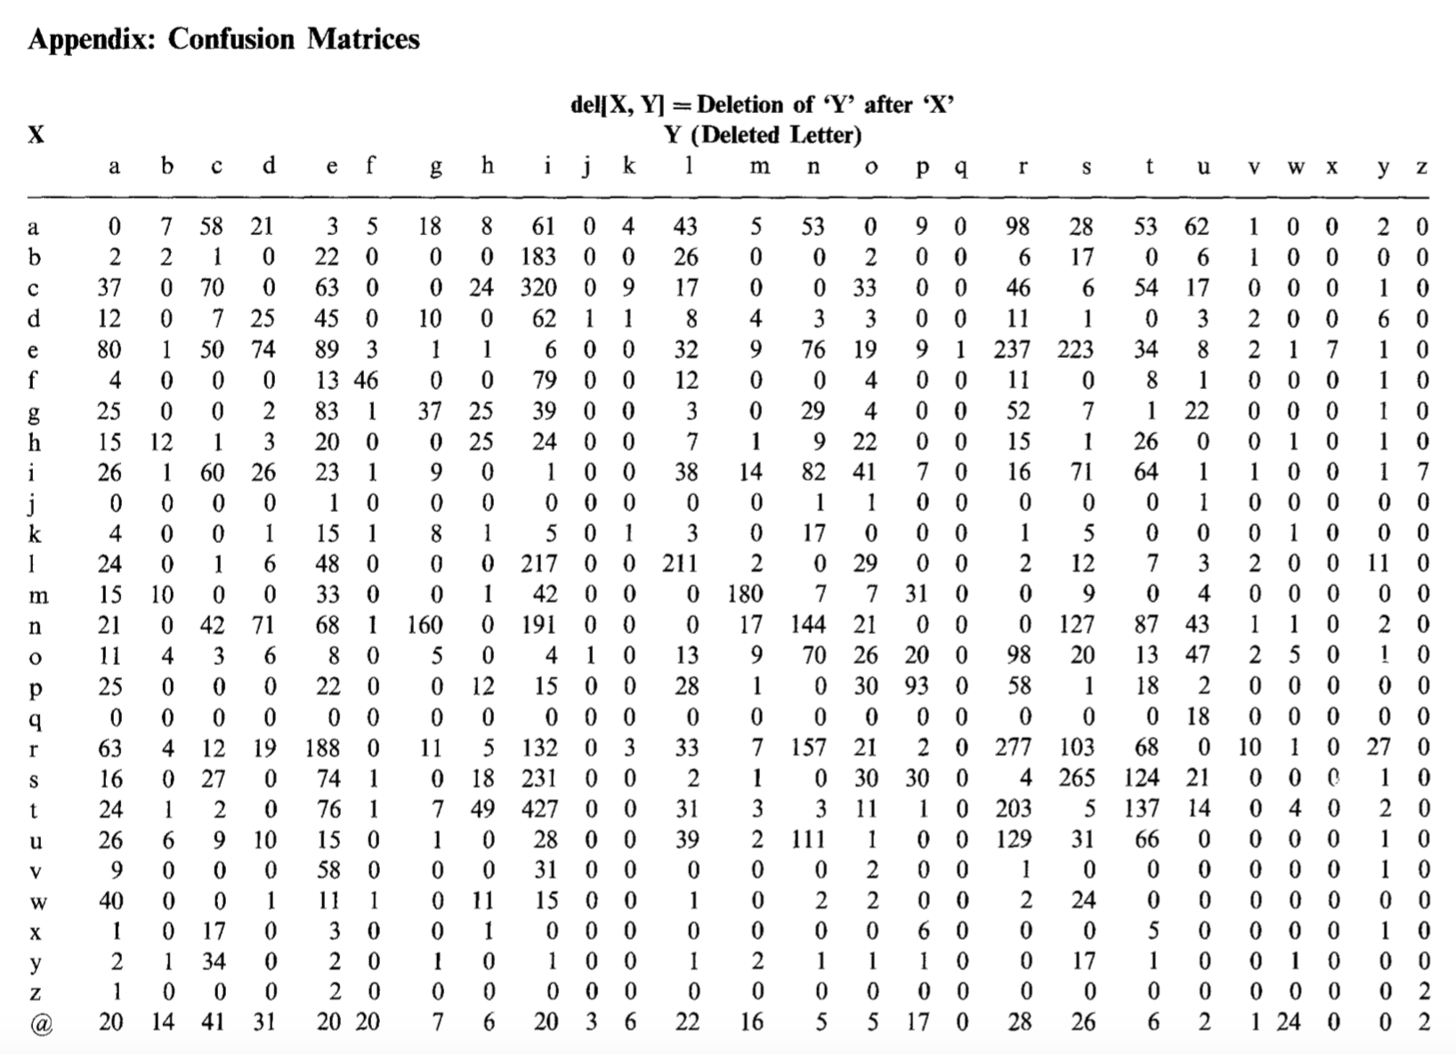

Slide 8
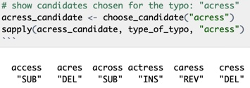
Candidate Correction:

Slide 9
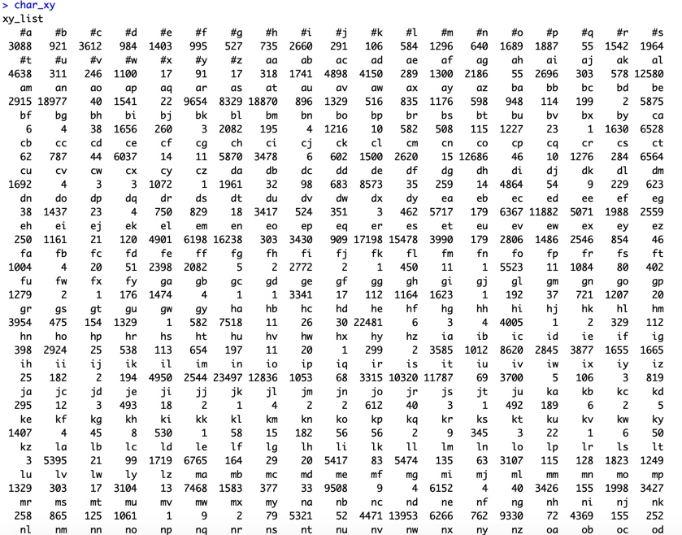

Slide 10
EVALUATION

Slide 11
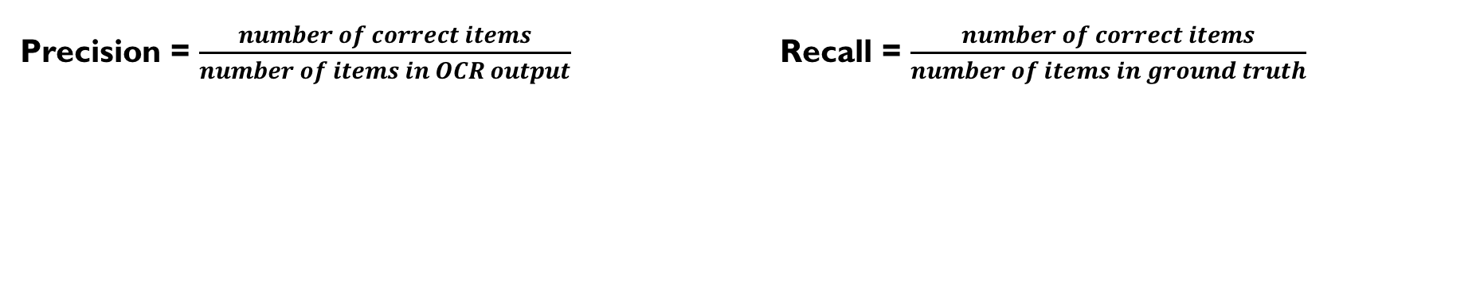
Precision = $\frac{number of correct items}{number of items in OCR output}$ Recall = $\frac{number of correct items}{number of items in ground truth}$
 | Tesseract | Tesseract_with_Postprocessing
word wise precision | 0.6151105 | 0.6432445
word wise recall | 0.6042648 | 0.6315354
character wise precision | 0.9039345 | 0.9047996
character wise recall | 0.9190134 | 0.9198930

Slide 12
Thank You

