Slide 1
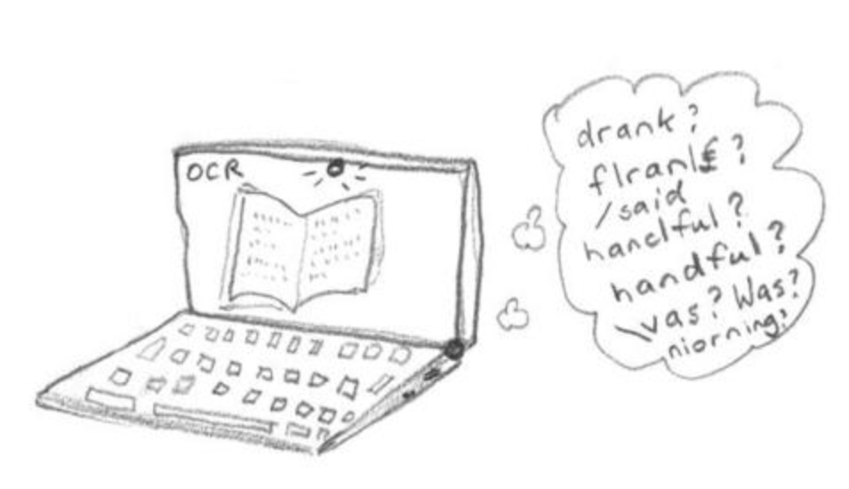
Optical Character Recognition
(OCR)
Group 3
Dubova, Elena (ed2801)
Ren, Claire (xr2134)
Wang, Zixiao (zw2513)
Wu, Qianqian (qw2284)
Zhang, Zhicheng (zz2555)

Slide 2
INDEX
Project Goal
Error Detection
Error Correction
Performance Evaluation

Slide 3
PROJECT GOAL
Create an OCR post-processing procedure to enhance Tesseract OCR output
01
02
Recall
Precision
Word-wise & Character-wise

Slide 4
ERROR DETECTION (Kulp & Kontostathis, 2007)
Rule-based techniques
1
More than 20 characters in length
2
The number of punctuation characters in a string is greater than the number of alphanumeric characters
3
There are two or more different punctuation characters in the string (ignoring the first and last characters)
4
There are three or more identical characters in a row in a string
5
The number of uppercase characters in a string is greater than the number of lowercase characters, and the number of uppercase characters is less than the total number of characters in the string
6
All the characters in a string are alphabetic, and the number of consonants in the string is greater than 8 times the number of vowels in the string, or vice-versa
7
There are four or more consecutive vowels in the string or five or more consecutive consonants in the string
8
The first and last characters in a string are both lowercase and any other character is uppercase
Source: http://webpages.ursinus.edu/akontostathis/KulpKontostathisFinal.pdf
Notes:
The code takes 100 documents, creates a single big corpus, which is splitted into two: one contains correct text elements, the other contains erroneous text elements. Only inuque tockens are left for alanysis to reduce the amount of computation.

Slide 5
ERROR CORRECTION (Wick et al, 2007)
Context-Sensitive Error Detection
Find correct word to substitute error by combining:
LDA Topic Model
Character Error Probability Model
Notes:
Error correction algorithm considered in the paper consists of two models: a topic model that provides information about word probabilities and OCR model that represents the probability of character errors. For each error word we compute a vector of candidates to substitute the erroneous word and pick the one that provides the best score according to the formula proposed in the paper.

Slide 6
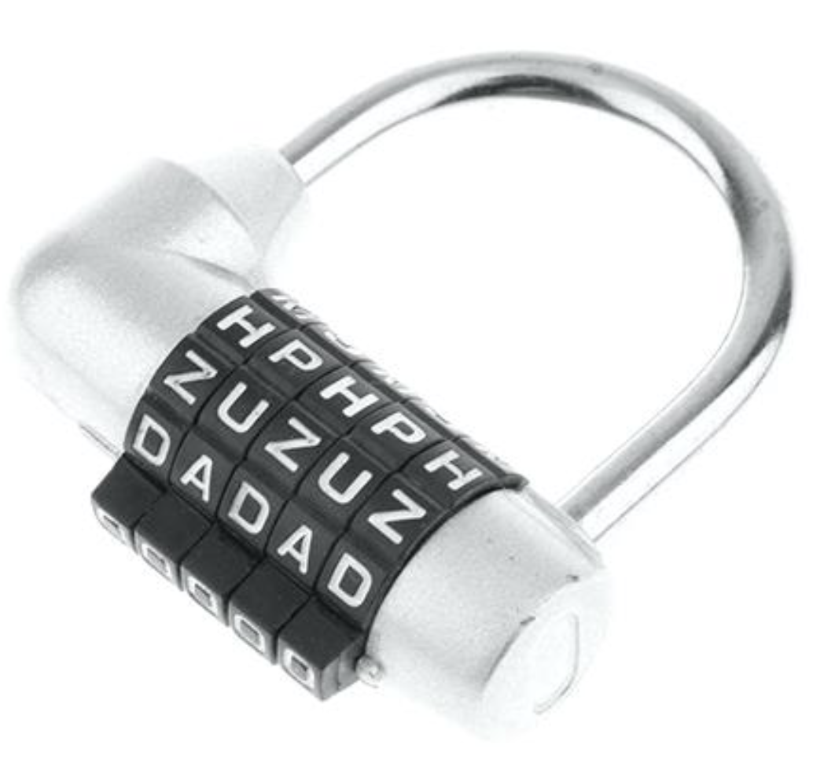

ERROR CORRECTION (Wick et al, 2007)
Preparation – 1. Candidate generator
Erroneous word
Candidate generator
*0,1,2 letters difference
from erroneous word
Candidate words vector
Notes:
Error correction algorithm considered in the paper consists of two models: a topic model that provides information about word probabilities and OCR model that represents the probability of character errors. For each error word we compute a vector of candidates to substitute the erroneous word and pick the one that provides the best score according to the formula proposed in the paper.

Slide 7
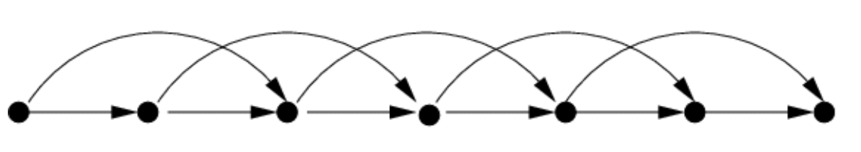

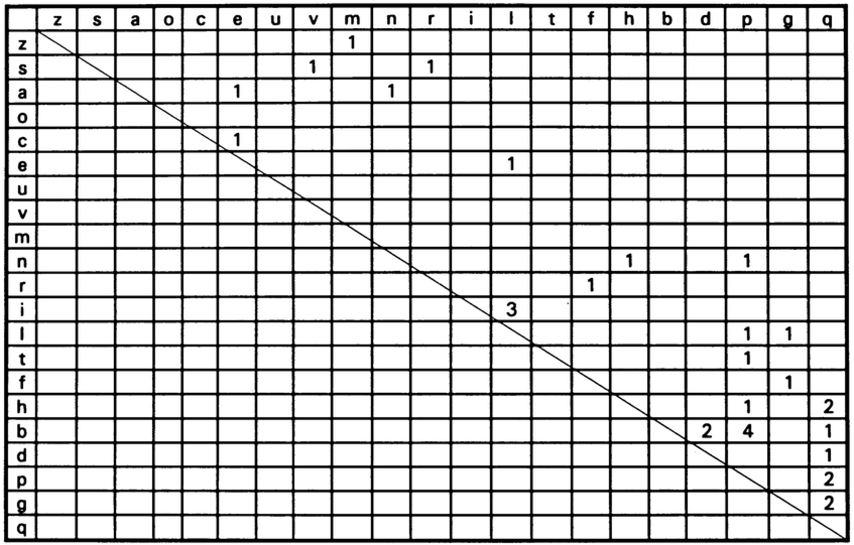
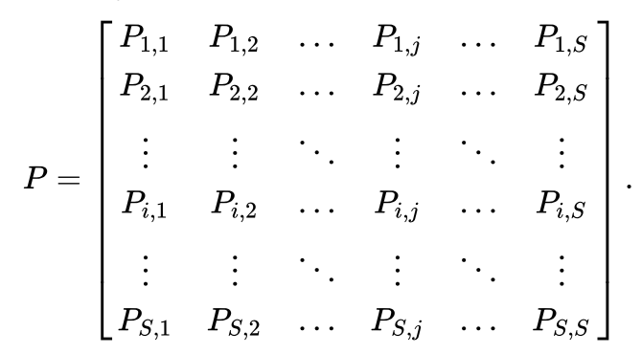
ERROR CORRECTION (Wick et al, 2007)
Preparation – 2. Confusion Matrix
Correct text
Filter OCR and correct text: same length of lines and words
Confusion Matrix Generator
Construct and smooth
confusion matrix
(zero -> 0.1)
Confusion matrix of probabilities
Compute probabilities
Notes:
Error correction algorithm considered in the paper consists of two models: a topic model that provides information about word probabilities and OCR model that represents the probability of character errors. For each error word we compute a vector of candidates to substitute the erroneous word and pick the one that provides the best score according to the formula proposed in the paper.

Slide 8
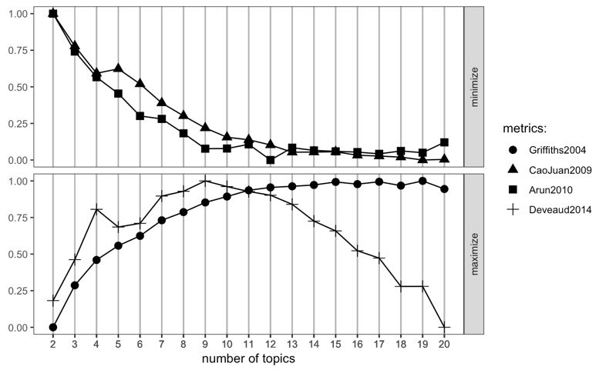
ERROR CORRECTION (Wick et al, 2007)
Preparation – 2. Confusion Matrix
Optimize number of topics in LDA: 13
Correct text
LDA
Topics, words, probabilities
*‘ldatuning’ package
Notes:
Error correction algorithm considered in the paper consists of two models: a topic model that provides information about word probabilities and OCR model that represents the probability of character errors. For each error word we compute a vector of candidates to substitute the erroneous word and pick the one that provides the best score according to the formula proposed in the paper.

Slide 9
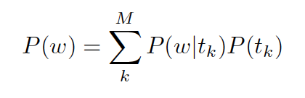
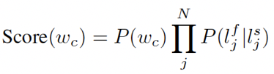

ERROR CORRECTION (Wick et al, 2007)
Process
Erroneous word
Total Score
Corrected word
Confusion Matrix Score
Max Score
Context Score
Candidate words vector

Slide 10
ERROR CORRECTION
Example
Error detected | commlttee
Candidate list | conmlttee | 7.640149e-11
 | committee | 1.718493e-04
 | conmittee | 3.684476e-10
 | coumittee | 4.642372e-12
 | committed | 6.332239e-12
Final choice | committee

Slide 11
EVALUATION
 | Metrics | Original OCR | Corrected OCR
Word-wise | Recall | 0.6304754 | 0.6765579
 | Precision | 0.6222718 | 0.6677546
Character-wise | Recall | 0.9006393 | 0.9119577
 | Precision | 0.9143944 | 0.9258856
Further Potential Improvement…
Baseline: Increase number of points and features…
Advanced: Increase number of patches, layers and epoch…

Slide 12
THE END
Thank you!
2019
4.16

