Slide 1
Applied Data Science Project 4 Group 5
Papers: D-3, C-4
Shengwei Huang(sh3825), Shaofu Wang(sw3294), Liwei Zhang (lz2655), Yiwei Li(yl3950), Xishi Chen(xc2455)

Slide 2
Project Goals
Tesseract text
Detected error words
Corrected words

Slide 3
ERROR Detection (D-3)
Extracted some features
Trained SVM model with this features
Predict error words
Notes:
Some steps are excluded here, like how the ground truth and Tesseract tokens were compared to each other to create training labels on which strings were correct or not. In the D-3 paper, these were separated out from the data set.

Slide 4
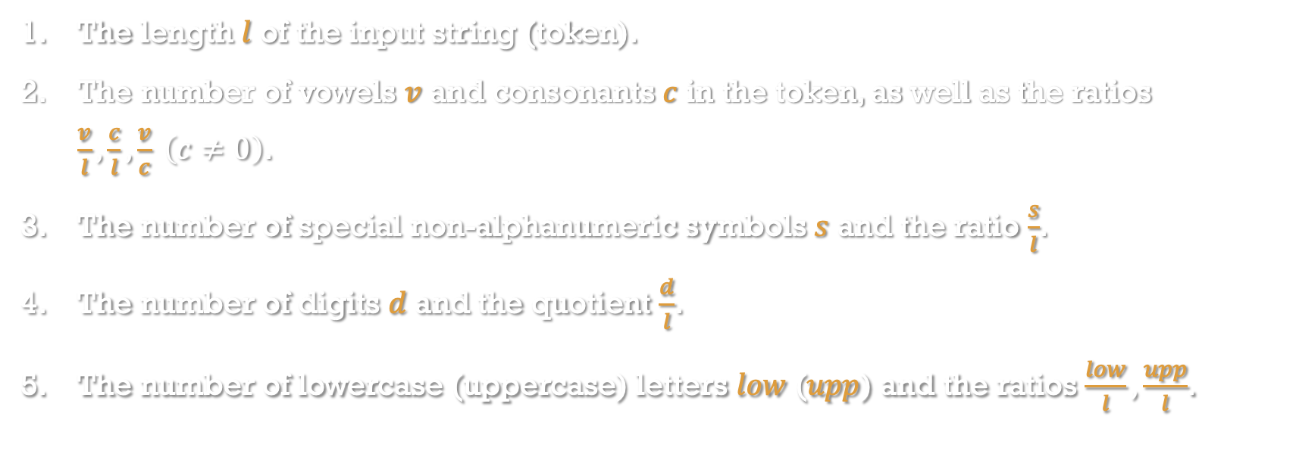
Feature List
The length $l$ of the input string (token).
The number of vowels $v$ and consonants $c$ in the token, as well as the ratios $\frac{v}{l},\frac{c}{l},\frac{v}{c} \left(c≠0\right)$.
The number of special non-alphanumeric symbols $s$ and the ratio $\frac{s}{l}$.
The number of digits $d$ and the quotient $\frac{d}{l}$.
The number of lowercase (uppercase) letters $low$ ($upp$) and the ratios $\frac{low}{l},\frac{upp}{l}$.
Notes:
In the D-3 paper, the features were decided on through manual (by-hand) analysis of patterns within the garbage and not-garbage strings (essentially, trial and error). They mentioned measuring things like the average lengths of strings in both groups which evidently did not make the cut for the final feature list. We did not speculate as to any additional features that might be of use for our particular corpus; doing so might have improved results.

Slide 5
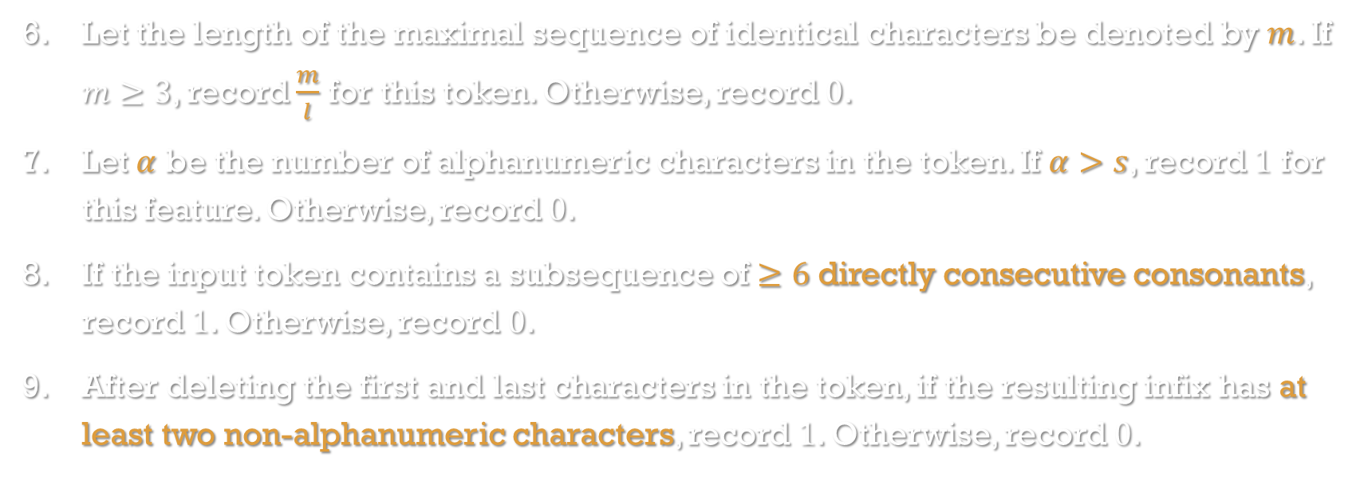
Feature List
Let the length of the maximal sequence of identical characters be denoted by $m$. If $m≥3$, record $\frac{m}{l}$ for this token. Otherwise, record $0$.
Let $α$ be the number of alphanumeric characters in the token. If $α>s$, record $1$ for this feature. Otherwise, record $0$.
If the input token contains a subsequence of $≥6$ directly consecutive consonants, record $1$. Otherwise, record $0$.
After deleting the first and last characters in the token, if the resulting infix has at least two non-alphanumeric characters, record $1$. Otherwise, record $0$.

Slide 6
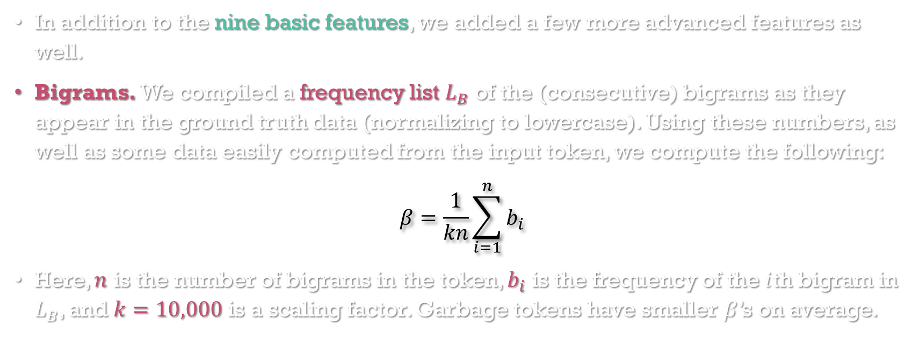
Feature List (Bigrams)
In addition to the nine basic features, we added a few more advanced features as well.
Bigrams. We compiled a frequency list $L_{B}$ of the (consecutive) bigrams as they appear in the ground truth data (normalizing to lowercase). Using these numbers, as well as some data easily computed from the input token, we compute the following:
$$β=\frac{1}{kn}\sum_{i=1}^{n}{b_{i}}$$
Here, $n$ is the number of bigrams in the token, $b_{i}$ is the frequency of the $i$th bigram in $L_{B}$, and $k=10,000$ is a scaling factor. Garbage tokens have smaller $β$’s on average.
Notes:
In the D-3 paper, the average garbage token had a bigram score of 5.3 while the average non-garbage token had a bigram score of 17.4.

Slide 7
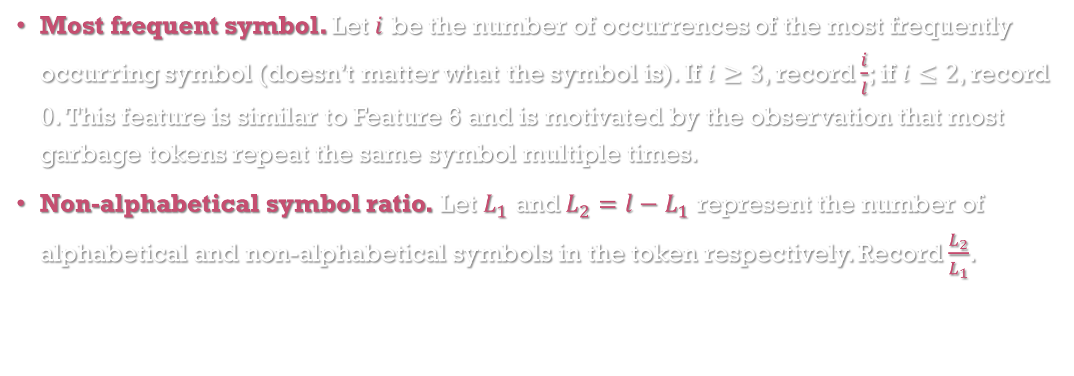
Feature List
Most frequent symbol. Let $i$ be the number of occurrences of the most frequently occurring symbol (doesn’t matter what the symbol is). If $i≥3$, record $\frac{i}{l}$; if $i≤2$, record $0$. This feature is similar to Feature 6 and is motivated by the observation that most garbage tokens repeat the same symbol multiple times.
Non-alphabetical symbol ratio. Let $L_{1}$ and $L_{2}=l−L_{1}$ represent the number of alphabetical and non-alphabetical symbols in the token respectively. Record $\frac{L_{2}}{L_{1}}$.

Slide 8
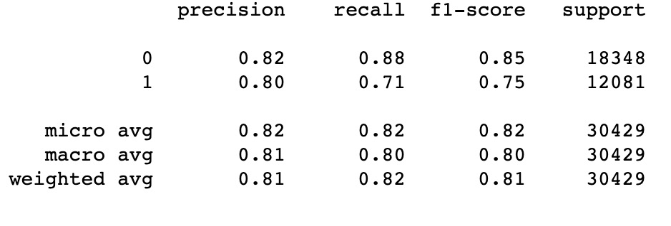
SVM Performance
Notes:
About 24,000 tokens were correctly classified, compared to about 8,500 incorrect classifications. This gives us 80% average precision and recall. Precision is defined as the ratio of correctly classified tokens to the total number of tokens predicted as a particular category. Recall is the ratio of correctly classified tokens to the total number of tokens that actually belong to a particular category. Our model has higher precision and recall for not-garbage tokens, which is good news (and also not too surprising, given that the data is likely imbalanced). F1 score is the harmonic mean of precision and recall. The D-3 algorithm without Levenshtein distance has precision higher by 8 points but recall higher by only 1 point.

Slide 9
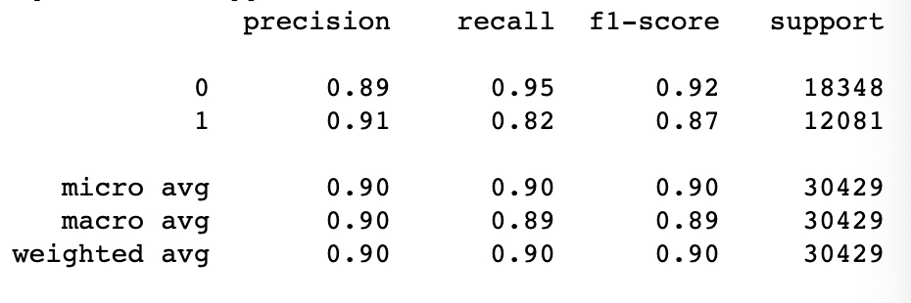
Random forest performance
Notes:
Levenshtein distance is measured between a token and some external dictionary or lexicon of accepted terms, perhaps taken from the ground truth data. This is the reason behind why Levenshtein distance is the culprit of significant speed reductions in the evaluation of error detection.

Slide 10
Error Correction
Listed corrected candidates
Four types: insertion, deletion, substitution, reversal
Change one place for every word

Slide 11
Error Correction
Listed corrected candidates
Calculated scores of candidates
p(c): MLE, ELE, GT
p(t|c)
p(l|c), p(r|c)

Slide 12
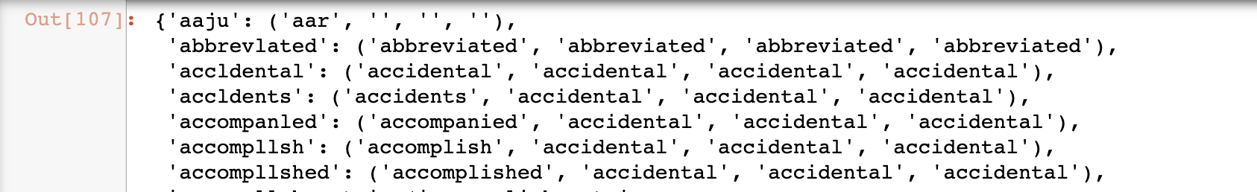
Error Correction
Listed corrected candidates
Calculated scores of candidates
Chose the candidate with the highest posterior probability

Slide 13
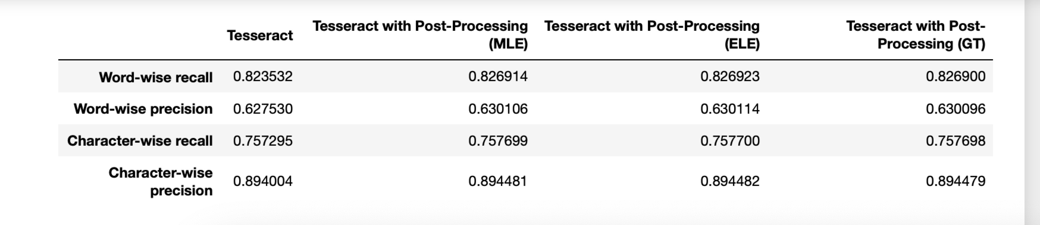
Correction Performance
Notes:
The numbers here are kinda strange, so I’m not sure how accurate the metrics are here. I do believe that word-wise metrics being in the neighborhood of 60% is accurate, but character-wise metrics may not be so accurate (and we were having issues getting them for the pre-processed data).

Slide 14
Problems we meet
Frequency in p(c) might be zero, like N(r+1)
→ set zero as 0.5
Insertion at the beginning of words
Use ‘{’ to represent it

Slide 15
Thanks for listening!
Notes:
The numbers here are kinda strange, so I’m not sure how accurate the metrics are here. I do believe that word-wise metrics being in the neighborhood of 60% is accurate, but character-wise metrics may not be so accurate (and we were having issues getting them for the pre-processed data).

