Slide 1

Optical Character Recognition
ADS PROJECT 4 GROUP 1
XI YANG (xy2378)

Slide 2
Content
Error Detection
Positional binary n-gram technique
Error Correction
probability scoring with contextual constraints
Evaluation
Paper: D2 + C4

Slide 3
Error Detection
Main idea: Positional binary n-gram technique
Implementation: dictionary
The dictionary may be partitioned by word length.
For each of these sub-dictionaries, a pair of letter positions (i, j) can be used to define a 26 X 26 binary matrix Dij.
The (k, l) th position of Dij is defined to be 1 only if some words in the ground truth data contain letter k in the i th position and letter l in the j th position. Otherwise, it should be 0.

Slide 4
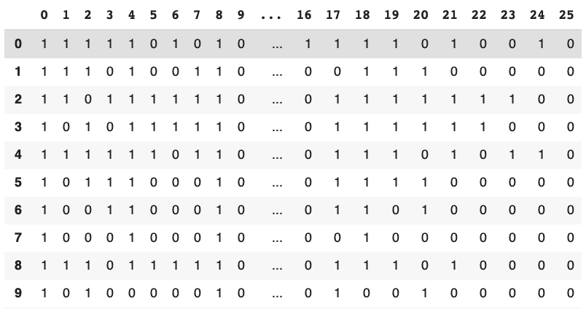

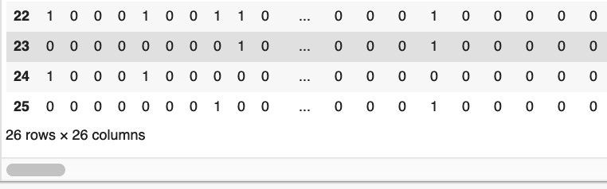
Positional binary n-gram
word length: 3
positional pair: (0, 1)

Slide 5
Error Detection
For word in test dataset:
Enter the sub-dictionary based on the word length.
Check each pair of letters in the word in the positional n-gram.
If the corresponding value is 0, then we detect the error.

Slide 6
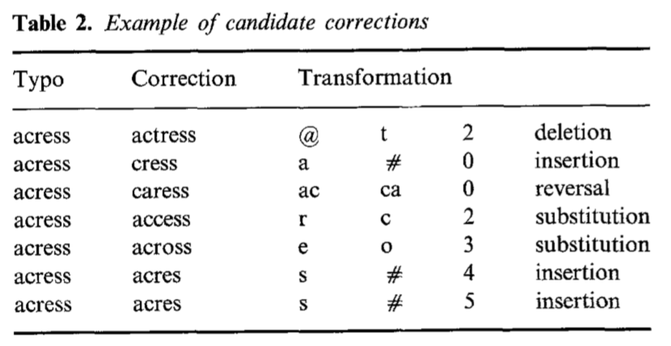
Error Correction
Four major types of errors:
Insertion
Deletion
Substitution
Reversal

Slide 7
Find Candidates
Find candidates based on the error type.
Example: ‘ank’
insertion:
deletion:
substitution:

Slide 8
Error Correction
Main idea: Probability scoring with contextual constraints
Formula:

Slide 9

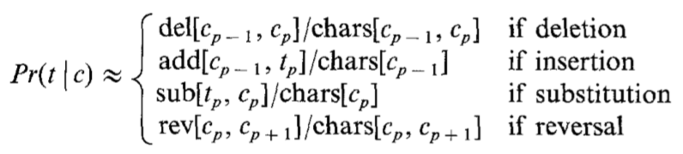
Probability Calculation
Pr(c): expected likelihood estimate (ELE)
Pr(t|c): confusion matrix
Pr(l|c) Pr(r|c): maximum likelihood estimate(MLE), expected likelihood estimate (ELE), Good-Turing(GT).

Slide 10
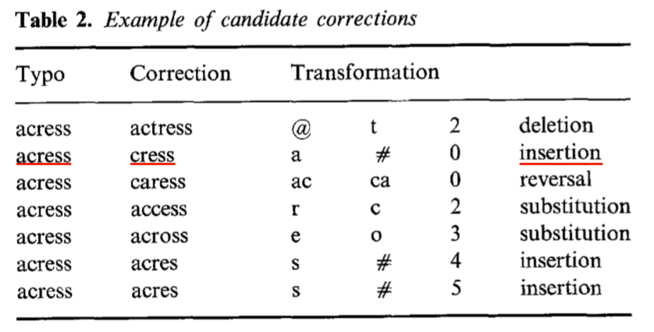
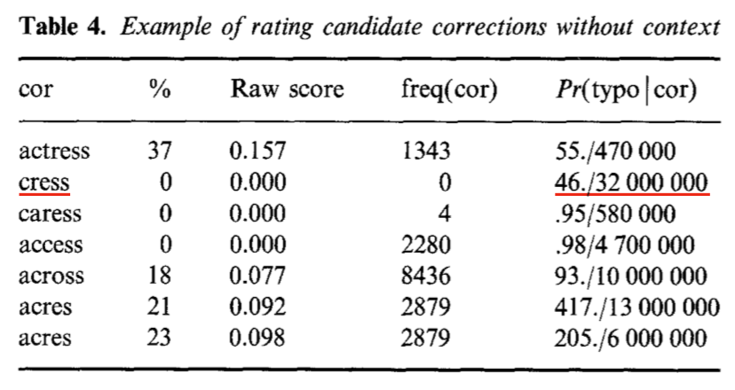
Calculation of channel probability
Value from confusion matrix & Frequency matrix (single character & character pair)

Slide 11
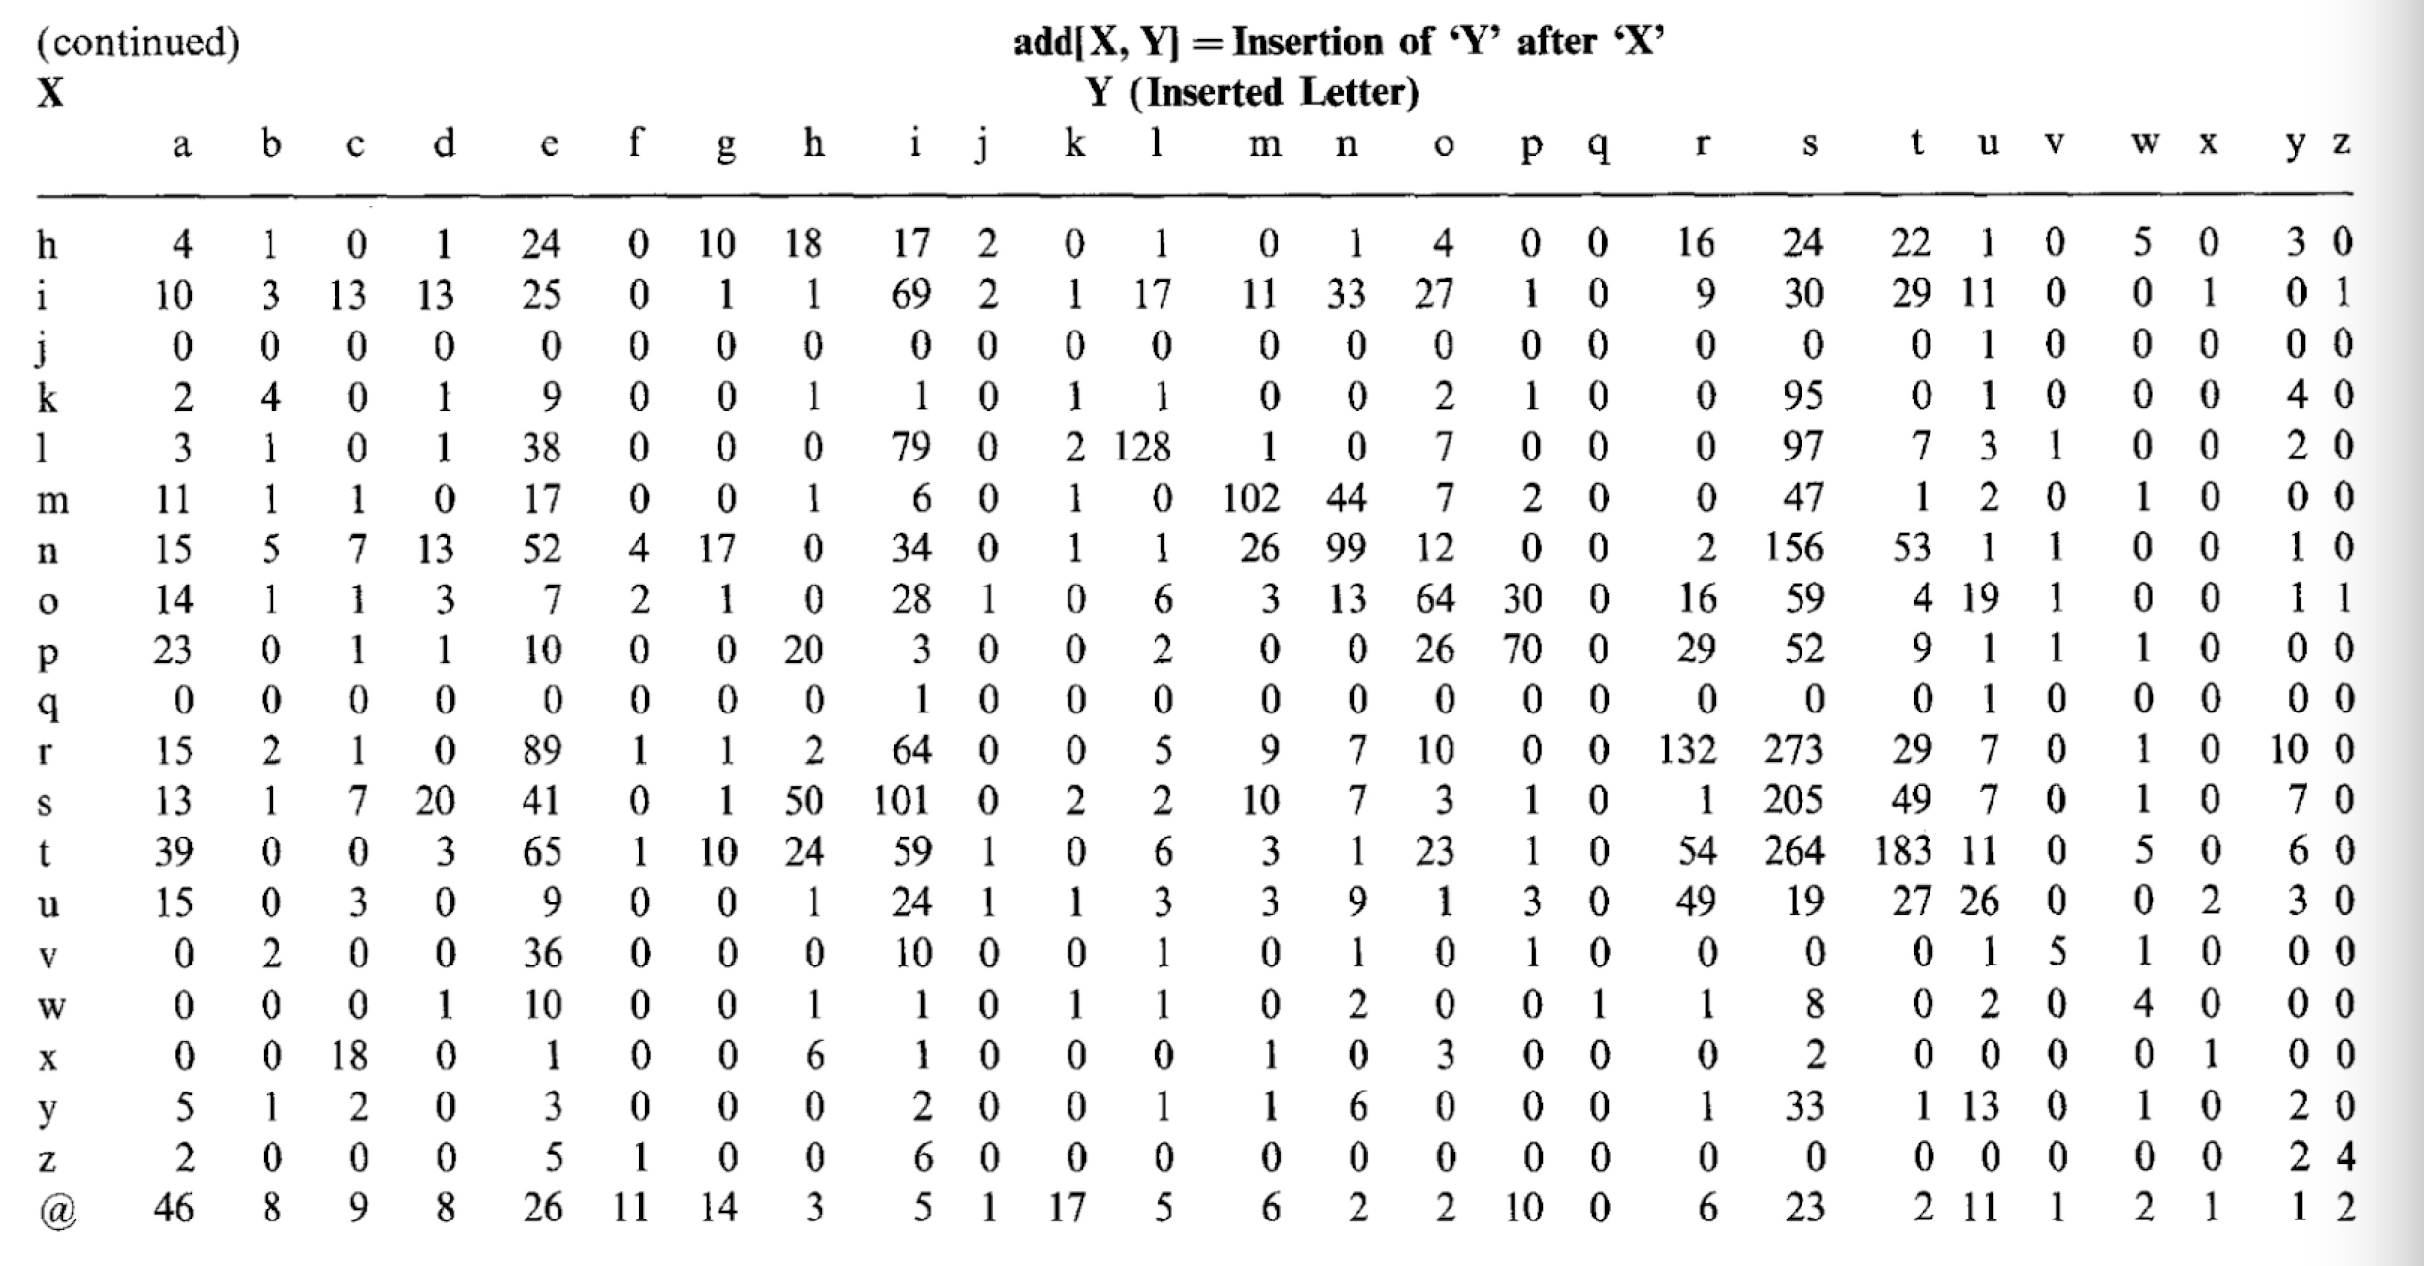

Slide 12
Calculation of Pr(l|c)Pr(r|c)
Three methods: MLE, ELE, GT
MLE method is uninformative in nearly half of the cases since the probability is 0.
ELE estimates assign non-zero probabilities, even when the observed frequencies is equal zero. But sometimes it badly overestimates the probability of a bigram that has not been seen in the training set.
GT is the most sophisticated method of fixing the zeros.

Slide 13
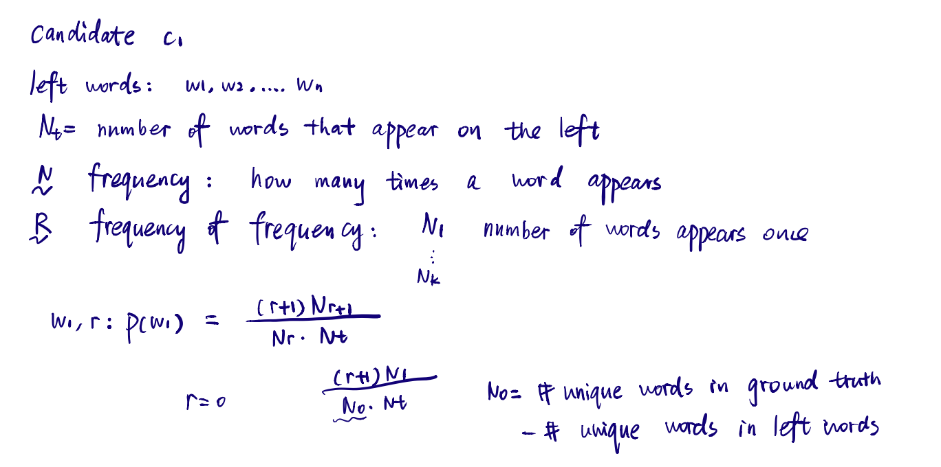
GT Implementation

Slide 14
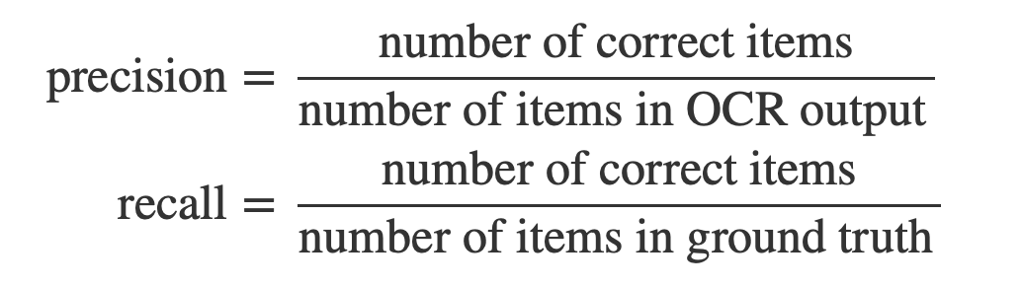
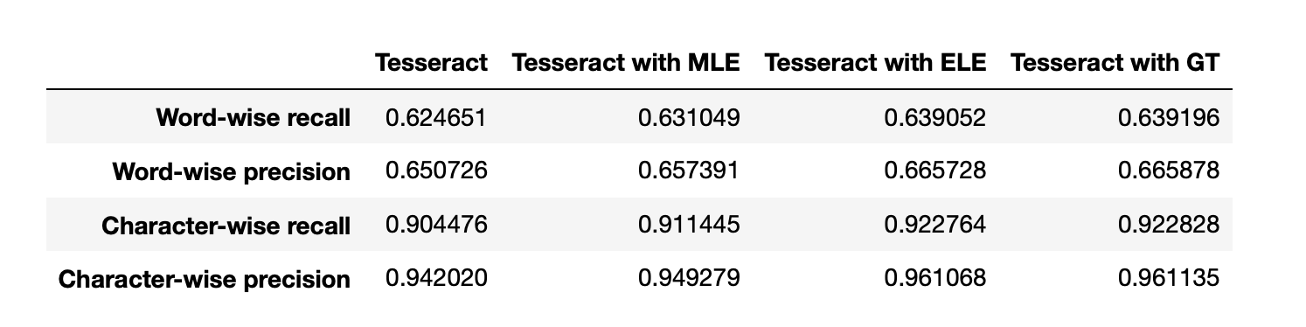
Evaluation

