Slide 1

Toxic comment classification
Project 5 Group 2
Fei Zheng shengjie sun zeyu yang xiaoxi zhao

Slide 2
overview
Project Goal
Exploratory Data Analysis
Model
Improvement
Next steps

Slide 3
Goal
Kaggle Link: https://www.kaggle.com/c/jigsaw-unintended-bias-in-toxicity-classification
Project Goal: Identify toxic comments in online conversations, where toxicity is defined as anything rude, disrespectful or otherwise likely to make someone leave a discussion.
Toxic: “haha you guys are a bunch of losers”, “ur a sh*tty comment.”

Slide 4
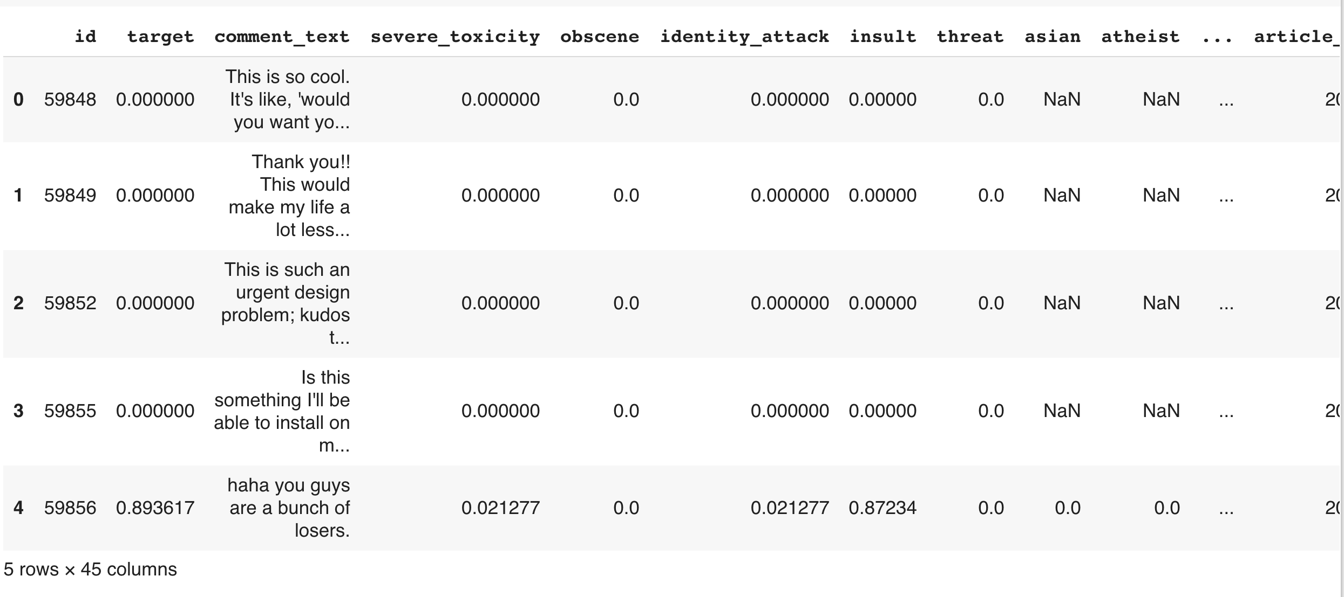
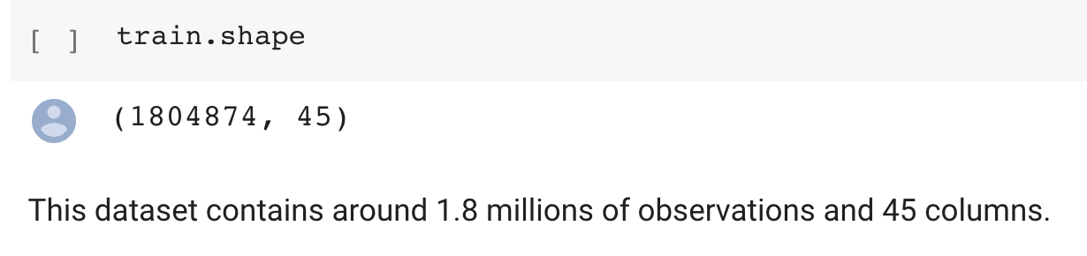
Data Overview

Slide 5
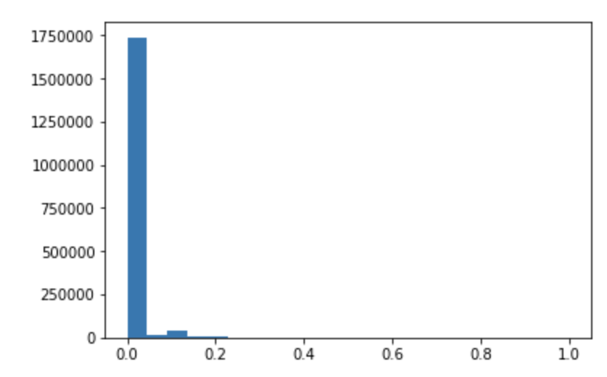
Proportion of toxic observations
This data is quite imbalanced. The majority of the observations are non-toxic. In fact, 94% of the data is not toxic.

Slide 6
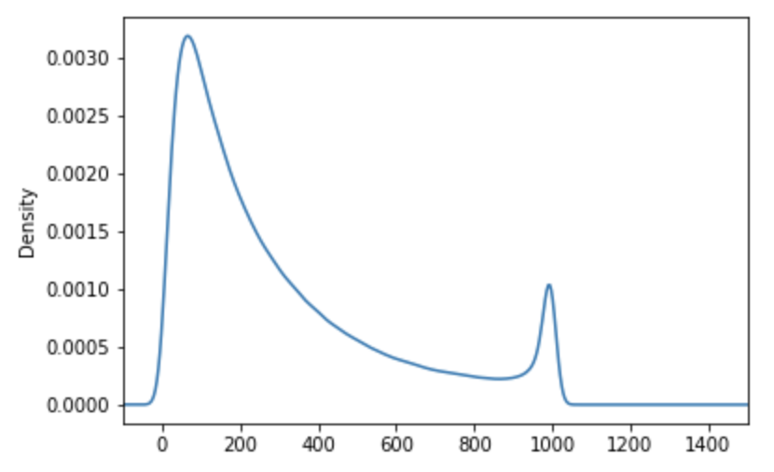
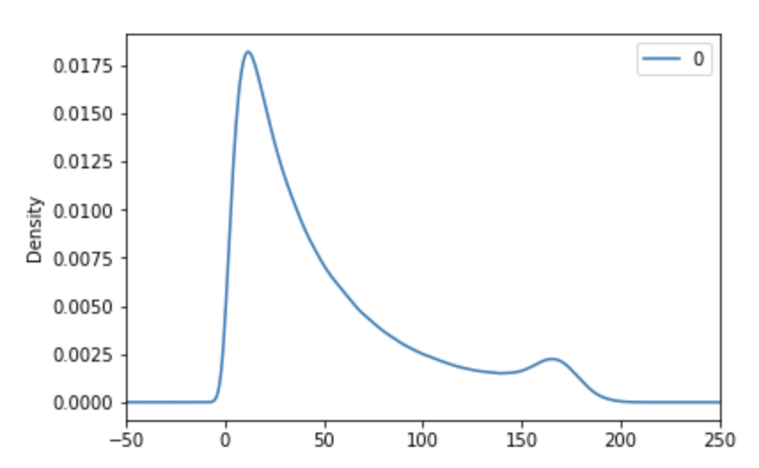
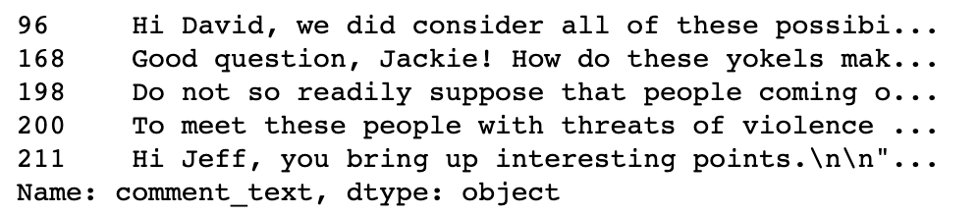
Number of characters in sentence
Number of words in sentence

Slide 7
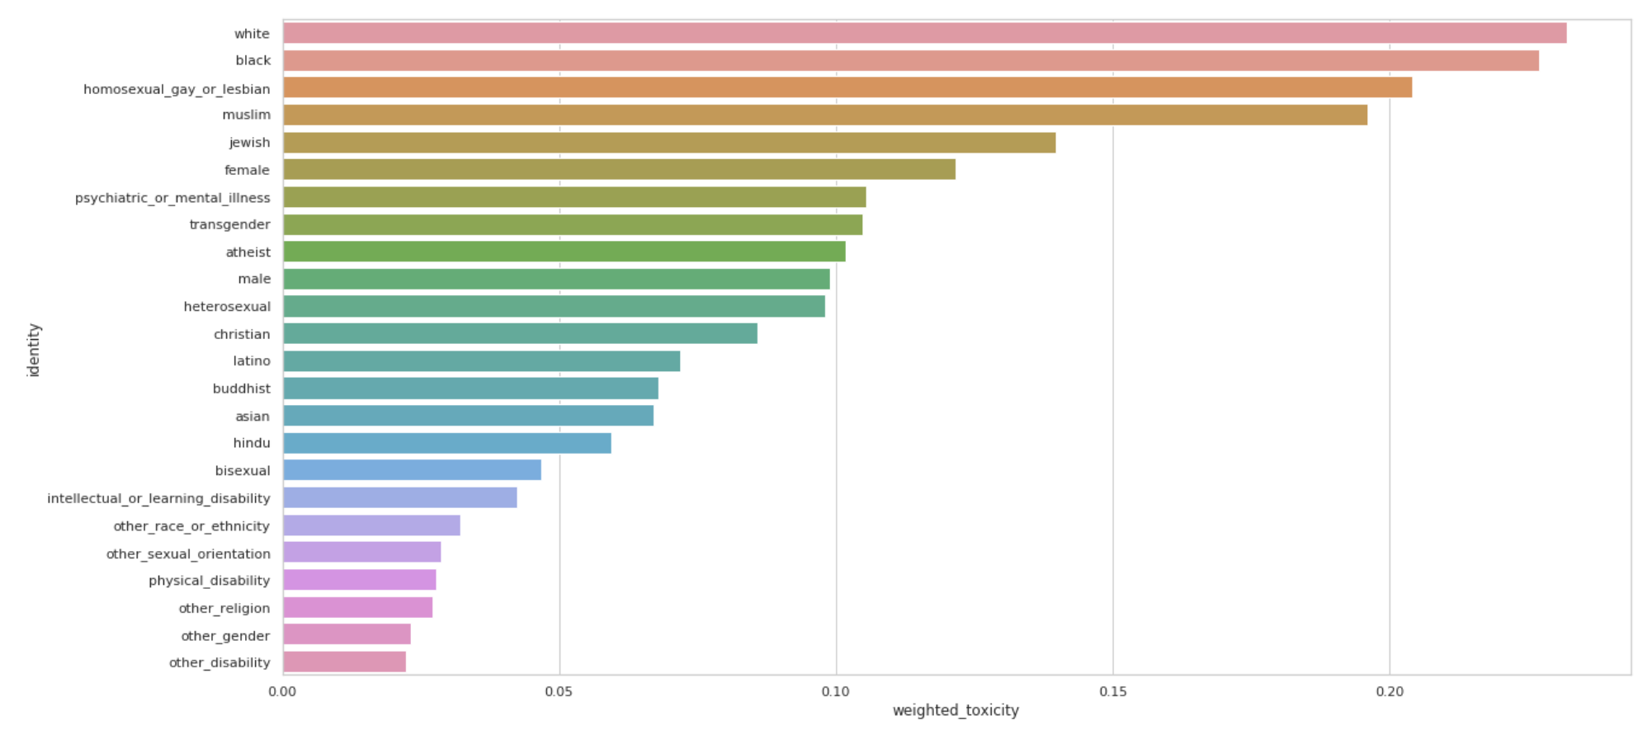
Percentage of toxic comments among different identity groups

Slide 8
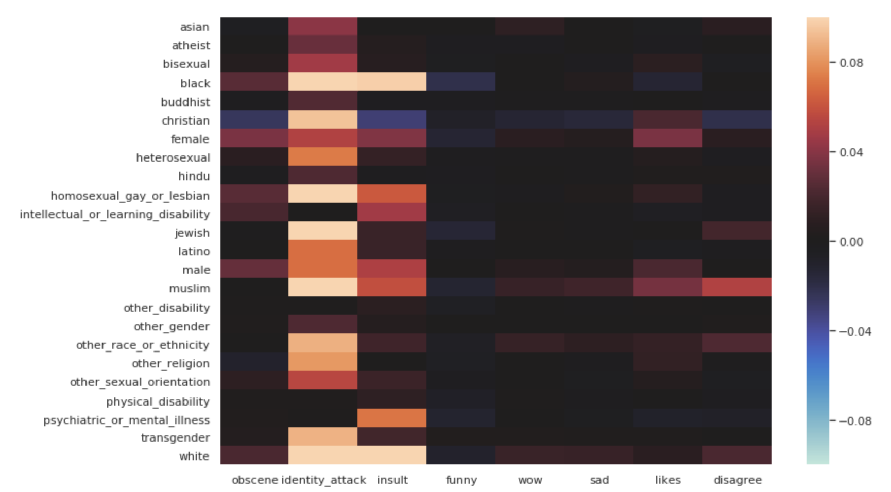
Correlation between comment labels and identity groups

Slide 9
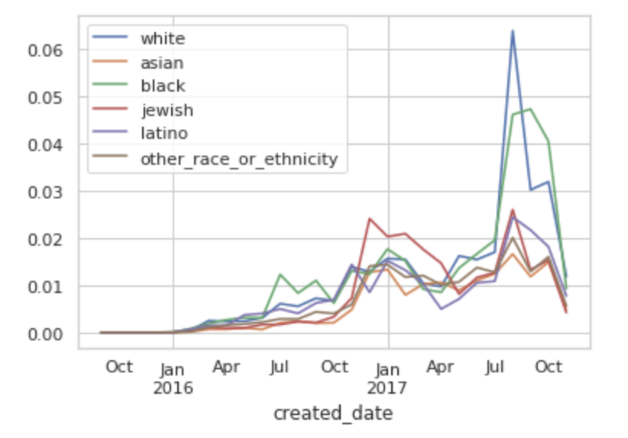
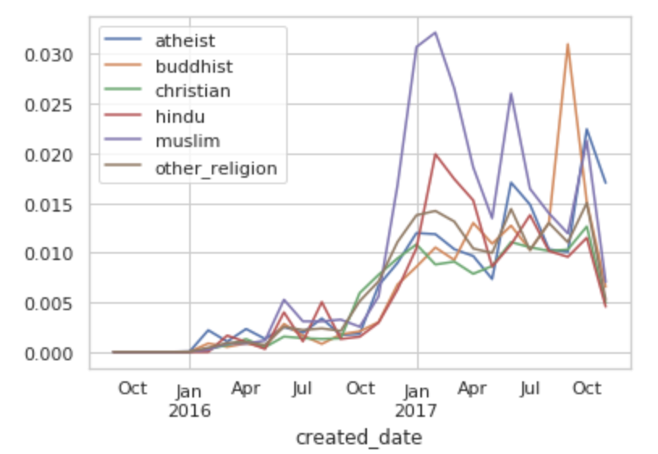
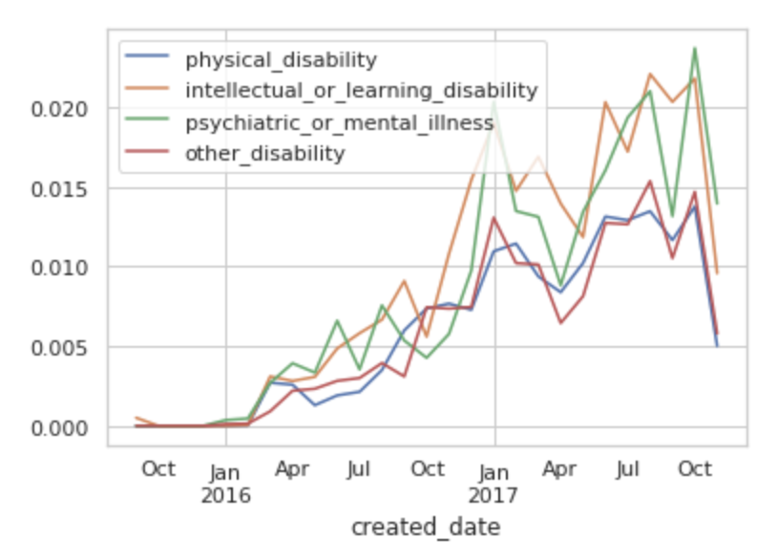
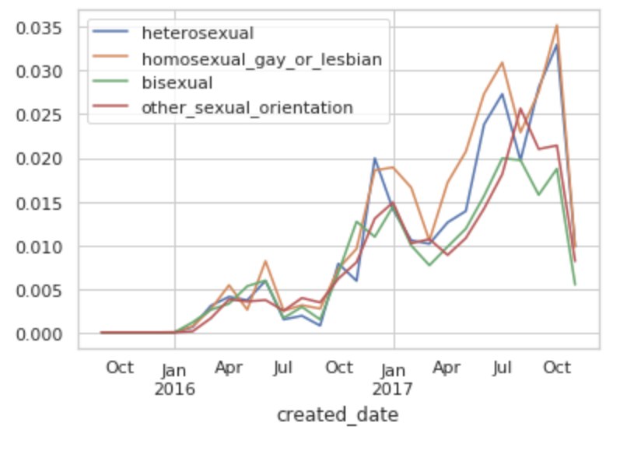
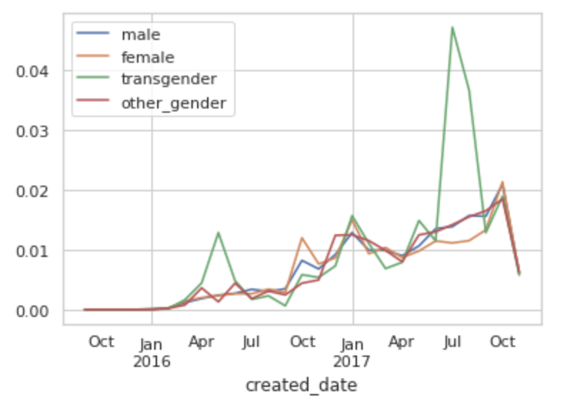

Slide 10
Model

Slide 11
Improvement
Correction of contraction
Correction of error words
Bucketing
Putting weight on observations
Change of the loss function

Slide 12
correction
Contraction: “isn’t”: “is not”, "I'd": "I would”, "there's": "there is" , "can't": "cannot”
Use upper case, lower case, opposite case and word stem to identify a unknown word
Edit a word by deleting a character, swapping 2 characters, replacing one character and inserting a character
Perform this edit twice to get candidate words
Reduced the unknown words from 174141 to 81028

Slide 13
Bucketing

Slide 14
Weight on data

Slide 15
Loss Function

Slide 16
VS Baseline model
 | Baseline Model | Improved Model (with bucketing) | Improved Model (without bucketing)
Accuracy | 0.93150 | 0.93365 | 0.93375
Running Time | 5291.7 | 4457.7 | 5564.1

Slide 17
Next Steps
Try weighted average of embeddings
Try cyclic learning rate
Try attention models and transformer

Slide 18
Thank you !

