Slide 1

Project 3: Predictive Analytics
Applied Data Science
Facial Emotion Recognition
Group 2: Chairuna, Marsya; Cheng, Lu; Heagy, David; Jiao, Hanbo; Pan, Zhongtian
Notes:
本PPT模板部分元素使用了幻灯片母版制作。如果需要修改，点击-视图-幻灯片母版-修改 完成后关闭编辑母版即可。

Slide 2
PART ONE
Feature Engineering
CONTENTS
PART TWO
Model Selection
PART THREE
Conclusion

Slide 3
01
Feature Engineering

Slide 4
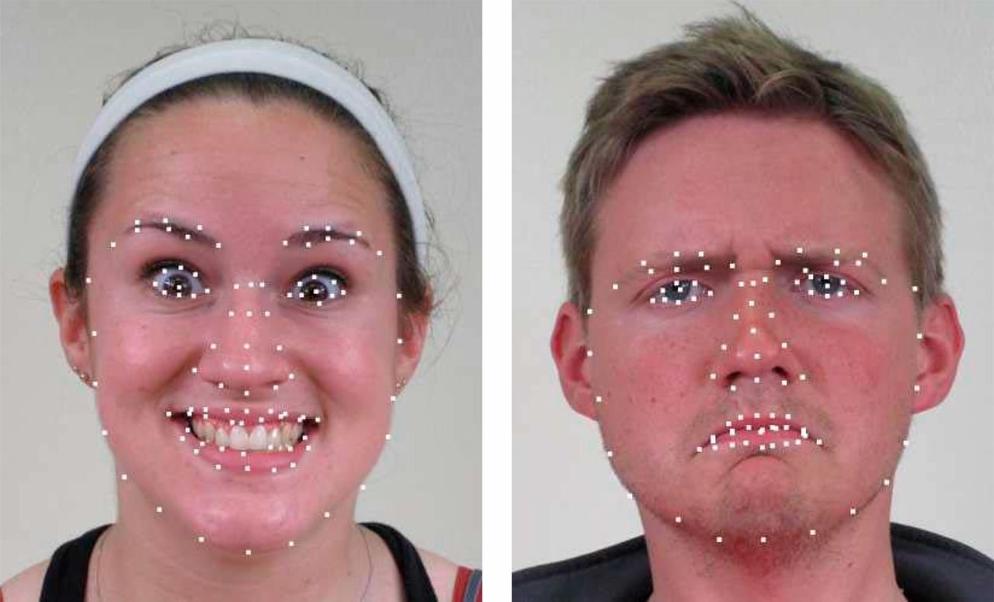
1. Feature Engineering
Data
2500 facial images
22 distinct emotion categories
Feature Extraction
Calculate pairwise distance between the fiducial points
Use the pairwise distance as features in our models
Time for feature extraction: 2s
Transform and Split Data
Transform data such that its distribution will have a mean of 0 and standard deviation of 1
Split data into a train and test set

Slide 5
02
Model Selection
Baseline Model
GBM
Advanced Models
KNN
Improved GBM
XGboost
Random Forest
Logistic Regression
SVM
Neural Network-MLPClassifier

Slide 6
2.1 Baseline Model - GBM
Gradient Boost Machine
Baseline Model
GBM
Accuracy Rate : 41.92%
Training Time : 472s
Testing Time : 0.023s
Chosen Parameters (Grid Search)
n_estimators: 100
max_depth: 1
Learning_rate: 0.1
点击此处添加标题
标题数字等都可以通过点击和重新输入进行更改，顶部“开始”面板中可以对字体、字号、颜色、行距等进行修改。
Disadvantages
Often requires many trees (>1000) which can be time and memory exhaustive
Requires a large grid search during tuning
Can overemphasize outliers and cause overfitting

Slide 7
2.2 Advanced Models
KNN
Chosen Parameters(Grid Search)
KNN
Accuracy Rate : 30.36%
Training Time : 472s
Testing Time : 0.023s
n_neighbors: 24
Compared with GBM(baseline)
Accuracy of KNN is less than that of GBM
Improved GBM
点击此处添加标题
Chosen Parameters(grid Search)
标题数字等都可以通过点击和重新输入进行更改，顶部“开始”面板中可以对字体、字号、颜色、行距等进行修改。
n_estimators: 100
max_depth: 2
Learning_rate: 0.1
Improved GBM
Accuracy Rate : 43.32%
Training Time : 1024s
Testing Time : 0.034s
Compared with GBM(baseline)
Accuracy is improved
Model fit time is significantly longer(1024.112s vs 472.039s)

Slide 8
2.2 Advanced Models
XGboost
SVM
Accuracy Rate: 47.12%
Training Time: 129.966s
Testing Time: 0.213s
Accuracy Rate: 50.04%
Training Time: 20.159s
Testing Time: 5.694
Random Forest
Neural Network-MLPClassifier
Accuracy Rate: 45.48%
Training Time: 7.565s
Testing Time: 0.035s
Accuracy Rate: 49.44%
Training Time: 328.237s
Testing Time: 0.202s
Logistic Regression
Accuracy Rate: 54.00%
Training Time: 37.204s
Testing Time: 0.009s

Slide 9
03
Conclusion
Model Comparison & Final Model
Voting Classifier

Slide 10
3.1 Final Model
Model | Accuracy | Training Time /s | Testing Time /s
KNN | 30.36% | 0.481s | 10.944s
Improved GBM | 43.32% | 1024.112s | 0.034s
XGboost | 47.12% | 129.966s | 0.213s
Random Forest | 45.48% | 7.565s | 0.035s
Logistic Regression | 54.00% | 37.204s | 0.009s
SVM | 50.04% | 20.159s | 5.694s
MLPClassifier | 49.44 | 328.237s | 0.202s
Final Model
Compare models and find top models
Use Voting Classifier to combine top models together as final model
Accuracy Rate: 54.32%
Training time: 492.856s
Testing time: 6.098s
Random Forest Classifier
Logistic Regression
MLP Classifier
XGboost
SVM

Slide 11
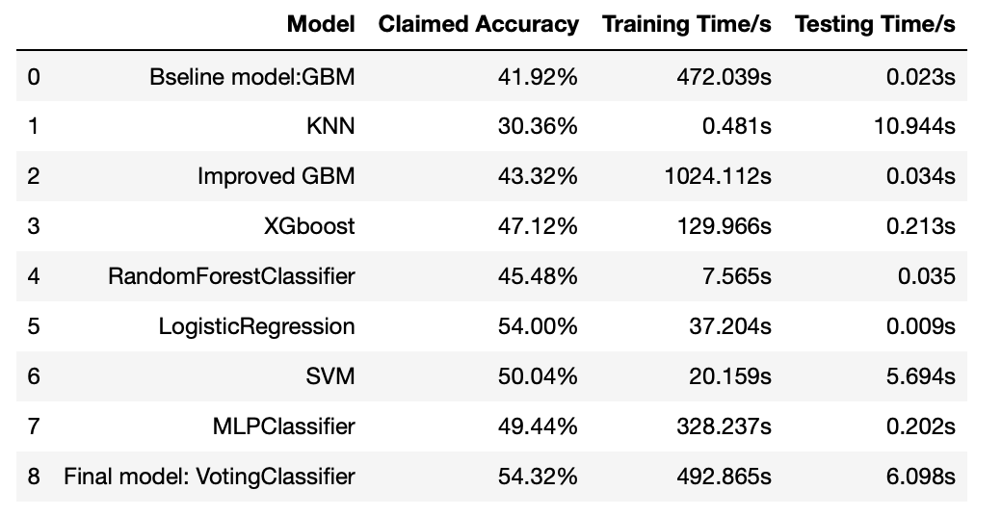
3.2 Model Results
点击此处添加标题
标题数字等都可以通过点击和重新输入进行更改，顶部“开始”面板中可以对字体、字号、颜色、行距等进行修改。

Slide 12
Thank you

