Slide 1
Facial Emotion Recognition
Group 9 Members
Huang, Huize - hh2816
Wang, Mengchen - mw33714
Wang, Rui - rw2795
Wu, Jiadong - jw3856
Zhang, Qin - qz2387
Presenter: Zhang, Qin
Date: April 1st, 2020

Slide 2
Model
Gradient Boosting – Baseline
Neutral Network – Advanced
Linear Discriminant Analysis
Logistic Regression
Support Vector Machine
Random Forest
Extreme Gradient Boosting
Ensemble Extreme Gradient Boosting and Support Vector Machine

Slide 3
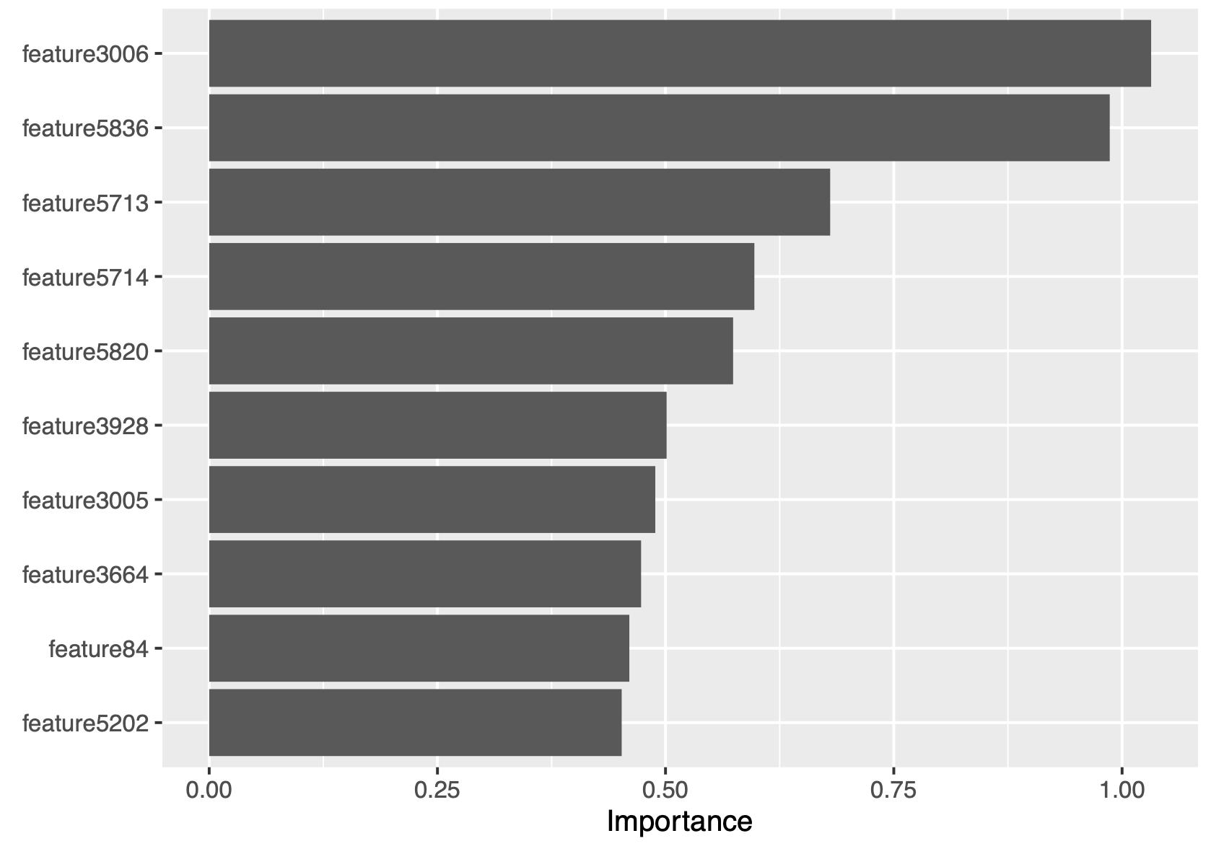
Baseline model: Gradient Boosting Machine (GBM)
n.trees | shrinkage | interaction.depth | n.minobsinnode
300 | 0.15 | 2 | 10
Testing Accuracy : 40.4%
Time for training model GBM : 1816.61s
Pros :
- accuracy not bad
- no need for data pre-processing
Cons :
- computational expensive
- less interpretable

Slide 4
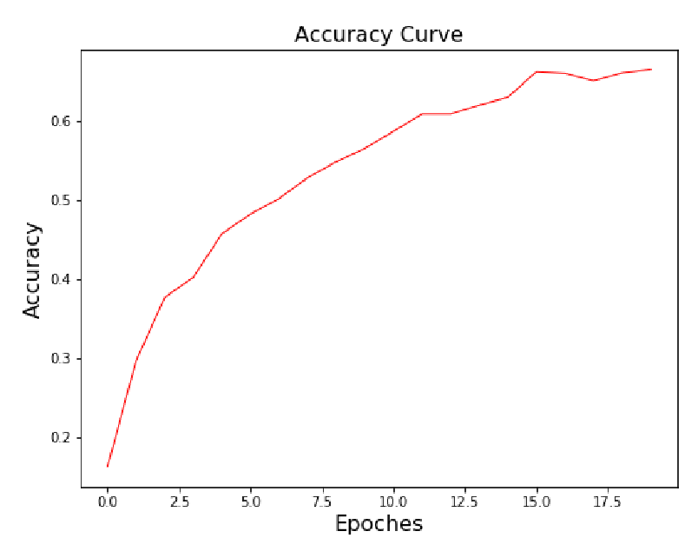
Advanced model: Neutral Network (NN)
Epoches | Training Accuracy | Testing Accuracy
20 | 66.5% | 56.2%
Testing Accuracy : 56.2%
Time for training model NN: 35s
The Neural Network gives us a good prediction accuracy within a very short time.

Slide 5
Linear Discriminant Analysis (LDA) with PCA
Input : Fiducial Points Coordinate With PCA
Testing Accuracy : 44.1%
Time for training model LDA : 88.012s

Slide 6
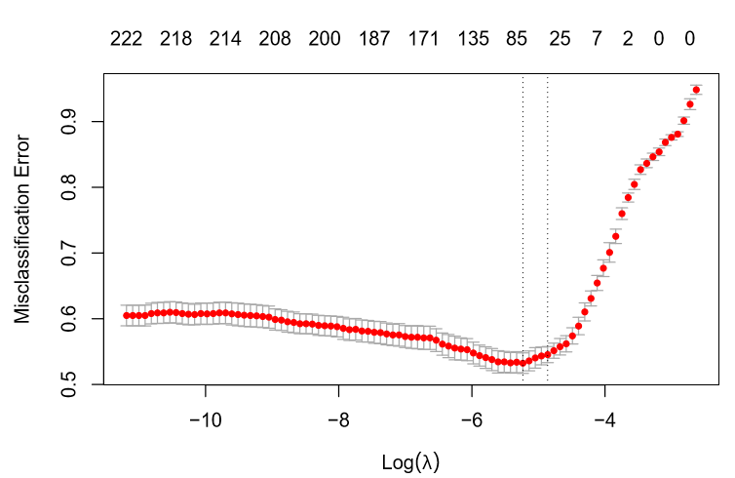
Logistic Regression Model (LR)
Find Optimal Lambda
Input : Fiducial Points Coordinate With PCA
Optimal Lambda : 0.0079388
Testing Accuracy : 39.2%
Time for training model LR : 421.2s

Slide 7
Support Vector Machine (SVM)
The global argument we need to consider is stated below :
- kernel: the kernel used in training and predicting
- degree: parameter needed for kernel of type polynomial (default: 3)
- gamma: parameter needed for all kernels except linear (default: 1/(data dimension))
Testing Accuracy : 51.4%
Time for training model SVM : 117.39s

Slide 8
Random Forest (RF)
The global argument we need to consider is stated below :
- ntrees: the number of trees in the forest.
- mtry: the number of features to consider when looking for the best split.
- max_depth: the maximum depth of each tree.
optimal parameter as mtry = 77
Testing Accuracy : 41.4%
Time for training model RF : 519.99s

Slide 9
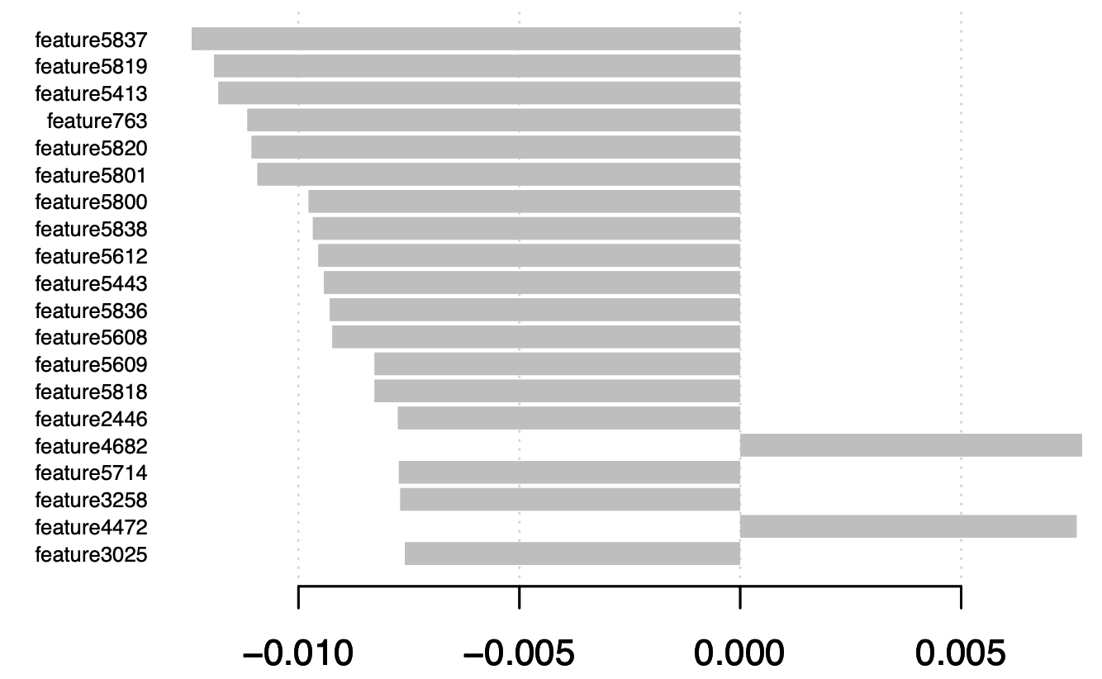
Extreme Gradient Boosting (XGBoost)
booster | objective | eval_metric | lambda | Lambda_bias | alpha
gblinear | multi:softmax | mlogloss | 1.46 | 0.23 | 0.0198
Testing Accuracy: 53.6%
Time for training model XGBoost: 533.71s
Pros:
- Higher accuracy
- Higher efficiency in both training and testing process

Slide 10
Ensemble Extreme Gradient Boosting (XGBoost) and Support Vector Machine (SVM)
XGBoost and SVM (With some seed, SVM has the accuracy above 50%) have better performance than others.
Build a simple ensemble model based on XGBoost result and SVM result, calculating a weighted average of the probability matrix then deciding the ﬁnal prediction, will increase the accuracy.
Testing Accuracy : 56%
Time for training model Ensemble model XGBoost and SVM : 701.346s

Slide 11
Summary
 | GBM - baseline | NN - advanced | LDA | LR | SVM | RF | XGBoost | Ensemble model XGBoost and SVM
Testing accuracy | 40.4% | 56.2% | 44.1% | 39.2% | 51.4% | 41.4% | 53.6% | 56%
Time for training model | 1816.61s | 35s | 88.01s | 421.23s | 117.39s | 519.99s | 533.71s | 701.346s
Time for testing model | 13.2s | 0.274 s | 4.26s | 0.35s | 8.83s | 0.608s | 0.54s | 9.822s

Slide 12
Thank you for listening!

