Slide 1
Facial Emotion Recognition
Group 9 Members
Huang, Huize - hh2816
Wang, Mengchen - mw33714
Wang, Rui - rw2795
Wu, Jiadong - jw3856
Zhang, Qin - qz2387
Presenter: Zhang, Qin
Date: April 1st, 2020

Slide 2
Model
Gradient Boosting – Baseline
Neutral Network– Advanced
Linear Discriminant Analysis
Logistic Regression
Support Vector Machine
Random Forest
Extreme Gradient Boosting
Ensemble Extreme Gradient Boosting and Support Vector Machine

Slide 3
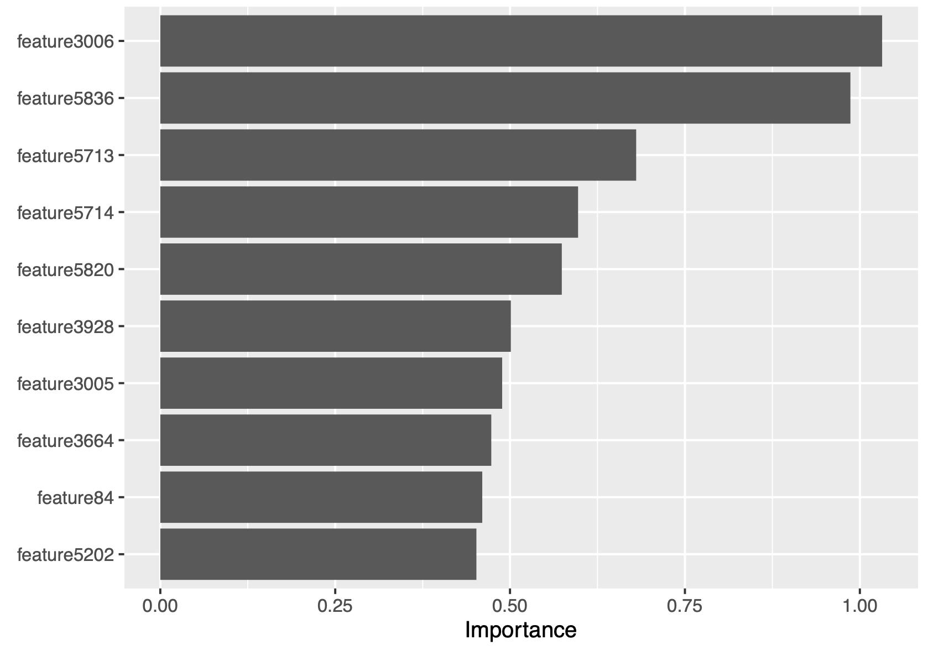
Baseline model: Gradient Boosting Machine (GBM)
n.trees | shrinkage | interaction.depth | n.minobsinnode
300 | 0.15 | 2 | 10
Testing Accuracy : 40.4%
Time for training model GBM : 1816.61s
Pros :
- accuracy not bad
- no need for data pre-processing
Cons :
- computational expensive
- less interpretable

Slide 4
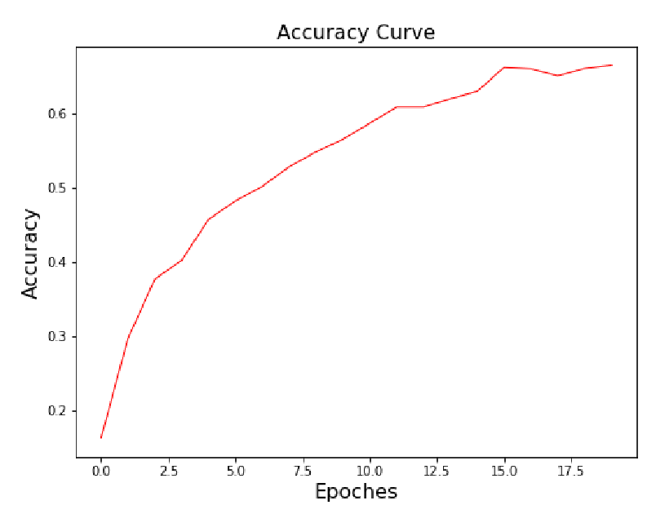
Advanced model: Neutral Network (NN)
Epoches | Training Accuracy | Testing Accuracy
20 | 66.5% | 56.2
Testing Accuracy : 56.2%
Time for training model NN: 35s
The Neural Network gives us a good prediction accuracy within a very short time.

Slide 5
Linear Discriminant Analysis (LDA) with PCA
Input : Fiducial Points Coordinate With PCA
Training Accuracy : 90.9%
Testing Accuracy : 44%
Time for training model LDA : 88.012s

Slide 6
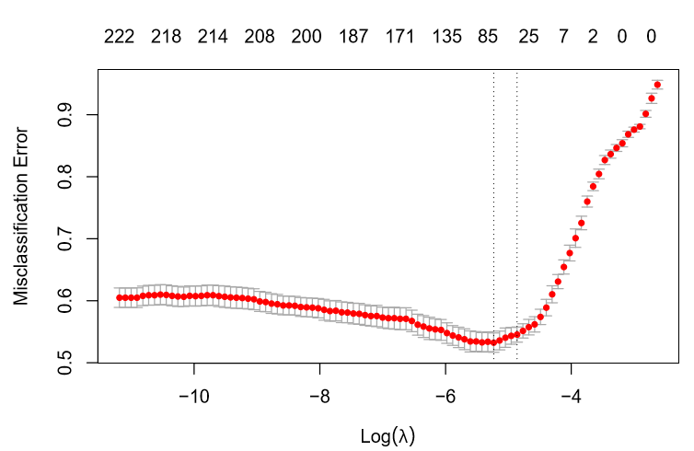
Logistic Regression Model (LR)
Find Optimal Lambda
Input : Fiducial Points Coordinate With PCA
Optimal Lambda : 0.0079388
Testing Accuracy : 39.2%
Time for training model LR : 421.2s

Slide 7
Support Vector Machine (SVM)
The global argument we need to consider is stated below :
- kernel: the kernel used in training and predicting
- degree: parameter needed for kernel of type polynomial (default: 3)
- gamma: parameter needed for all kernels except linear (default: 1/(data dimension))
Testing Accuracy : 51.4%
Time for training model SVM : 117.39s

Slide 8
Random Forest (RF)
The global argument we need to consider is stated below :
- ntrees: the number of trees in the forest.
- mtry: the number of features to consider when looking for the best split.
- max_depth: the maximum depth of each tree.
optimal parameter as mtry = 77
Testing Accuracy : 41.4%
Time for training model RF : 519.99s

Slide 9
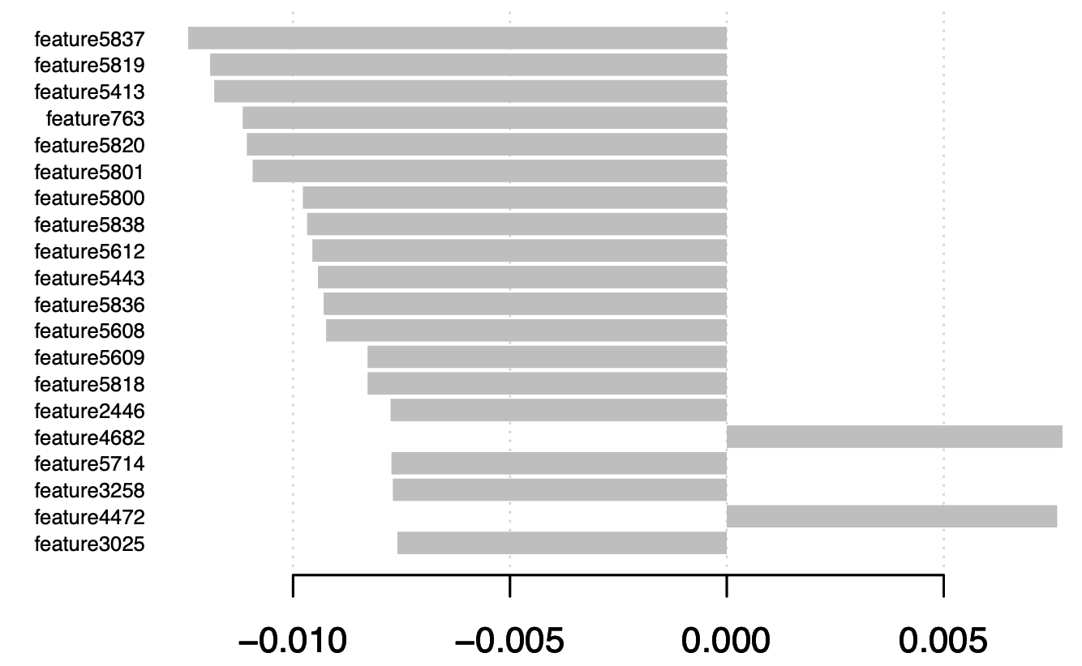
Extreme Gradient Boosting (XGBoost)
booster | objective | eval_metric | lambda | Lambda_bias | alpha
gblinear | multi:softmax | mlogloss | 1.46 | 0.23 | 0.0198
Testing Accuracy: 53.6%
Time for training model GBM: 533.71s
Pros:
- Higher accuracy
- Higher efficiency in both training and testing process
Cons:
- computational expensive
- less interpretable

Slide 10
Ensemble Extreme Gradient Boosting (XGBoost) and Support Vector Machine (SVM)
XGBoost and SVM (With some seed, SVM has the accuracy above 50%) have better performance than others.
Build a simple ensemble model based on XGBoost result and SVM result, calculating a weighted average of the probability matrix then deciding the ﬁnal prediction, will increase the accuracy.
Testing Accuracy : 56%
Time for training model Ensemble model XGBoost and SVM : 701.346s

Slide 11
Summary
 | GBM - baseline | NN - advanced | LDA | LR | SVM | RF | XGBoost | Ensemble model XGBoost and SVM
Testing accuracy | 40.4% | 56.2s | 90.9% | 39.2% | 51.4% | 41.4% | 53.6% | 56%
Time for training model | 1816.61s | 35s | 88.01s | 421.23s | 117.39s | 519.99s | 533.71s | 701.346s
Time for testing model | 13.2s | 0.274 s | 4.26s | 0.35s | 8.83s | 0.608s | 0.54s | 9.822s

Slide 12
Thank you for listening!

