Slide 1

Collaborative Filtering Algorithm Implementation and Evaluation
Group 11 @ Applied Data Science 2020 Fall

Slide 2
Introduction to Algorithm
Contents
Implementation and Training
Evaluation and Comparison
Conclusion and Presentation

Slide 3
01
Part One
Intro to Algorithm

Slide 4
1. Introduction
Optimized with Stochastic Gradient Decent
Compare between Two Post-processing: KNN & KRR
Factorized Rating Model
Adding Two Regularizing Terms: Penalty of Magnitudes & Bias and Intercepts

Slide 5
02
Part Two
Implement & Train

Slide 6
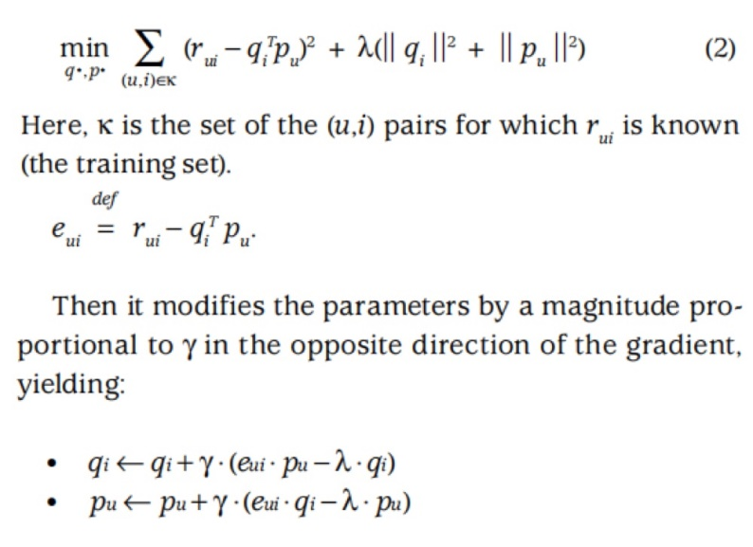
2-1. SGD
Equation (2) is the objective function;
Optimized with SGD;
Tuned row number of p & q;
Rating matrix gained by q.T*p.

Slide 7
2-2. Regularizations
Penalty of Magnitudes
Regularizing matrices p and q to prevent it from exploding and over fitting.
Bias and Intercepts
Taking into account the identical effects that users and items could give to each other by adding biases to objective function.

Slide 8
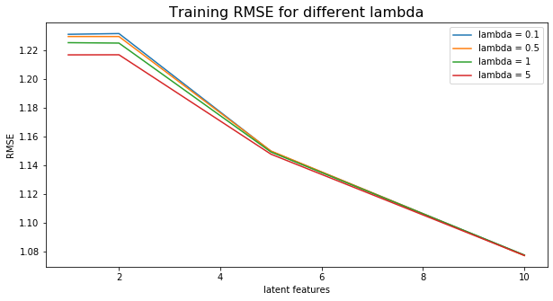
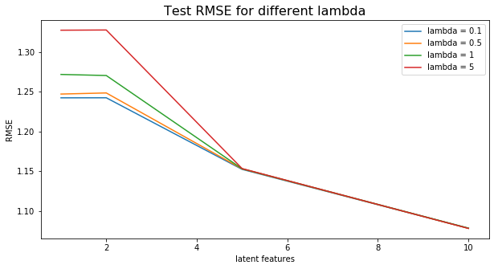
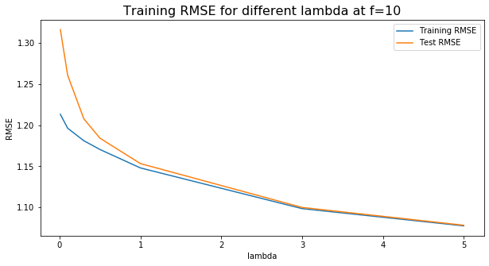
2-3. Cross-Validation
5-fold cross validation over hyper-parameters lambda & f to optimize training & test MSE:
To take lambda = 5 & f = 10.
Training MSE over lambda
Test MSE over lambda
Training MSE at f = 10

Slide 9

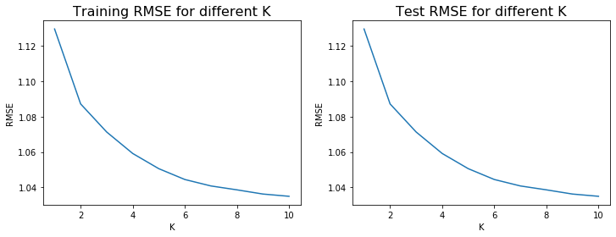
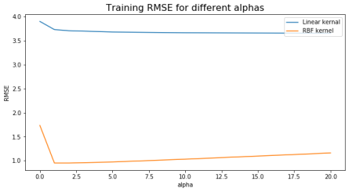

3-2 Post-processing

Slide 10
03
Part Three
Evaluate & Compare

Slide 11
3. Time & MSE
18.3s Running time for KNN
36.9s Running time for KRR
Running
Time
KNN
KRR
MSE
Test MSE is 1.03 for KNN
Test MSE is 0.96 for KRR

Slide 12
04
Part Four
Conclusion

Slide 13



4. Conclusion
Post-processing P1 has a lower running time but a higher MSE, P2 is the opposite.
SGD + R1 + R2 has a running time of 27.8s as well as a MSE of 1.08.
There is an accuracy-cost trade-off in this algorithm selection.
02
01
03
Conclusion

Slide 14
Thank You

