Slide 1
Maximizing Accuracy and Fairness using Fairness Constraint & Information Theoretic Measures for Fairness-aware Feature Selection
Group 6: Tianxiao He, Linda Lin, Xinming Pan, Namira Suniaprita, Han Wang, YiXun Xu
Presenter: Han Wang

Slide 2
Table of content
Data Preprocessing
Logistic Regression
Baseline Model
Fairness Constraints: Mechanisms for Fair Classification
Information Theoretic Measures for Fairness-aware Feature Selection(FFS)
Support Vector Machine
Baseline Model
Fairness Constraints: Mechanisms for Fair Classification
Information Theoretic Measures for Fairness-aware Feature Selection(FFS)
Evaluation & Discussion

Slide 3
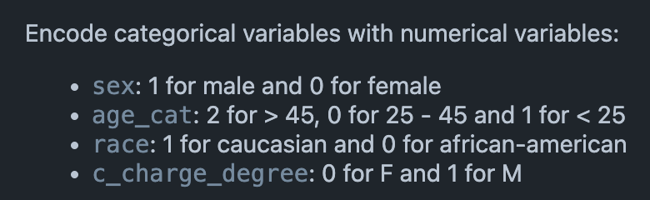
Data Preprocessing
Change categorical data to numerical
features = df[['sex', 'age_cat', 'c_charge_degree', 'length_of_stay',"priors_count"]]
sensitive = df['race']
target = df['two_year_recid']

Slide 4
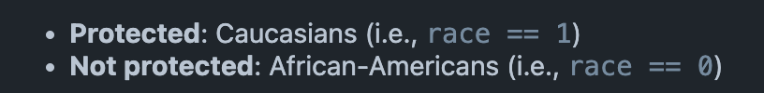
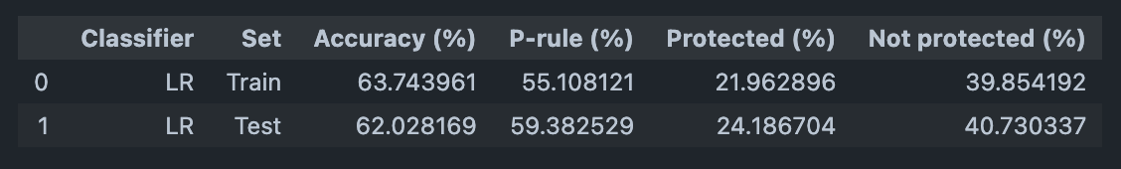
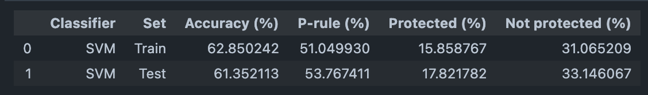
Baseline Model
The p-rule function is commonly used in evaluate fairness in machine learning model, by checking whether the model's positive predictions are distributed similarly across different sensitive groups. The higher the p-rule, the better the fairness.

Slide 5
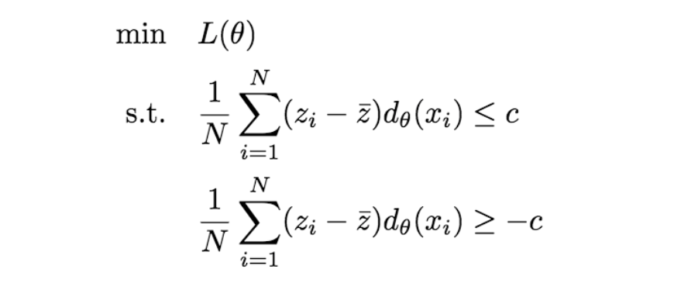
A2 Algorithm
minimize the loss function L subject to fairness constraint
c controls the tradeoff between fairness and accuracy

Slide 6
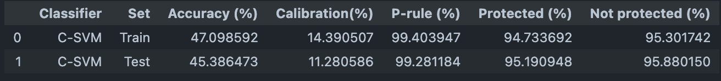
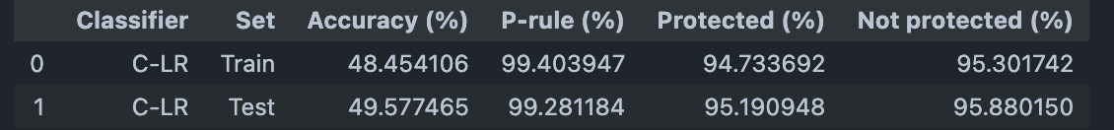
A2 Algorithm: Results
Accuracy drop by 15%

Slide 7
A7 Algorithm (FFS)
Accuracy coefficient and Discrimination coefficient are two information–theoretic measures that separately quantify the accuracy and discriminatory impact of features. Using Shapley value, we can deduce the marginal impacts of each features. The Shapley value ensures each feature gains as much or more as they would have from acting independently.
Notes:
Xs is a subset of features

Slide 8
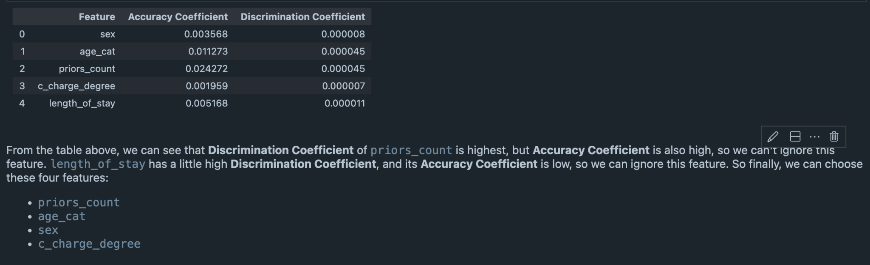
A7 Algorithm (FFS): Results

Slide 9
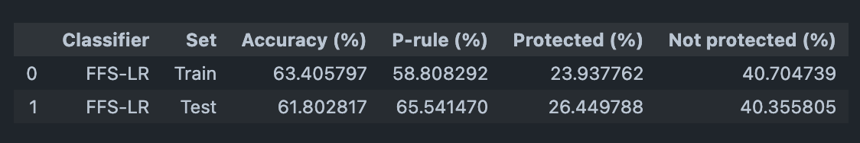
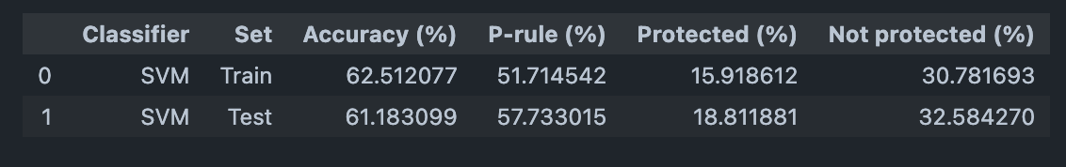
Logistic Using FFS
SVM Using FFS
P-rule increases by 5%, accuracy stays the same

Slide 10
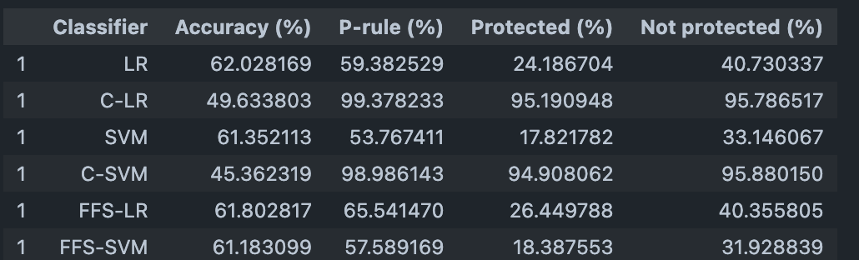
Evaluation & Discussion
If we take both accuracy and fairness into account, we would recommend FFS-LR with 61.8% accuracy as the second highest of all models, and with p-rule score 65.54% that's reasonably well (third highest of all models).

Slide 11
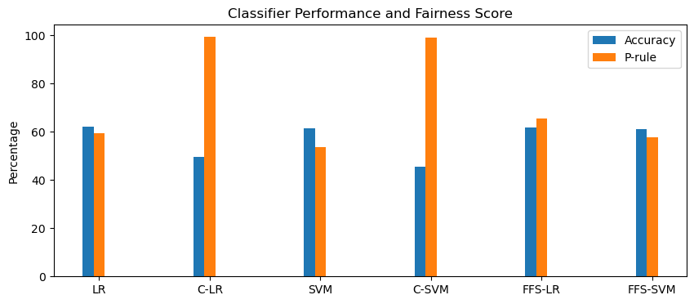
The reason we don't choose C-LR or C-SVM is because despite their high P-rule value, their accuracy is too low for a binary classifier. The reason we don't choose traditional LR or SVM is because despite their relative high accuracy, they do not take fairness into account.

