Slide 1
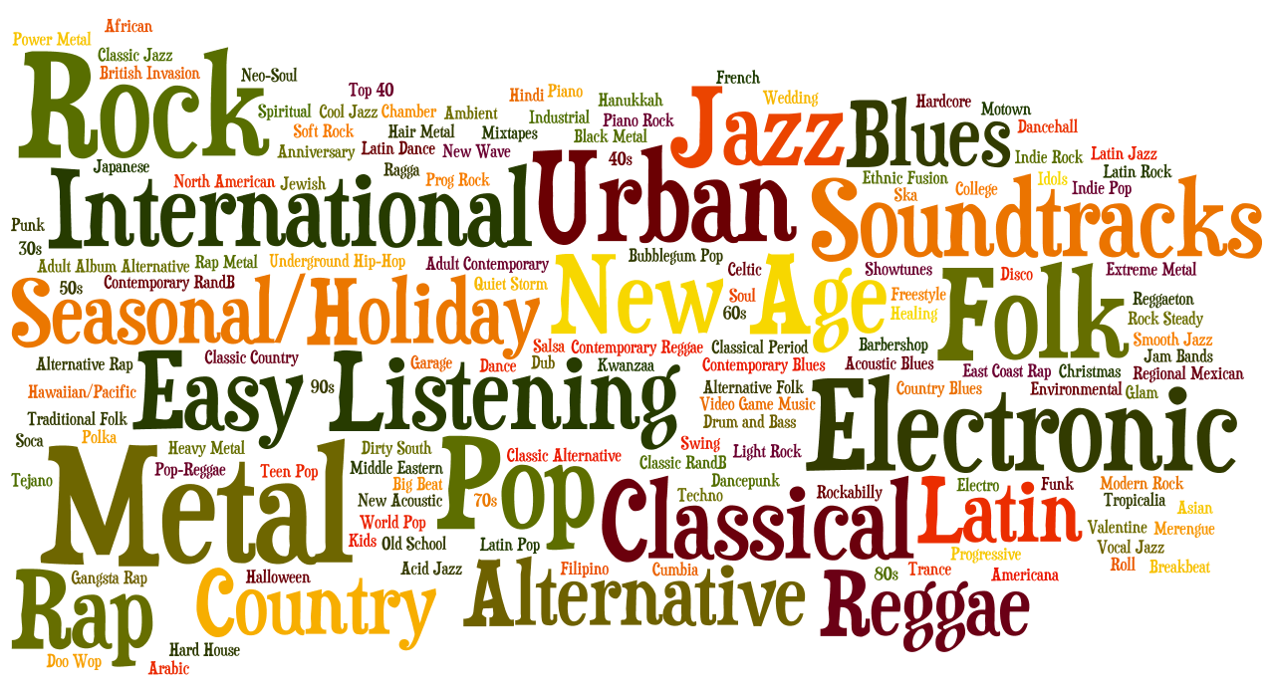
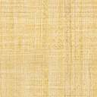
A Data Story on the Songs of Our Times
Applied Data Science, Project 1
By Tushar Ponkshe

Slide 2
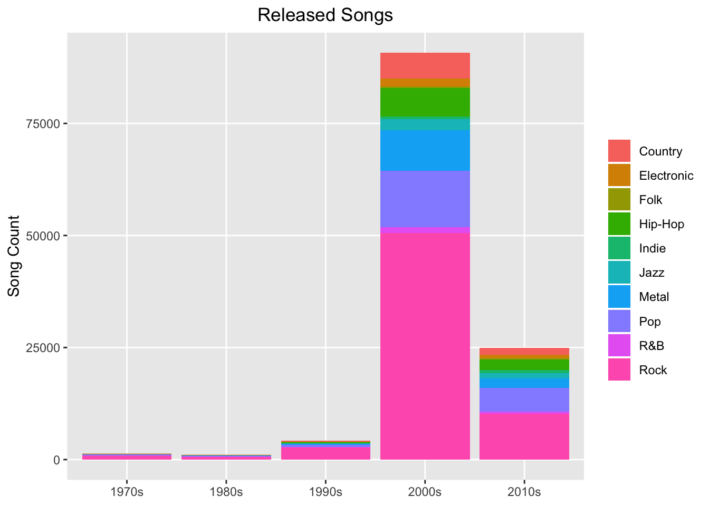

Slide 3
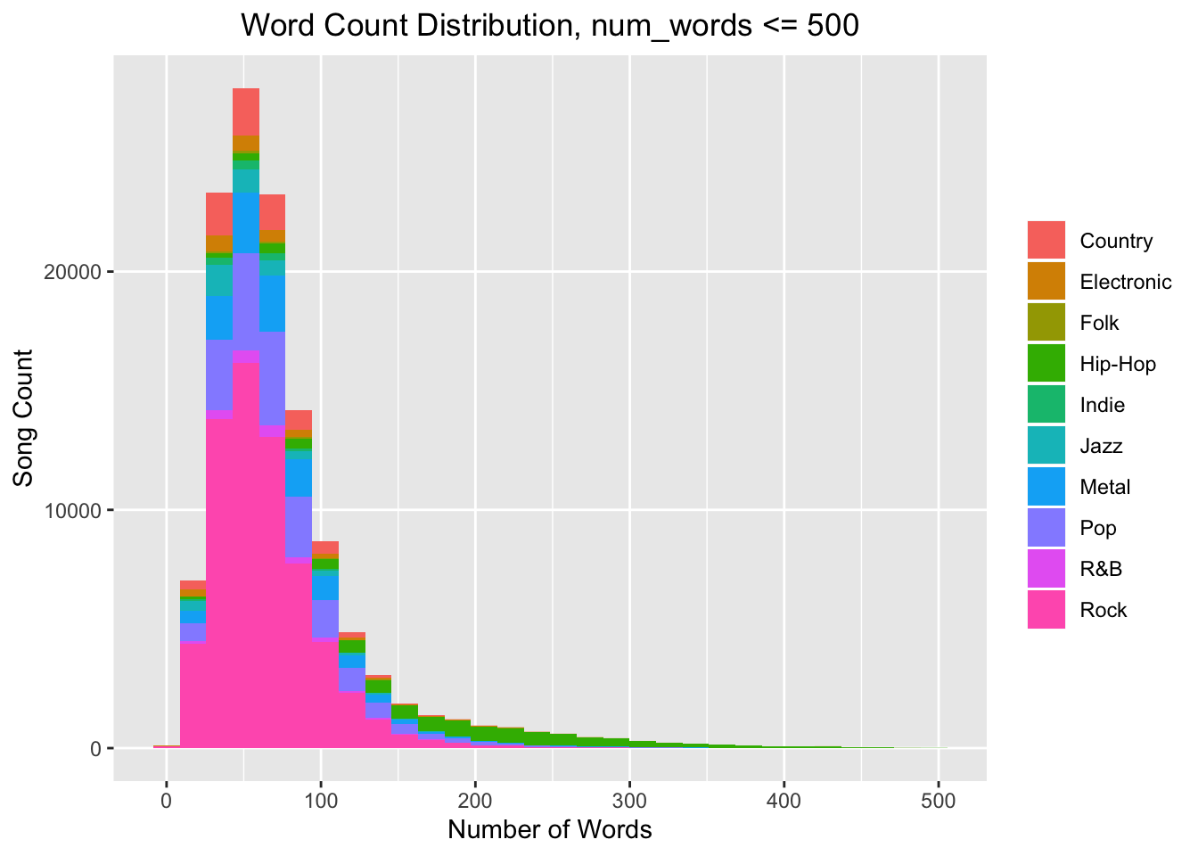
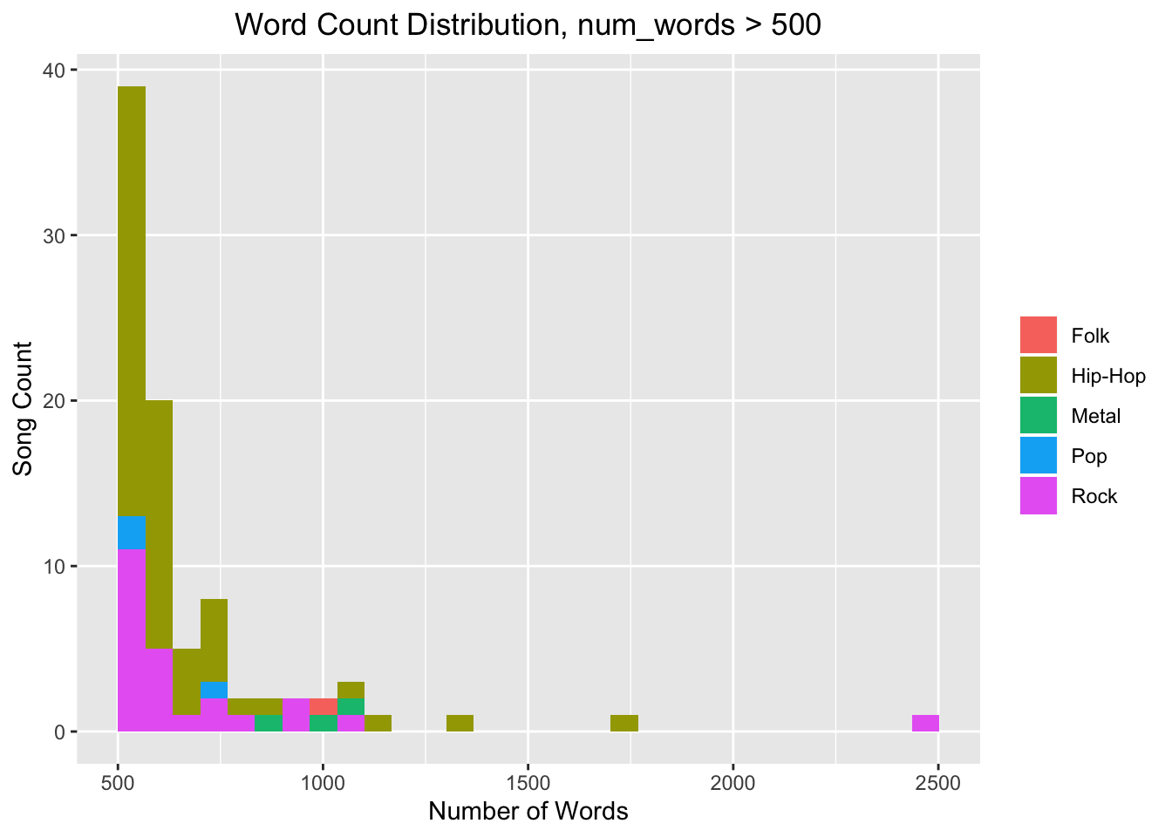

Slide 4
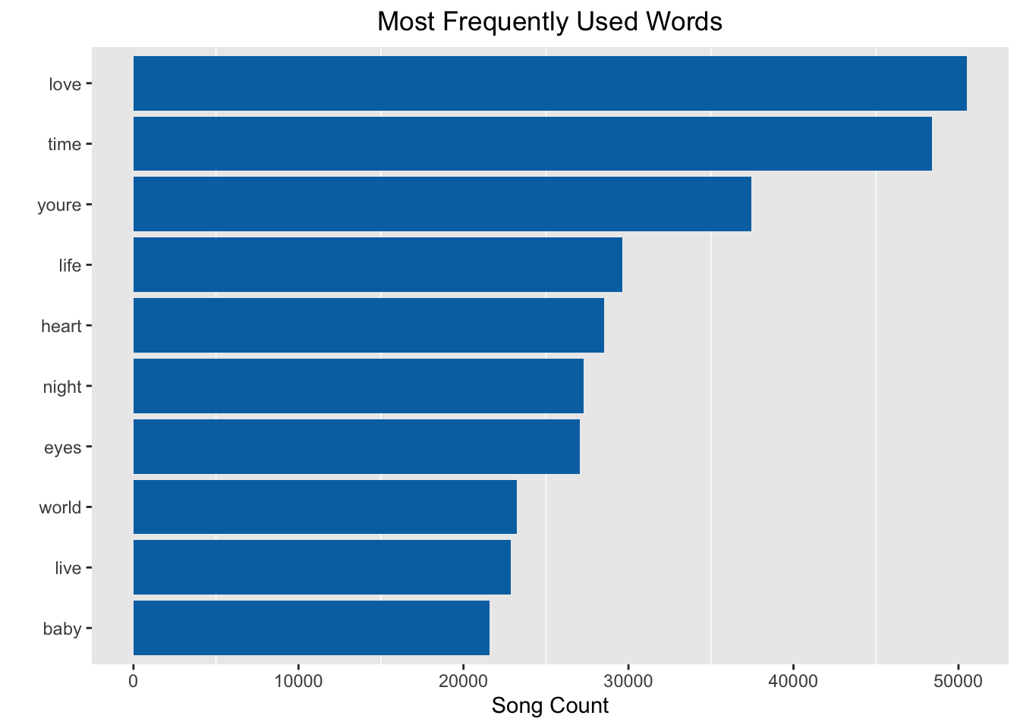
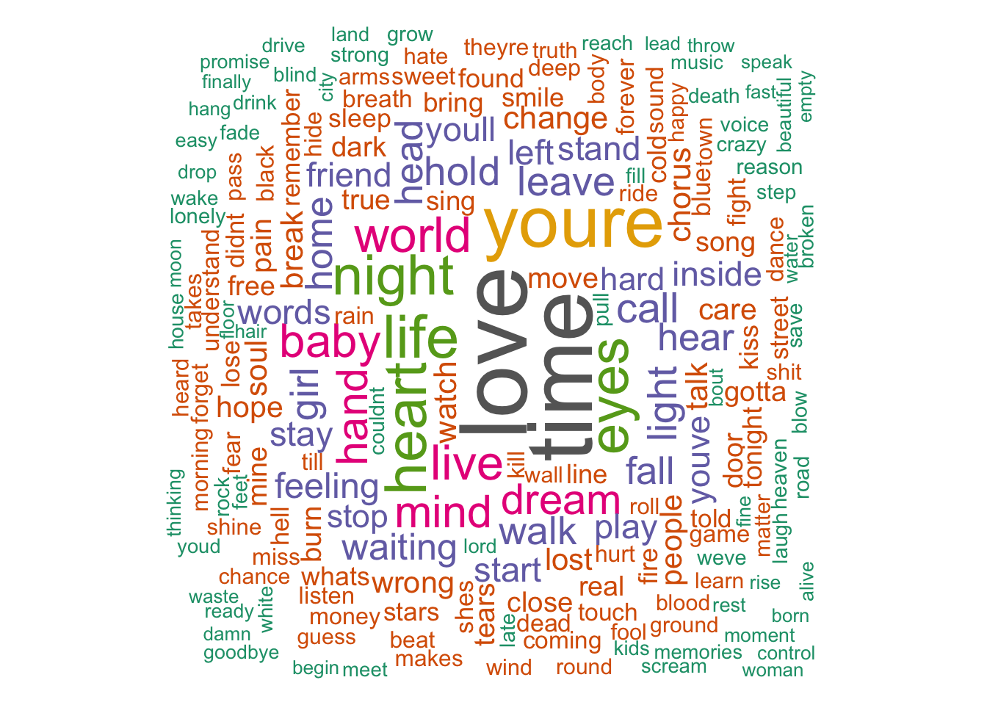

Slide 5
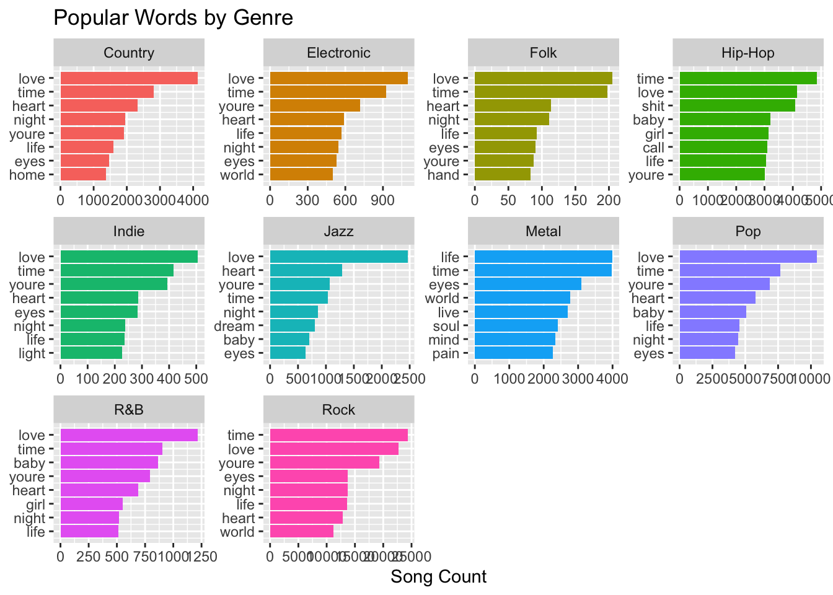

Slide 6
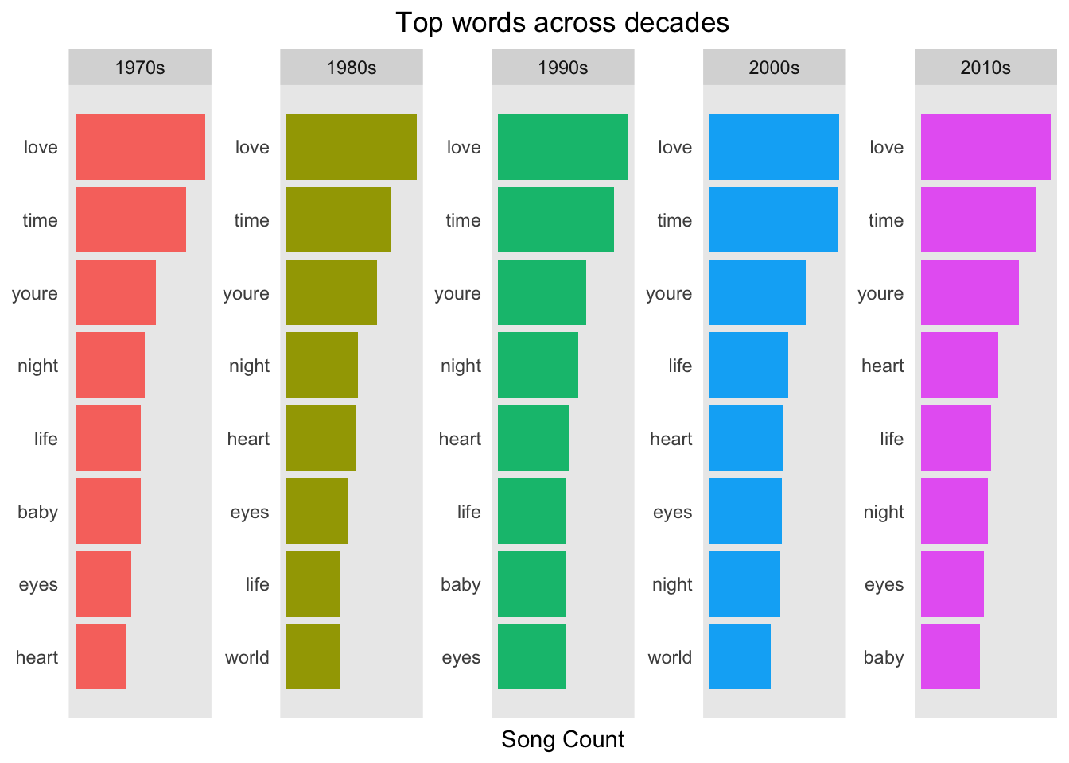

Slide 7
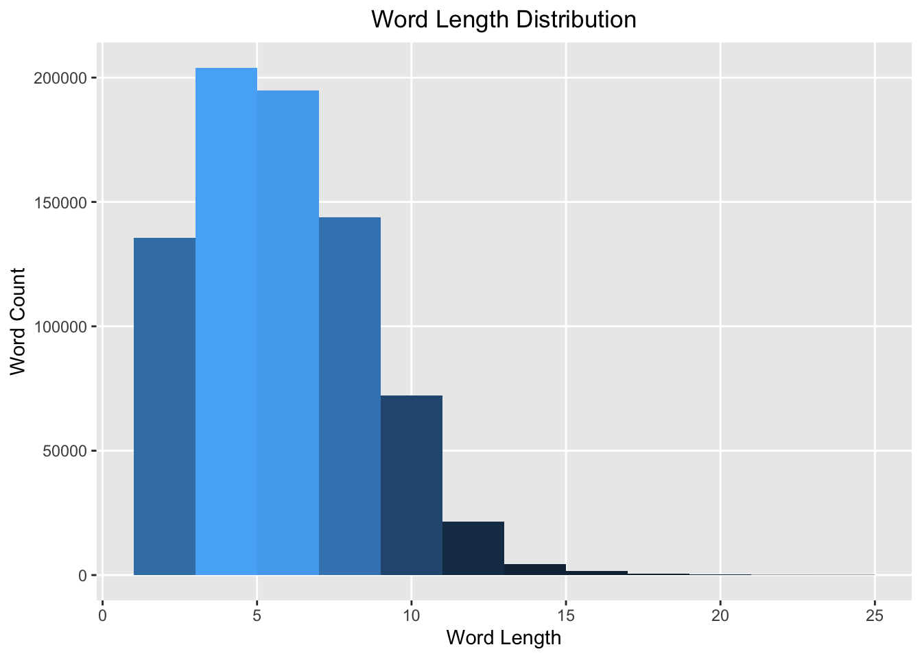

Slide 8
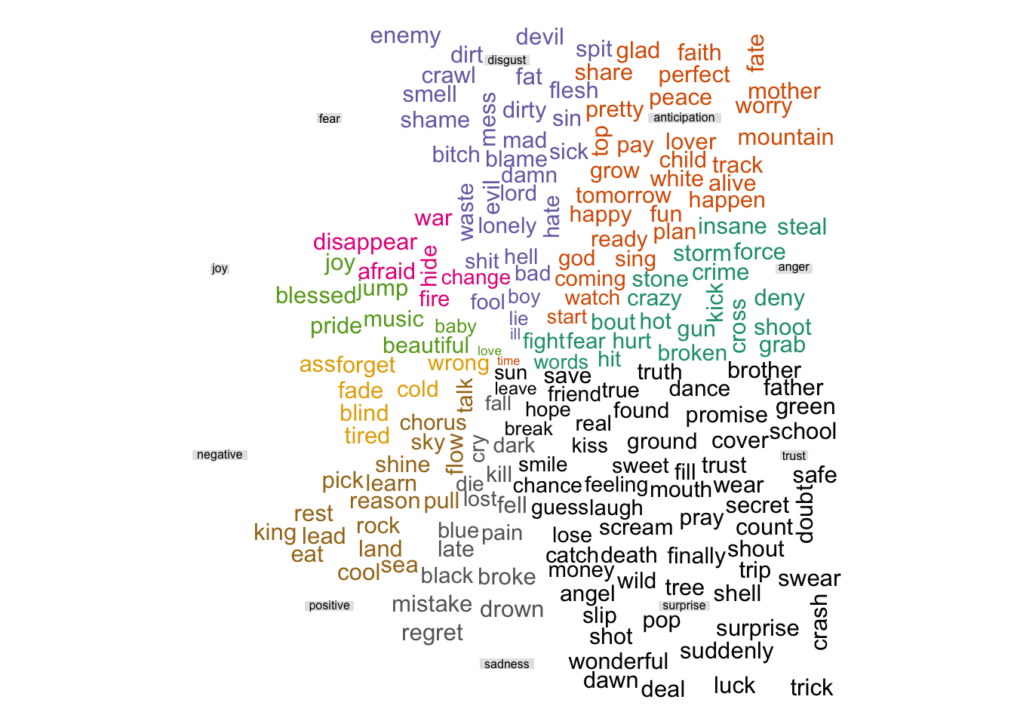

Slide 9
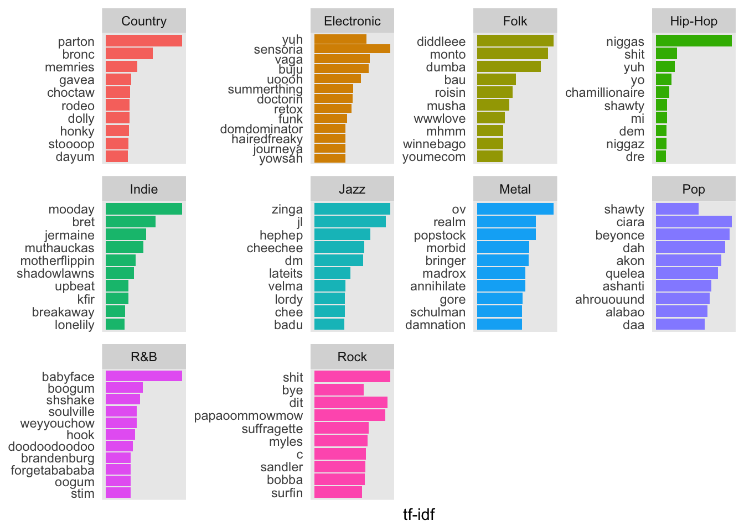

Slide 10
Conclusion
In this project report I have explored various trends in the lyrics data. Some of the topics I have explored are listed below:
EDA
Distribution of number of songs over 5 decades
Songs with most number of words
Distribution of word count across genre
Most frequently used words in coupus (with wordcloud)
Most frequent words in each genre
Most frequent words in each decade
Length of individual words and identifying really long words (wordcloud)
Words groupd by emotions (wordcloud)
Identifying some positive/negative words in corpus according to bing dictionary
TF-IDF words across genres

Slide 11
Resources
- https://towardsdatascience.com/text-analysis-of-successful-song-lyrics-e41a4ccb26f5
- https://www.datacamp.com/community/tutorials/R-nlp-machine-learning
- https://www.tidytextmining.com/topicmodeling.html

