Slide 1
Love Dogs!
Fall2019 project2 section1 group5
Syed Ahsan Bukhari (sab2302)
Haofeng Chen (hc2962)
Qichao Chen (qc2254)
Yanling Dai (yd2456)
Yifan Yang (yy2955)
Notes:
Our group is aim to find the dog distribution in nyc

Slide 2
summary
Goal
Data Source
Target users
regional characteristics of dogs in New York City.
New York City's Open Data and data.gov
Individual users (Dog Lovers or non-dog lover)
New Yorkers considering having a dog
Dog owners considering moving to New York.
Non-dog lovers who are trying to avoid seeing dogs
Commercial users:
Pet store retailers in nyc.
Notes:
The goal of our app is to explore the regional characteristics of dogs in New York City.
In our project, we mainly used data of licensed dog, dog bite incidents and regional data of hospitals and parks from New York City‘s Open Data and data.gov；
dog license data is 346K and dog bite data size is 10.3K
For individual use, our app is designed for New Yorkers considering having a dog or dog owners considering moving to New York.
For commercial use, our app can provide information for the prior study for anyone who want to start a dog business in nyc.

Slide 3

Background information
Background
84.9 millions U.S. households have pets, among them, 63.4 millions owns at least one dog
There are 344,633 dogs in NYC, of which 298,211 is currently licensed.
Notes:
According to the APPA, 67% of U.S. households have pets, equivalent to 84.9 millions homes. Among them, 63.4 millions U.S. households owns at least one dog.
All dogs in New York City must have licenses, and the licenses must be attached to their collars while in public. There are 344,633 dogs in NYC, of which 298,211 is currently licensed.

Slide 4
Background information
Background (cON’T)
($Biliion)
Notes:
Pets have long been considered as part of the family.
Pet owners are seeking out supplies and service in higher quality. Therefore, the pet industry has been experiencing explosive growth., and will continue to boom unabated in the future.
In 2018, pet care was a $72.56billion business in U.S, and in 2019, the figure is expected to keep rising to $75,38 billion.

Slide 5
Density
For
dog owners
choose the best neighborhoods for their dogs
recommend suitable breeds based on their address
For Pet-care retailer
choose the perfect store's location
decide its store inventories and service offered
Notes:
The most dog-dense places in NYC are Mahanttan ( Borough-wise), Upper-West side, Upper-East Side and Downtown Brooklyn (District-wise) and 10025 and 10024 (zip-code wise)
for a pet retailer opening a new store in NYC, they may interest to see the dog density in each area of the city and find the store locations which are surrounded by numerous of dog owners. In addition, by looking at the dog breed distribution in the associated area, a local pet retailer could decide its store inventories to meet the needs of the popular dog breed in For example, people in the Upper Eastern area tend to have long-haired dogs, and need to brush their hair frequently. the store can consider bath & grooming service.
for the individual user, if you are a dog lover that recently move to New York, you may want to move to a dog-friendly neighborhood so that it will suit for you and your dog, and the dog density information on our app can help you on such decisions
For non-dog lovers, you may try to avoid walking in those dog-dense areas, and if you don’t like certain types of dogs, you may also try to avoid walking in certain district.

Slide 6
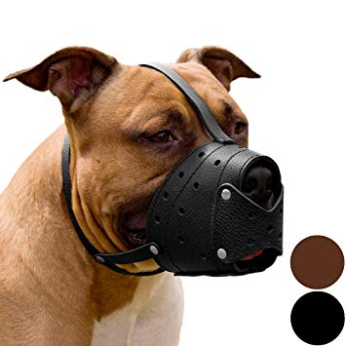

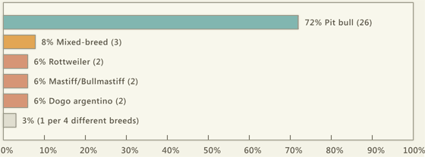
Danger area
Danger area
Each day about 1,000 U.S. citizens require emergency care treatment for serious dog bite injuries.
Notes:
Each day about 1,000 U.S. citizens require emergency care treatment for serious dog bite injuries. The ferocity of dogs is mainly related to their breeds.
For non-dog lover, you can check out which dog breeds have the most attacking incident in your area, or you can check if the area you live is considered danger area. More important, we have the hospital function that can show you the nearby hospital in case if you got bitten by dogs.
For pet-care store nearby those dangers area, perhaps you can consider offering dog bite prevention medical care, inoculations and some products like the Dog Muzzle.

Slide 7
Future development
Avg store rent price.
Store traffic data
Report and handle bites
Walk the Dog
(totally 29,000 acres parks in NYC)
Notes:
New Yorkers enjoy the outdoors with their dogs with nearly 29,000 acres of park space, In this part, we show the park area on the nyc map to help the dog owners better plan the walks zone and route.

