Slide 1

Matrix Factorization
Group 2:
Ashley Culver, Alexandra DeKinder, Samir Hadzic, Richard Lee, Yicheng Li

Slide 2
Pairings
9: A3 + P2
ALS & Postprocessing SVD with KNN
11: A3 + R1 + R2 + P2
ALS & Penalizing Magnitudes & Bias and Intercepts & Postprocessing SVD with KNN
13: A3 + R3 + P2
ALS & Temporal Dynamics & Postprocessing SVD with KNN

Slide 3
Focus
To test the different regularizations on ALS (alternating least squares) and postprocessing SVD (single value decomposition) with KNN (k-nearest neighbors)
The regularization methods:
1. penalizing magnitudes
2. bias and intercepts
3. temporal dynamics

Slide 4

Alternating Least Squares
ALS factorizes a given matrix R into two factors U and M, where R = U^{T} * M
1. R = {r_{ij}}_{nu*nm} : this represents the user-movie matrix
2. n_{u} is number of users and n_{m} is number of movies
3. Our task is to estimate missing values in R based on known values
4. User feature matrix: U = [u_{i}]
5. Movie feature matrix: M = [m_{j}]

Slide 5
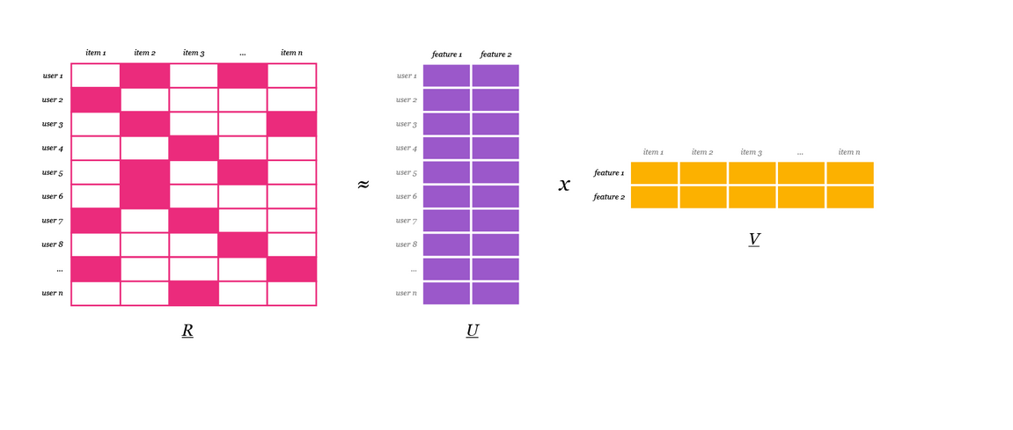
Alternating Least Squares

Slide 6
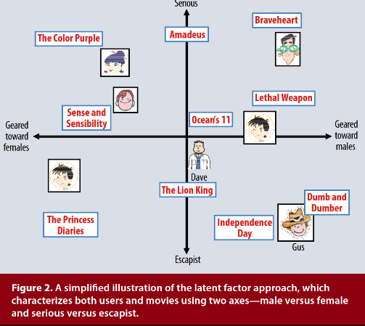
Alternating Least Squares (Latent Factors)

Slide 7




Alternating Least Squares
1. Minimizing the empirical mean-square loss function:
2. The loss from a single rating is:
3. The total loss is:
4. As a result, it can be formulated as:
5. Because the parameters will overfit the data, we regularize it:

Slide 8
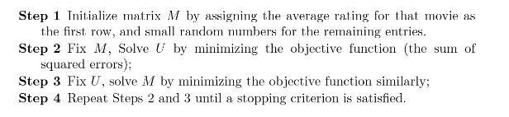
Alternating Least Squares
1. an iterative algorithm to solve the low rank approximation problem
2.
3.

Slide 9
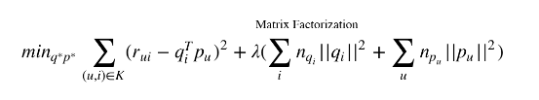
Alternating Least Squares
1. We fix one of the unknowns q_{i} or p_{u} and solve the quadratic (a least-squares problem)
This ultimately converges since each step decreases
2. The while loop stops when RSME does not change by more than 0.0001 from the last iteration
3. Allows for parallelization because each q_{i} is computed independently of p_{u}
4. Because of the many free parameters, ALS leads to overfitting
5. As a result, we use different regularization methods to penalize large parameters

Slide 10

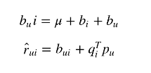

Regularization
1. To avoid overfitting, we can penalize the magnitudes of the learned parameters
2. Account for bias and intercepts:
3. Treat the item bias and user bias as a function of time:

Slide 11

Regularization (Biases and Intercepts)
1. Biases and intercepts are effects associated with either users or items on the observed variation in rating values
2. An example is a user that tends to give higher ratings than others
3. Another example is an item that tends to receive higher ratings than others
4. As a result the rating value u^{T} * m might not be able to fully capture the complete rating
5. A first order approximation bias involved in rating r_{ui} is:
Where mu is the overall average rating and b_{i} b_{u} represent biases in item i and user u

Slide 12


Explaining biases with an example
1. Biases in the movie Titanic:
If the average rating for all movies is 3.7
And Titanic is a better than overage movie, so it is rated 0.5 stars above average
A user, Joe, is a critical user and tends to rate 0.3 stars lower
The estimate for Titanic’s rating for Joe would be (3.7 + 0.5 – 0.3) = 3.9 stars
2. Thus, the predicted rating with biases can be found through:
3. The overall formula can be summarized as:

Slide 13
Temporal Dynamics
1. Perception and popularity constantly change as new items come up
2. A user also evolves though time and may change their interests or tastes
3. Temporal dynamics accounts for the time drifting nature of user-item interactions

Slide 14
Temporal Dynamics
1. Decomposing ratings into distinct terms allows for algorithm to treat different temporal aspects separately
2. Biases from items and users as well as user preferences change over time
3. Since items are static in nature q_{i} does not change, but user factors do change over time so p_{u} denotes user factors as a function of time

Slide 15
Single Value Decomposition
1. approximates the original user movie rating matrix R by the product of two rank-k matrices:
R = U^{T} * M
2. However, because of missing elements in the rating matrix R, SVD algorithms cannot find U and M

Slide 16

Postprocessing SVD with KNN
1. The similarity between two movies j and j2 can be seen as a cosine similarity between the vectors vj and vj2 from regularized SVD
2. This can be expressed as:
3. KNN can be used through similarity, s

Slide 17
Results
9: A3 + P2
ALS & Postprocessing SVD with KNN
RMSE of train: 0.6180, RMSE of test: 1.601
11: A3 + R1 + R2 + P2
ALS & Penalizing Magnitudes & Bias and Intercepts & Postprocessing SVD with KNN
RMSE of train: 1.358, RMSE of test: 1.139
13: A3 + R3 + P2
ALS & Temporal Dynamics & Postprocessing SVD with KNN
RMSE of train: 1.671, RMSE of test: 2.115

Slide 18
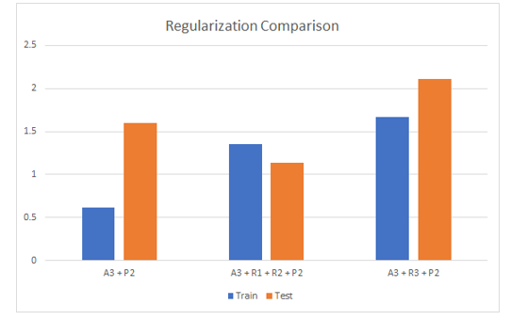
Visual Comparison

