Slide 1

Collaborative Filtering Algorithms Evaluation
Group Members
Chen, Haofeng hc2962@columbia.edu
Gong, Yuting yg2641@columbia.edu
Song, Mingming ms5710@columbia.edu
Zhang, Jerry jz2966@columbia.edu
Zheng, Kaiyan kz2324@columbia.edu
STAT5243: Applied Data Science | Project 4, Section 1 Group 5

Slide 2
Evaluation Summary
Goal:
Evaluate A1 & A3, (SGD & ALS in Factorization Methods dealing with Temporal Dynamics)
Factorization Methods
Gradient Descent (Nonprobabilistic)
Alternating Least Squares
Regularization Method
Temporal Dynamics
Postprocessing Method
SVD with KNN
2 | Collaborative Filtering Algorithms Evaluation

Slide 3
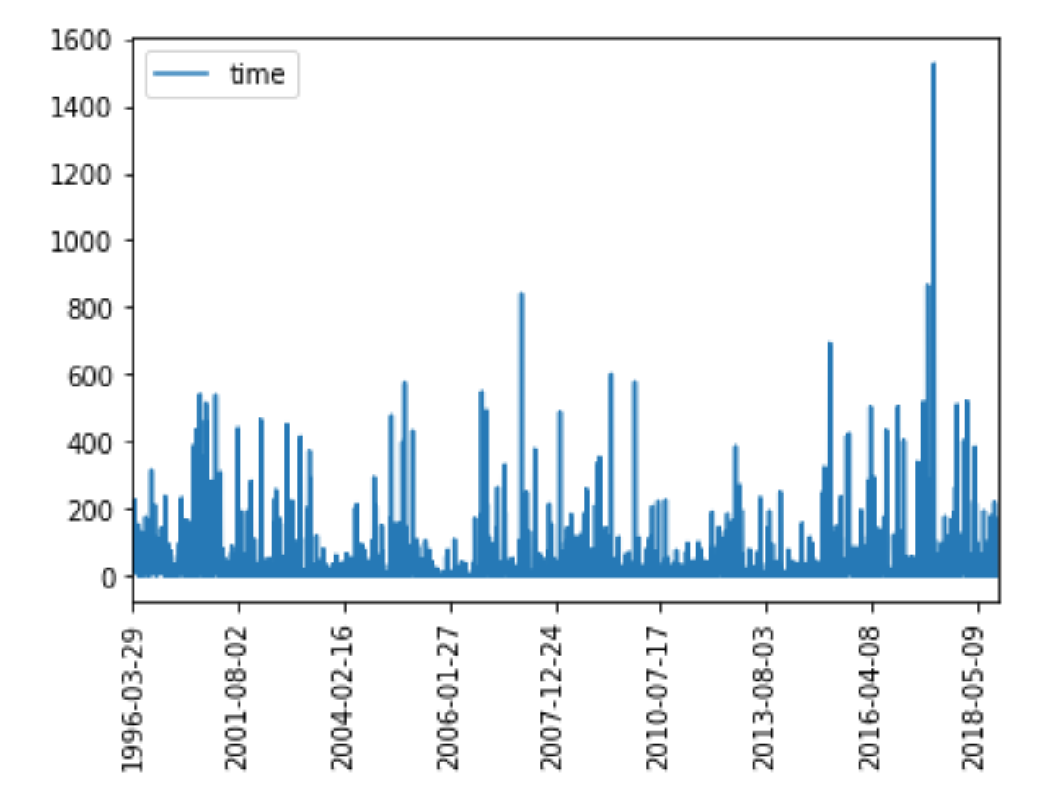
Data Preprocessing
Split the data into time bins based on years: 3 bins
80-20 Train-test split: For movies/users in test but not in train, we manually move them into the train dataset
3 | Collaborative Filtering Algorithms Evaluation

Slide 4
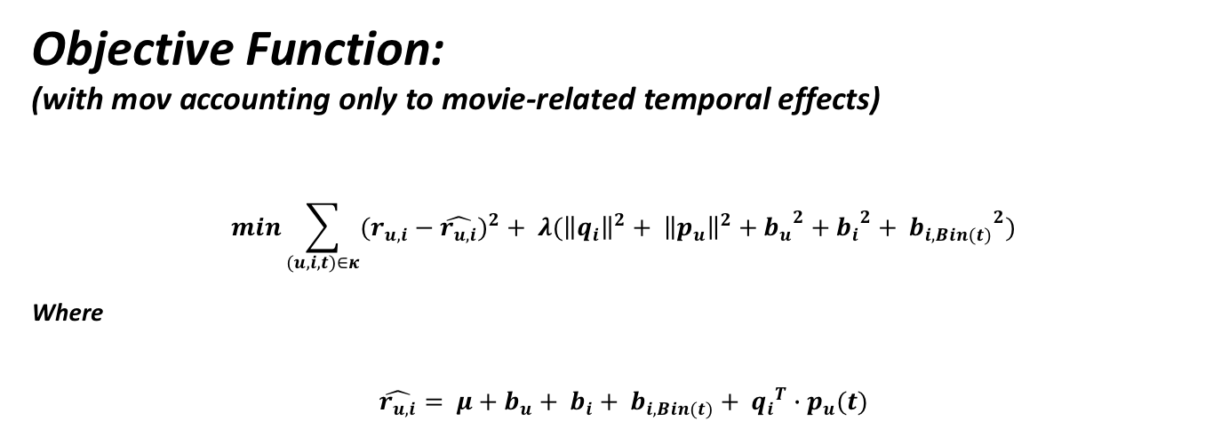
Objective function
Objective Function:
(with mov accounting only to movie-related temporal effects)
$$min\sum_{(u,i,t)∈κ}{{(r_{u,i}−\hat{r_{u,i}})}^{2}}+ λ({\left\|q_{i}\right\|}^{2}+ {\left\|p_{u}\right\|}^{2}+{b_{u}}^{2}+{b_{i}}^{2}+ {b_{i,Bin(t)}}^{2})$$
Where
$$\hat{r_{u,i}}= μ+b_{u}+ b_{i}+ b_{i,Bin(t)}+ {q_{i}}^{T}∙p_{u}(t)$$
4 | Collaborative Filtering Algorithms Evaluation

Slide 5
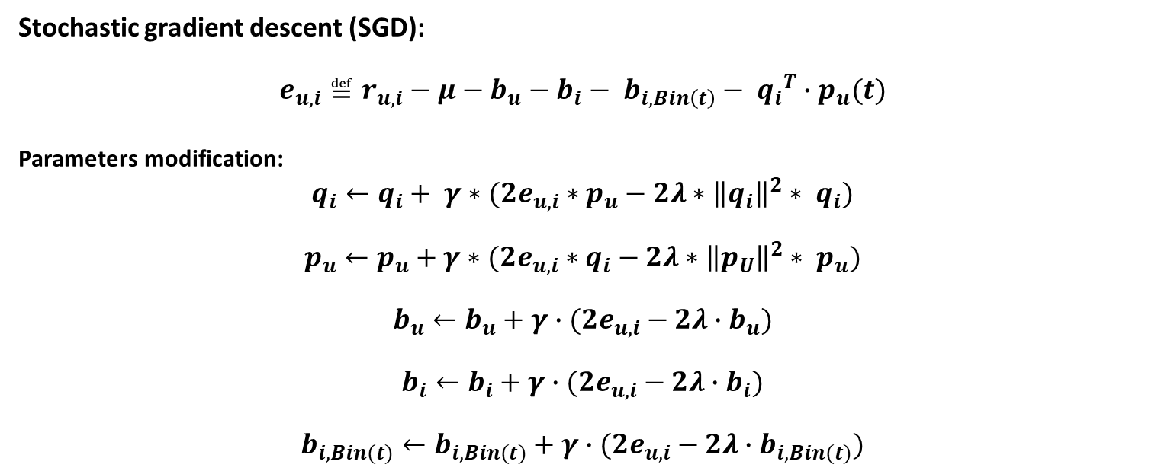
Factorization Methods
Stochastic gradient descent (SGD):
$$e_{u,i}≝r_{u,i}−μ−b_{u}−b_{i}− b_{i,Bin\left(t\right)}− {q_{i}}^{T}∙p_{u}(t)$$
Parameters modification:
$$q_{i}←q_{i}+ γ∗(2e_{u,i}∗p_{u}−2λ∗{\left\|q_{i}\right\|}^{2}∗ q_{i})$$
$$p_{u}←p_{u}+γ∗(2e_{u,i}∗q_{i}−2λ∗{\left\|p_{U}\right\|}^{2}∗ p_{u})$$
$$b_{u}←b_{u}+γ∙(2e_{u,i}−2λ∙b_{u})$$
$$b_{i}←b_{i}+γ∙(2e_{u,i}−2λ∙b_{i})$$
$$b_{i,Bin(t)}←b_{i,Bin(t)}+γ∙(2e_{u,i}−2λ∙b_{i,Bin(t)})$$
5 | Collaborative Filtering Algorithms Evaluation
Notes:
Jerry, pls make sure I have the highlighted gradient part right.

Slide 6
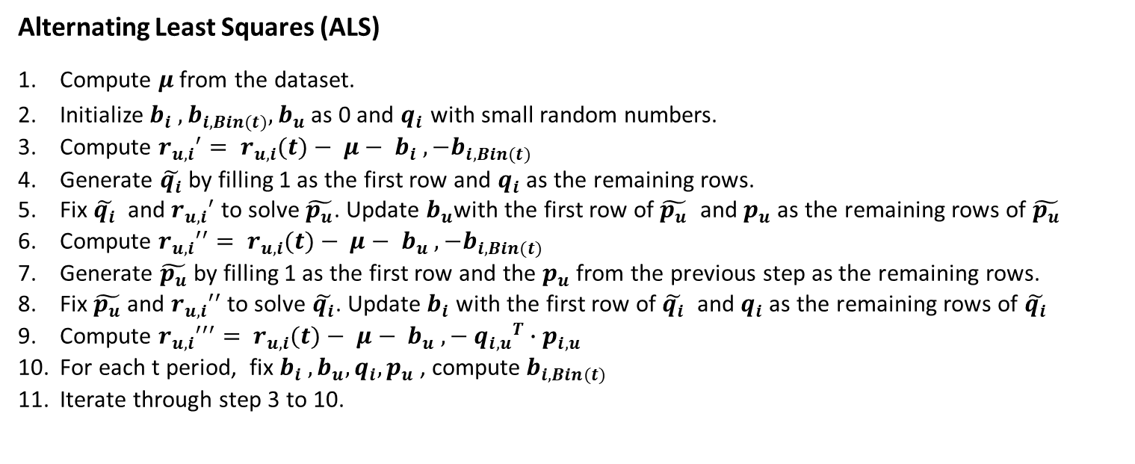
Factorization Methods
Alternating Least Squares (ALS)
Compute $μ$ from the dataset.
Initialize $b_{i} , b_{i,Bin(t)}, b_{u}$ as 0 and $q_{i}$ with small random numbers.
Compute ${r_{u,i}}^{′}= r_{u,i}(t)− μ− b_{i} ,−b_{i,Bin(t)}$
Generate $\tilde{q_{i}}$ by filling 1 as the first row and $q_{i}$ as the remaining rows.
Fix $\tilde{q_{i}}$ and ${r_{u,i}}^{′}$ to solve $\tilde{p_{u}}$. Update $b_{u}$with the first row of $\tilde{p_{u}}$ and $p_{u}$ as the remaining rows of $\tilde{p_{u}}$
Compute ${r_{u,i}}^{′′}= r_{u,i}(t)− μ− b_{u} ,−b_{i,Bin(t)}$
Generate $\tilde{p_{u}}$ by filling 1 as the first row and the $p_{u}$ from the previous step as the remaining rows.
Fix $\tilde{p_{u}}$ and ${r_{u,i}}^{′′}$ to solve $\tilde{q_{i}}$. Update $b_{i}$ with the first row of $\tilde{q_{i}}$ and $q_{i}$ as the remaining rows of $\tilde{q_{i}}$
Compute ${r_{u,i}}^{′′′}= r_{u,i}(t)− μ− b_{u} ,− {q_{i,u}}^{T}∙p_{i,u}$
For each t period, fix $b_{i} , b_{u}, q_{i}, p_{u}$ , compute${ b}_{i,Bin(t)}$
Iterate through step 3 to 10.
6 | Collaborative Filtering Algorithms Evaluation
Notes:
Yunting and Mingming pls make sure the highlighted part is correct.

Slide 7
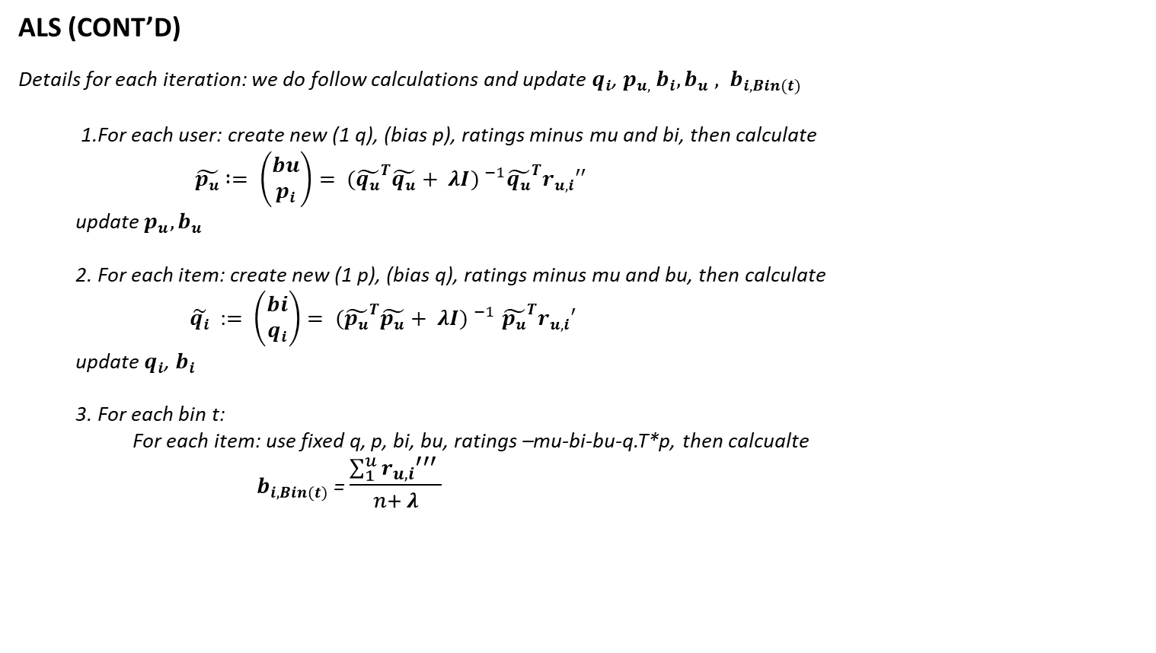
Factorization Methods
ALS (CONT’D)
Details for each iteration: we do follow calculations and update $q_{i}$, $p_{u, }b_{i}, {b_{u} , b}_{i,Bin(t)}$
1.For each user: create new (1 q), (bias p), ratings minus mu and bi, then calculate
$\tilde{p_{u}}$ $:= \left(\begin{matrix}bu \\ p_{i}\end{matrix}\right)= {({\tilde{q_{u}}}^{T}\tilde{q_{u}}+ λI) }^{−1}{\tilde{q_{u}}}^{T}{r_{u,i}}^{′′}$
update $p_{u}, b_{u}$
2. For each item: create new (1 p), (bias q), ratings minus mu and bu, then calculate
$\tilde{q_{i}}$ :$= \left(\begin{matrix}bi \\ q_{i}\end{matrix}\right){= ({\tilde{p_{u}}}^{T}\tilde{p_{u}}+ λI) }^{−1}{\tilde{p_{u}}}^{T}{r_{u,i}}^{′}$
update $q_{i}$, $b_{i}$
3. For each bin t:
For each item: use fixed q, p, bi, bu, ratings –mu-bi-bu-q.T*p, then calcualte
${ b}_{i,Bin(t)}$ = $\frac{\sum_{1}^{u}{{r_{u,i}}^{′′′} }}{n+ λ}$
7 | Collaborative Filtering Algorithms Evaluation

Slide 8
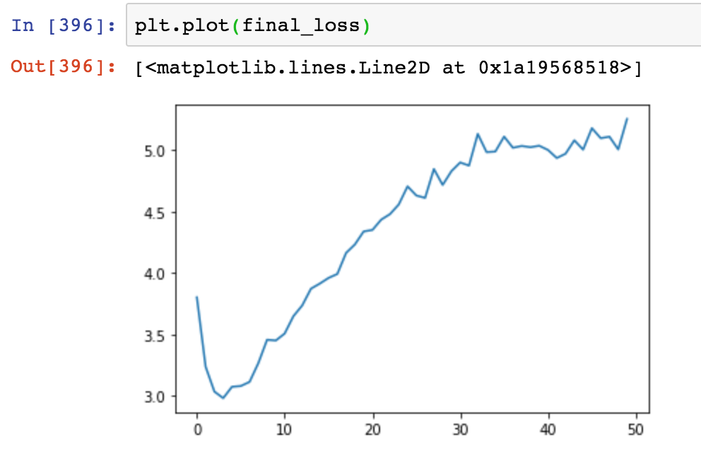
Factorization Methods
ALS (CONT’D)
We separated out dataset into 3 time bins
Calculated Train loss after each iteration: the train loss first go down then go up
Efficiency: ALS with R3 regularization is very time consuming. It takes an average of 150 seconds (2.5 minutes) to run
Train Loss plot by number of iterations
8 | Collaborative Filtering Algorithms Evaluation

Slide 9
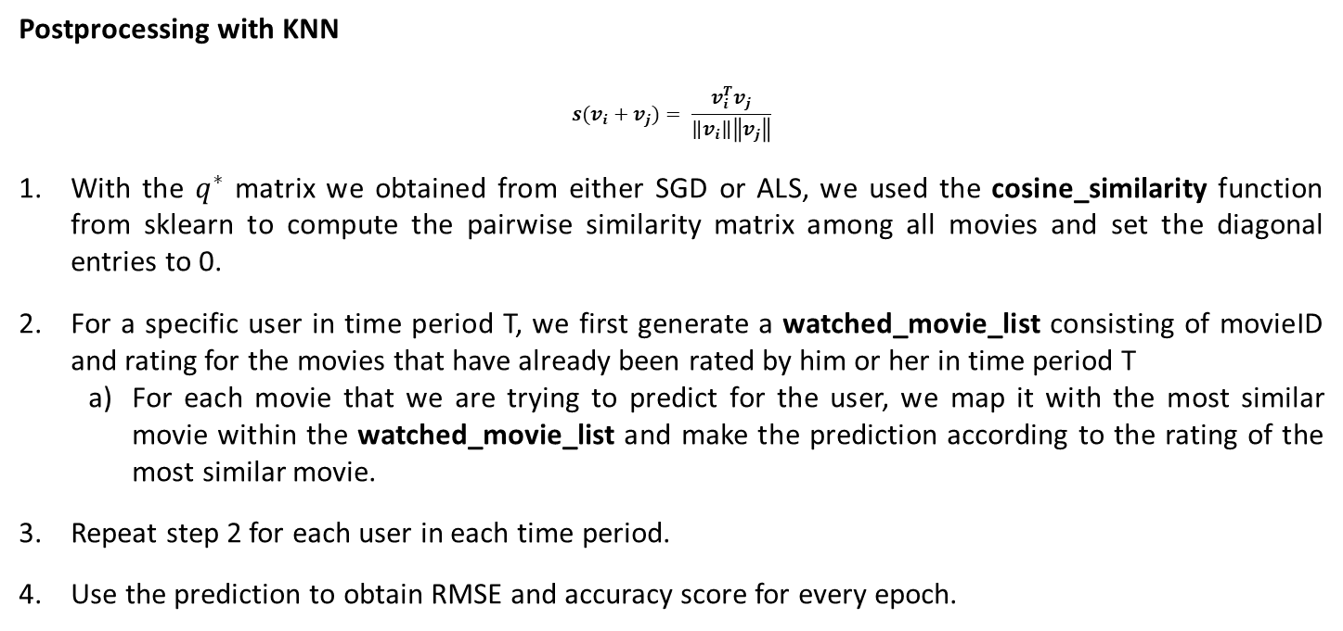
Postprocessing with KNN
Postprocessing with KNN
$$s(v_{i}+v_{j})= \frac{v_{i}^{T}v_{j}}{\left\|v_{i}\right\|\left\|v_{j}\right\|}$$
With the $q^{∗}$ matrix we obtained from either SGD or ALS, we used the cosine_similarity function from sklearn to compute the pairwise similarity matrix among all movies and set the diagonal entries to 0.
For a specific user in time period T, we first generate a watched_movie_list consisting of movieID and rating for the movies that have already been rated by him or her in time period T
For each movie that we are trying to predict for the user, we map it with the most similar movie within the watched_movie_list and make the prediction according to the rating of the most similar movie.
Repeat step 2 for each user in each time period.
Use the prediction to obtain RMSE and accuracy score for every epoch.
9 | Collaborative Filtering Algorithms Evaluation
Notes:
Jerry pls make sure step 4 is correct

Slide 10
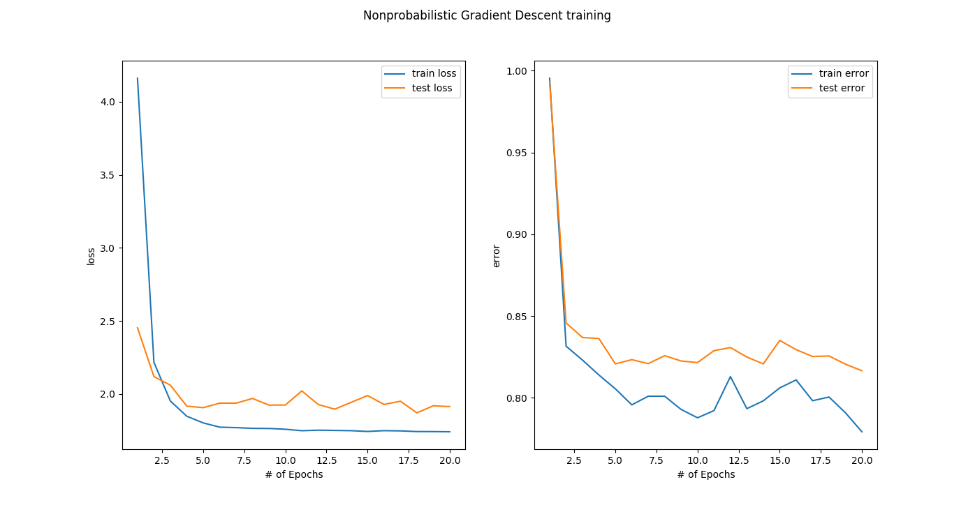
Results
Only SGD
Parameters
Lambda = 0.1
Features = 10
Learning_Rate = 01
10 | Collaborative Filtering Algorithms Evaluation

Slide 11
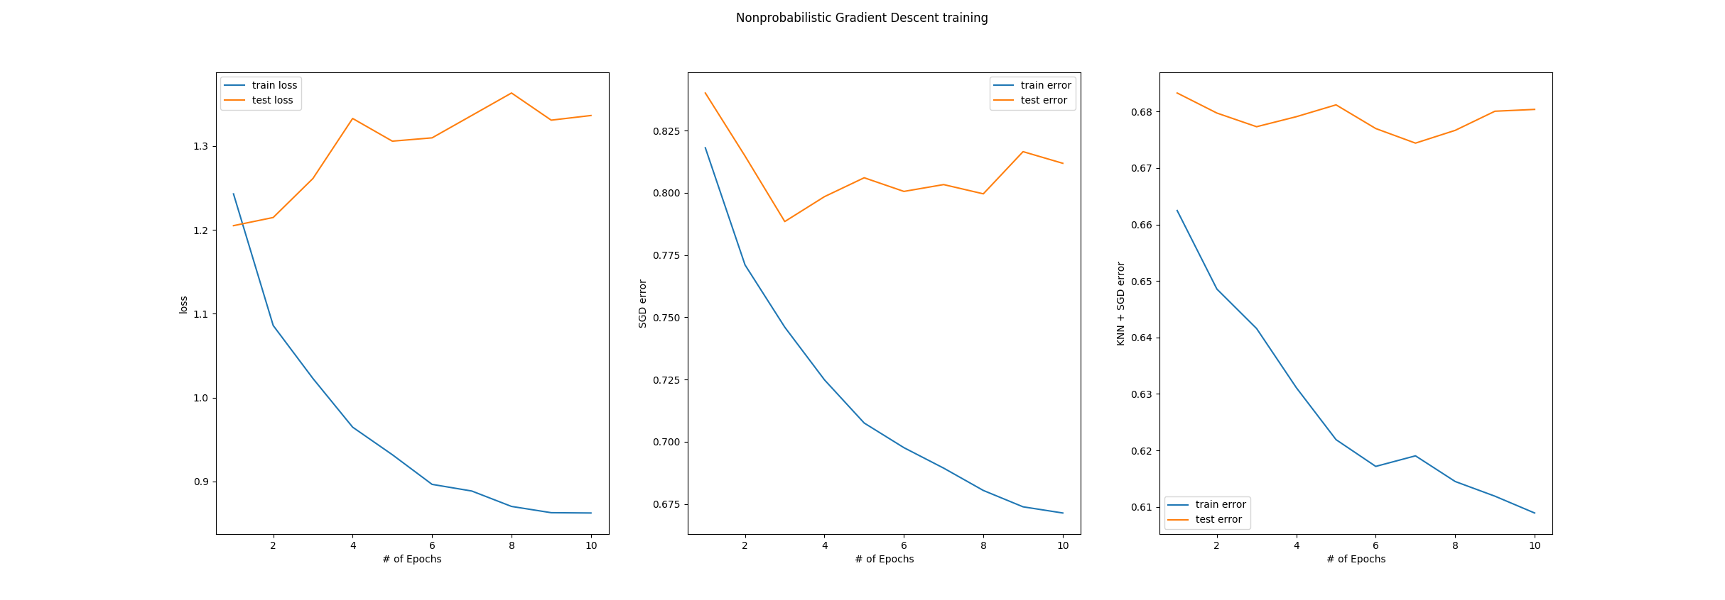
Results
Bin 1
Parameters
Lambda = 0.1
Features = 15
Learning_Rate = 0.1
11 | Collaborative Filtering Algorithms Evaluation

Slide 12
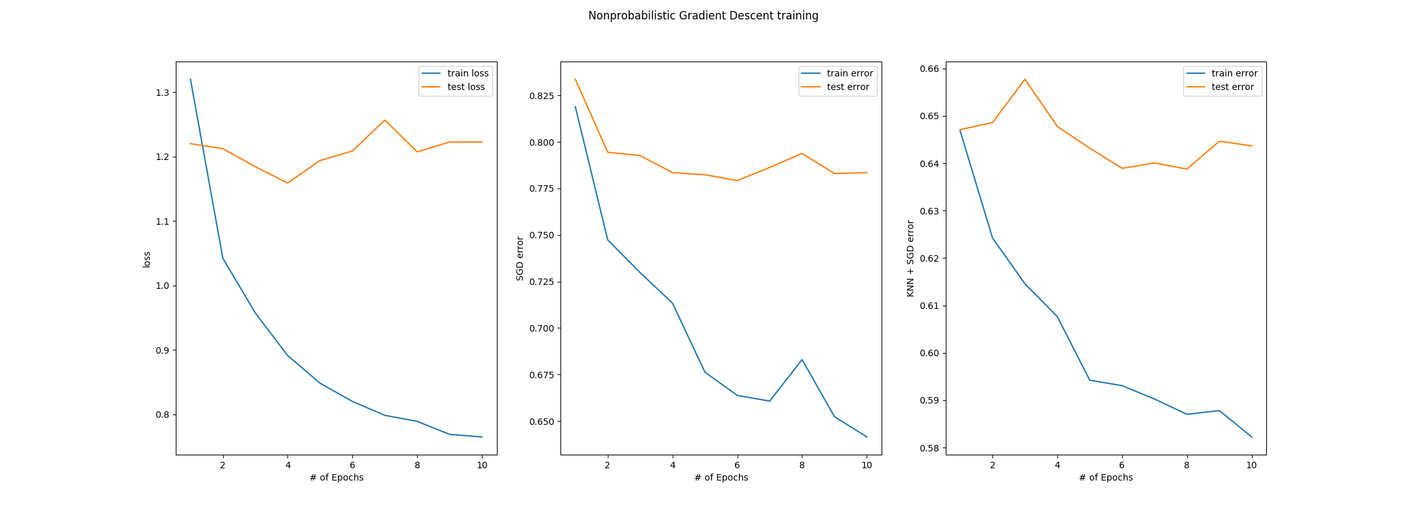
Results
Bin 2
Parameters
Lambda = 0.1
Features = 15
Learning_Rate = 0.1
12 | Collaborative Filtering Algorithms Evaluation

Slide 13
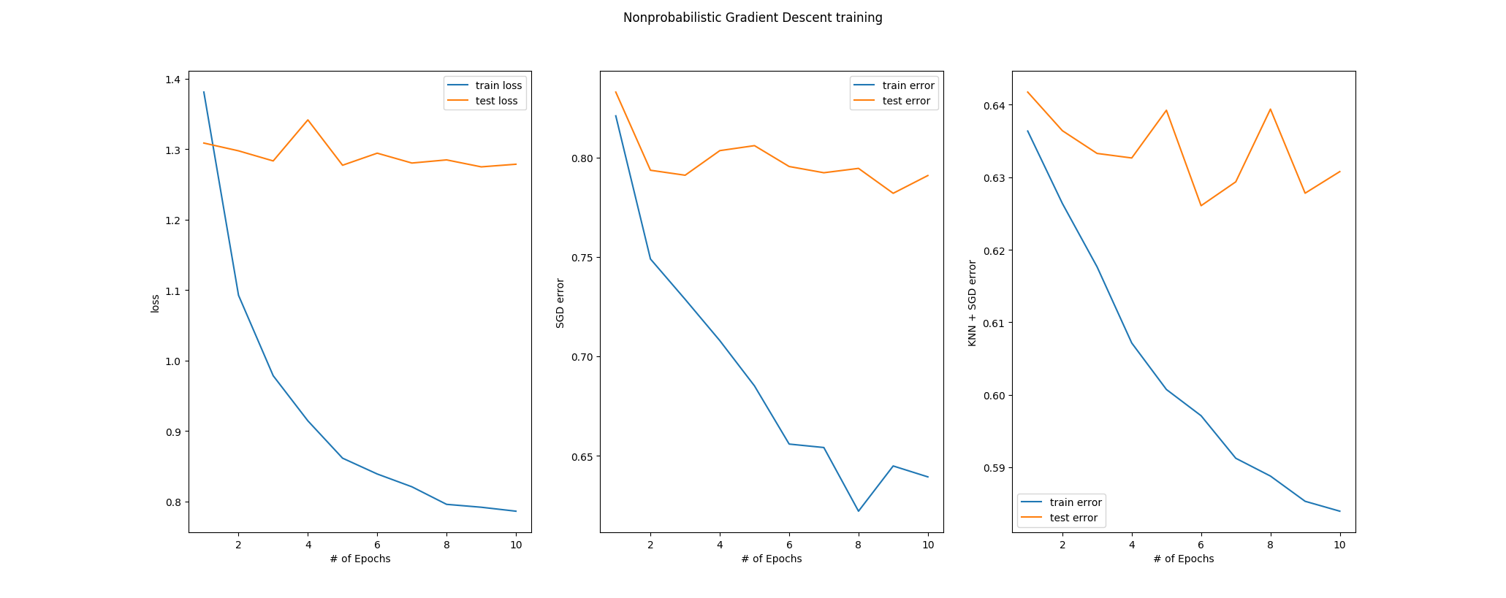
Results
Bin 3
Parameters
Lambda = 0.1
Features = 15
Learning_Rate = 0.1
13 | Collaborative Filtering Algorithms Evaluation

