Slide 1
Applied Data Science Project 4 Group 5
Sixuan Li, Jess Mathew, Nicole Mbithe, Qiqi Wu, Lihao Xiao

Slide 2
Task
Create a movie recommender system with a randomly assignment pairing of algorithm, regularization, and post-processing.
Compare the performance of the pairings and understand the meaning behind the results

Slide 3
Assigned Pairings for Comparison
Pairings | Algorithm | Regularization | Post-processing
A1 with R3 + P2 | Stochastic Gradient Descent | Temporal Dynamics | KNN
A3 with R3 + P2 | Alternating Least Squares | Temporal Dynamics | KNN

Slide 4
Data Set
Describes rating and free-text tagging activity from a movie recommendation service.
Contains 100,836 ratings and 3,683 tag applications across 9,742 movies. This data was created by 610 users between March 29, 1996 and September 24, 2018.
All selected users rated at least 20 movies.

Slide 5
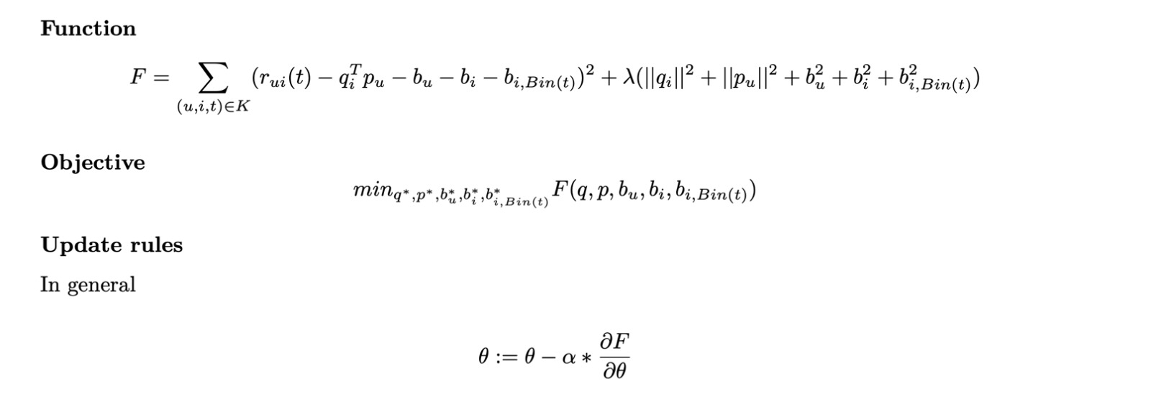
Objective Function

Slide 6
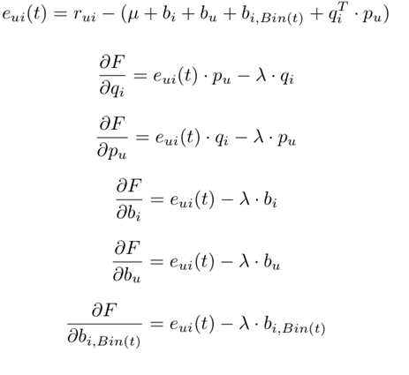
Stochastic Gradient Descent
New variables are equal to the original variable minus the learning term*partial derivative of the original variables
Variables are iteratively recalculated until a stopping point is reached.

Slide 7

Alternating Least Squares
Compute $μ$ from the dataset.
Initialize $b_{i} , b_{i,Bin(t)}, b_{u}$ as 0 and $q_{i}$ with small random numbers.
Compute ${r_{u,i}}^{′}= r_{u,i}(t)− μ− b_{i} ,−b_{i,Bin(t)}$
Generate $\tilde{q_{i}}$ by filling 1 as the first row and $q_{i}$ as the remaining rows.
Fix $\tilde{q_{i}}$ and ${r_{u,i}}^{′}$ to solve $\tilde{p_{u}}$. Update $b_{u}$with the first row of $\tilde{p_{u}}$ and $p_{u}$ as the remaining rows of $\tilde{p_{u}}$
Compute ${r_{u,i}}^{′′}= r_{u,i}(t)− μ− b_{u} ,−b_{i,Bin(t)}$
Generate $\tilde{p_{u}}$ by filling 1 as the first row and the $p_{u}$ from the previous step as the remaining rows.
Fix $\tilde{p_{u}}$ and ${r_{u,i}}^{′′}$ to solve $\tilde{q_{i}}$. Update $b_{i}$ with the first row of $\tilde{q_{i}}$ and $q_{i}$ as the remaining rows of $\tilde{q_{i}}$
Compute ${r_{u,i}}^{′′′}= r_{u,i}(t)− μ− b_{u} ,− {q_{i,u}}^{T}∙p_{i,u}$
For each t period, fix $b_{i} , b_{u}, q_{i}, p_{u}$ , compute${ b}_{i,Bin(t)}$
Iterate through step 3 to 10.

Slide 8

Alternating Least Squares (cont.)
Details for each iteration: we do follow calculations and update $q_{i}$, $p_{u, }b_{i}, {b_{u} , b}_{i,Bin(t)}$
1. For each user: create new (1 q), (bias p), ratings minus mu and bi, then calculate $\tilde{p_{u}}$ $:= \left(\begin{matrix}bu \\ p_{i}\end{matrix}\right)= {({\tilde{q_{u}}}^{T}\tilde{q_{u}}+ λI) }^{−1}{\tilde{q_{u}}}^{T}{r_{u,i}}^{′′}$
update $p_{u}, b_{u}$
2. For each item: create new (1 p), (bias q), ratings minus mu and bu, then calculate $\tilde{q_{i}}$ :$= \left(\begin{matrix}bi \\ q_{i}\end{matrix}\right){= ({\tilde{p_{u}}}^{T}\tilde{p_{u}}+ λI) }^{−1}{\tilde{p_{u}}}^{T}{r_{u,i}}^{′}$
update $q_{i}$, $b_{i}$
3. For each bin t:
For each item: use fixed q, p, bi, bu, ratings –mu-bi-bu-q.T*p, then calcualte ${ b}_{i,Bin(t)}$ = $\frac{\sum_{1}^{u}{{r_{u,i}}^{′′′} }}{n+ λ}$

Slide 9

K-Nearest Neighbors
With the $q^{∗}$ matrix we obtained from either Stochastic Gradient Descent or Alternating Least Squares, we used the cosine similarity function available in Python to compute the pairwise similarity matrix among all movies and set the diagonal entries to 0.
For each user in each time period we generate a watched movies list that contains the movies and ratings for movies that the user has already rated.
For each movie we try to predict, we look at the most similar movie in the watched movies list and use that to make the rating

Slide 10
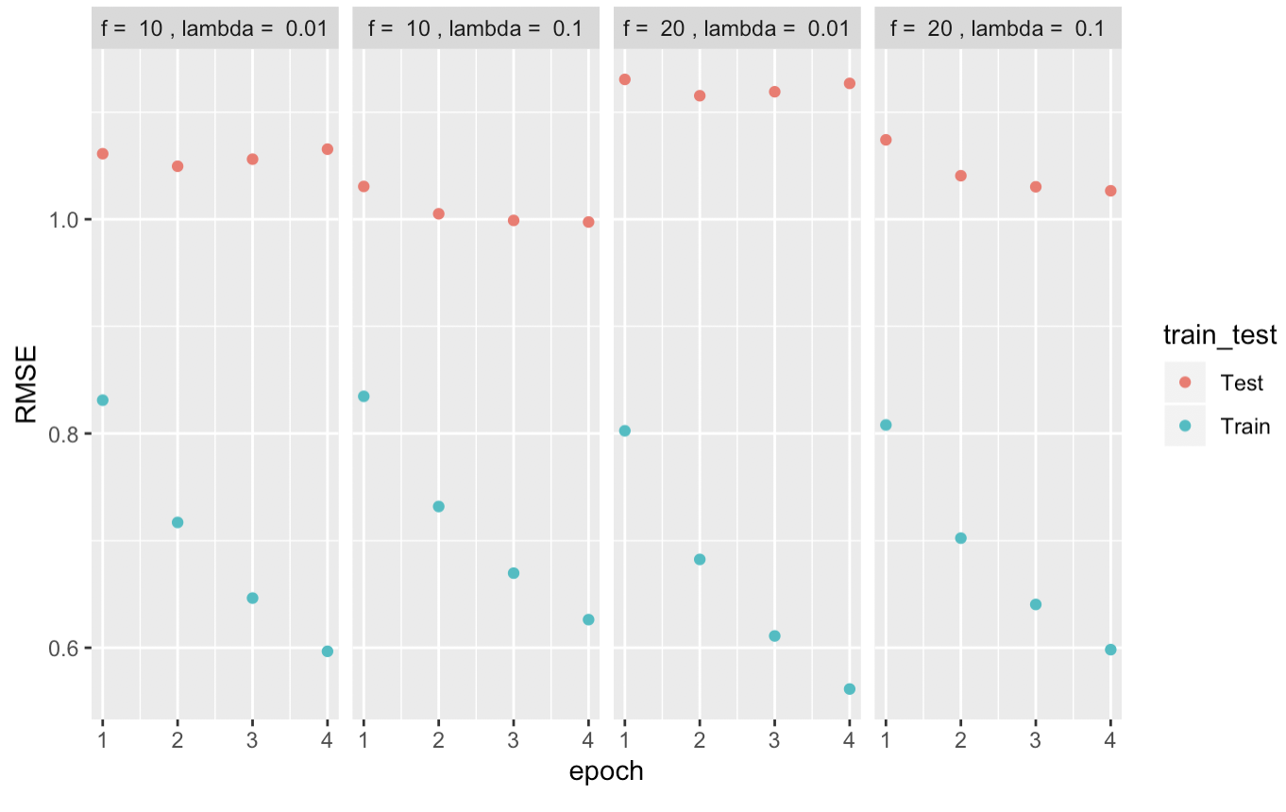
Cross – Validation Plots
Stochastic Gradient Descent
Alternating Least Squares

Slide 11
Results
Adjusted RMSE after post-processing for Stochastic Gradient Descent: 0.835110083137787
Adjusted RMSE after post-processing for Alternating Least Squares: 0.75

