Slide 1
Algorithm implementation and evaluation: Collaborative Filtering
Group 5
Sixuan Li, Jess Mathew, Nicole Mbithe, Qiqi Wu, Lihao Xiao

Slide 2
Task
Create a movie recommender system with temporal dynamics regularization, and KNN post-processing for ALS and SGD
Compare SGD vs ALS performance given (temporal dynamics regularization and KNN post-processing)

Slide 3
Data Set
Rating and free-text tagging activity from a movie recommendation service.
Contains 100,836 ratings by 610 users between March 29, 1996 and September 24, 2018 for 9724 movies
All selected users rated at least 20 movies.

Slide 4
Procedure
Read in the data and preprocess it to get the Ratings matrix
Learn the P matrix, Q matrix and biases from via Matrix decomposition with either ALS or SGD
Post-process using KNN to find movies similar to movie we want to predict
Linear regression to predict the rating for a movie given user, movie and time

Slide 5
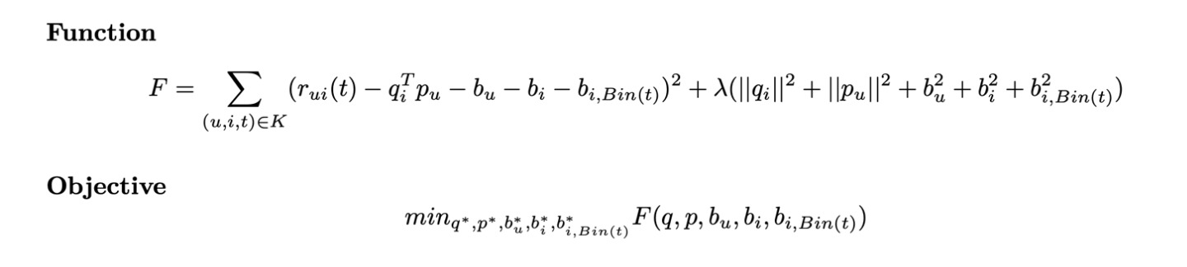
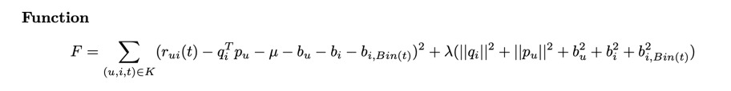
Loss and Objective functions

Slide 6
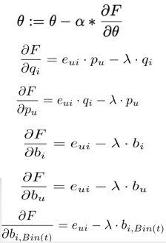
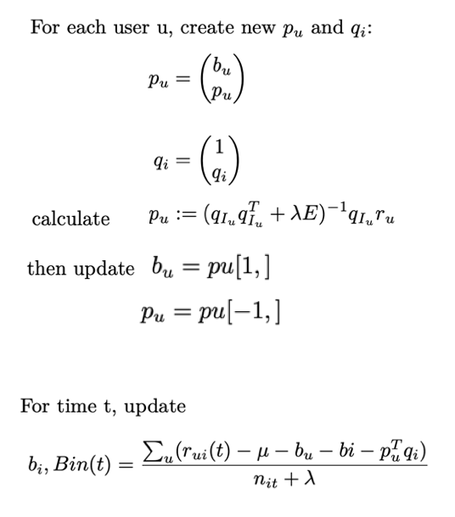
Updating P and Q matrices
SGD Update Equations ALS Update Equations

Slide 7
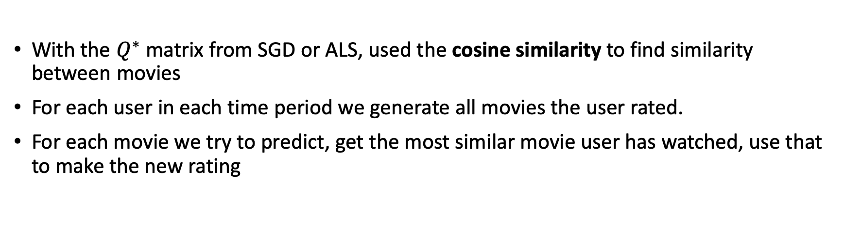
KNN post-processing and prediction
With the $Q^{∗}$ matrix from SGD or ALS, used the cosine similarity to find similarity between movies
For each user in each time period we generate all movies the user rated.
For each movie we try to predict, get the most similar movie user has watched, use that to make the new rating

Slide 8
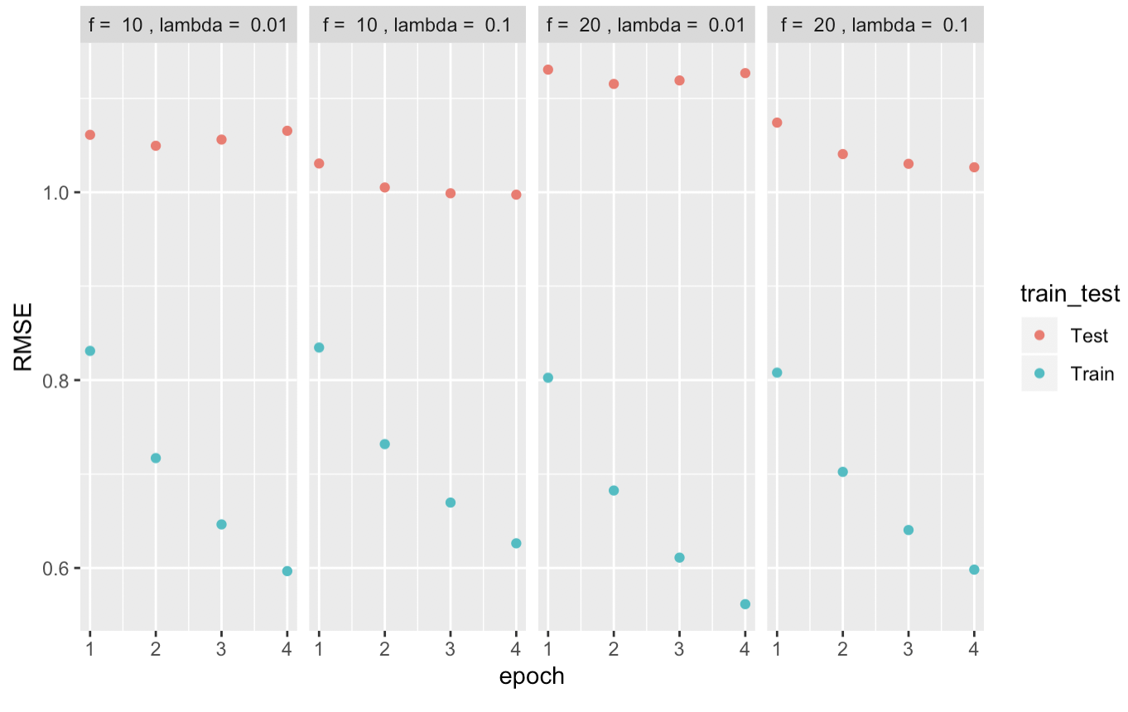
Evaluation: SGD Cross Validation Plots

Slide 9
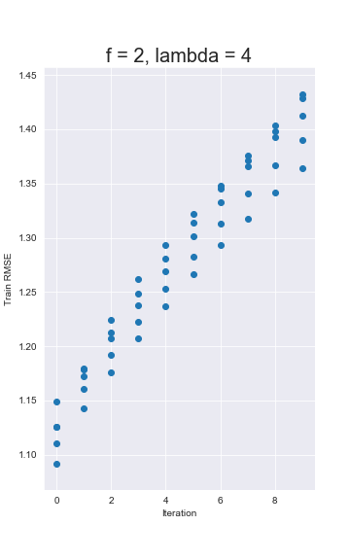
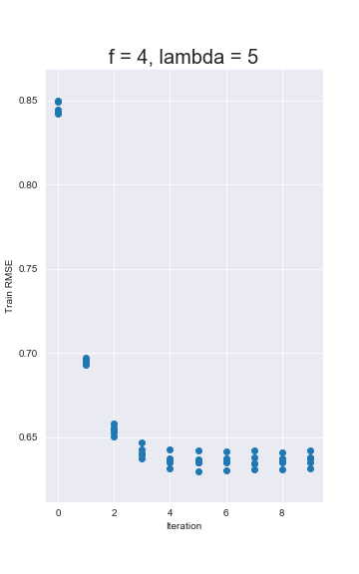
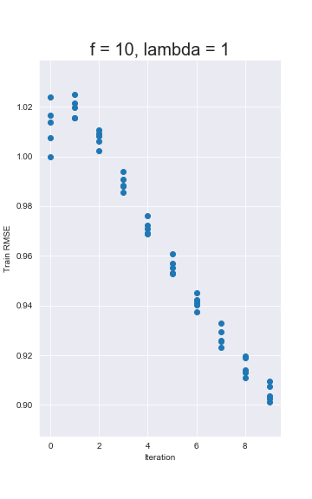
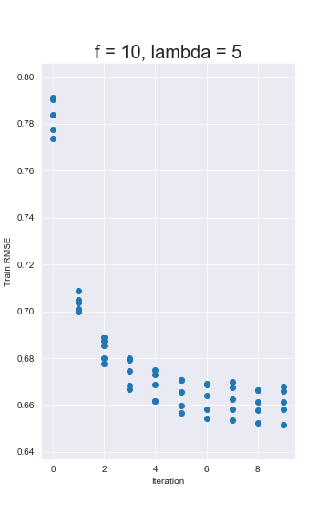
Evaluation: ALS Cross Validation Plots

Slide 10
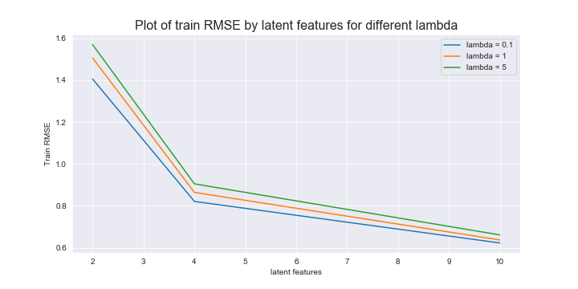
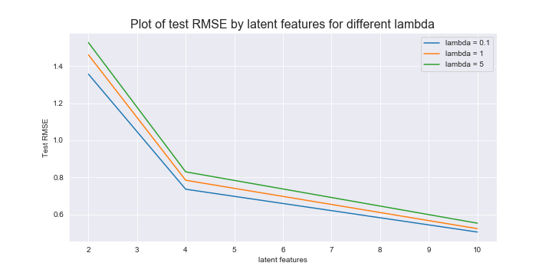
ALS Final train and test RMSE

Slide 11
Overall Results
Algorithm | Training Time | Optimal parameters | Optimal Train RMSE | Test RMSE before KNN | Test RMSE with KNN
SGD | ~ 19 hours | F = 10, λ = 0.1 | 0.67 | 0.99 | 0.85
ALS | ~ 6 hours | F = 10, λ = 5 | 0.66 | 0.87 | 0.75

