Slide 1
Weakly Supervised Learning: Label Noise and Correction
Group 9: Sameer Kolluri, Shubham Laddha, Jenny Li,
Kieu-Giang Nguyen, Yuli Yin

Slide 2
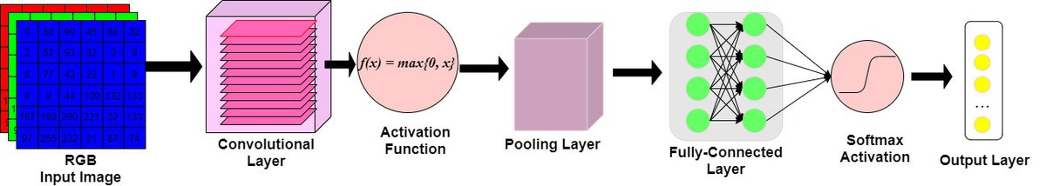
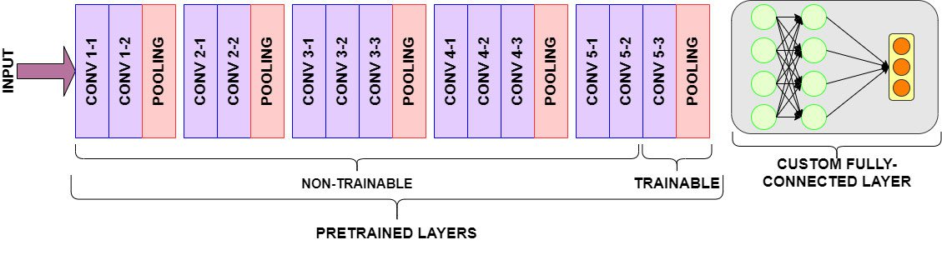
Core Idea: CNN and Transfer Learning
Fig 1. A graphic representation of a CNN’s architecture
Fig 2. Transfer learning example of fine-tuning a pre-trained model

Slide 3
Model I: Candidate Predictive Models
Type | Model | Note | Pros | Cons
Convolutional Neural Network | VGG-16/VGG-19 | Trained on a subset of the ImageNet dataset with millions of images. They contain 16 layers and 19 layers, respectively (including 3 fully-connected layers). | Relatively uniform and simple architecture. | Huge network, time-consuming
 | ResNet50 | Fitting a residual mapping rather than fitting the actual mapping in all the layers. | Less complex (since has fewer filter) compared to VGG models. No vanishing gradient problem.
 | InceptionV3 | Just performing convolutions with different filter sizes, performing max pooling and concatenating the result for the next inception module. | Smaller network helps to reduce the parameters drastically, much faster to run.
 | MobileNetV3 | Designed to be used in mobile applications with only 4 million parameters compared to 138 million parameters in VGG16. | Vastly smaller in size and faster to run. | Not as accurate as other large, resource-heavy models.
Machine Learning | SVM | A supervised learning algorithm that is mainly used to classify data into different classes. Core idea is to find a maximum marginal hyperplane that best divides the dataset into classes. |  | Similar with logistic regression, which is not as sophisticated as CNN models.
 | Random Forest | A classification and regression algorithm that can be applied to image classification. | Non-parametric; not sensitive to over-fitting.
 | KNN | Basic machine learning classifier. | Simple to perform.
 | Boosting | A group of machine learning algorithms that combine many weak learning models together to create a strong predictive model.

Slide 4
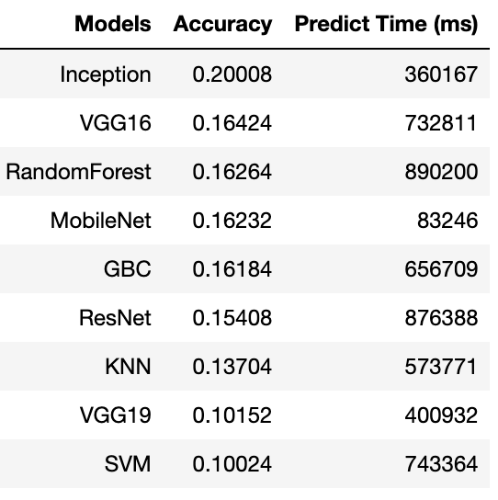
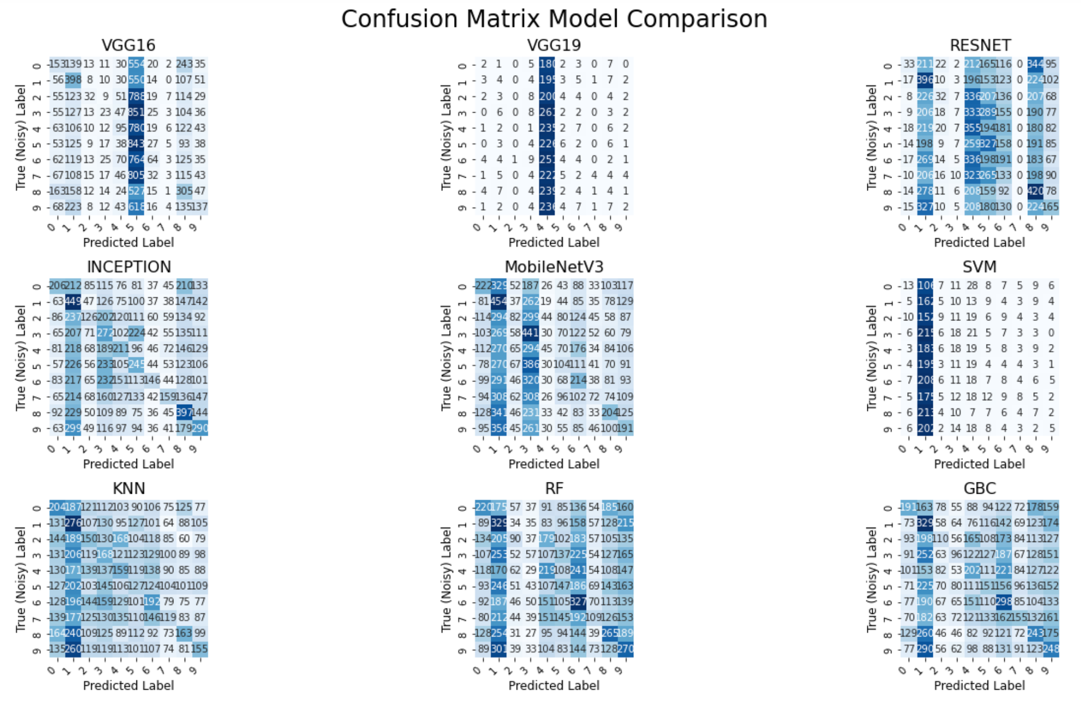
Model I: Model Comparison (on the test set)

Slide 5
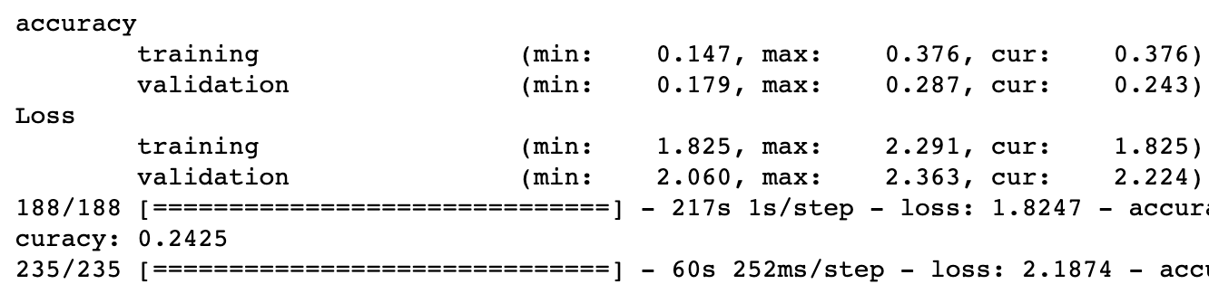
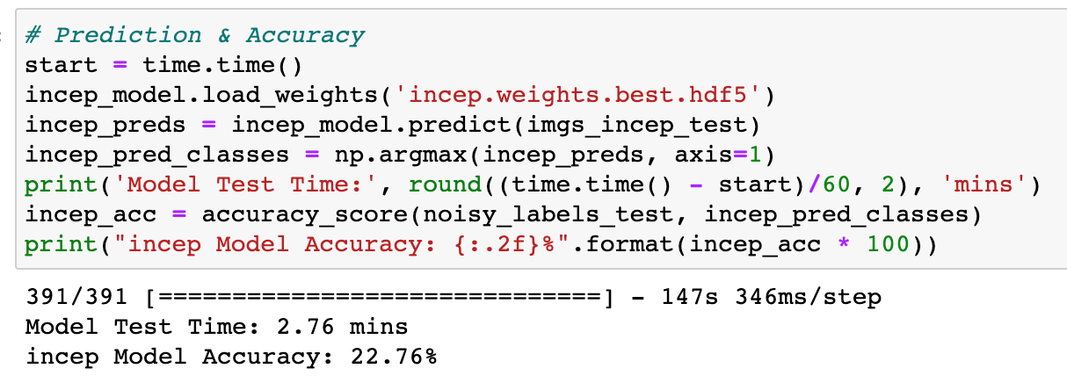
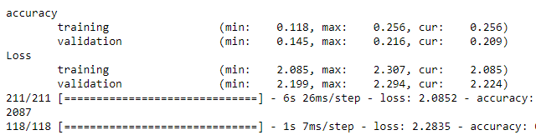
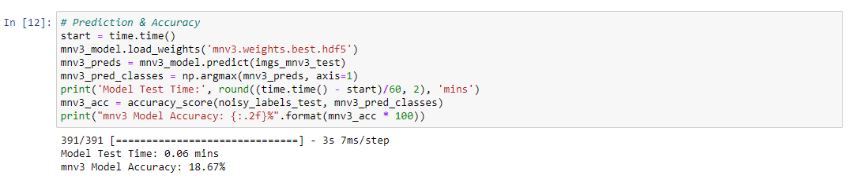
Model I: InceptionV3 vs. MobileNetV3
Parameters:
5-fold cv; batch size = 128; epochs = 20; optimizer: Adam w/ 0.001 learning rate; loss: sparse categorical cross entropy
InceptionV3 performance:
MobileNetV3 performance:

Slide 6
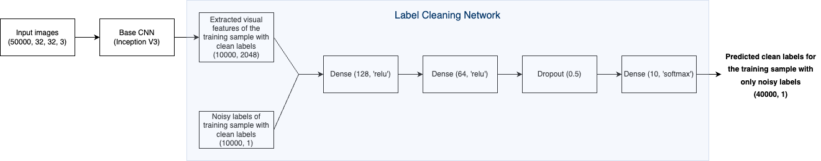
Model II: Label Cleaning Network
Step 1: Extract visual features from raw images, using Inception V3 as the pre-trained base CNN model.
Step 2: Collect the visual features of images from the training sample with available clean data and concatenate them
with their corresponding noisy labels. This will be our train input.
Step 3: Build a fully-connected network.
Step 4: Train the model, with our train labels being the clean labels.

Slide 7
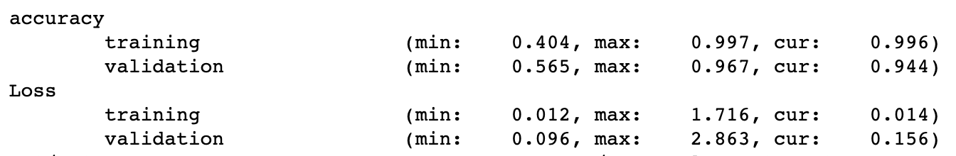
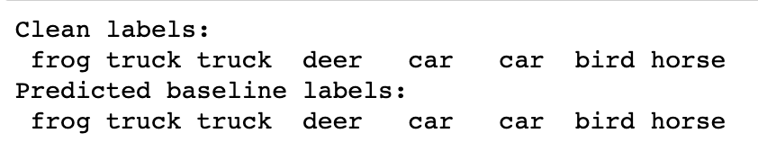
Model II: Performance of Label Cleaning Model
Some training model parameters:
5-fold cross validation
batch size = 64, epochs = 10
Optimizer: Adam w/ 0.001 learning rate
Loss: sparse categorical cross entropy
Model performance on the training set (images with clean labels):
Cross check the predicted clean labels for the first 8 images – all predictions match!

Slide 8
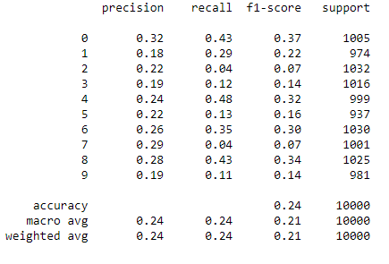
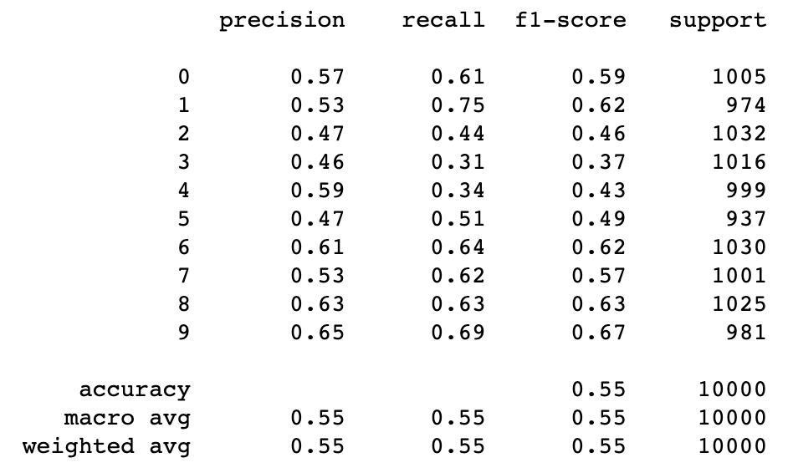
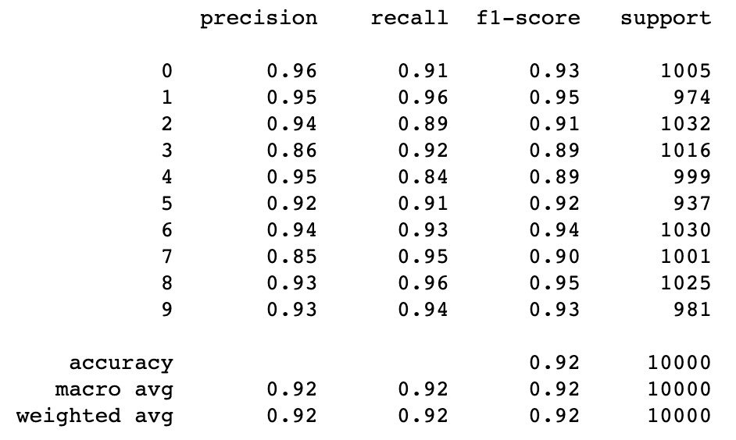
Evaluation: Three Models
The evaluation was performed on the first 10,000 images, i.e. comparing the predicted labels with the true clean labels.
Baseline
Model I (~ 14min)
Model II (~ 29min)

