Slide 1
Project 4 Algorithm implementation and evaluation
Group 10:
Saumya Pandey
Weilin Zhou
Jenny Li
Tianyu Yao

Slide 2
A7: Information Theoretic Measures for Fairness-aware Feature selection (FFS)
What does FFS do?
Develops a framework for fairness-aware feature selection which takes into account the correlation among the features and the decision outcome, and is based on information theoretic measures for the accuracy and discriminatory impacts of features.
For consequential decision making regarding individuals based on their relevant features. Features that are relevant for accurate decisions may however lead to either explicit or implicit forms of discrimination against unprivileged groups, such as those of certain race or gender.
This happens due to existing biases in the training data, which are often replicated or even exacerbated by the learning algorithm. Identifying and measuring these biases at the data level is a challenging problem due to the interdependence among the features, and the decision outcome.

Slide 3
A7: Information Theoretic Measures for Fairness-aware Feature selection (FFS)
What does FFS do?
First proposes information theoretic measures which quantify the impact of different subsets of features on the accuracy and discrimination of the decision outcomes.
Then deduces the marginal impact of each feature using Shapley value function; a solution concept in cooperative game theory used to estimate marginal contributions of players in a coalitional game.
Designs a fairness utility score for each feature (for feature selection) which quantifies how this feature influences accurate as well as nondiscriminatory decisions.

Slide 4
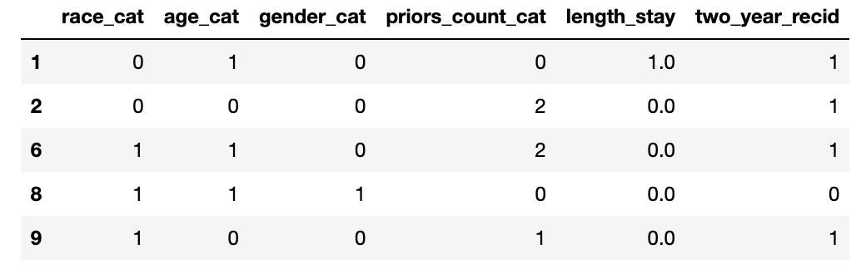
A7: Information Theoretic Measures for Fairness-aware Feature selection (FFS)
How the evaluation is carried out?
Dataset
`compas-scores-two-years.csv`: contains criminal history, jail and prison time, demographics and COMPAS risk scores for defendants from Broward County.
features:
race_cat: Caucasian being 1 and others 0;
age_cat: 0 – 25 being 0, 25 – 45 being 1 and > 45 0;
gender_cat: female being 1 and others 0;
priors_count_cat: no priors being 0, less than 3 priors being 1 and others 2;
length_stay: less than 7 days being 0, btw 7 and 90 days being 1 and others 2;
classes:
two_year_recid: has recidivism being 1 and otherwise 0.

Slide 5
A7: Information Theoretic Measures for Fairness-aware Feature selection (FFS)
How the evaluation is carried out?
2. shapley
def info_coef(left, right) - proposes information theoretic measures;
def conditional_info_coef(left, right, conditional) - deduces the marginal impact of each feature;
def shapley_disc(y, x, sensitive, i) - fairness utility score for nondiscriminatory;
Discrimination Coefficient:
def shapley_acc(y, x, sensitive, i) - fairness utility score for accuracy.
Accuracy Coefficient:

Slide 6
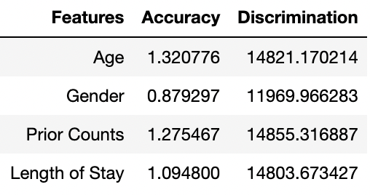
A7: Information Theoretic Measures for Fairness-aware Feature selection (FFS)
How the evaluation is carried out?
3. Results
The table shows that Age and Prior Counts have the strongest discriminatory coefficients, but also the largest impact on accuracy, which is in line with the paper. Eliminate this feature may prove problematic for the classifier.

Slide 7
References
https://arxiv.org/abs/2106.00772
https://christophm.github.io/interpretable-ml-book/shapley.html

