Slide 1
Project 4 Algorithm implementation and evaluation
Group 10:
Saumya Pandey
Weilin Zhou
Jenny Li
Tianyu Yao

Slide 2
A7: Information Theoretic Measures for Fairness-aware Feature selection (FFS)
What does FFS do?
Develops a framework for fairness-aware feature selection which takes into account the correlation among the features and the decision outcome, and is based on information theoretic measures for the accuracy and discriminatory impacts of features.
For consequential decision making regarding individuals based on their relevant features. Features that are relevant for accurate decisions may however lead to either explicit or implicit forms of discrimination against unprivileged groups, such as those of certain race or gender.
This happens due to existing biases in the training data, which are often replicated or even exacerbated by the learning algorithm. Identifying and measuring these biases at the data level is a challenging problem due to the interdependence among the features, and the decision outcome.

Slide 3
A7: Information Theoretic Measures for Fairness-aware Feature selection (FFS)
What does FFS do?
First proposes information theoretic measures which quantify the impact of different subsets of features on the accuracy and discrimination of the decision outcomes.
Then deduces the marginal impact of each feature using Shapley value function; a solution concept in cooperative game theory used to estimate marginal contributions of players in a coalitional game.
Designs a fairness utility score for each feature (for feature selection) which quantifies how this feature influences accurate as well as nondiscriminatory decisions.

Slide 4
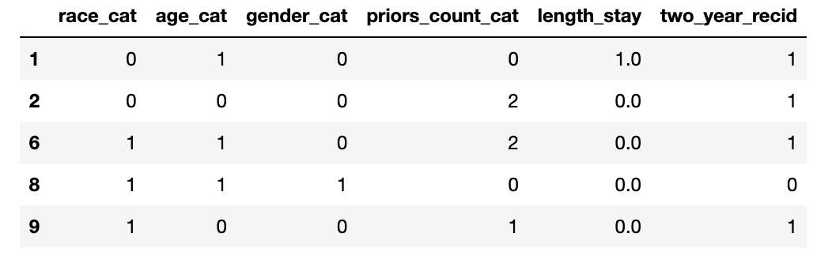
A7: Information Theoretic Measures for Fairness-aware Feature selection (FFS)
How the evaluation is carried out?
Dataset
`compas-scores-two-years.csv`: contains criminal history, jail and prison time, demographics and COMPAS risk scores for defendants from Broward County.
features:
race_cat: Caucasian being 1 and others 0;
age_cat: 0 – 25 being 0, 25 – 45 being 1 and > 45 0;
gender_cat: female being 1 and others 0;
priors_count_cat: no priors being 0, less than 3 priors being 1 and others 2;
length_stay: less than 7 days being 0, btw 7 and 90 days being 1 and others 2;
classes:
two_year_recid: has recidivism being 1 and otherwise 0.

Slide 5
A7: Information Theoretic Measures for Fairness-aware Feature selection (FFS)
How the evaluation is carried out?
2. shapley
def info_coef(left, right) - proposes information theoretic measures;
def conditional_info_coef(left, right, conditional) - deduces the marginal impact of each feature;
def shapley_disc(y, x, sensitive, i) - fairness utility score for nondiscriminatory;
Discrimination Coefficient:
def shapley_acc(y, x, sensitive, i) - fairness utility score for accuracy.
Accuracy Coefficient:

Slide 6
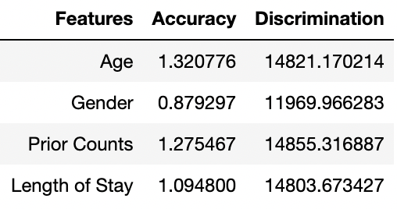
A7: Information Theoretic Measures for Fairness-aware Feature selection (FFS)
How the evaluation is carried out?
3. Results
The table shows that Age and Prior Counts have the strongest discriminatory coefficients, but also the largest impact on accuracy, which is in line with the paper. Eliminate this feature may prove problematic for the classifier.

Slide 7
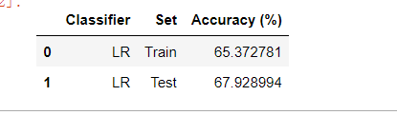
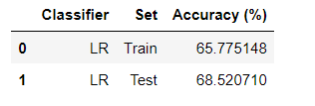

A7: Information Theoretic Measures for Fairness-aware Feature selection (FFS)
How the evaluation is carried out?
4. Evaluation
Based on the results, priors_count has the greatest impact on discrimination, but it also has the greatest effect on accuracy, which may be a problem if we removed it from the classifier.
Drop Prior_Count
Drop Gender

Slide 8
A5: Fairness-aware Classifier with Prejudice Remover Regularizer
Data Mining is increasingly being applied for serious decisions (e.g. credit, insurance rates, employment applications).
Serious topics like these must be fair in legal and social viewpoints and unbiased relative to sensitive attributes like gender, religion, race, etc. Must be treated carefully in data mining algorithms.
One way: exclude sensitive features but that is insufficient due to red-lining effect (indirect influence of sensitive features even if removed).
e.g. race attribute is removed from determining credit scoring. But, if people of one race live in a specific area and address is counted in training a prediction model, the model will make unfair predictions even though race is not used.

Slide 9
A5: Fairness-aware Classifier with Prejudice Remover Regularizer
3 causes of unfairness in data mining:
Indirect Prejudice - statistical dependence between sensitive features and dependent variable
Underestimation - state in which a classifier has not yet converged
Negative Legacy - problems of unfair sampling or labeling in the training data

Slide 10
A5: Fairness-aware Classifier with Prejudice Remover Regularizer
The main focus is indirect prejudice and the motivation of the paper is to diminish it.
The Prejudice Remover Regularizer brings modifications to the logistic regression model and adds a constraint of a no indirect prejudice condition.

Slide 11
A5: Fairness-aware Classifier with Prejudice Remover Regularizer
Experiment result:
we implemented the prejudice removal model and use logistic regression model as baseline model to compare. We compared two models with different numbers of input features and observed the accuracy rate of implemented model was higher in all the cases.
# of features | baseline model | prejudice removal model
3 | 56.4% | 60.2%
5 | 61.9% | 62.3%
7 | 62.1% | 62.4%

Slide 12
References
https://arxiv.org/abs/2106.00772
https://christophm.github.io/interpretable-ml-book/shapley.html
https://www.slideshare.net/shima__shima/fairnessaware-classifier-with-prejudice-remover-regularizer
https://link.springer.com/content/pdf/10.1007/978-3-642-33486-3_3.pdf?pdf=inline%20link

