Slide 1
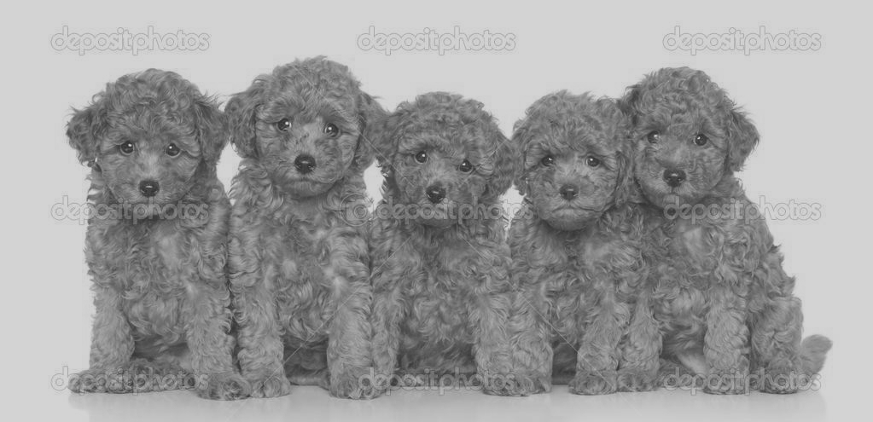
Labradoodles versus Fried Chicken: Grayscale Version
Vikas Arun
Xuanyu Xiao
Boxuan Zhao
Boya Zhao
Yuxi Zhou

Slide 2
Outline
Models
Feature Extraction
Results
Analysis

Slide 3
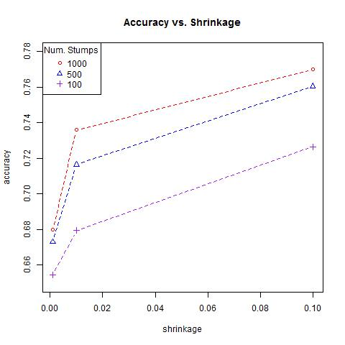
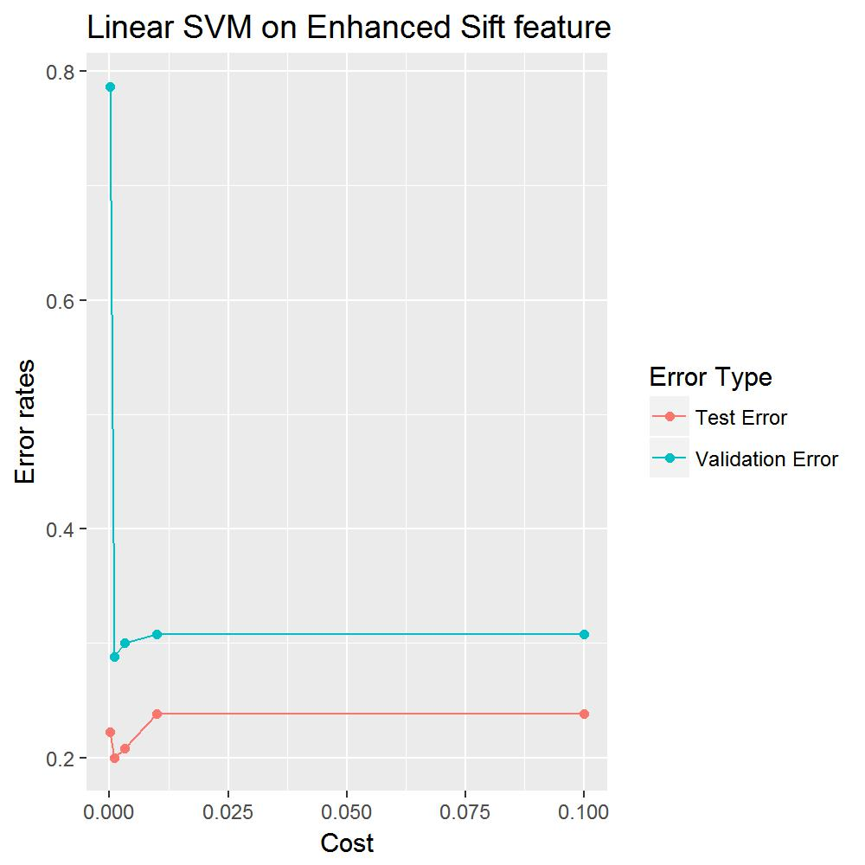
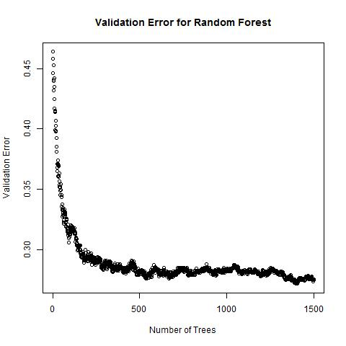
Models
GMB with Decision Stumps
Support Vector Machine
Random Forests

Slide 4
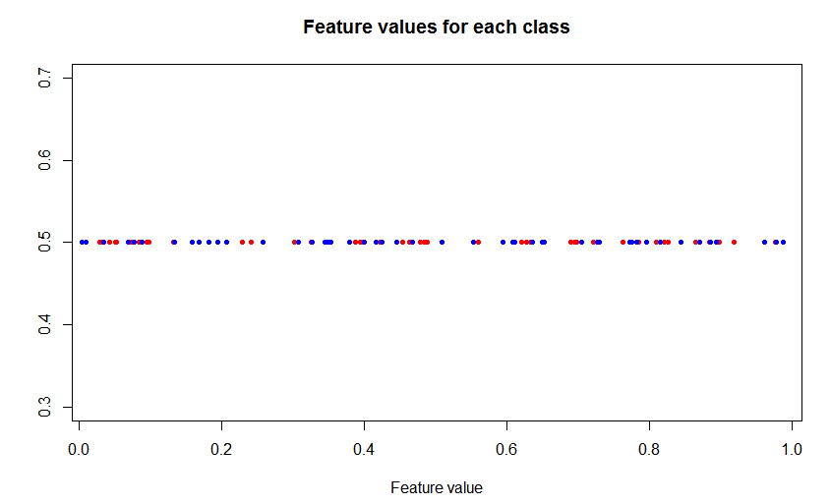
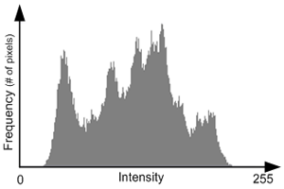
Feature Extraction
2. Grayscale binning features
256 bins
Removed low variance features
Downsized SIFT features
Removed low variance features
Removed homogenous features

Slide 5
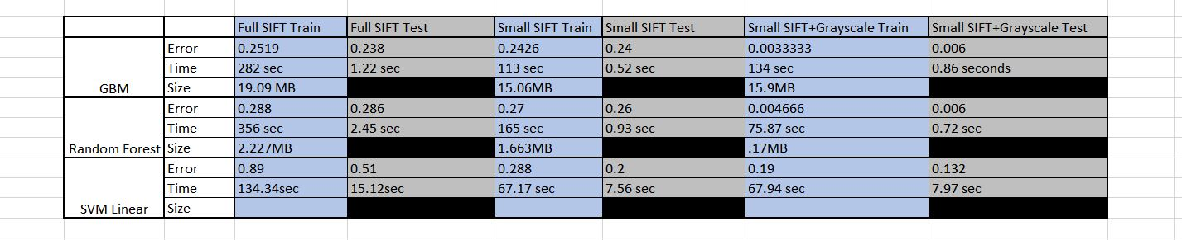
Results
3 models: GBM, Random Forest, Linear SVM
3 feature sets: Full SIFT, Small SIFT, Small SIFT + Grayscale
Blue =Training results
Grey = Test results

Slide 6
Analysis
Random Forest Benefits
Small Storage Space
Quick Prediction
Small Training Time
Baseline Model, Original features
Blue =Training results
Grey = Test results
Improved Model,
Improved Features

