Slide 1
Labradoodle or Fried Chicken
Image Analysis Project
Group 5
Group member: Kai Chen, Zhengyuan Guo, Yi Jiang, Jiahao Liu, Song Wang

Slide 2
Summary of the project
Framework
Feature Extraction: SIFT
Feature Extraction: HOG + PCA
Results

Slide 3
1. Framework
Features
SIFT
HOG
Classifier
GBM
SVM(radial)
SVM(linear)
KNN
Notes:
Gradient boosting is a machine learning technique for regression and classification problems, which produces a prediction model in the form of an ensemble of weak prediction models, typically decision trees. It builds the model in a stage-wise fashion like other boosting methods do, and it generalizes them by allowing optimization of an arbitrary differentiable loss function.
An SVM model is a representation of the examples as points in space, mapped so that the examples of the separate categories are divided by a clear gap that is as wide as possible
SVMs can efficiently perform a non-linear classification using what is called the kernel trick, implicitly mapping their inputs into high-dimensional feature spaces
The binary logistic model is used to estimate the probability of a binary response based on one or more predictor (or independent) variables (features). It allows one to say that the presence of a risk factor increases the probability of a given outcome by a specific percentage
SIFT: Extract key points per picture->Sampling all the key points ->K-means classify all the key points bag of words
HOG:

Slide 4
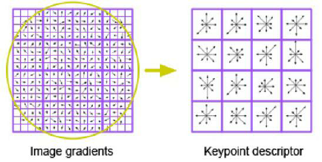
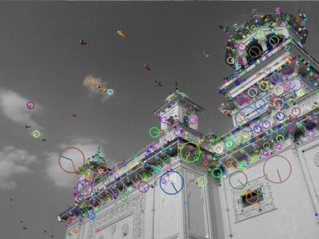
Feature Extraction
2. SIFT

Slide 5
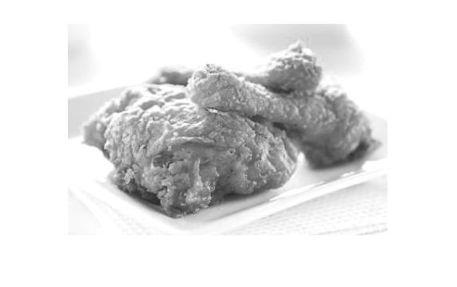
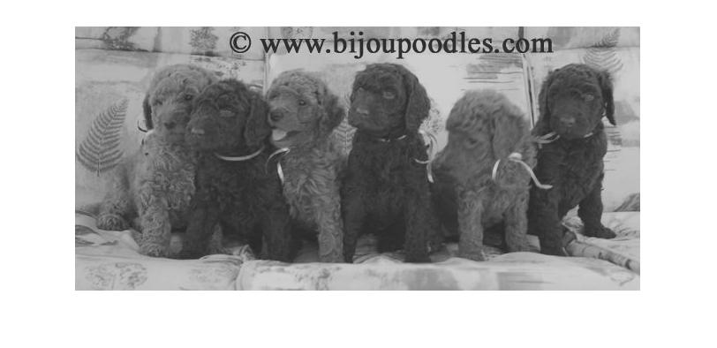
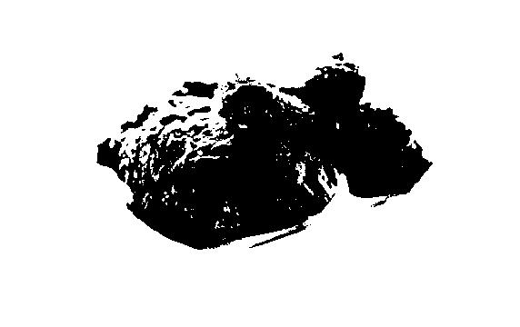
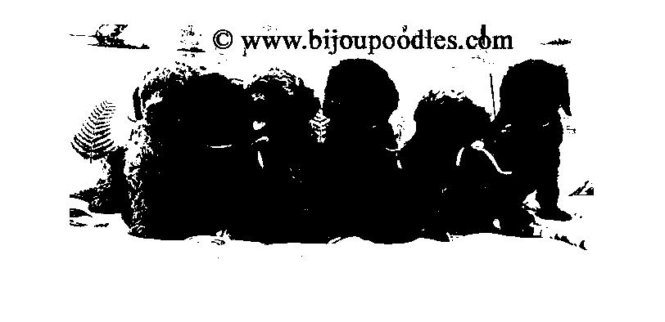
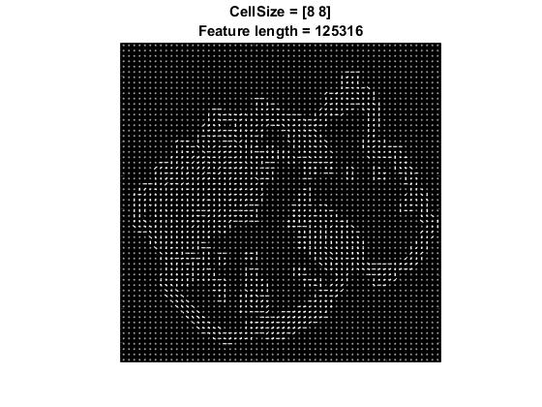
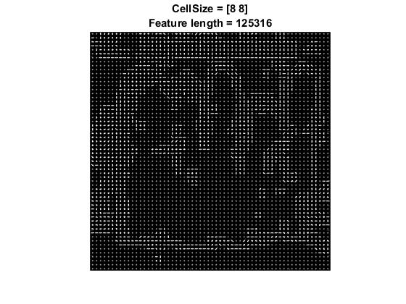
Feature Extraction
3. HOG + PCA
a. original
b. Global image threshold using Otsu's method
c. HOG feature visualization
Notes:
Prior to training and testing a classifier, a pre-processing step is applied to remove noise artifacts introduced while collecting the image samples. This provides better feature vectors for training the classifier.
By varying the HOG cell size parameter and visualizing the result, you can see the effect the cell size parameter has on the amount of shape information encoded in the feature vector:
The graythresh function uses Otsu's method, which chooses the threshold to minimize the intraclass variance of the black and white pixels
Overfitting : PCA

Slide 6
4. Result
Classification Method | Best training Accuracy: SIFT Features | Best testing accuracy: SIFT Features | Best training Accuracy: HOG Features | Best testing Accuracy: HOG Feature
GBM | 72.2% | 67% | 80.4% | 72%
SVM (Linear Kernel) | 100% | 54% | 90.1% | 84.1%
SVM (Radial Kernel) | 82.1% | 85% | 91% | 88%
KNN | 69% | 62.2% | 78% | 72%
Tuning Time |  | 1476s |  | 109s
Testing Time |  | 0.1s |  | 0.36s
Notes:
Support vector machines (SVMs) are a set of supervised learning methods used for classification, regression and outliers detection.

Slide 7
Q&A

