Slide 1
POODLES AND CHICKEN
Group 1

Slide 2
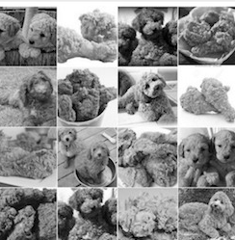
Introduction
In this project, we carried out model evaluation and selection for predictive analytics on the image data. We created a classification engine for grayscale images of poodles versus images of fried chickens. We compared the different models with the baseline model (SIFT feature + GBM classifier) and chose the final model.

Slide 3
Project Pipeline
Feature Extraction
(GIST)
01
Training the Model
02
Model Comparison
03
Results
04

Slide 4
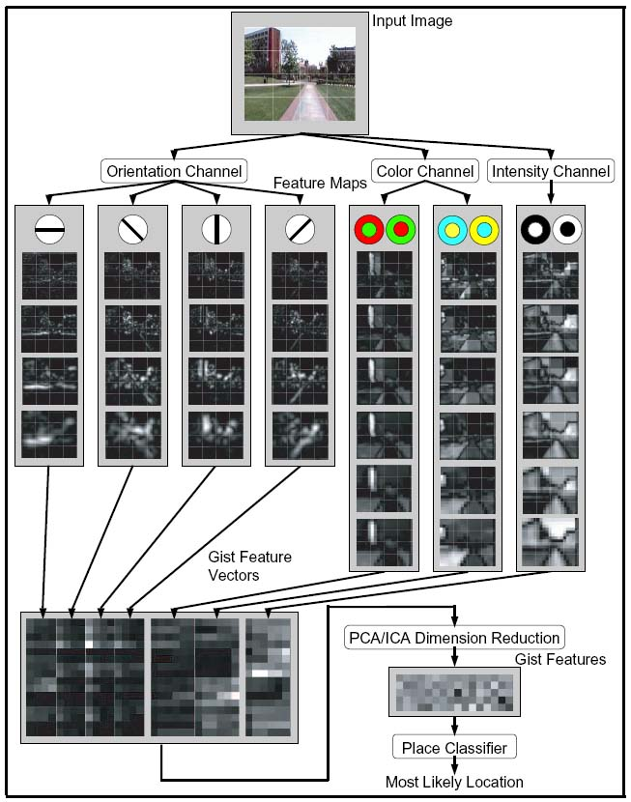
Features Extraction (GIST)
GIST summarizes the gradient information (scales and orientations) for different parts of an image, which provides a rough description (the gist) of the scene.
Step1: Convolve the image with 32 Gabor filters at 4 scales, 8 orientations, producing 32 feature maps of the same size of the input image.
Step2: Divide each feature map into 16 regions (by a 4x4 grid), and then average the feature values within each region.
Step3: Concatenate the 16 averaged values of all 32 feature maps, resulting in a 16x32=512 GIST descriptor.

Slide 5
Why do we use GIST?
30
minutes
Fast running time
About 5 minutes to extract features for 2000 images. Six times faster than sift
Easy to understand
GIST uses a easy way to build dimension
5 minutes
Low Dimension
512 features per picture, avoid overfitting for model training
GIST
512 features
SIFT
More than 5000 features

Slide 6
Algorithm Training Progress
25% Test Set
Split the data
Run the CV on the training set
Select the parameters with lowest CV error rate
Use the selected parameters to train the entire training set
Compare the CV error and test error to detect the overfitting
Modify and improve the model
75% Training Set

Slide 7
Model Comparison
Random
Forest
GBM
(Baseline)
SIFT
&
GIST
Linear
SVM
XGBoost
Non-linear
SVM

Slide 8
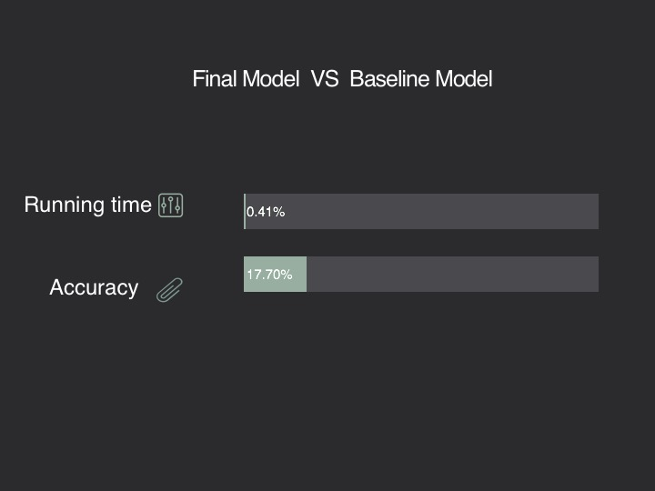
Model Comparison
FEATURES | ALGORITHMS | ERROR RATE (CV) | RUNNING TIME
SIFT | Gradient Boosting Machine (GBM) | 27.1% | 18 mins
SIFT | Random Forest | 27.3% | 5-6 mins
SIFT | XGBoost | 23.8% | 49.39 sec
SIFT | Linear SVM | 24.6% | ~30 sec
SIFT | Non-linear SVM | 21.4% | ~30 sec
GIST | Gradient Boosting Machine (GBM) | 14% | 5 mins
GIST | Random Forest | 14.8% | 1-2 mins
GIST | XGBoost | 14.2% | 4.45 sec
GIST | Linear SVM | 14.5% | ~10 sec
GIST | Non-linear SVM | 15.1% | ~10 sec

Slide 9
About Us
😳😳😳
😂
🙂
🤗
😝
😉
Nie, Kexin
Schiltz, Marie
Wei, Jihan
Zhu, Chenyun
Zhu, He
Lean more: https://github.com/TZstatsADS/spr2017-proj3-grp1

