Slide 1
Philosophy in Wikipedia vs philosophy in data
Jun Ding
jd3716

Slide 2

Three Eras
1. Ancient (Greco-Roman)
before 5th century
metaphysics, cosmology, the nature of the well-lived life,
the possibility of knowledge, and the nature of reason
2. Medieval philosophy
5th century ~ 16th century
existence and nature of God, the nature of faith and
reason, metaphysics, the problem of evil
3. Modern philosophy
17th century ~ present
develop a secular and rational foundation for knowledge
move away from traditional structures of authority

Slide 3
What does data tell us

Slide 4
1. Schools of Ancient Era
the possibility of knowledge, and the nature of reason
2. Schools of Medieval Era
5th century ~ 16th century
3. Schools of Modern Era
17th century ~ present

Slide 5
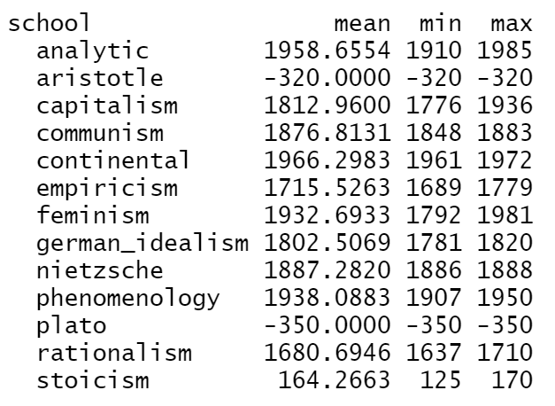
Schools “Aristotle”, “Plato” and “Stoicism” belong to ancient era; all the other schools belong to modern era.
This classification does not work well.
Let’s look at the WordCloud of each school.

Slide 6

data vs. wiki
Plato
In Plato's dialogues, Socrates and his company of disputants had something to say on many subjects, including several aspects of metaphysics. These include religion and science, human nature, love, and sexuality. More than one dialogue contrasts perception and reality, nature and custom, and body and soul.

Slide 7




data vs. wiki
aristotle
His writings cover many subjects including physics, biology, zoology, metaphysics, logic, ethics, aesthetics, poetry, theatre, music, rhetoric, psychology, linguistics, economics, politics, meteorology, geology and government.
His philosophy has exerted a unique influence on almost every form of knowledge in the West.

Slide 8

data vs. wiki
stoicism
It is a philosophy of personal eudemonic virtue ethics informed by its system of logic and its views on the natural world, asserting that the practice of virtue is both necessary and sufficient to achieve eudaimonia – flourishing, by means of living an ethical life.

Slide 9

data vs. wiki
rationalism
Rationalism is defined as a methodology or a theory "in which the criterion of the truth is not sensory but intellectual and deductive".

Slide 10

data vs. wiki
empiricism
In philosophy, empiricism is a theory that states that knowledge comes only or primarily from sensory experience.
Empiricism emphasizes the role of empirical evidence in the formation of ideas, rather than innate ideas or traditions.

Slide 11
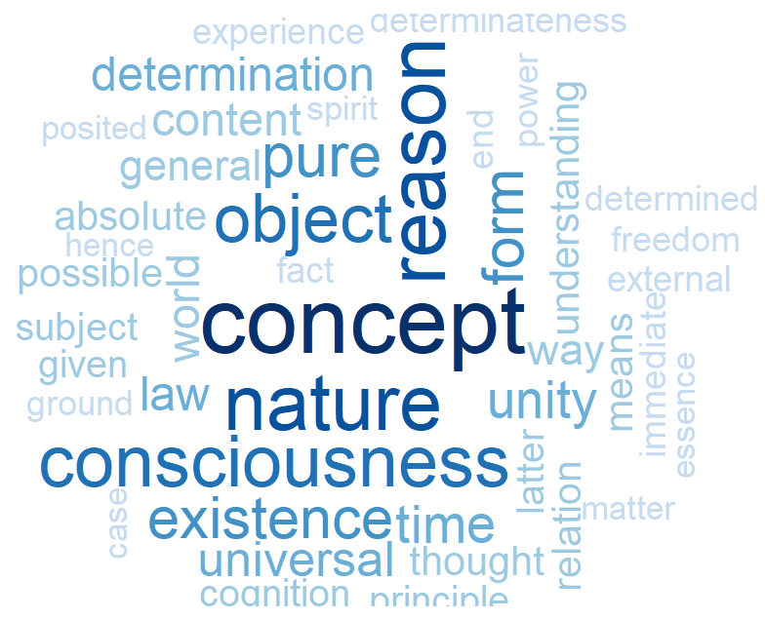
data vs. wiki
German idealism
German idealism was a philosophical movement that emerged in Germany. It was closely linked both with Romanticism and the revolutionary politics of the Enlightenment.

Slide 12

data vs. wiki
capitalism
Capitalism is an economic system based on the private ownership and control of the means of production and their operation for profit. Central characteristics of capitalism include capital accumulation, competitive markets, a price system determined by supply and demand, private property, property rights recognition, voluntary exchange, and wage labor.

Slide 13

data vs. wiki
communism
Communism is a philosophical, social, political, and economic ideology and movement whose goal is the establishment of a communist society, namely a socioeconomic order structured upon the ideas of common ownership of the means of production and the absence of social classes, money, and the state.

Slide 14

data vs. wiki
nietzsche
Prominent elements of Nietzsche philosophy include his radical critique of truth in favor of perspectivism; a genealogical critique of religion and Christian morality and a related theory of master–slave morality; the aesthetic affirmation of life in response to both the "death of God" and the profound crisis of nihilism; the notion of Apollonian and Dionysian forces; and a characterization of the human subject as the expression of competing wills, collectively understood as the will to power.

Slide 15

data vs. wiki
feminism
Feminism is a range of socio-political movements and ideologies that aim to define and establish the political, economic, personal, and social equality of the sexes. Feminism incorporates the position that societies prioritize the male point of view, and that women are treated unjustly within those societies.

Slide 16

data vs. wiki
phenomenology
Phenomenology is the philosophical study of the structures of experience and consciousness.
Phenomenology is not a unified movement; rather, different authors share a common family resemblance but also with many significant differences.

Slide 17
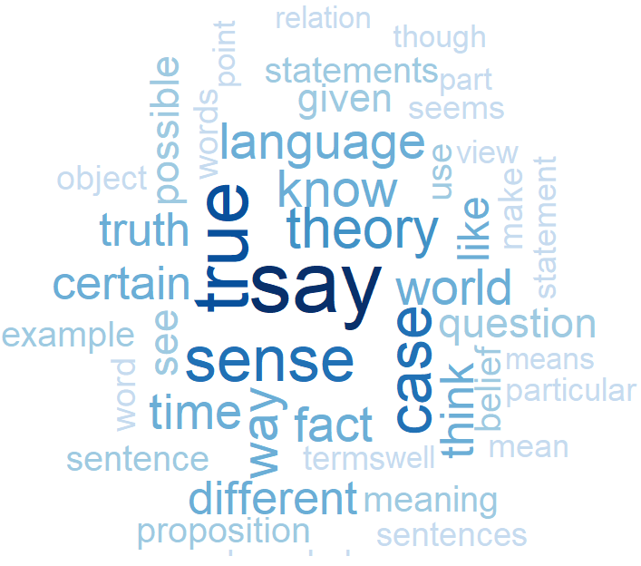
data vs. wiki
analytic
Analytic philosophy is a branch and tradition of philosophy using analysis.
Analytic philosophy is characterized by an emphasis on language, known as the linguistic turn, and for its clarity and rigor in arguments, making use of formal logic and mathematics, and, to a lesser degree, the natural sciences.

Slide 18
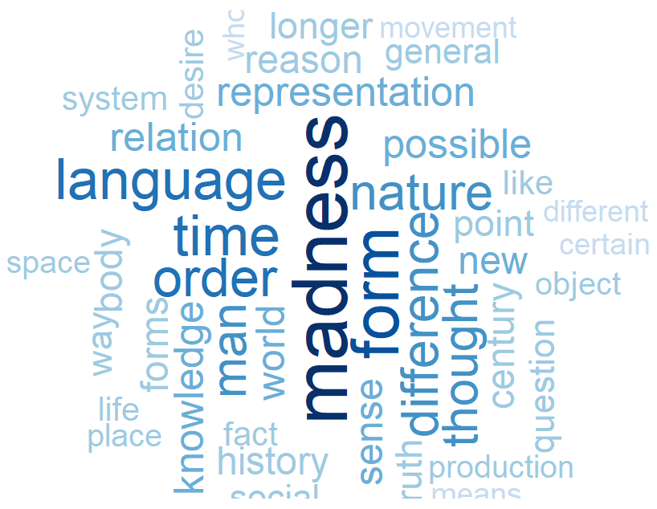
data vs. wiki
continental
This term originated among English-speaking philosophers, who used it to refer to a range of thinkers and traditions outside the analytic movement.
It includes German idealism, phenomenology, Nietzsche, and French feminism.
The term continental philosophy, like analytic philosophy, lacks clear definition and may mark merely a family resemblance across disparate philosophical views.

Slide 19
Not every WordCloud shares commonalities with its corresponding description in Wikipedia.
Some schools’ WordCloud work well, like Empiricism, German Idealism, Capitalism, Communism and Feminism.
For the rest, I would like to first check if there is any obvious distinction between schools in ancient and modern eras by showing the overall WordCloud and 10 most frequent words.

Slide 20


ancient vs. modern

Slide 21
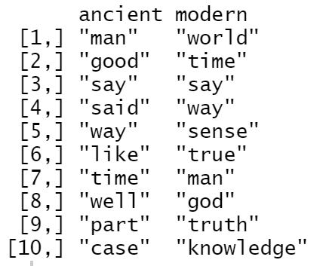









Distinguishing the two eras is not easy. Most frequent words in both eras cannot clearly relate to philosophy, especially the ancient era.
After removing the overlapping frequent words, we can get two different lists of frequent words. Then given any sentence, we may count the frequent words. Based on the counting result, we may be able to distinguish the schools in different eras.
(Furthermore, we can assign value to words on frequent-words list according to their number of appearance in the overall text.)

Slide 22
According to Wikipedia, some modern schools are interrelated with each others. For instance, capitalism and communism; empiricism and rationalism.
I want to see whether such relationship can be shown in data.

Slide 23
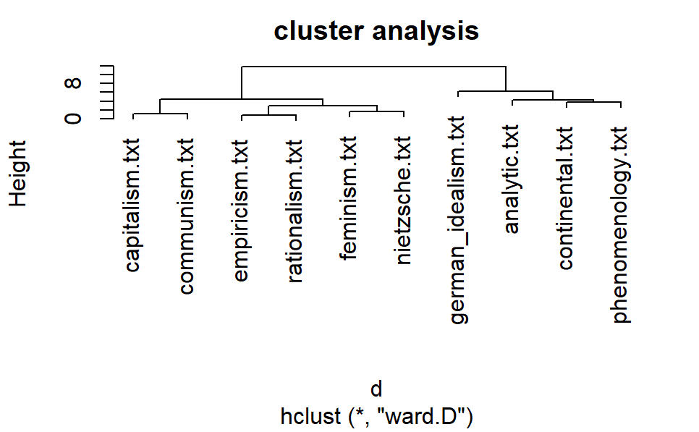
We can clearly see what we expect: capitalism and communism cluster together; empiricism and rationalism cluster together; continental and phenomenology cluster together.
Some patterns are left unexplained. For example, the reason why the left 6 schools and the right 4 schools are considered as two group is still unclear.

Slide 24
I am totally a layman of philosophy, but I could see that some stories the data tells me are the same as what Wikipedia tells me.
There are some questions that I cannot answer. Why the most frequent words of ancient-school text seem irrelevant to philosophy? Why the cluster analysis separate German Idealism, Analytics, Continental and Phenomenology from other 6 schools?
Perhaps, it is due to splitting all the sentences into words. Or, maybe a philosophy scholar could give us the answer.

