Slide 1
Image Classification {
model_building.html
model_evaluation.py
[Semi-supervised Learning]
<Marvin Limpijankit, Jiachen Liu,
Jiahao Shao, Nichole Zhang, Xile Zhang>
}
Project_03_Group_11_20220323

Slide 2
Table of ‘Models’ {
01
02
03
model_building.html
model_evaluation.py
Baseline Model
<Use Logistic Regression, on noise data only.>
Model I
<Use CNN model, fit on noise data only.>
Model II
<Improving Model I with label correction process.>
}
Project_03_Group_11_20220323

Slide 3
Proposed Strategies; {
[Model II]
model_building.html
model_evaluation.py
‘Higher accuracy, but relatively low increase in running cost and storage’
<p 31% higher accuracy compared to baseline model; 10% higher accuracy compared to model I; lower running cost on test set>
}
Project_03_Group_11_20220323

Slide 4
01 {
[Model Building]
model_building.html
model_evaluation.css
< Models are trained using the last 49,000 images. Saving rest for evaluation >
}
Project_03_Group_11_20220323

Slide 5
Model I ‘Layers’ {
model_building.html
model_evaluation.py
tf.keras.layers.experimental.preprocessing.Rescaling(1. / 255),
tf.keras.layers.Conv2D(32, (3, 3), padding='same', activation="relu", input_shape=(32, 32, 3)),
tf.keras.layers.MaxPooling2D((2, 2), strides=2),
tf.keras.layers.Dropout(0.25),
tf.keras.layers.Conv2D(64, (3, 3), padding='same', activation="relu"),
tf.keras.layers.MaxPooling2D((2, 2), strides=2),
tf.keras.layers.Dropout(0.25),
tf.keras.layers.Flatten(),
tf.keras.layers.Dense(128, activation="relu"),
tf.keras.layers.Dense(10, activation="softmax")
}
Project_03_Group_11_20220323

Slide 6
Model I ‘Compile & Fit’ {
model_building.html
model_evaluation.py
modelI.compile(optimizer=tf.keras.optimizers.Nadam(0.001),
loss=tf.keras.losses.CategoricalCrossentropy(),
metrics=['accuracy'])
history = modelI.fit(x_train, y_train, batch_size=128, epochs=6,
validation_split=0.2,
callbacks=EarlyStopping(patience=2))
}
Project_03_Group_11_20220323

Slide 7
Model II ‘Label Correction’ {
model_building.html
model_evaluation.py
# Image branch - Image feature extraction
Resnet = tf.keras.applications.ResNet50(include_top=False,
weights="imagenet", input_tensor=None,
input_shape=(32, 32, 3), pooling='max')
# Fit resnet and scale it down
img_vec = resnet(img_input)
img_vec = Dense(1024)(img_vec)
img_vec = Dense(512)(img_vec)
img_vec = Dense(256)(img_vec)
}
Project_03_Group_11_20220323

Slide 8
Model II ‘Label Correction’ {
model_building.html
model_evaluation.py
# Noisy label branch
noisy_l = Dense(10)(noisy_label)
# Concatenate
x = Concatenate(axis=-1)([noisy_l, img_vec])
x = Dense(256, activation='relu')(x)
out = Dense(10, activation='softmax')(x)
model = Model([img_input, noisy_label], out)
# Compile the model
model.compile(loss=tf.keras.losses.CategoricalCrossentropy(),
metrics=['acc'], optimizer=tf.keras.optimizers.Adam(0.001))
}
Project_03_Group_11_20220323

Slide 9
02 {
[Model Evaluation]
model_building.html
model_evaluation.py
< The first 1,000 data with clean labels are reserved as test set for evaluation only >
}
Project_03_Group_11_20220323

Slide 10
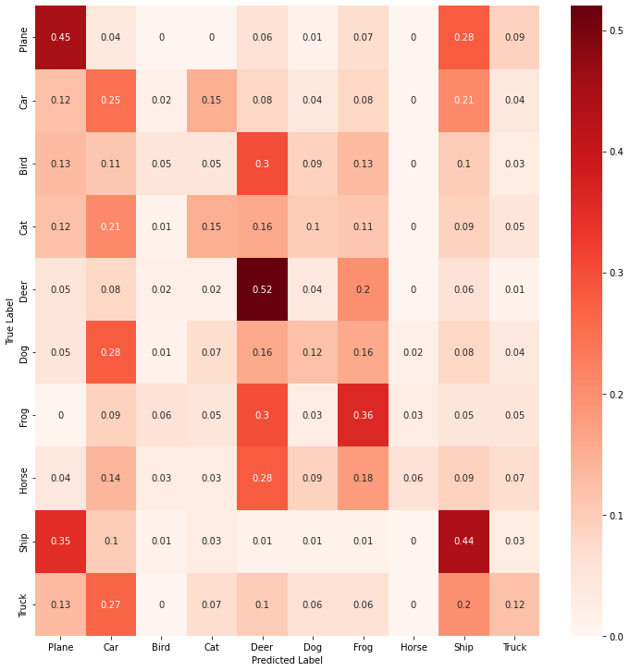
Baseline Model ‘Confusion Matrix’ {
model_building.html
model_evaluation.py
Chaotic
}
Project_03_Group_11_20220323

Slide 11
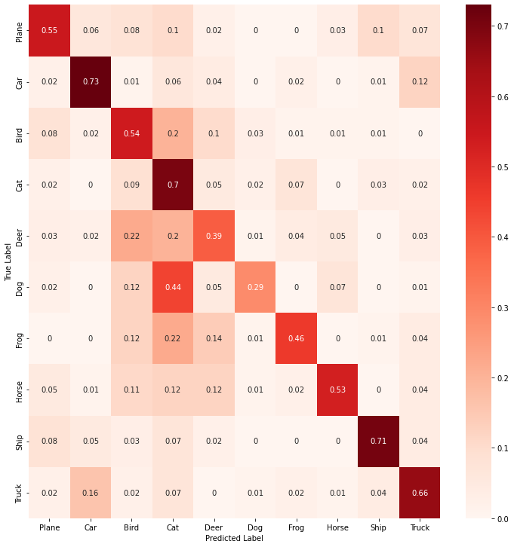
Model I ‘Confusion Matrix’ {
model_building.html
model_evaluation.py
Clear Concentration on diagonal!
Except Cat
and Dog
}
Project_03_Group_11_20220323

Slide 12
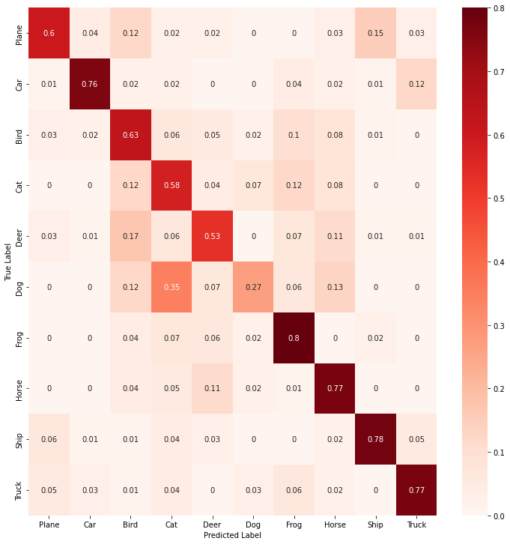
Model II ‘Confusion Matrix’ {
model_building.html
model_evaluation.py
Even more concentration achieved!
}
Project_03_Group_11_20220323

Slide 13
Comparison for ‘Best Model’{
model_building.html
model_evaluation.py
Baseline
Model I
Model II
Training Time
36.650s
Running Time
0.184s
Training/Model Storage
—-MB
Accuracy
25%
Training Time
138.522s
Running Time
20.943s
Training/Model Storage
6.7MB
Accuracy
56%
Training Time
1,073.510s
Running Time
21.086s
Storage Including Label Correction
13.6MB
Model Storage
6.7MB
Accuracy
66%
}
Project_03_Group_11_20220323

Slide 14
Thanks;) {
model_building.html
model_evaluation.py
‘Do you have any questions?’
GitHub: https://github.com/TZstatsADS/spring-2022-prj3-group11
}
Project_03_Group_11_20220323

