Slide 1
The AI Gold Mine: Predicting Stock Market Prices
Supervised by:
Mohammad Obaidur Rahman
Assistant Professor Department of CSE,CUET
Presented by :
Ta-Seen Junaid
ID: 1304092

Slide 2
Introduction
Predicting the future prices of stock market
Collecting data from web
Building deep artificial neural networks
Using one of the most advanced and powerful neural networks
Modifying the traditional version of that neural networks
Performance analysis

Slide 3
Motivation
To reinvest money instead of bank savings
To reduce the volatility of stock market
Making of artificial business agent in future
To earn profit at less effort
Financial analysis
rr

Slide 4
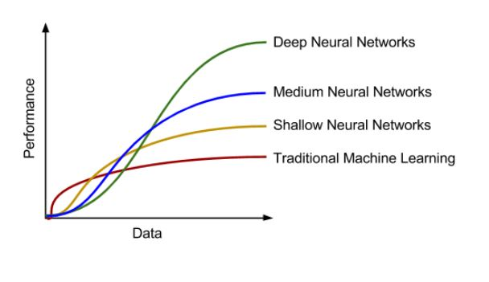
Previous Works
Traditional Machine Learning Based System
[Chen, Yingjun, and Yongtao Hao]:
Try to predict the future prices
Less accurate

Slide 5
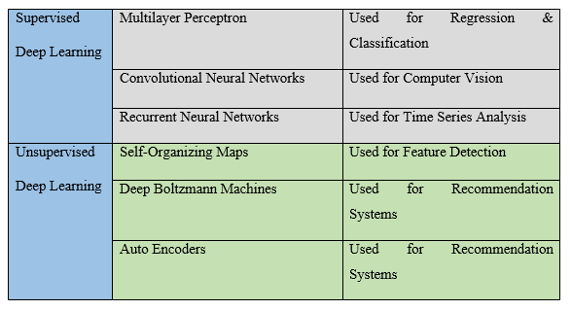
Previous Works
Artificial Neural Networks Based System
[Guresen, Erkam, et al.]:
Time series prediction problem
Matching problem with dataset

Slide 6
Previous Works
Traditional Recurrent Neural Networks Based System
[Bernal, Armando, et al. ]:
Try to predict the future prices
Vanishing gradient problem
Can only remember recent events
Forgetting the more distance past

Slide 7
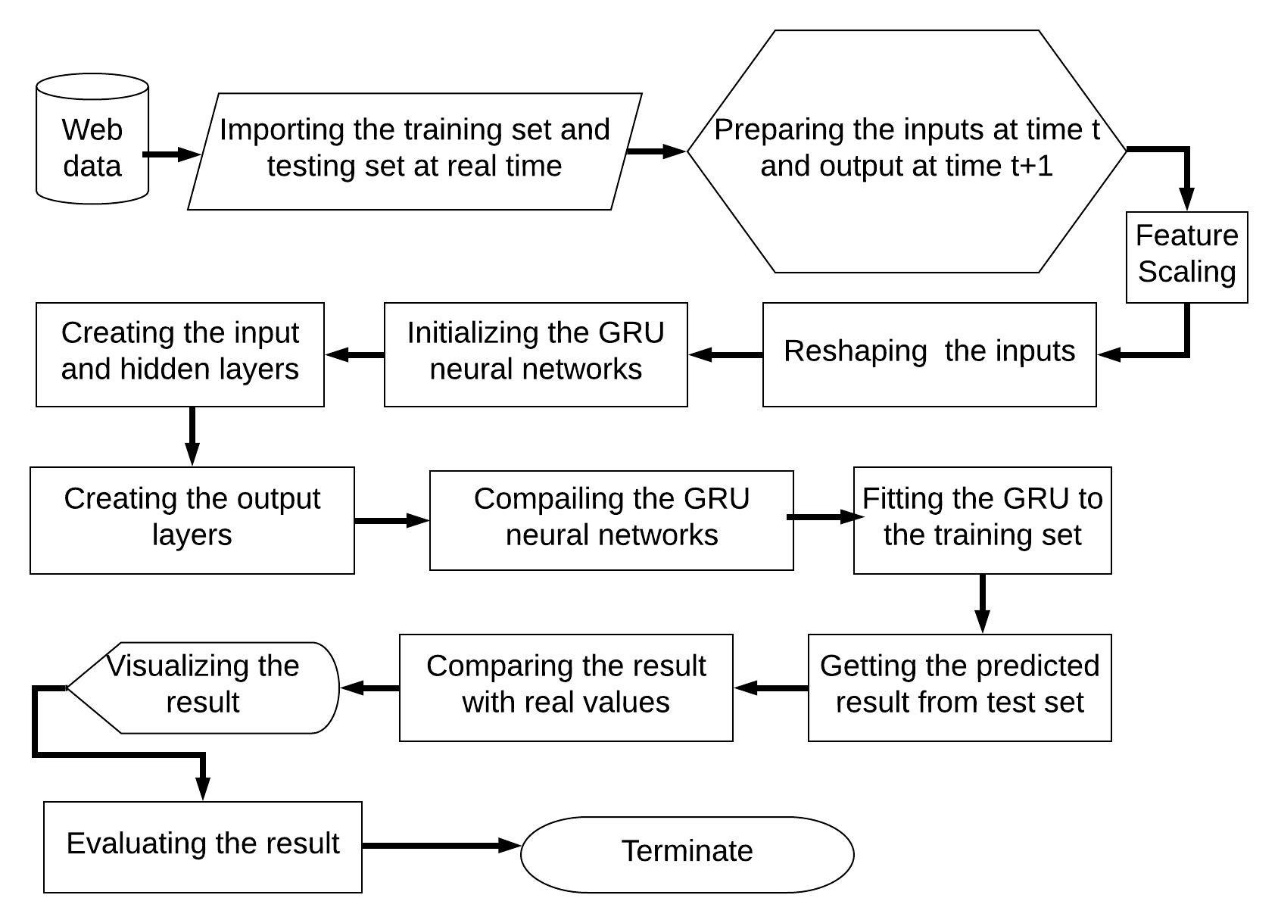
Methodology

Slide 8
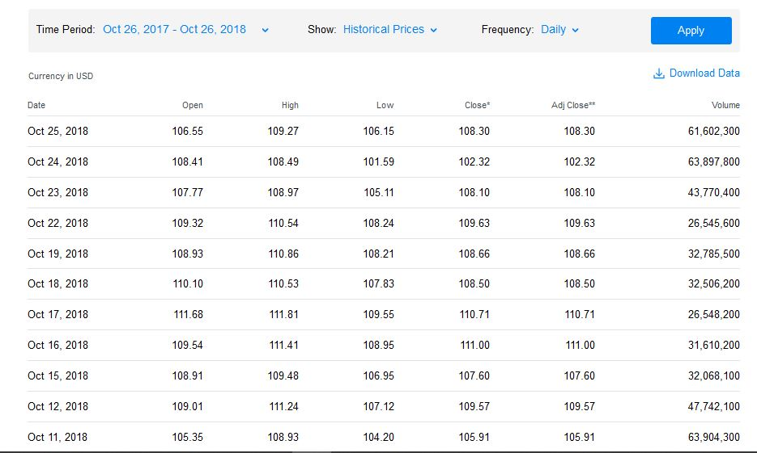
Data Source
Collected from Yahoo! Finance
Symbolized by a ticker
Real time data

Slide 9
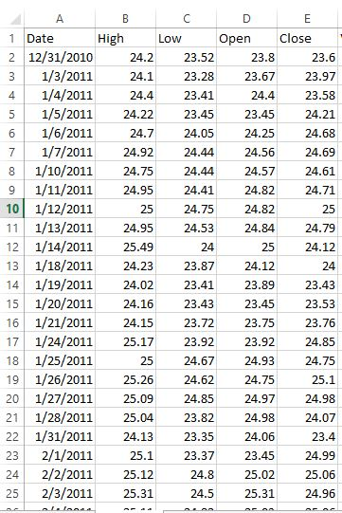
Data Collection
Real time data collection
Saving into CSV file
Collected both training and testing data set

Slide 10
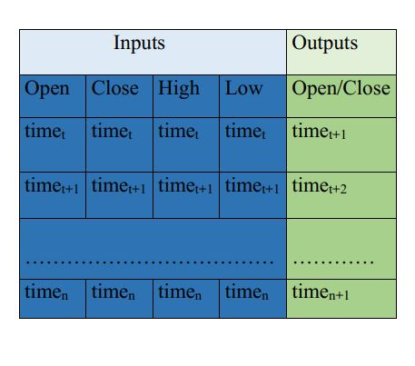
Inputs & Outputs
Inputs at time t
Outputs at time t+1

Slide 11
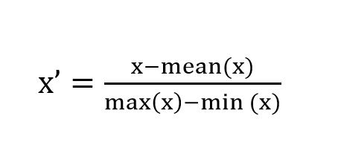
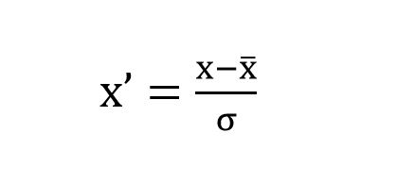
Feature Scaling
Standardized the range of features of independent variables
Avoiding attributes in greater numeric ranges dominating those in smaller numeric ranges
Helping gradient descent convergence faster
Min-max normalization
Standardization

Slide 12
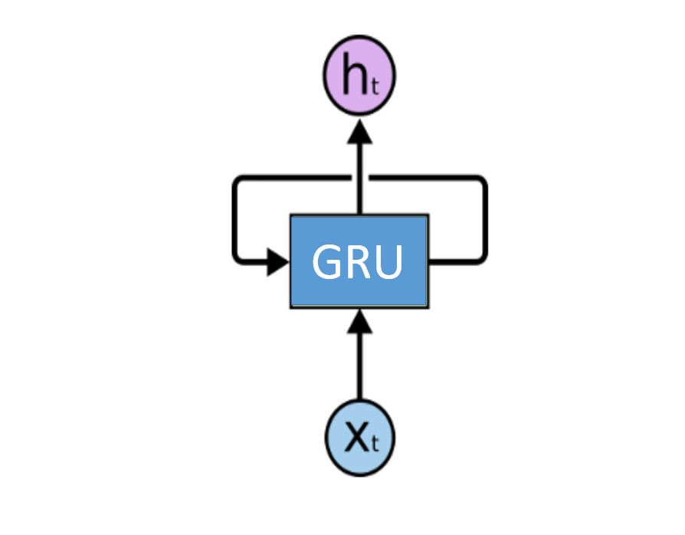
GRU Neural Networks
GRU = Gated Recurrent Units
Introduced by Cho, et al. (2014)
Capabilities of learning long-term dependencies
One of the most modern and powerful
Why recurrent?
Performing the same task
for every element of a sequence
Rolled GRU neural networks

Slide 13
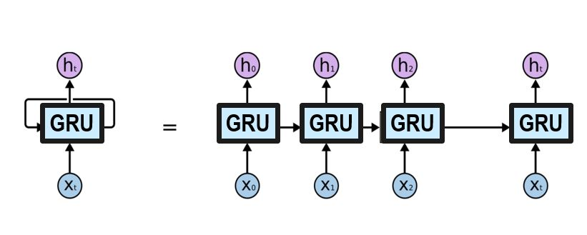
GRU Neural Networks
Unrolling of a rolled GRU neural networks
X_{t} = Inputs vector at time t
h_{t} = Outputs vector at time t
Outputs at time t to a input at time t+1

Slide 14
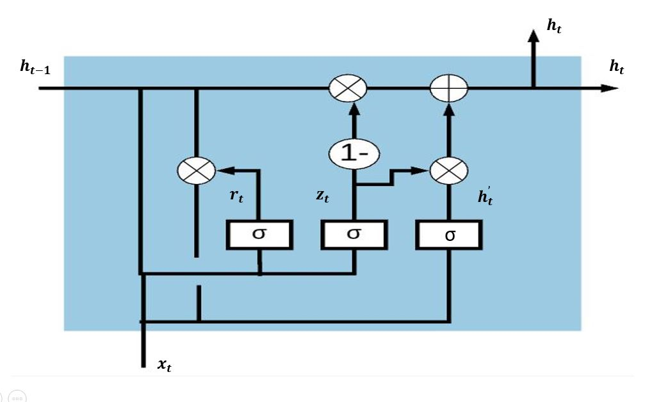
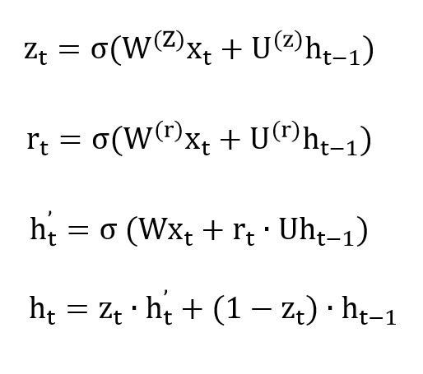
A Single GRU Cell

Slide 15
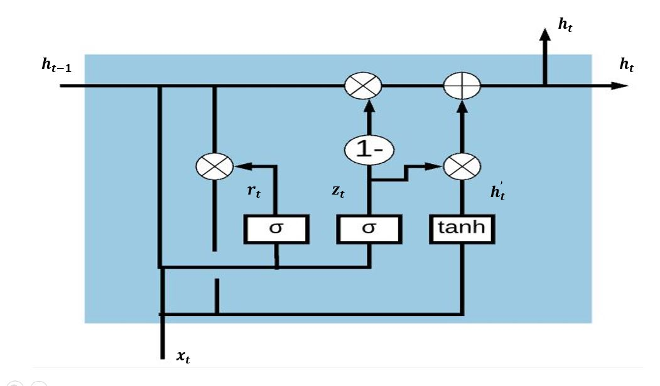
Modification
Traditional
Modified

Slide 16
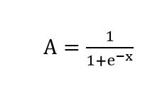
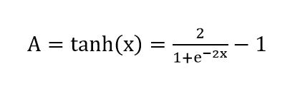
Modification
Sigmoid
range zero to one
Hyperbolic tangent
range minus one to one
Data non negative
Sigmoid also non negative

Slide 17
Training of Our Model
Backpropagation through time
The backward propagation of errors through time
Used by the gradient descent optimization algorithm
To adjust the weight of neurons

Slide 18
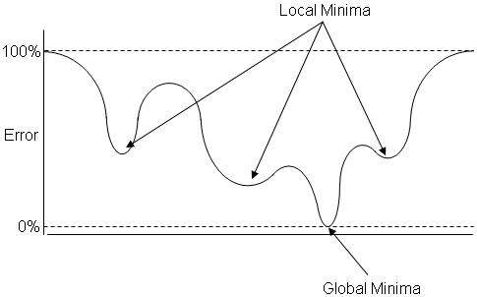
Training of Our Model
Local Minima Problem with Gradient Descent

Slide 19
Training of Our Model
Stochastic Gradient Descent
Evaluating the cost/loss function after each sample
Updating the weights after every training sample
No local minima problem
taking much computation time
Adding noise frequently

Slide 20
Training of Our Model
Mini-batch Gradient Descent
Good trade-off between stochastic and batch gradient descent
Opposed to the stochastic gradient descent batch size of 1
Opposed to the batch gradient descent size of all the training samples
Avoiding the local minima problem
Much more faster than stochastic gradient descent

Slide 21
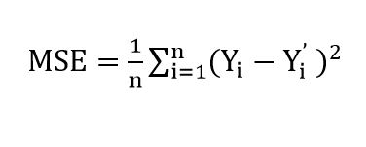
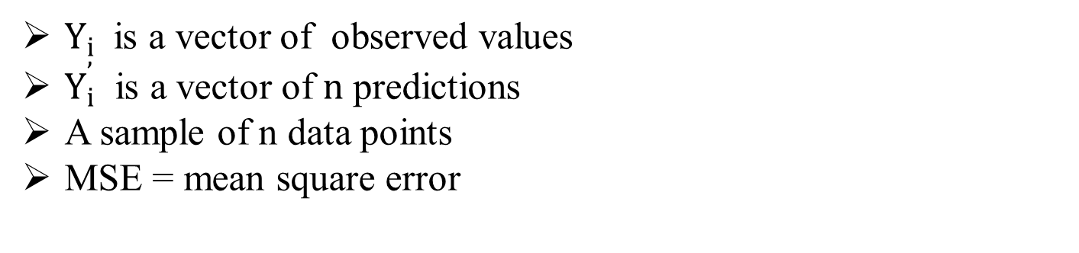
Training of Our Model
Loss Function
$Y_{i}$ is a vector of observed values
$Y_{i}^{’}$ is a vector of $n$ predictions
A sample of n data points
MSE = mean square error

Slide 22
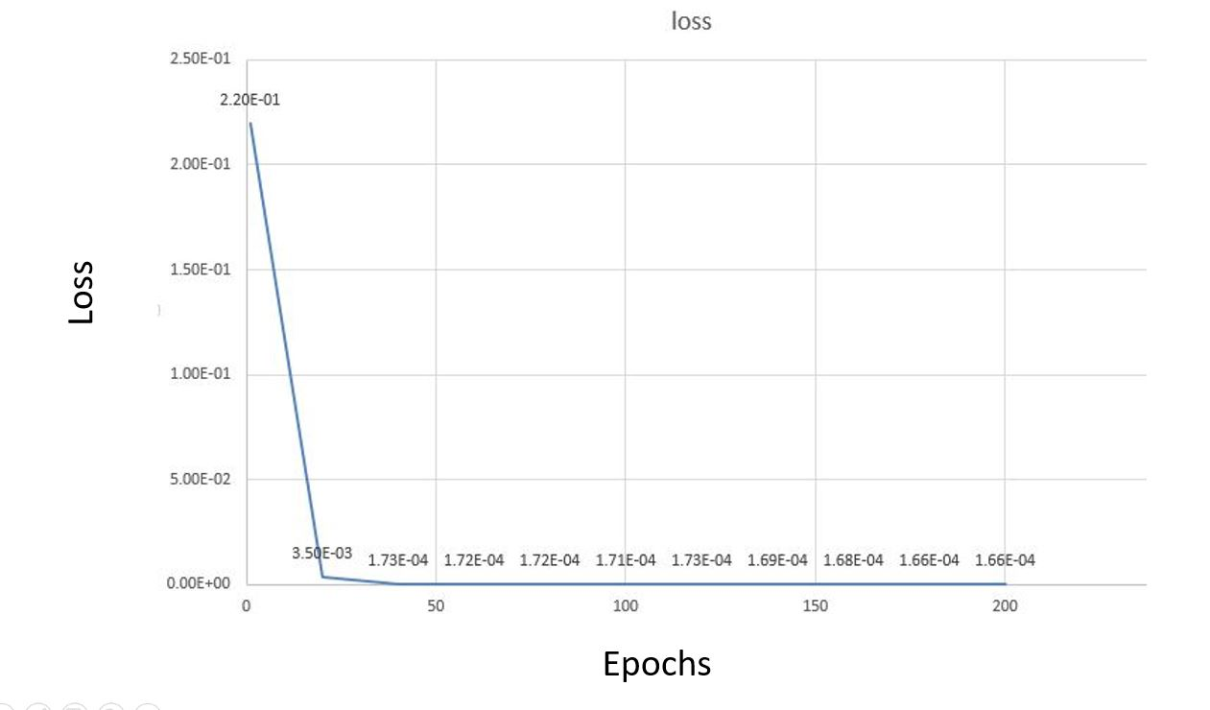
Performance Analysis
Effect of Epochs to Learn the Patterns

Slide 23
Performance Analysis
Effect of Epochs to Learn the Patterns
More loss at less epochs
Happening of saturation after 150 epochs
Low loss function values approximately 1.66E-04
Learned the pattern properly

Slide 24
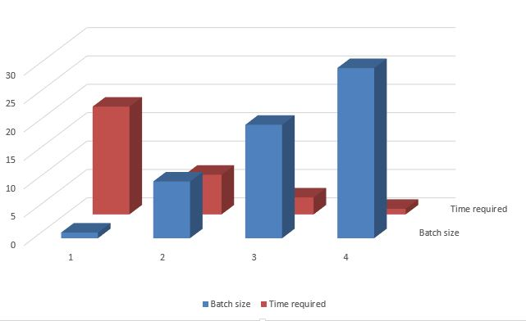
Performance Analysis
Effect of Mini-batch Gradient Descent:

Slide 25
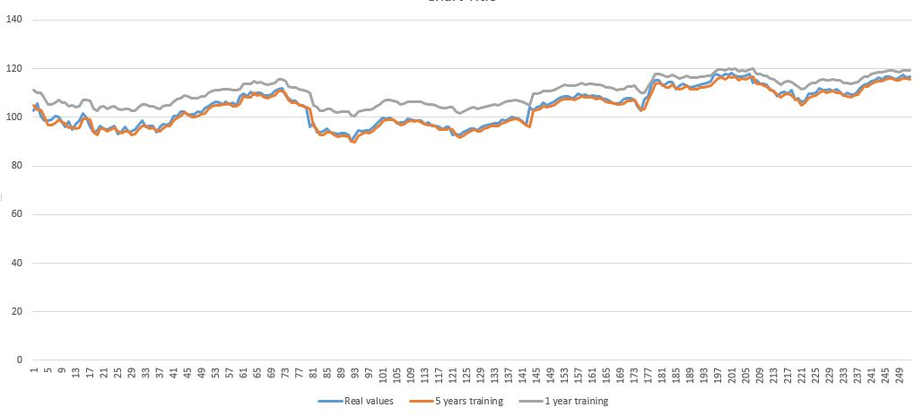
Performance Analysis
Effect of Training Periods:

Slide 26
Performance Analysis
Effect of Training Periods:
Bad prediction with less training data
Good prediction with more training data

Slide 27
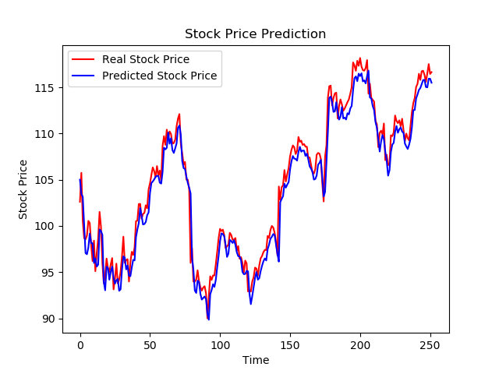
Performance Analysis
Predicted Results:
RMSE=0.013996
Apple Inc.

Slide 28
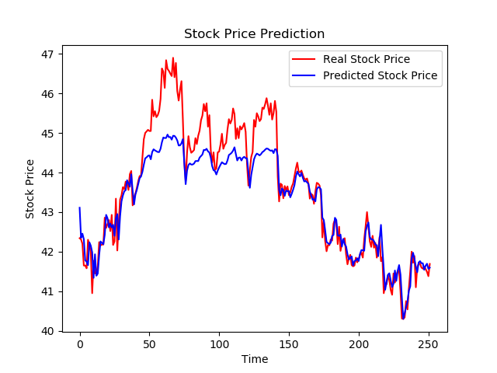
Performance Analysis
Predicted Results:
RMSE=0.0144508
The Coca-Cola Company

Slide 29
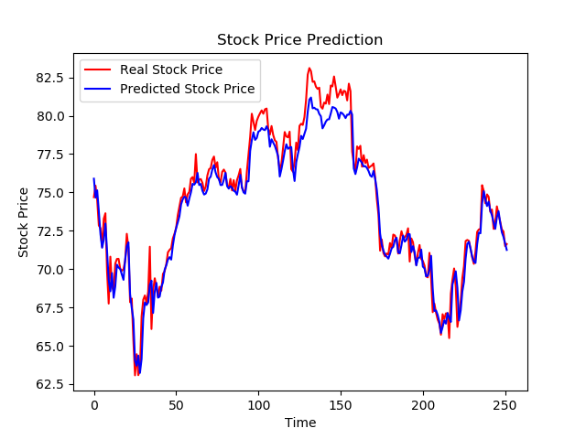
Performance Analysis
Predicted Results:
RMSE=0.0127464
Lowe's Companies, Inc

Slide 30
Future Works
Making of artificial agent
Financial analysis
Adding more features

Slide 31
Conclusion
Thank You

Slide 32
References

Slide 33
References

Slide 34
References

