Slide 1

World Energy Consumption
Tara Shingadia

Slide 2
Problem Definition and Tools
What does energy consumption and production look like over the years?
What is the distribution of energy usage by continent and by country?
Is there a correlation between energy usage and economic growth?
Has the energy usage per person increased over time?
Used Python for analysis
Matplotlib
Sklearn
Plotly
Seaborn

Slide 3
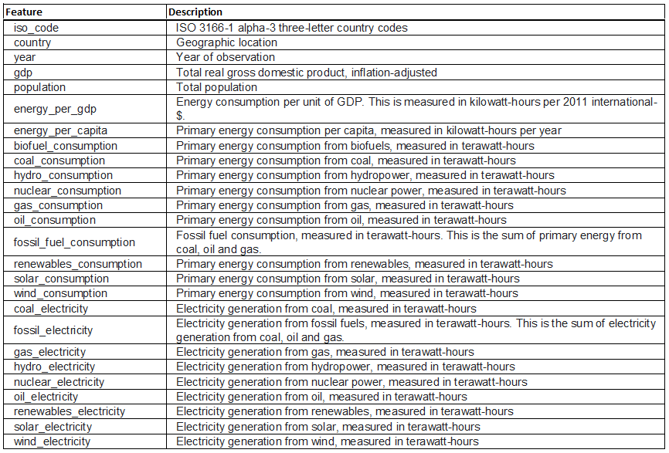
Data Dictionary
26 features
Data from 1990 to 2020
World Energy Consumption Data from Kaggle

Slide 4
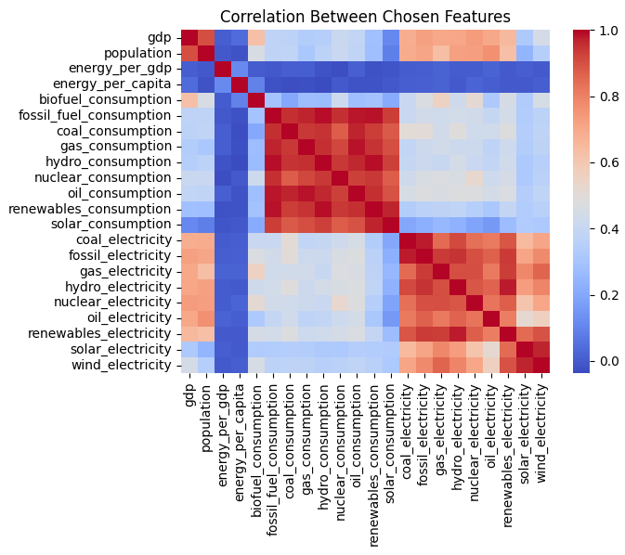
Correlation Overview
Includes all features used for analysis

Slide 5
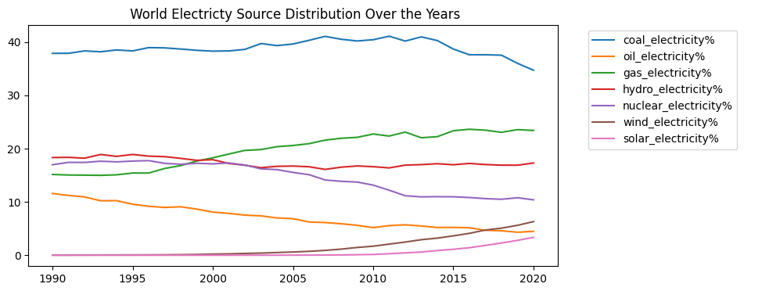
World Energy Trends

Slide 6
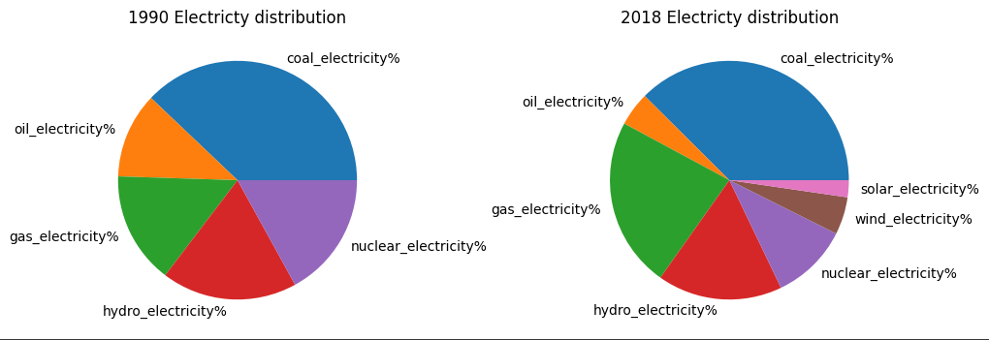
World Electricity Comparison

Slide 7
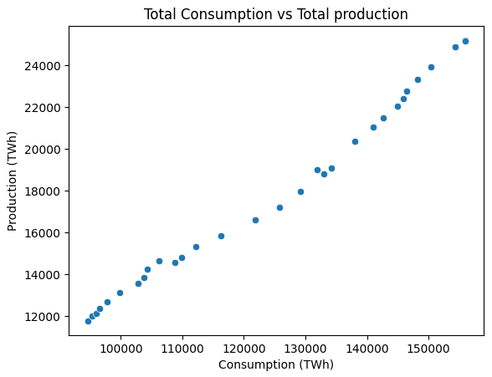
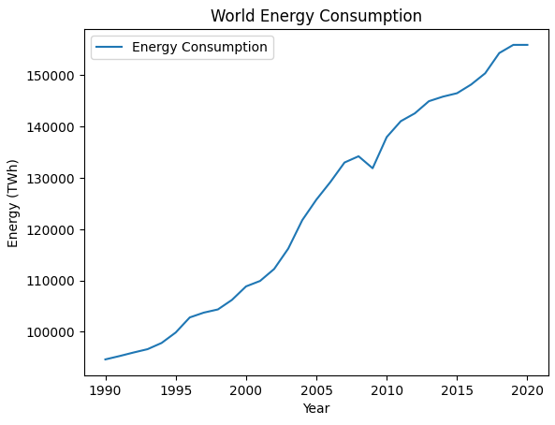
Energy Trends

Slide 8
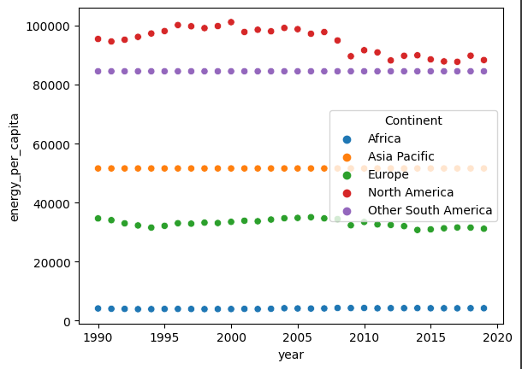
Energy Usage per Capita Over the Last 30 Years

Slide 9
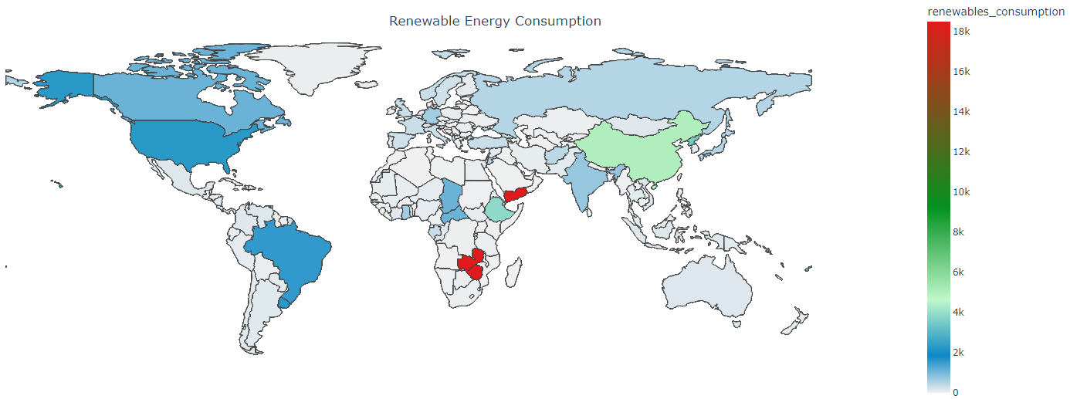
Renewable Energy Consumption
Zambia, Zimbabwe, and Yemen have a high renewable energy consumption

Slide 10
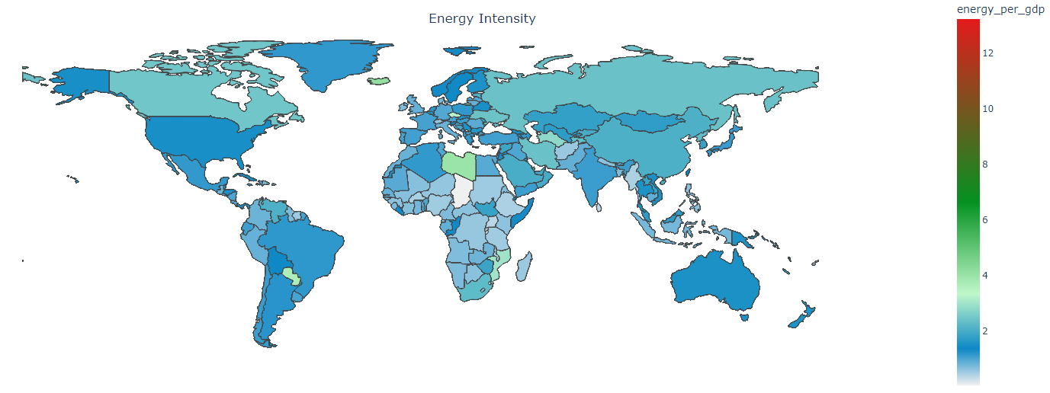
Energy Consumption per GDP
Iceland, Libya, and Paraguay have the highest energy consumption per GDP
Notes:
Emphazises the efficiency of energy use

Slide 11
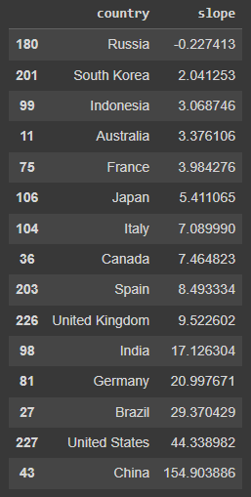
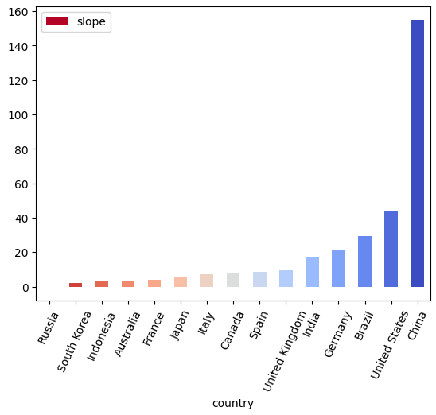
Renewables Consumption
Top 10 countries with the highest GDP
Countries with the highest increase in renewable energy consumption over the years:
China,
The United States
Brazil

Slide 12
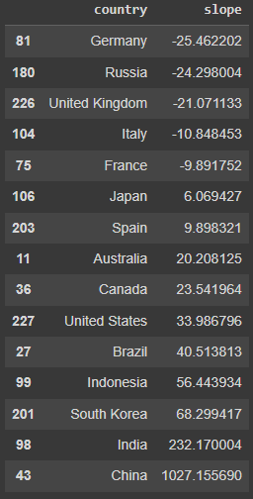
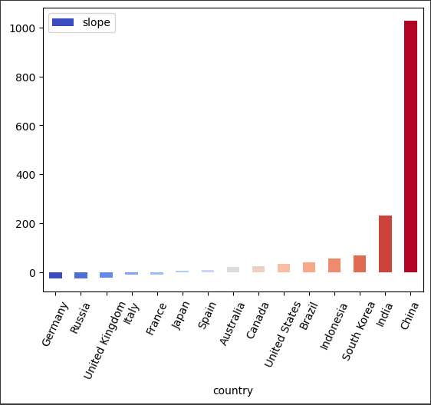
Fossil Fuels Consumption
Top 10 countries with the highest GDP
Countries with the highest increase in fossil fuels consumption over the years:
China
India
South Korea

Slide 13
Conclusion
World energy consumption is increasing but is quite stable per capita
Of the countries with the highest GDP, China is the largest consumer of both renewable and fossil fuel energy
Wind and Solar energy are on the rise
Nuclear and Oil energy usage is on the decline

Slide 14
Thank you!

