Slide 1

Cab Company Analysis
7/20/2023
Terry Chou

Slide 2
Data
Customer Data
Customer ID
Gender
Age
Income (USD/Month)
Transaction Data
Transaction ID
Customer ID
Payment_Mode
Cab Data
Transaction ID
Date of Travel
Company
City
KM Travelled
Priced Charged
Cost of Trip
Additional column:
Profit: Priced Charged - Cost of Trip
Holiday Data(external data)
Date
Holiday
Weekday
City Data
City
Population
Users counts

Slide 3
Hypothesis
Do the demand for cab service has seasonality, and do different companies experience different pattern
Which company is more profitable, what are factors that influence the profit
What are the structure for customer age, income, gender, and payment method for each company
Which company has better customer loyalty
How do the cab companies perform in different locations/cities
Do holidays have an impact on the demand for cab service

Slide 4
Seasonality

Slide 5
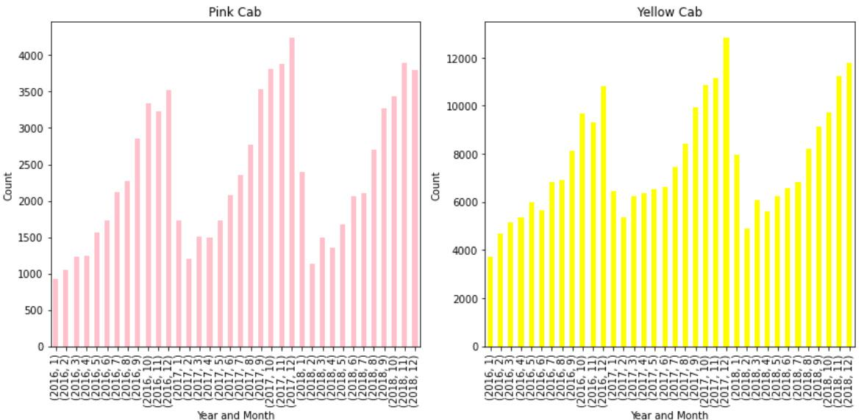
Seasonality (Year & month demand)
Highly similar year-month seasonality pattern for demand.
Low at the beginning of the year.
Gradually increases until the end of the year.

Slide 6
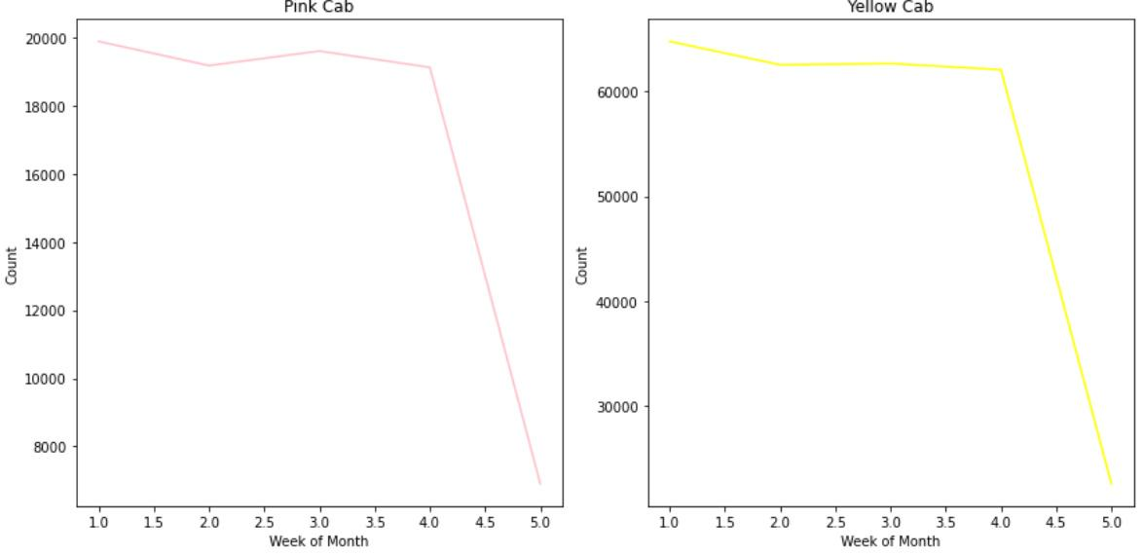
Seasonality (by week)
Have similar pattern for weekly demand.
Consistently high demand until the final week of the month

Slide 7
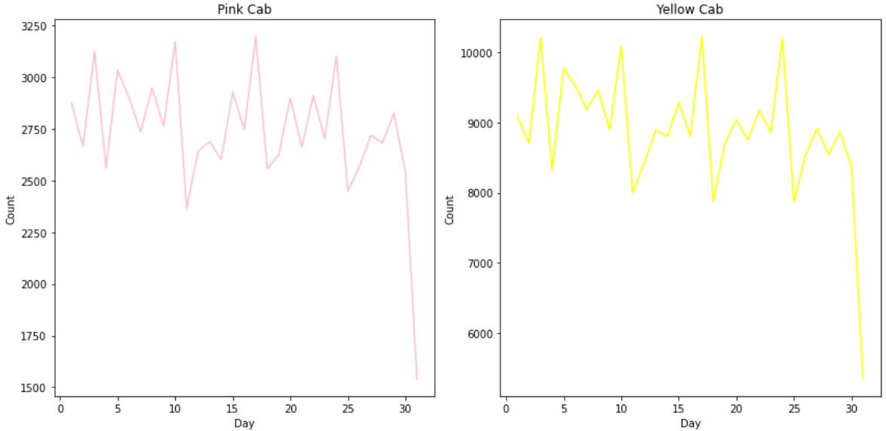
Seasonality (by day of the month)
Have similar pattern of daily demand.
Experience highly similar peak and trough pattern

Slide 8
Insights
Both company have the same pattern of seasonality for demand.
The demand starts low at the beginning of the year and gradually increases until the end of the year.
The demand for cab decline rapidly at the end of the month

Slide 9
Profitability

Slide 10
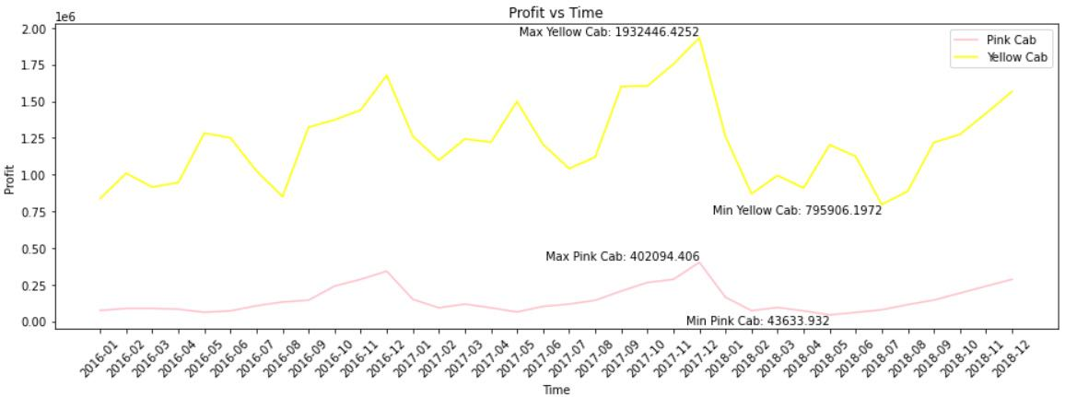
Profit Comparison
 | Yellow Cab | Pink Cab
Max monthly profit | $ 1932446.43 | $ 402094.41
Min monthly profit | $ 795906.20 | $ 43633.93

Slide 11
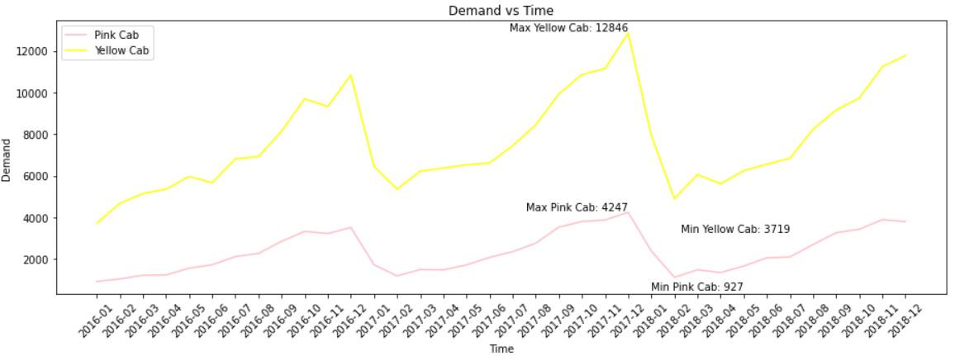
Demand Comparison
 | Yellow Cab | Pink Cab
Max. user counts | 12846 | 4247
Min. user counts | 3719 | 927

Slide 12
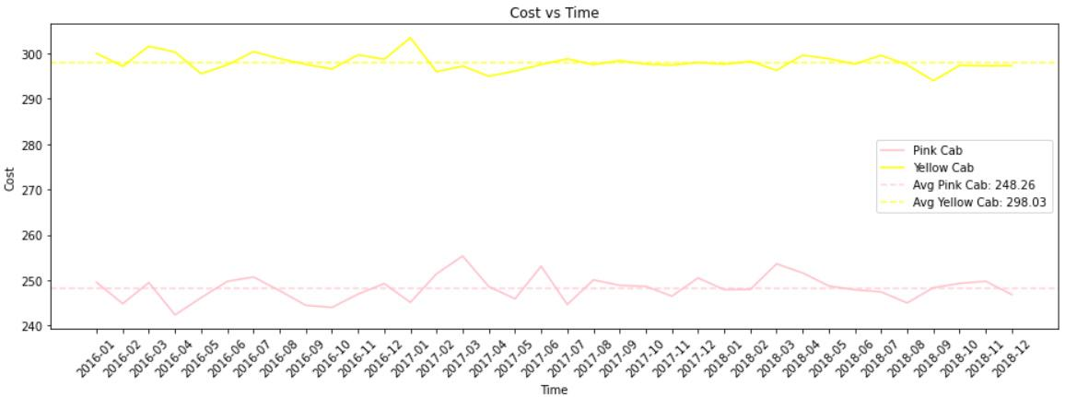
Cost Comparison
The cost per trip for both company stays fairly consistent throughout the period.
Yellow cab average cost: 298.03
Pink cab average cost: 248.26

Slide 13
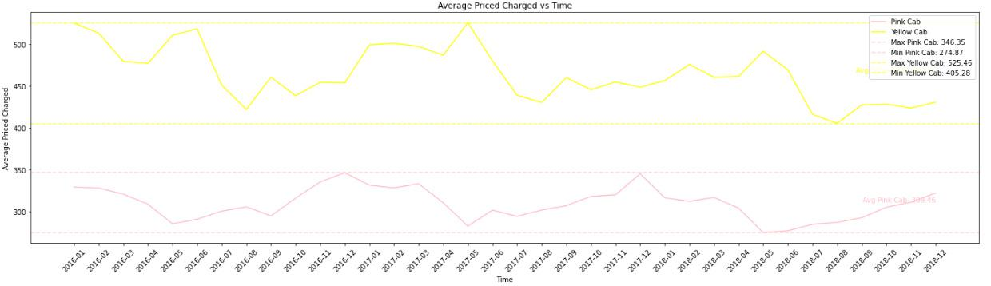
Price Comparison
 | Yellow Cab | Pink Cab
Max price | $ 525.46 | $ 346.35
Min price | $ 405.28 | $ 274.87

Slide 14
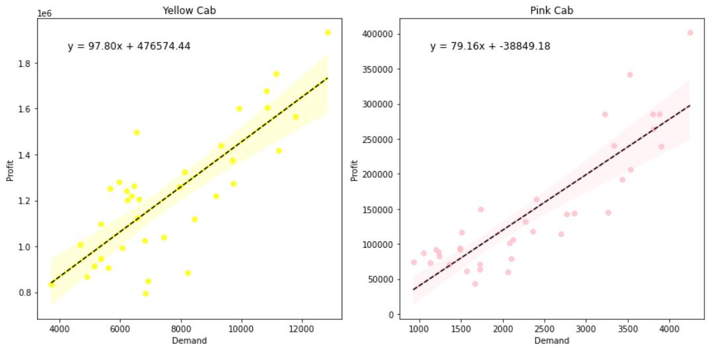
Correlation between profit and demand
Yellow Cab:
Positive correlation
profit = demand * 97.80 + 476574
Pink Cab:
Positive correlation
profit = demand * 79.16 -38849
The change in demand has slightly greater impact on the profit of yellow cab since the yellow cab has a larger slope.

Slide 15
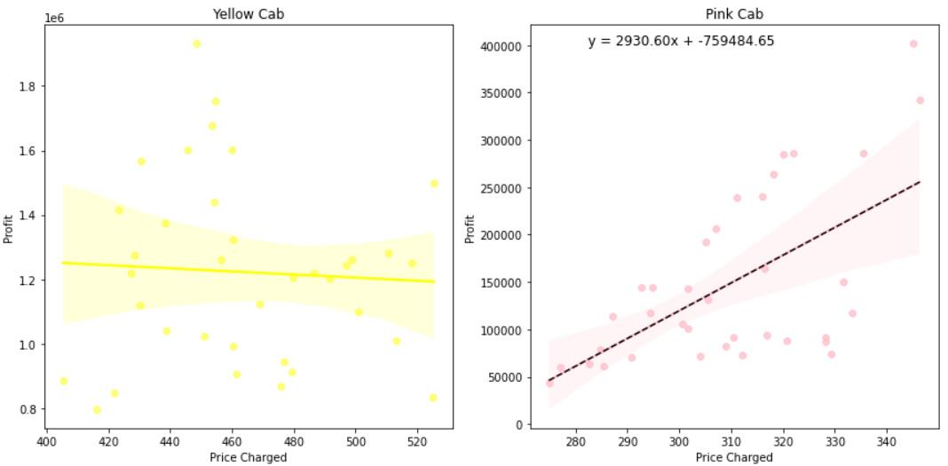
Correlation between profit and price
Yellow Cab:
No clear correlation
PInk Cab:
Positive correlation
price *2930.6 -759484.65

Slide 16
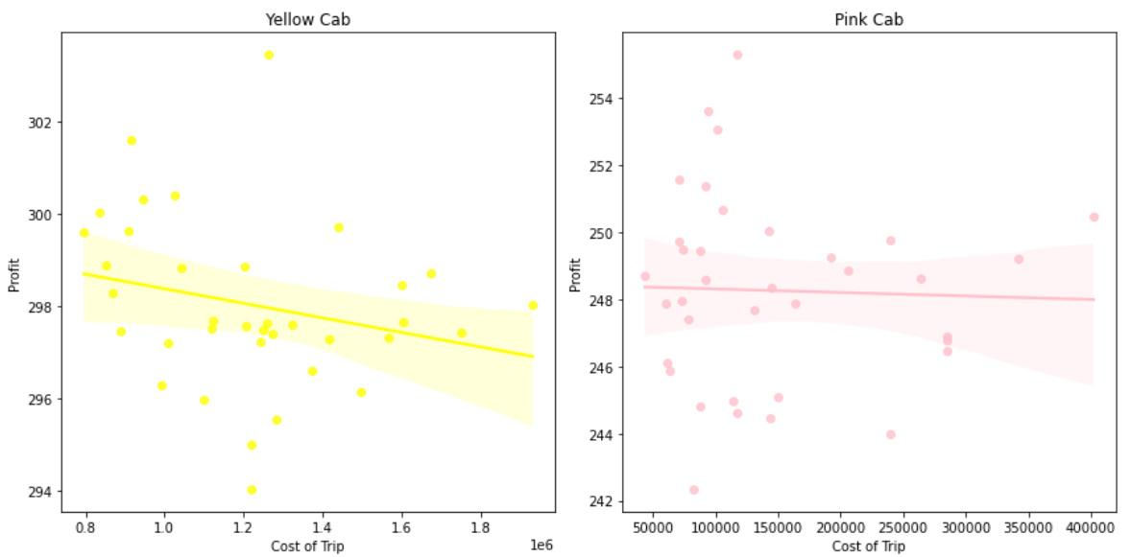
Correlation between profit and cost
Weak correlation between profit and cost.

Slide 17
Insights
Yellow Cab is significantly more profitable than Pink Cab.
Demand has a strong correlation with profit.
Cost doesn’t show correlation with profit
Price and profit:
Positive correlation for Pink Cab; No clear correlation for yellow cab
 | Yellow Cab | Pink Cab
Profit | High | Low
Demand | High | Low
Price | High | Low
Cost | High | Low

Slide 18
Customer Structure and Attribute

Slide 19
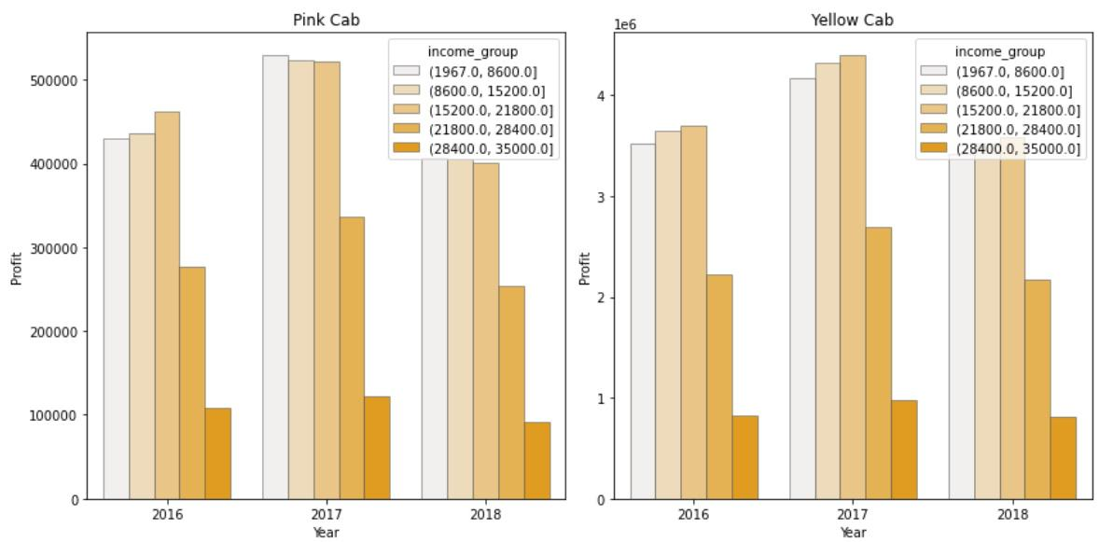
Profit by different Income group
Profit | Income group
Highest | 1.9k ~ 8.6k 86.k ~ 15k 15k ~ 21k
Medien | 21k~28k
Lowest | 28k~35k
Profit | Income group
Highest | 1.9k ~ 8.6k 86.k ~ 15k 15k ~ 21k
Medien | 21k~28k
Lowest | 28k~35k
Similar income group proportion each year for both companies

Slide 20
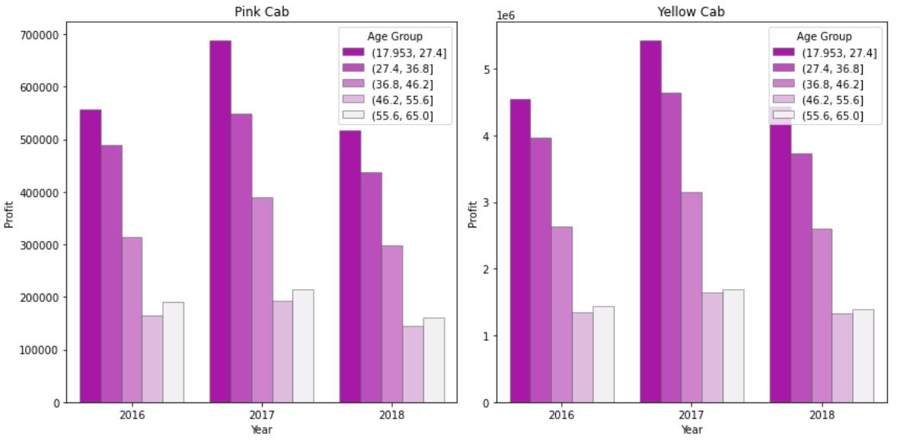
Profit by different age group
Pink Cab:
18~27 > 27~ 36 > 36~46 > 56~ 65> 46~56
Yellow Cab:
18~27 > 27~ 36 > 36~46 > 56~ 65> 46~56
Similar age group proportion each year for both companies

Slide 21
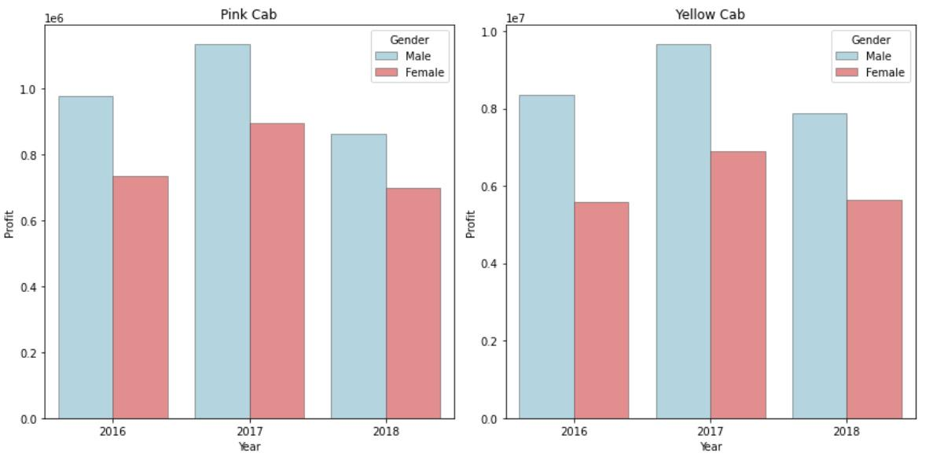
Profit by different gender
Pink Cab:
18~27 > 27~ 36 > 36~46 > 46~56 > 56~ 65
Pink Cab:
Male > female
Yellow Cab:
Male > female
Similar gender proportion each year for both companies

Slide 22
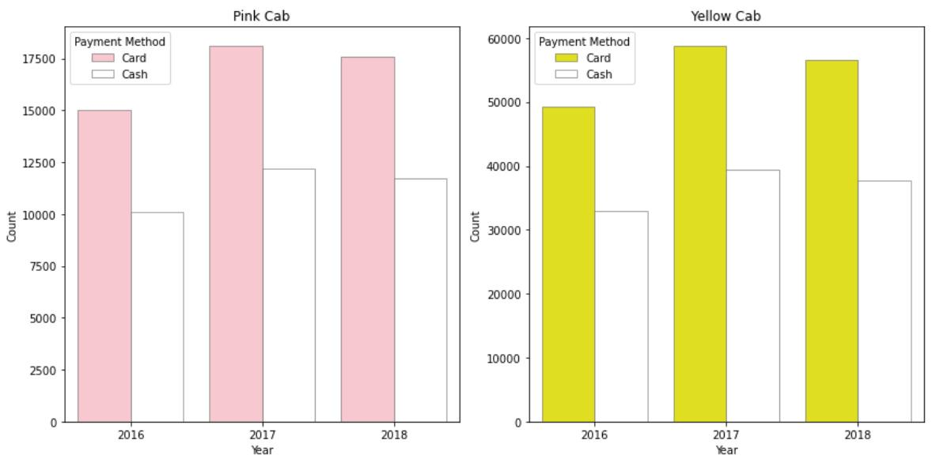
Payment method counts
Pink Cab:
Card > cash
Yellow Cab:
Card > cash
Similar payment method proportion each year for both companies

Slide 23
Insights
Both companies have similar profit proportion for income, age, gender
Both companies have similar payment method proportion (card vs cash)
No recommendation could be made in terms of which company is better to invest in for this section of analysis.

Slide 24
Customer Loyalty

Slide 25
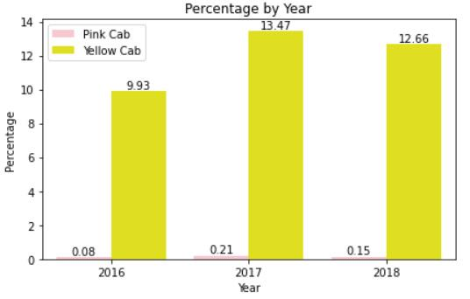
Customer who uses cab service in 6 different month
Yellow Cab:
around 10% of customers use their service in 6 different month every year.
Pink Cab:
around 0.1% ~ 0.2% of customers use their service in 6 different month every year.

Slide 26
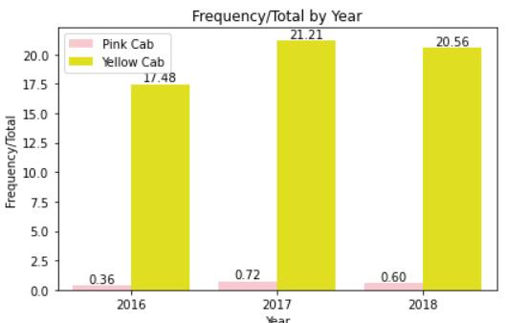
Customer who uses cab service more than 5 times
Yellow Cab:
above 15% of customers use their service more than 5 times each year.
Pink Cab:
less than 1% of customers use their service more than 5 times each year.

Slide 27
Insights
On top of having a larger user base, yellow cab also has higher percentage of loyal users that return to use their service.
Pink cab do not have significant proportion of loyal users. They have less than 1% of users that consistently return to use their service.

Slide 28
Performance in difference Location

Slide 29
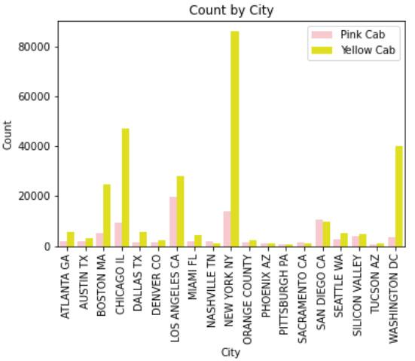
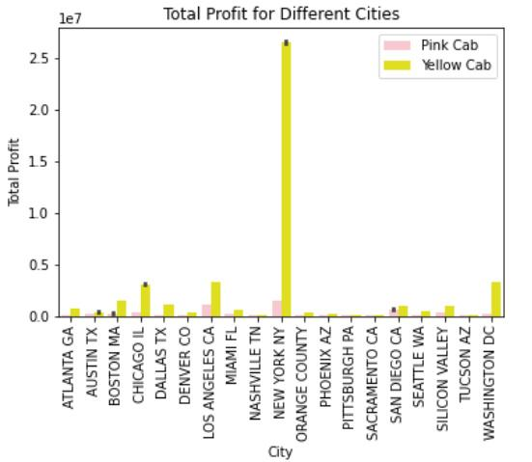
User counts & profit in different cities
Yellow cab has more users in most cities, and is more profitable by huge margin.

Slide 30
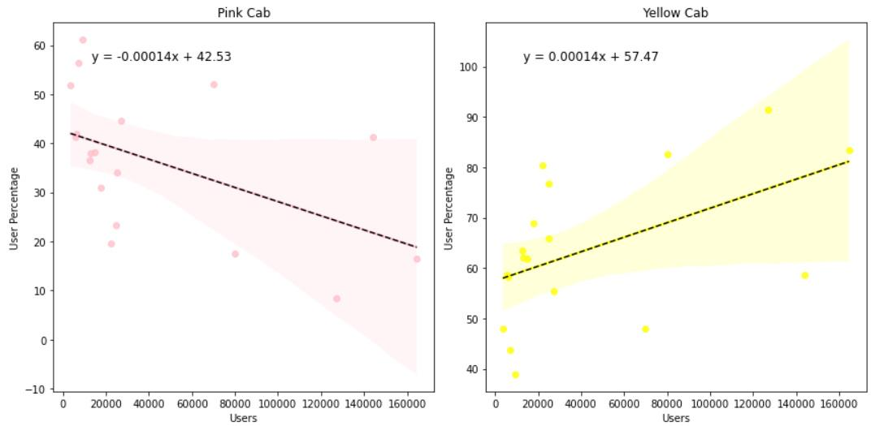
User proportions vs User counts
Pink Cab:
User percentage = -0.00014* total users +42.53
Yellow Cab:
User percentage =
0.00014* total users +57.47
According to the trend line, as the total user counts get larger:
Yellow Cab takes up a larger proportion of users
Pink Cab takes up a smaller proportion of users

Slide 31
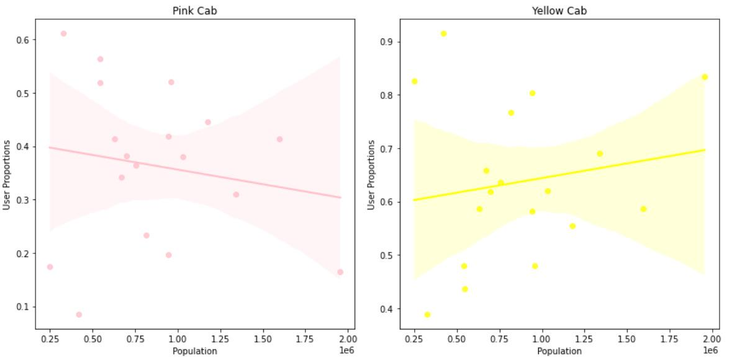
User Proportions vs Population Size
Pink Cab:
Plots are scattered
No clear correlation
Yellow Cab:
Plots are scattered
No clear correlation
No clear relationship between user proportion & population size can be derived for both companies.

Slide 32
Insights
Possible correlation:
As user amount increases → Yellow Cab takes up a larger proportion of users
As user amount increases → Pink Cab takes up a smaller proportion of users
On the other hand:
User proportion and total population don’t express clear relationship

Slide 33
Holiday

Slide 34
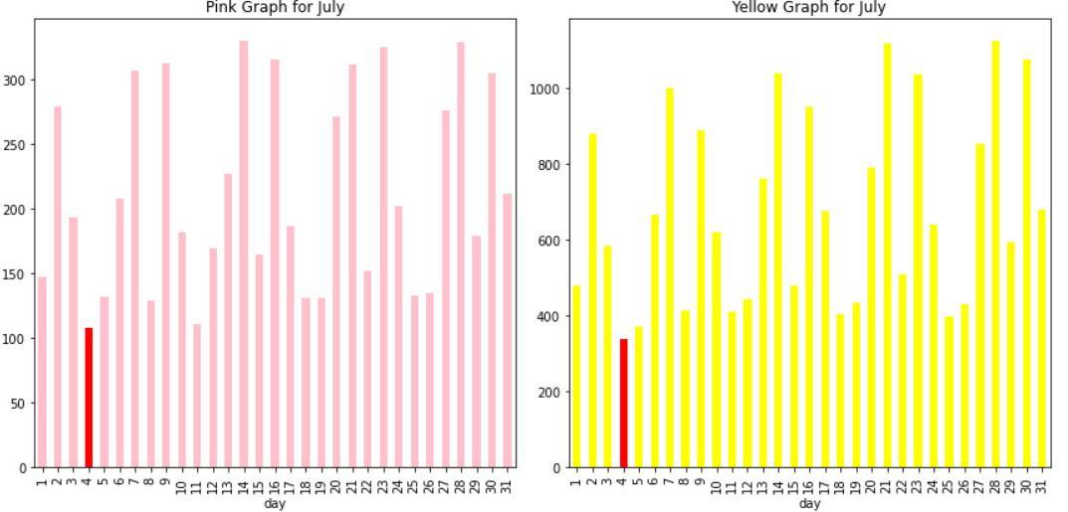
Holiday Demand (July 4th)
Demand of July 4th is low
The seasonality of demand does not express anything unique around July 4th
Thee impact of this holiday on demand of cab service is very small

Slide 35
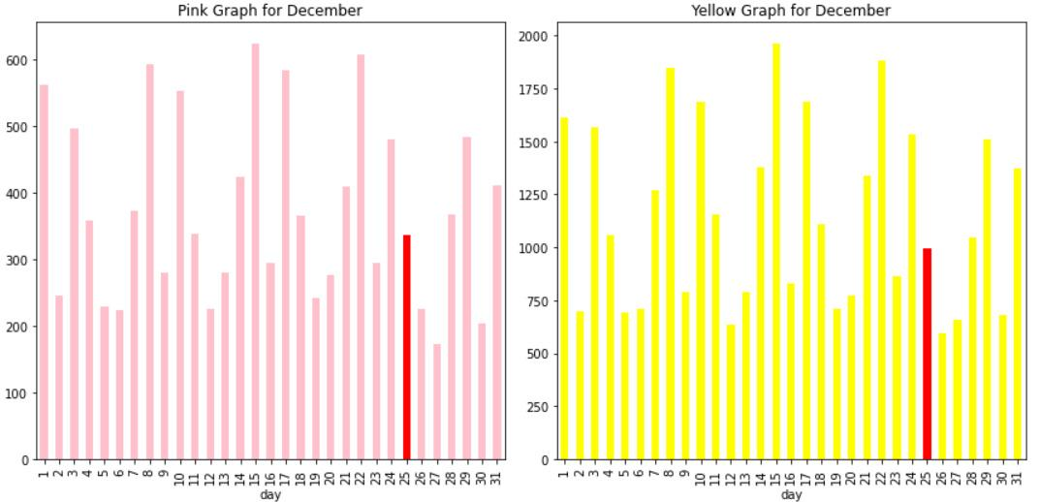
Holiday Demand (Christmas)
Demand on Christmas is quite low
The seasonality of demand does not express anything unique around Christmas
Thee impact of this holiday on demand of cab service is very small

Slide 36
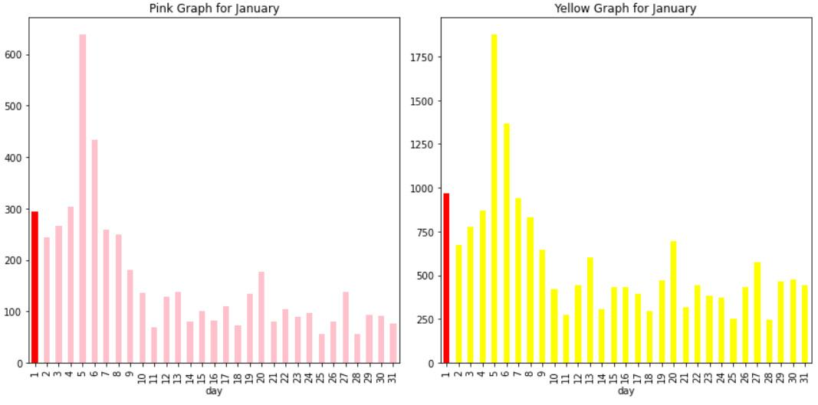
Holiday Demand (New Year)
Demand New Year day (1/1) is higher than the days that follow closely
Demand is very high on 1/5, but it’s hard to say whether it’s due to the impact of new year day.

Slide 37
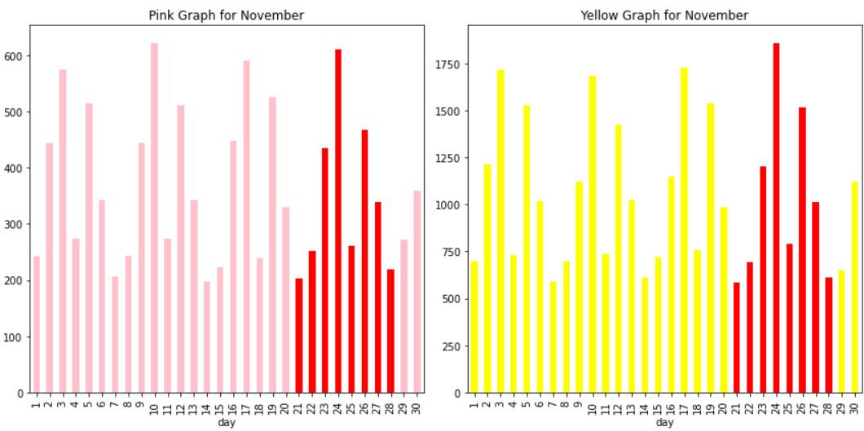
Holiday Demand (Thanksgiving)
The demand in the Thanksgiving week is almost identical to the previous demand patterns
The influence of thanksgiving on demand of cab service is very little

Slide 38
Conclusion
Yellow & Pink Companies have similar characteristics in
Seasonality of demand
Customer income, gender, age, payment method structure
XYZ company should invest in Yellow Cab
Yellow Cab is more profitable throughout the entire period
Yellow Cab has significantly higher proportion of loyal customers
Takes up the majority of business in most cities

Slide 39
Thank You

