Slide 1
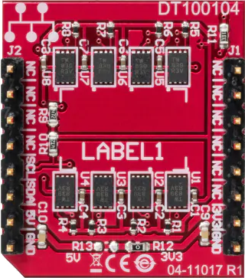
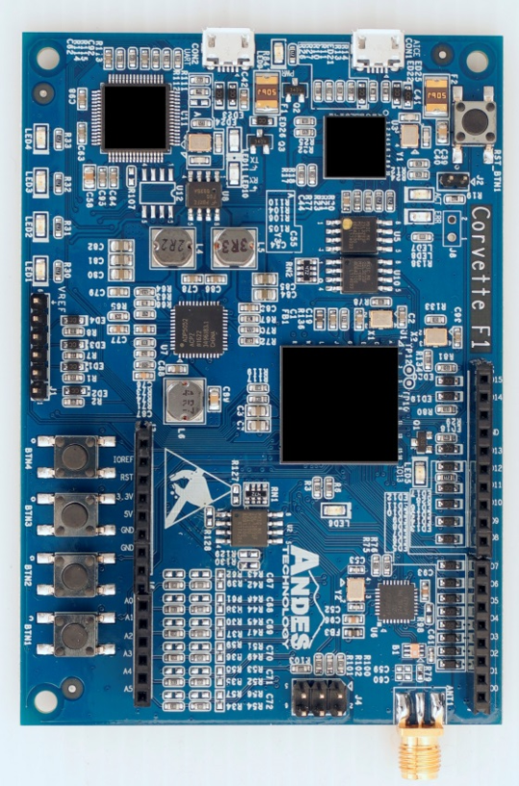
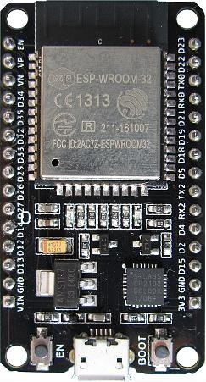
USB port of
Windows/Linux PC
CON2 UART
SCL
SDA
3V3
GND
IO15
IO14
3V3
GND
3V3
RX2
GND
TX2
IO3
IO2

