Slide 1

Web Programming Final Project Report
Tạ Minh Quân – 20194824
Vũ Hoàng Nam - 20194809

Slide 2
Outline
Introduction
Features
Member Contribution
Q&A

Slide 3
1. Introduction
Our web application is a restaurant table booking (reservation) system

Slide 4
1. Introduction
Technology stack:
PHP
Javascript
Bootsrap
MySql
Follow MVC model

Slide 5
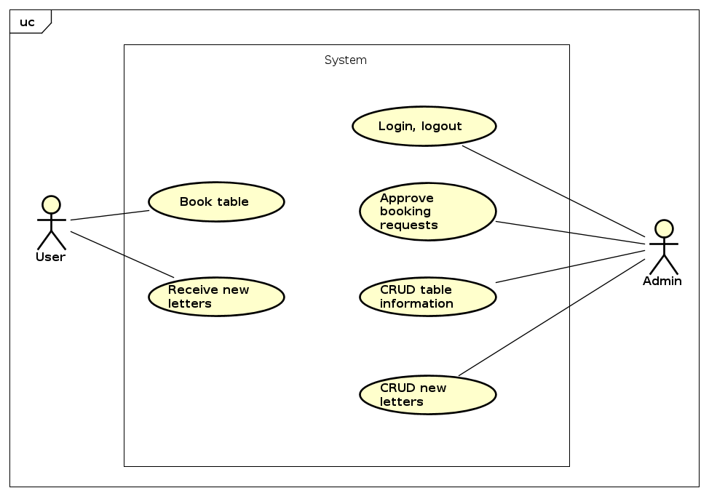
2. Features
Use cases

Slide 6
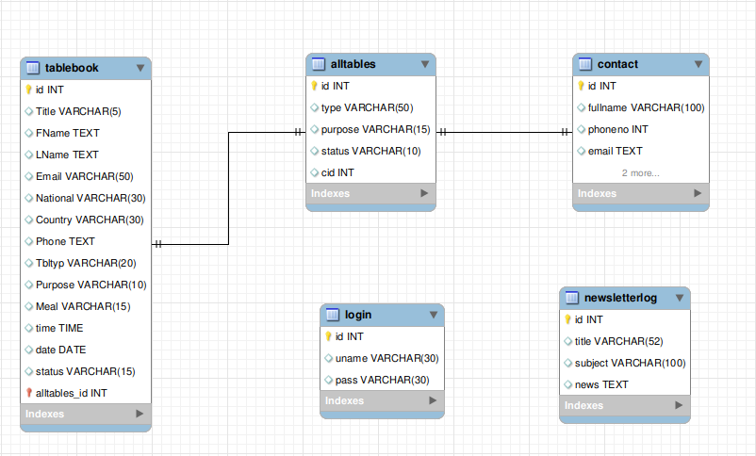
2. Features
ER diagram

Slide 7
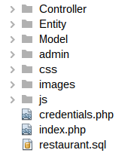
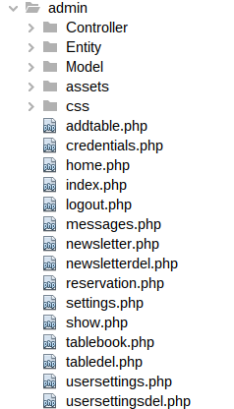
2. Features
Project structure
User side
Admin side

Slide 8
3. Member Contribution
Tạ Minh Quân:
Login, Logout, Change admin accounts info
CRUD functionality for tables
CRUD functionality for newsletters
Vũ Hoàng Nam:
Table Booking
Subscribe for newsletters
Manage table booking information

Slide 9
4. Demo

Slide 10
5. Q&A

