Slide 1





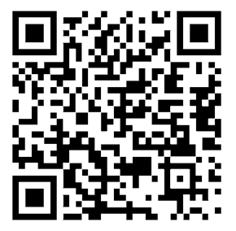
READY TO KICKSTART YOUR THESIS?????????
R-club
GET AHEAD OF SCHEDULE
WITH HELP FROM THE
R-CLUB
U READY?
THIS
AND
EVERY
WEDNESDAY
@ 12-14 S124 SØRHELLINGA
R Cheat sheets - Self-help guides
Free books on R - Facebook group
Map to the classroom – Tips
Every Wednesday | 12:00-14:00 | S124 Sørhellinga

