Slide 1

The Complete Journey
Campaign Success and
Customer Conversion
Presented by Tabitha Diaz
PHOTO BY TOM WERNER/GETTY IMAGES
Notes:
Hello all! Thank you for being here today, my name is Tabitha Diaz and I will be presenting
The complete journey: campaign success and customer conversion. We are at the time of year when
Any amount of saving helps… from holiday gifts, to large family meals, we are always on the search for great deals.
That’s why there are so many coupon websites presenting some of the most competitive deals around. In the last couple of
years we have worked tirelessly to provide the best deals for our loyal customers. This presentation will
Dive into the numbers and see how successful we have been.

Slide 2
Agenda
Overview
Customer Demographics
Campaign Analysis
Customer Conversion Rate
Suggestions for the Future
Further Analysis
Notes:
Today we will be going over a brief overview of the data.
Then we will touch on our customer demographics for our sample.
Then we will go into a campaign analysis, customer conversion rate,
suggestions for the future based off of our findings, and further analysis

Slide 3

Dataset overview
Collected data from 2,500 households
30 campaigns held over a two-year period
3 different implementation types:
Type A
Type B
Type C
Notes:
We collected data from 2,500 households
- This sample represents some of our most frequent shoppers.
Across all our stores we have implemented:
30 Campaigns held over a two-year period
We have done this through 3 different implementation types:
Type A
- Customers received 16 coupons from the pool of possible coupons.
- These coupons were selected based on previous purchase behavior.
Type B
Type C
-Type B and Type C all participating customers were provided the same coupons though we ran TypeB more frequently than TypeC which we will explore later during this presentation.

Slide 4
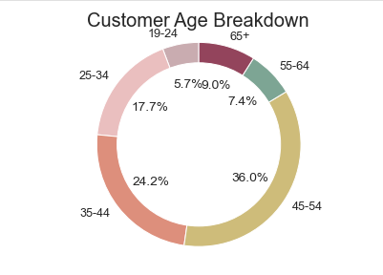
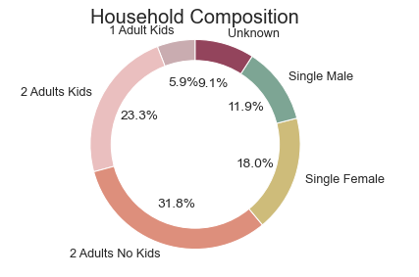
Customer demographics
- We collected customer demographics from our 2,500 selected households.
Notes:
As we can see from our Customer age breakdown most of our customers range between ages 35-54. When broken down further we see that customers aged 35-44 make up 24.2% of our sample and customers aged 45-54 make up 36%. Our lesser performing age is between 19-24.
As for household composition a little over 50% of our customers consist of 2 adults with or without kids, for two adults with children they make up 23.3% of our sample, where 2 adults with no children represent 31.5% of our sample. Our lesser performing household composition is 1 adult with a kid at 5.9%. We must also take note to the fact that around 9% of our customers did not provide information on their household composition and that is represented by unknown.

Slide 5
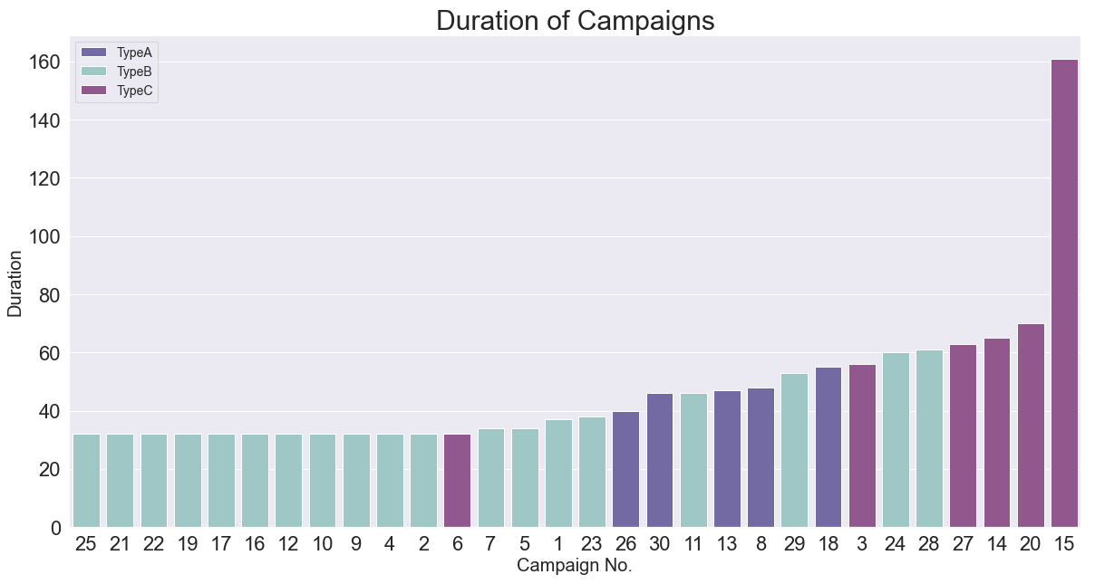
Notes:
Here we have a breakdown by campaign duration time with color showing campaign type.
Our longest running campaign was campaign 15 which can be seen on the far right hand side and it lasted a total of 161 days when most of our other campaigns ranged from 30- 70 days in length. That is a little over double the length of our other campaigns.
The average run length across all of our campaigns in around 47 days.

Slide 6
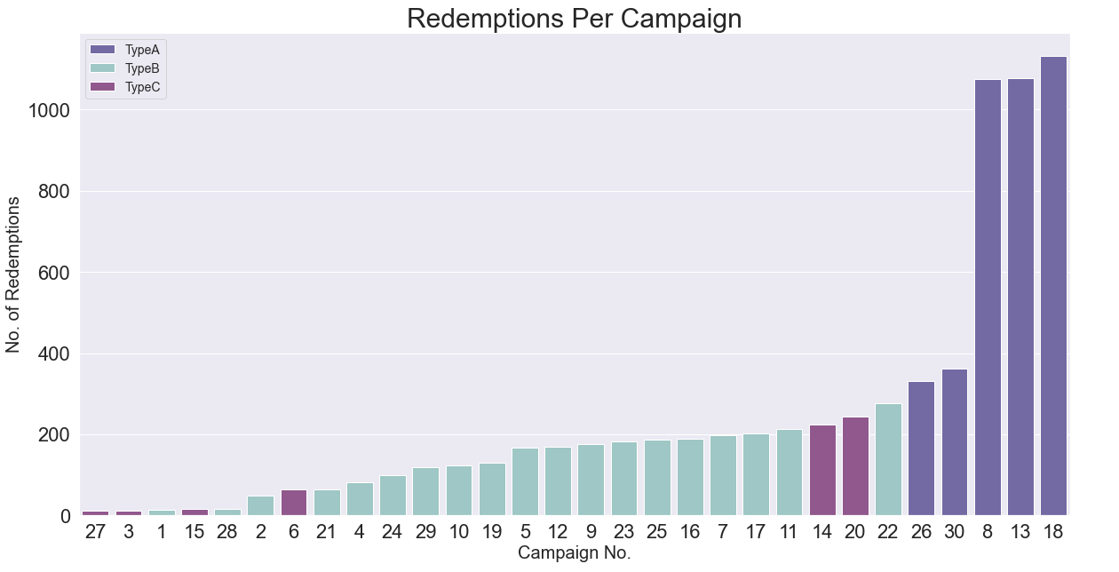
Campaign Analysis
6
Notes:
To take a further look at our campaigns successes we have broken down the campaign no. by redeems per each type.
Here we can see that campaigns that fall under Type A on the far right are redeemed at a higher rate that those under Type B or Type C.
It is also important to note that Type A campaigns make up only 5/30 campaigns we have ran during the 2 year period.
Campaigns under Type C represent the lowest amount of coupon redemptions overall though they represent the longest running campaigns as mentioned in the previous slide.

Slide 7
a/b testing
A/B Testing is a method of comparing two versions of a campaign against each other in order to determine which one performs better.
Type A
Contacted: 3979
Converted: 1791
Type B
Contacted: 2655
Converted: 454
Type C
Contacted: 574
Converted: 73
VS.
VS.
VS.
Type B
Contacted: 2655
Converted: 454
Type C
Contacted: 574
Converted: 73
Type A
Contacted: 3979
Converted: 1791
Successful : Type A
z_stat: 23.540, p_value: 0.000
Reject the null hypothesis - suggest the alternative hypothesis is true
Successful: Type B
z_stat: 2.576, p_value: 0.005
Reject the null hypothesis - suggest the alternative hypothesis is true
Successful : Type A
z_stat: 14.709, p_value: 0.000
Reject the null hypothesis - suggest the alternative hypothesis is true
Notes:
To further explore which campaign type was the most successful overall I preformed several A/B tests.
Just for clarification:
A/B Testing is a method of comparing two versions of a campaign against each other in order to determine which one performs better.
Under this guideline I performed three different A/B test.
For my test I used a significance level of .05 or 5% and to determine success rate I used the p_value.
A low p_value means that the difference between the two is statistically significant.
In this case a p_value of 0.05 or lower is considered statistically significant based off the significance level.
First - Type A VS. Type B – and found that Type A was more successful because the p value was 0.
I repeated these steps for the following two A/B tests.
Second - Type B VS. Type C – and found that type B was more successful because the p value was 0.005.
Lastly - Type A VS. Type C – and Type A was more successful because the p value was equal to 0.
These results led me to conclude that our best performing campaign type overall was Type A.
Now that we know that Type A campaigns ran best overall. Let's take a look at our customer conversion rate.
The p_value also known as the probability value shows how likely it is that your data could have occurred under the null hypothesis.
The null hypothesis is an accepted fact until proved otherwise.

Slide 8
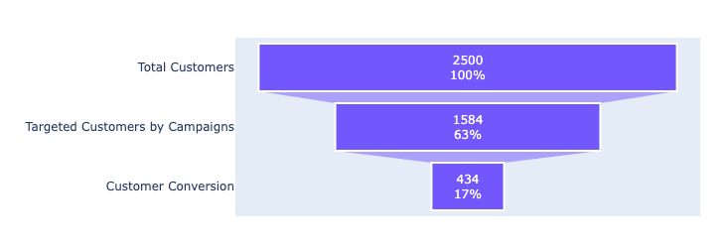
Customer conversion
Customer Conversion: 17%
Customer conversion rate is the percentage of potential customers who take a specific desired action.
Notes:
Customer conversion rate is the percentage of potential customers who take a specific desired action.
In this case it is the amount of customers that redeemed campaign coupons over the two year period.
Our data was collected from 2,500 customers which is represented by the top and is 100% of our sample.
We then decided to target a little over half of those customers with our 30 different campaigns. As a reminder our campaigns were split into 3 types.
As we saw in the A/B testing our best performing type overall was Type A.
In the last box we can see how many customers were converted which is 17%.
That just means that 17% of our customers actively participated in a campaign at some point within the two year time frame.
With a conversion rate of 17% we can tell that our campaigns are doing well across our sample.

Slide 9
Future suggestions
Develop
Develop a strategy for our lower age demographic.
Lean
Lean heavily into targeted campaigns.
Run
Run campaigns between 30 – 70 days.
Notes:
Develop a strategy to bring our younger customers into our stores.
- Whether through campaigns or special events/promotions
Lean heavily into targeted campaigns.
Specifically those created within Type A
A lot of our success lies in finding out the common buying trends of our customers and then leaning into that.
Run campaigns between 30-70 days as anything above that does not influence coupon redemption for a campaign.

Slide 10
Further analysis
Look into our busiest times across all stores.
Determine how income level influences use of campaigns.
Dive further into our customer demographics to improve future campaigns.
Notes:
Look into our busiest times across all of our stores.
To provide adequate staffing, in order to provide the best experience for our customers.
Determine how income level influences use of campaigns.
- As that was not explored through this analysis.
Dive deeper into our customer demographics to improve campaigns.
Though we have seen great success with our TypeA campaigns.
How can we improve this across the board with our other implementation types.

Slide 11

Contact Information:
Email – TabithaADiaz@gmail.com
Linkedin – www.linkedin.com/in/tabithadiaz
Website – sites.google.com/view/tabithadiaz/home
Tools Used:
Excel, SQL, Python
Notes:
That wraps up my presentation…I want to thank you for your time today.
Should you have any questions our want to connect I can be reached by email or linkedin and additional projects can be found on my website.
The tools I used for this analysis were excel, SQL, and Python.
And lastly I want to extend a huge thank you to the staff at Fullstack Academy and the New York City Tech to Talent Pipeline.

