Slide 1
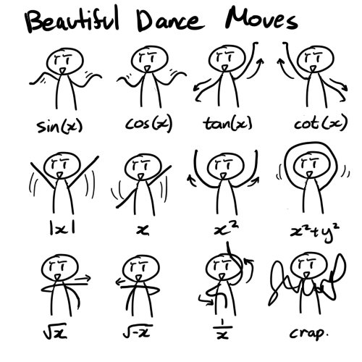
SpongeBob WavePants
GGJ17
This project was inspired by the following post which I think @standupmaths retweeted in 2011:

Slide 2
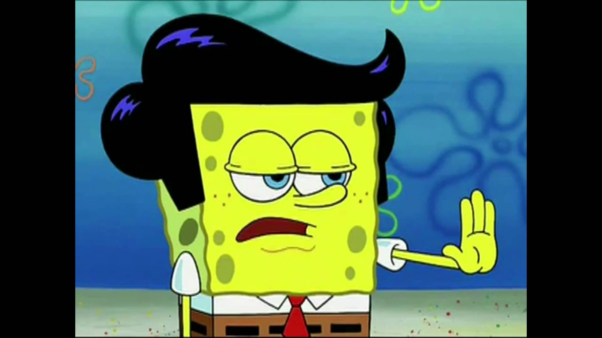
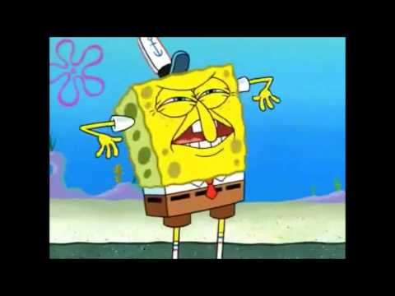
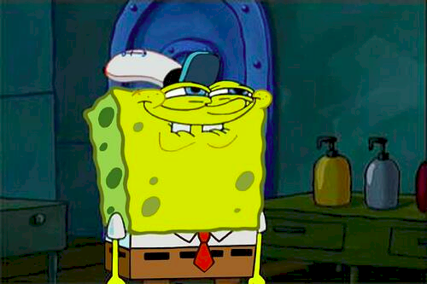
There is also an episode of Spongebob where his dancing resembles a sine wave
I believe this might have been from S7 Ep 1 – Second half (EP 127B) – I ♥ Dancing
https://www.youtube.com/watch?v=2N6AcMv2OGE
http://spongebob.wikia.com/wiki/I_%E2%99%A5_Dancing

Slide 3
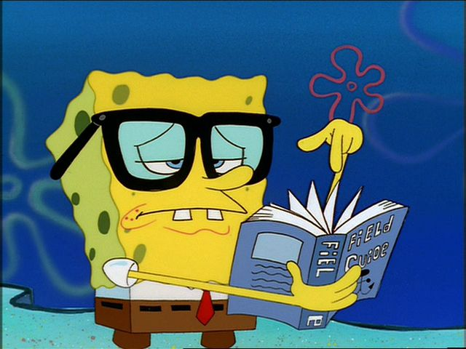

The Game
I don’t think I’ve created a game, but more of a fun educational tool, which might be used by kids to understand and play with different wave patterns
The game cheekily suggests that if you’re a nerd and can’t dance, then this might help disprove that (or not, I don’t know)

Slide 4
Possible Improvements
So surprisingly because I purposely picked an extremely easy idea – I managed to implement most of what I set out to
HSL Colours of background related to music, use mic for input, or key press to work out beats per minute?
History of 1x old functions, and tweening between old and new functions using speed variable 0-100% for new, and 100-0% for old

