Slide 1
Project NAO
By Fredrik Folkesson & Johan Nyholm

Slide 2
Plans and Goals
Initial Plan: Let the NAO robot lean to recognize faces and greet people it recognizes.
Final Plan: Let the NAO robot follow lines marked on the floor.
Additional: Learn how to use the NAO robot python API, its restrictions and potential for serving as a platform for implementing algorithms.

Slide 3
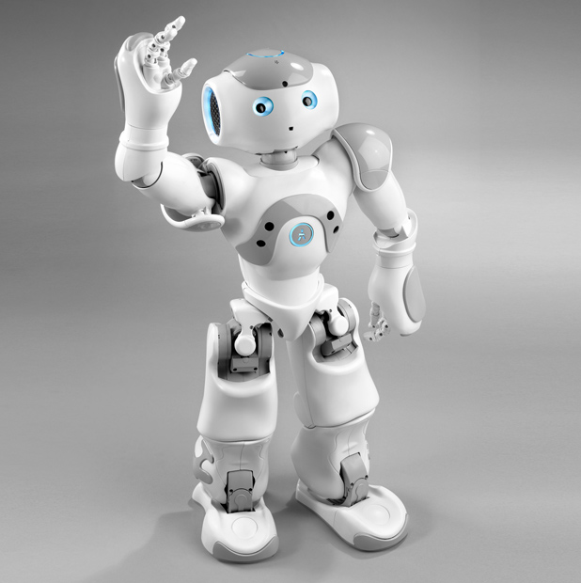
The Process 1
Coreographer, Python and C++.
Read up on the NAO Pyhon API.
Develop out first NAO Python scripts.
  Say ”Hello”
  Let the robot walk forward

Slide 4
The Process 2
Started researching how to do face detection and recognition.
NAO already had finished face detection and recognition modules.
  They were not optimal but we decided to try to follow a different path in out project.

Slide 5
New Project
Decided on new project to let NAO find and follow a wall.
Decided to use the NAO robots sonar to keep a constant distance to the wall.

Slide 6
Difficulties with NAO Sonar
Used NAO Sonar to measure distances to a wall.
Tried to use sonar readings to calculate how to navigate.
Sonars on the left and right side often gave inconsistent and erroneous measurements.
Difficulties with Sonar API, and inconsistency in documentation.
Stereo vision?

Slide 7
Implemented navigation tools
Created Python modules in order to control the robot.
Navigation, posture.
Built program to control the robot with keyboard.
Tested the use of speech recognition control. (forward vs backward?)

Slide 8
NAO Image processing
Follow a line marked on the floor instead of a wall.
Use NAO Camera in order to take pictures.
Found instructions and code for NAO line detection from Aldebaran.
Tried to make rough implementation work.

Slide 9
NAO Line Follower
Code and data flow analysis.
Image processing understanding.
Lighting issues, glossy floor created reflections.
Tweeked constants in algorithm.
SOLUTION 1: Change environement.
SOLUTION 2: Better algorithm? (Hough transform)

Slide 10
NAO Line Follower Continuation
Extended the program, making NAO try to find a new line when finished following the last line.

Slide 11
NAO Line Follower Final
(Video not included in mail)

