Slide 1
Project NAO
By Fredrik Folkesson & Johan Nyholm

Slide 2
The NAO Robot
A humanoid robot developed by Aldebaran Robotics

Slide 3
Plans and Goals
Initial Plan: Let the NAO robot lean to recognize faces and greet people it recognizes.
Final Plan: Let the NAO robot follow lines marked on the floor.
Additional: Learn how to use the NAO robot python API, its restrictions and potential for serving as a .

Slide 4
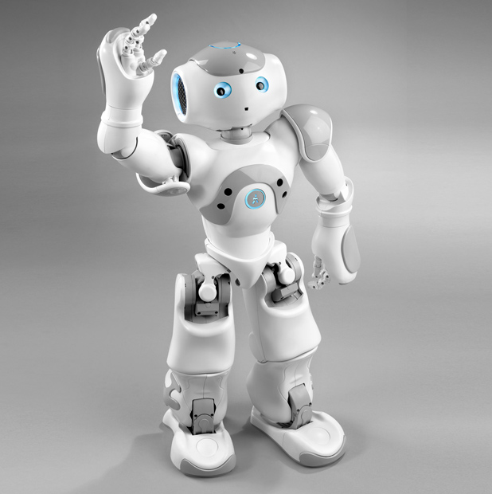
The Process 1
Read up on the NAO Pyhon API.
Develop out first NAO python scripts.
  Say ”Hello”
  Let the robot walk

Slide 5
The Process 2
Started researching how to do face detection and recognition.
NAO already had finished face detection and recognition modules.
  They were not optimal but we decided to try to follow a different path in out project.

Slide 6
New Project
Decided on new project to let NAO find and follow a wall.
Decided to use the NAO robots sonar to keep a constant distance to the wall.

Slide 7
Difficulties with NAO Sonar
NAO Sonar distances in a room.
Sonars on the left and right side easily interfeared by robot arms.
Tried to use sonar readings to calculate how to navigate the robot.

Slide 9
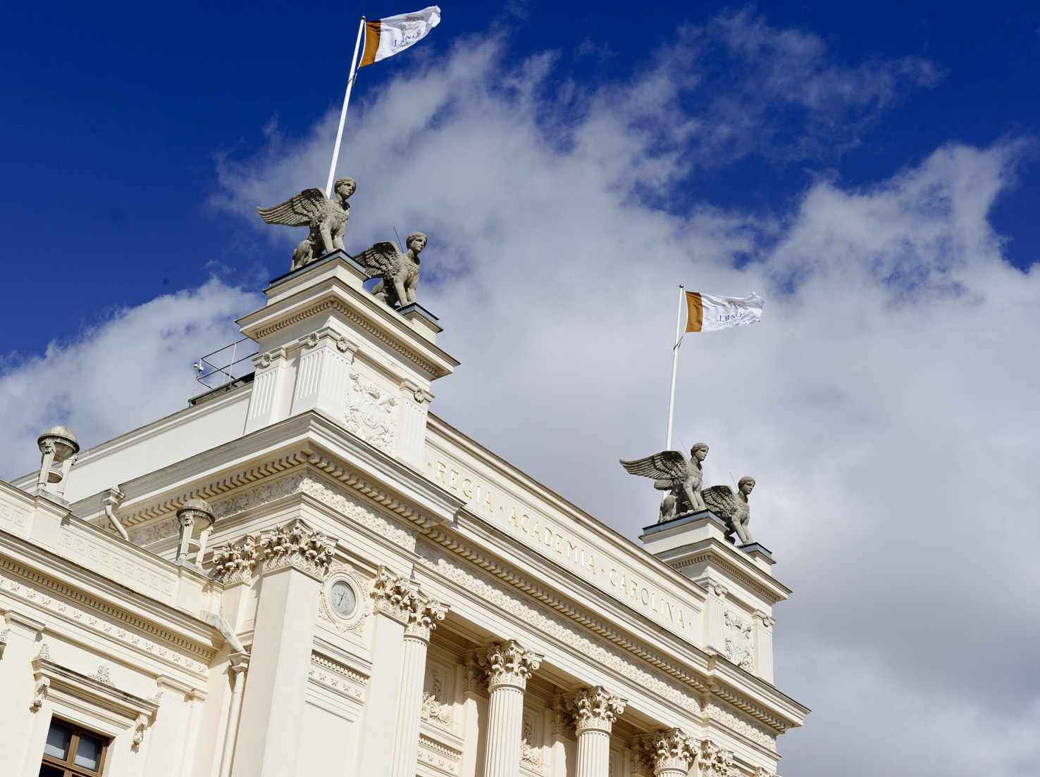

Insert own photo
Insert a photograph that fills the slide and place it furthest back (right-click and select “send to back”). Then remove the sample photo! (select and press “delete”)
One-line title
subtitle

Slide 10
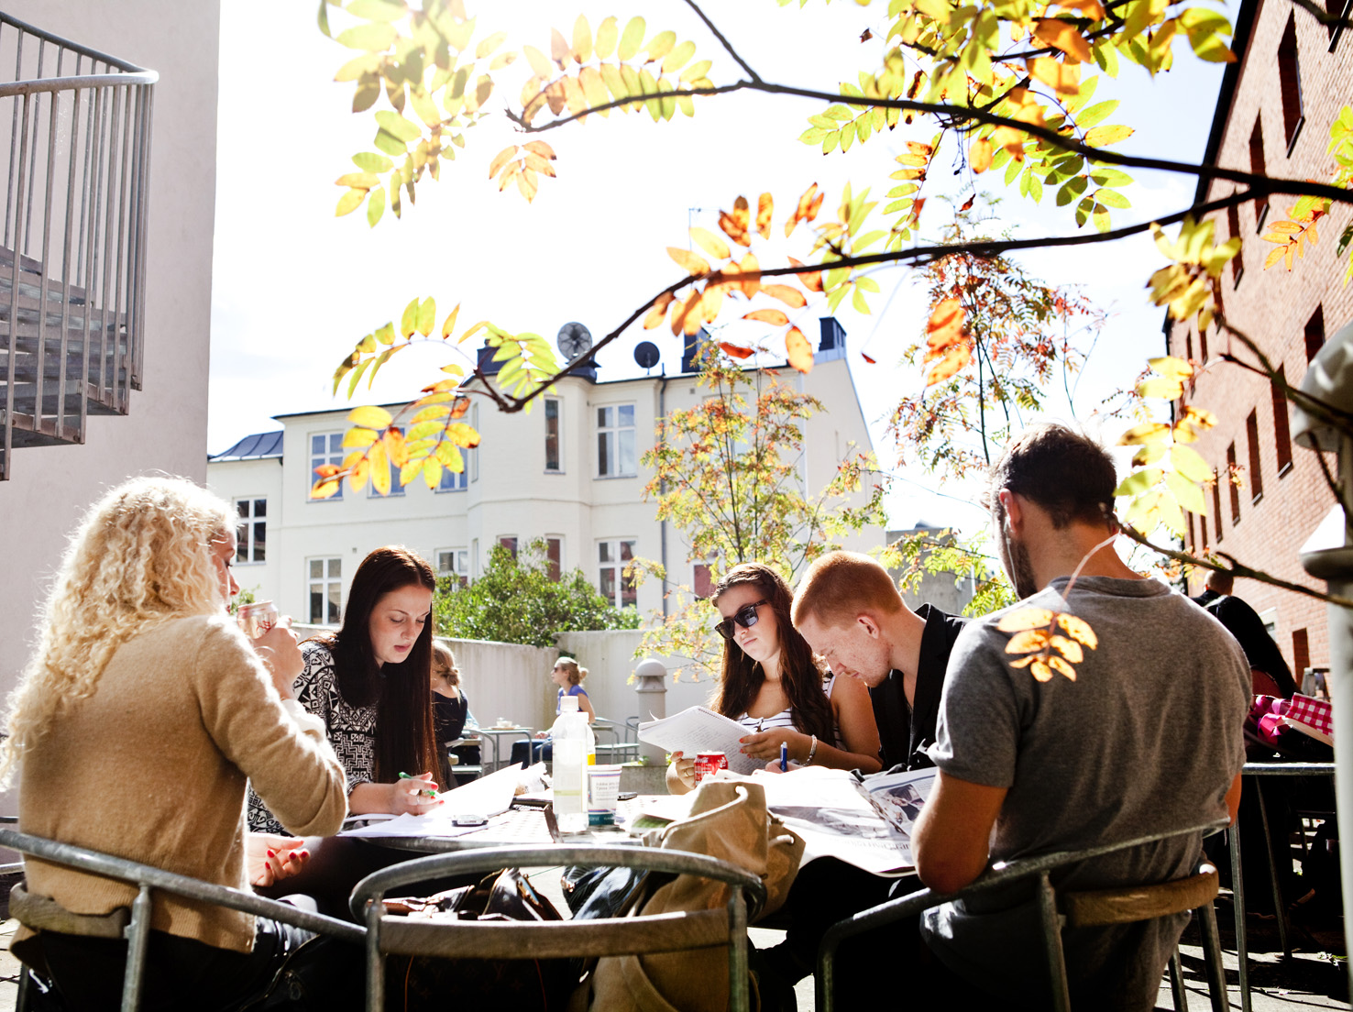
Insert own photo
Insert a photograph that fills the slide and place it furthest back (right-click and select “send to back”). Then remove the sample photo! (select and press “delete”)
Longer two-line
title
subtitle

Slide 11
Title
Add text
5th quarter
1st quarter
4th quarter
3rd quarter
2nd quarter

Slide 12
Title
Add text

Slide 13
Title
Add text

Slide 14
1st quarter | 2nd quarter | 3rd quarter
Education
Education
Education
Education

