Slide 1
GHW Heart Failure Readmission Prediction
Domain: Healthcare Analytics
Presented by: Tabashu Thulasi

Slide 2
Project Objective
To develop a predictive model that identifies patients who are at high risk of being readmitted after a heart failure-related hospitalization using clinical, demographic, and historical hospital data.

Slide 3
Dataset Overview
- Source: Hospital Readmissions Data from Kaggle
- Total Records: 1000
- Readmission Rate: 501 (50.1%) were readmitted, 499 (49.9%) were not
- Target Variable: Readmission_30or60Days (0 = Not Readmitted, 1 = Readmitted)
- Features include:
• Demographics: Age, Gender, Ethnicity
• Medical History: Previous Admissions
• Lab Vitals: NT_proBNP, Sodium, Creatinine
• Hospitalization Info: Length of Stay, Discharge Disposition

Slide 4
Methodology
Data Preprocessing & Cleaning
Exploratory Data Analysis (EDA)
One-Hot Encoding & Scaling
SMOTE to handle class imbalance
Model Training (LogReg, RF, XGBoost, SVM)
Evaluation using F1 Score, ROC AUC, Confusion Matrix
Feature Importance Analysis

Slide 5
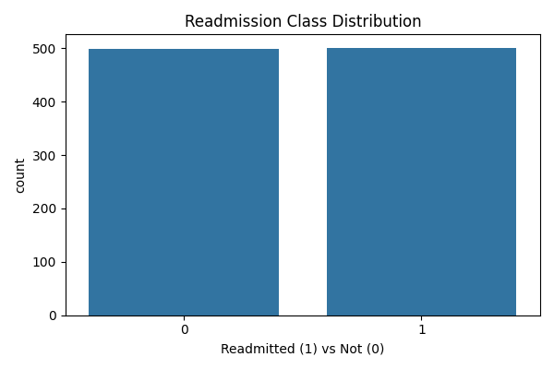
Data Preprocessing & EDA
- Checked and confirmed no missing values
- One-hot encoded categorical features
- Standardized features using StandardScaler
- SMOTE applied to balance classes
Readmission Class Distribution:
Before SMOTE: 50.1% readmitted
After SMOTE: 50% each class
- Visualized readmission distribution and correlations

Slide 6
Models & Hyperparameters
Trained and evaluated four models with GridSearchCV:
- Logistic Regression: C = [0.1, 1, 10]
- Random Forest: n_estimators = 100, max_depth = [5, 10]
- XGBoost: learning_rate = 0.1, max_depth = 3
- SVM: C = [0.1, 1], gamma = 'scale'

Slide 7
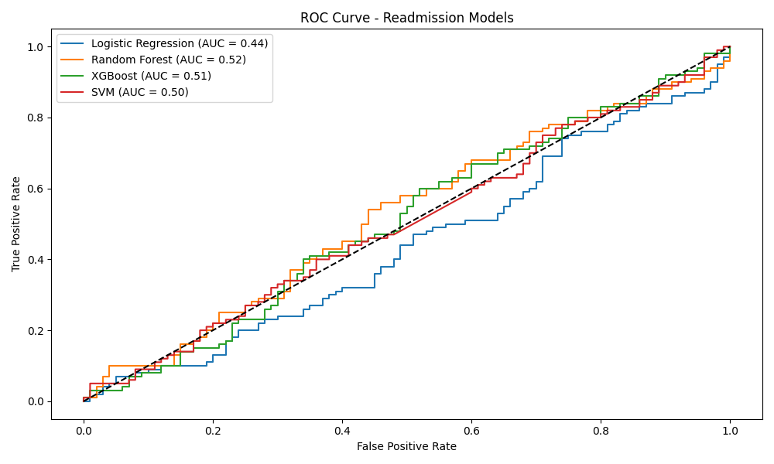
Model Evaluation Results
Random Forest (Best Model):
- Accuracy: 55%
- Precision: 54%
- Recall: 55%
- F1 Score: 55%
- ROC AUC: 0.52
- Random Forest correctly predicted 55 out of 100 readmission cases (Recall = 55%).
- 54 non-readmitted patients were correctly flagged (True Negatives = 54).
- SMOTE balanced class distribution to 401 samples per class for fair model learning.
Other models (F1 Scores):
- Logistic Regression: 45%
- XGBoost: 48%
- SVM: 48%

Slide 8
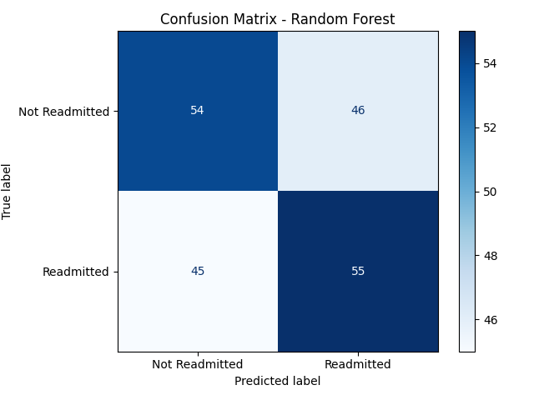
Confusion Matrix (Random Forest)
True Negatives (TN): 54
False Positives (FP): 46
False Negatives (FN): 45
True Positives (TP): 55

Slide 9
Key Insights
- Random Forest gave the best performance trade-off
- XGBoost Feature Importance (Top 5):
Ethnicity_White (Importance: 0.062)
Creatinine (0.061)
Gender_Male (0.056)
BUN (0.056)
Ejection Fraction (0.054)
- SMOTE balanced class distribution for better generalization
- SVM showed 100% recall earlier, but final model had balanced F1 with Random Forest

Slide 10
Recommendations
- Deploy Random Forest model in clinical workflows for early readmission flagging.
- Use XGBoost insights to enhance clinician decision-making.
- Implement post-discharge care interventions for flagged patients.
- Monitor model performance quarterly and retrain with new data.

Slide 11
Conclusion
This project successfully built and evaluated machine learning models to predict heart failure readmissions. Random Forest emerged as the most balanced model. Integrating this model into hospital systems can reduce readmission rates, optimize resources, and improve patient outcomes.

