Slide 1
System Analysis and Design on Dutch Bangla Bank Ltd. (Noapara Branch)
Supervised By:
Dr. Kaushik Deb
Professor
Dept. of CSE, CUET
Sabiha Anan
Assistant Professor
Dept. of CSE, CUET
Submitted By:
Moutushi Afrin – 1804073
Tabassum Ferdous – 1804082
Ohcitya Bhattacharjee – 1804086
Sadia Islam Nova – 1804091
Fahmida Ahmed - 1804095

Slide 2
Contents
Introduction
SDLC
Data Flow Diagram(DFD)
i) Context Diagram
ii) Logical & Physical DFD
Validating the Data Flow Diagram
Conclusion

Slide 3
Introduction
A traditional way to visualize the information flows within a system.
Good communication tool between user and system
analyst.
Purpose is to show the scope and boundaries of a system.

Slide 4
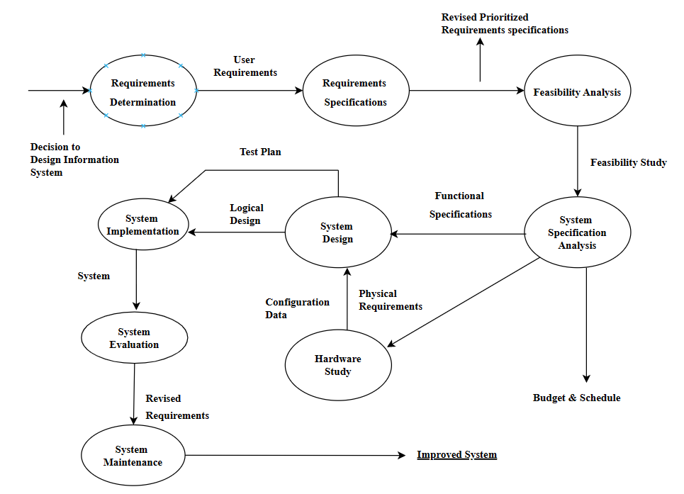
System Development Life Cycle(SDLC)
Fig1. SDLC

Slide 5
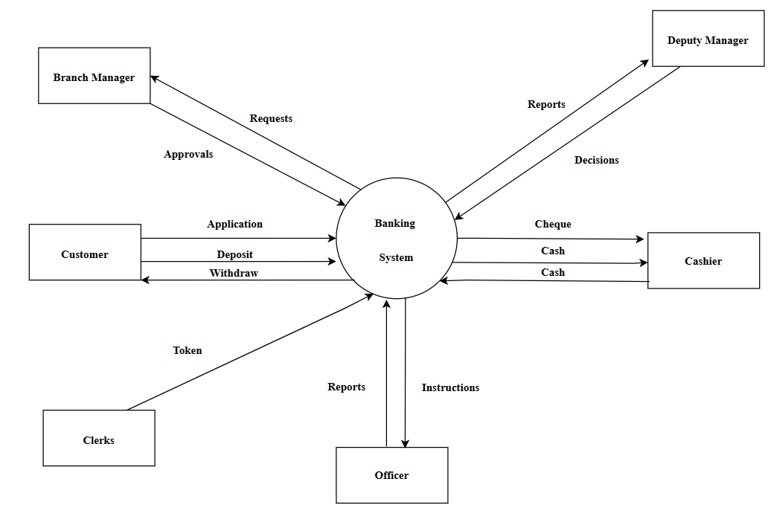
Data Flow Diagram(DFD)
Fig2. Context Diagram

Slide 6
Data Flow Diagram(DFD)(contd.)
Classified as –
Physical DFD
Logical DFD

Slide 7
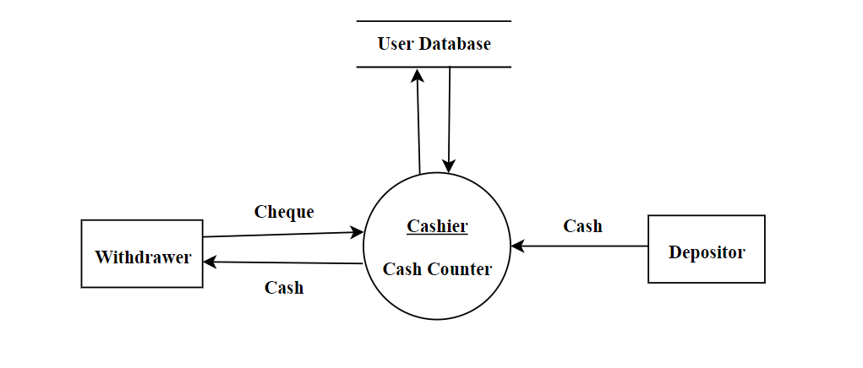
Data Flow Diagram(DFD)(contd.)
Fig3. Physical DFD of Transaction system

Slide 8
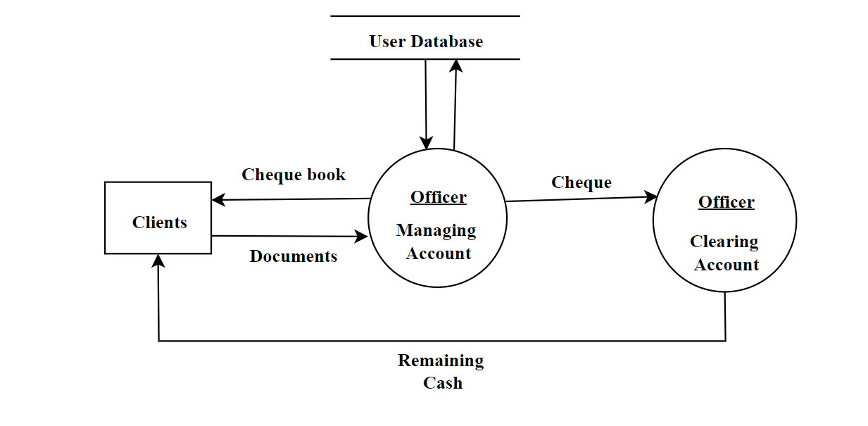
Data Flow Diagram(DFD)(contd.)
Fig4. Physical DFD of General Banking system

Slide 9
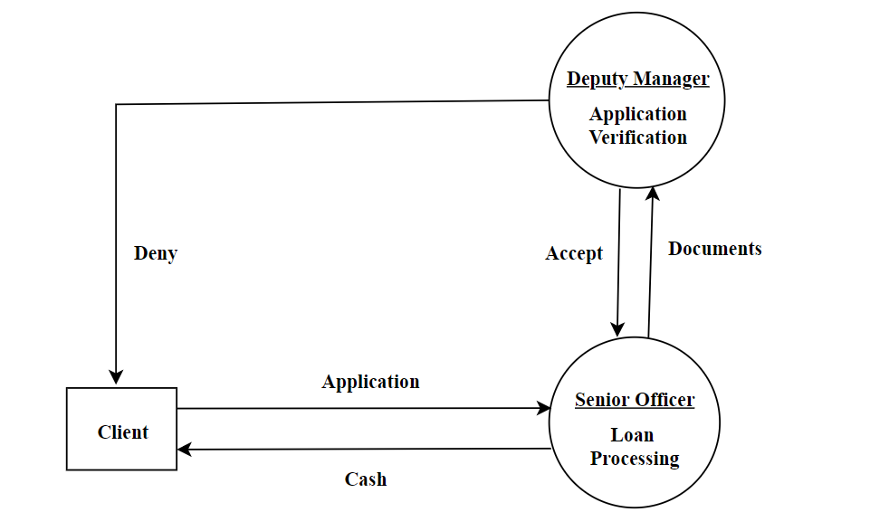
Data Flow Diagram(DFD)(contd.)
Fig5. Physical DFD of Loan System

Slide 10
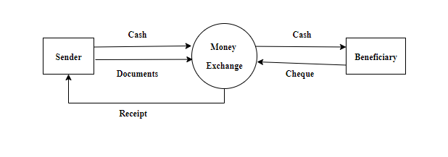
Data Flow Diagram(DFD)(contd.)
Fig6. Physical DFD of Remittance

Slide 11
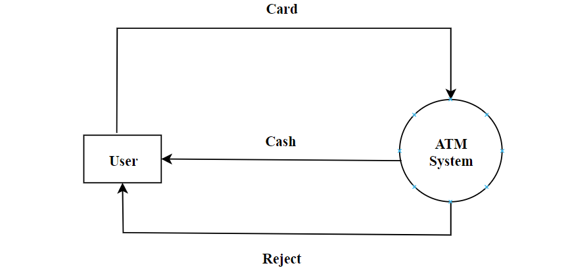
Data Flow Diagram(DFD)(contd.)
Fig7. Physical DFD of ATM System

Slide 12
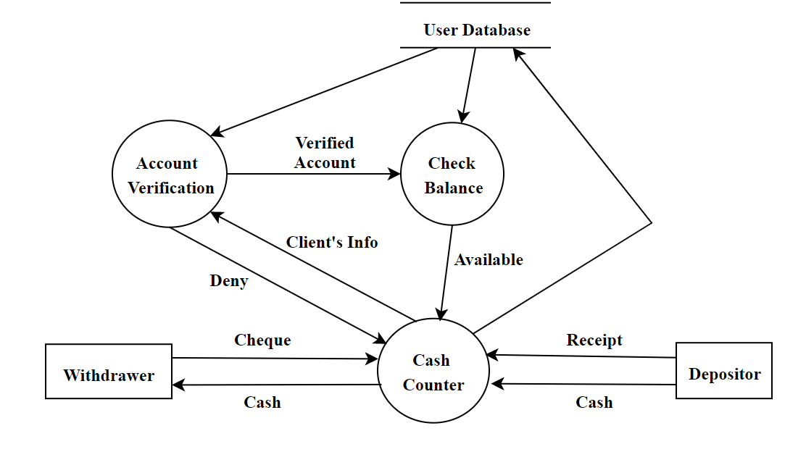
Data Flow Diagram(DFD)(contd.)
Fig8. Logical DFD of Transaction System

Slide 13
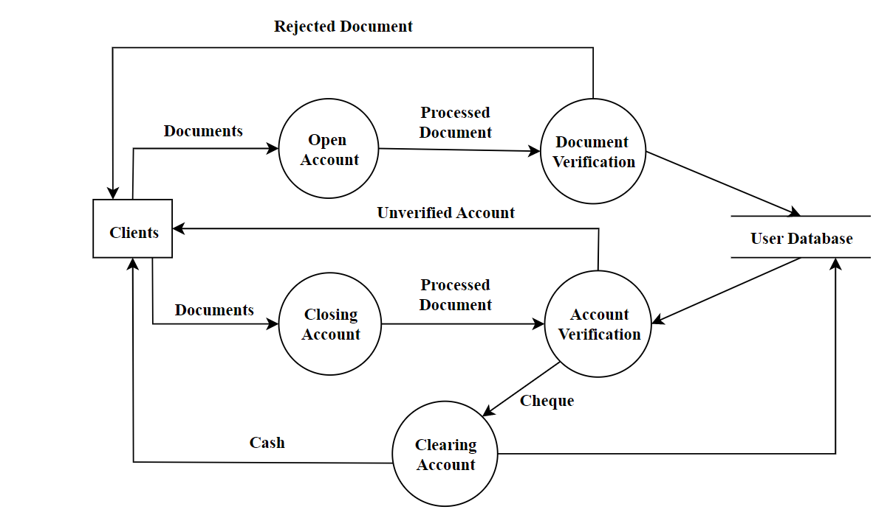
Data Flow Diagram(DFD)(contd.)
Fig9. Logical DFD of General Banking System

Slide 14
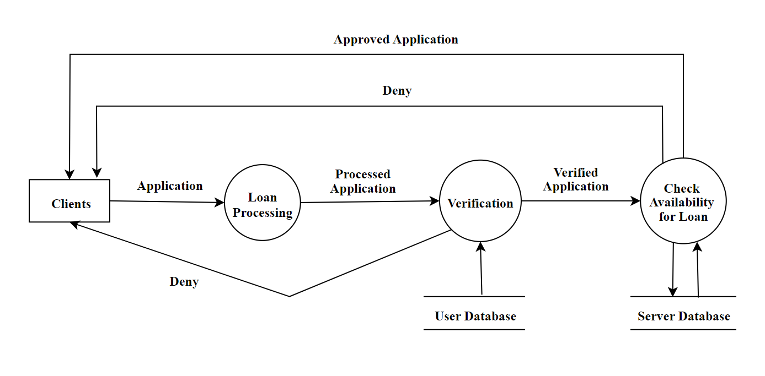
Data Flow Diagram(DFD)(contd.)
Fig10. Logical DFD of Loan System

Slide 15
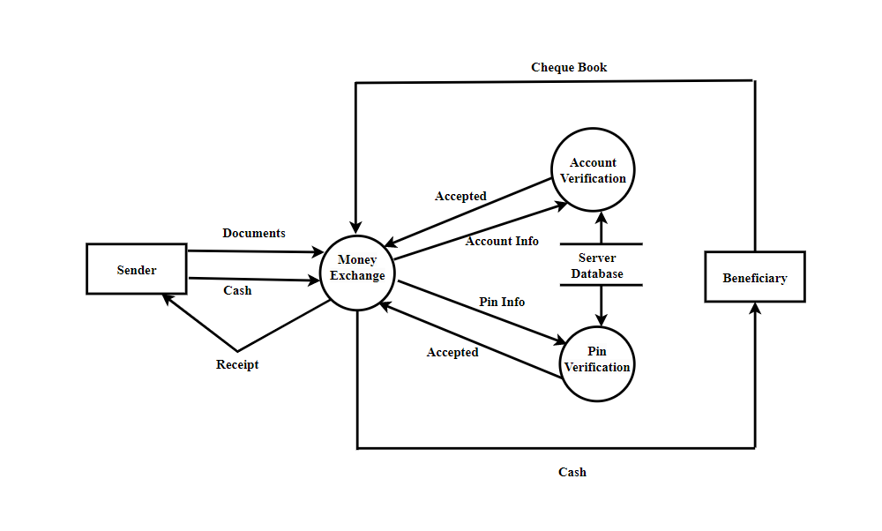
Data Flow Diagram(DFD)(contd.)
Fig11. Logical DFD of Remittance System

Slide 16
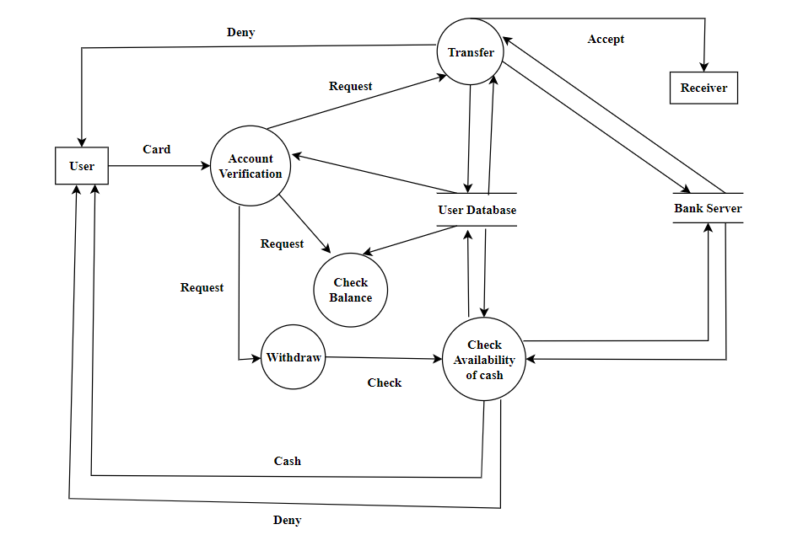
Data Flow Diagram(DFD)(contd.)
h
Fig12. Logical DFD of ATM System

Slide 17
Validating the Data Flow Diagram
Rules for DFD (Data Flow Diagram):
Data can flow from:
i) External entity to Process
ii) Process to External entity
iii) Process to Store and Back
iv) Process to Process

Slide 18
Validating the Data Flow Diagram(Contd.)
Rules for DFD (Data Flow Diagram):
Data cannot flow from:
i) External entity to External entity
ii) External entity to Store
iii) Store to External entity
iv) Store to Store

Slide 19
Validating the Data Flow Diagram(Contd.)
Rules for DFD (Data Flow Diagram):
Illegal Constructs in DFD:
i) No loops are allowed in DFD
ii) A single data flow should not be split into many flows … with different labels
iii) No data flow allowed between data stores

Slide 20
Conclusion
From the study
Able to know how the context diagram and DFD work
How data is transferred and system implemented
How the processes are conducted

Slide 21
Thank You!
☺

