Slide 1
System Analysis and Design on Dutch Bangla Bank Ltd. (Noapara Branch)
Supervised By:
Dr. Kaushik Deb
Professor
Dept. of CSE, CUET
Sabiha Anan
Assistant Professor
Dept. of CSE, CUET
Submitted By:
Moutushi Afrin – 1804073
Tabassum Ferdous – 1804082
Ohcitya Bhattacharjee – 1804086
Sadia Islam Nova – 1804091
Fahmida Ahmed - 1804095

Slide 2
Contents
Introduction
UML Diagram
i) Use Case Diagram
Conclusion

Slide 3
Introduction
To analyze and visualize, the system needed to be
designed
For Object Oriented Analysis and design, UML is a
modest approach

Slide 4
UML Diagram
UML – Unified Modeling Language
UML is a language for Visualizing, Specifying,
Constructing, Documenting
The main components of UML are things,
relationships, and diagrams.

Slide 5
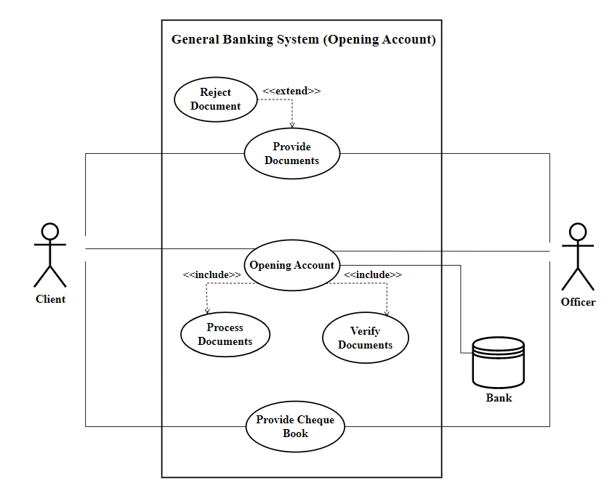
Use Case Diagrams
i) General Banking:
Figure 1: Use Case Diagram for General Banking (Opening Account)

Slide 6
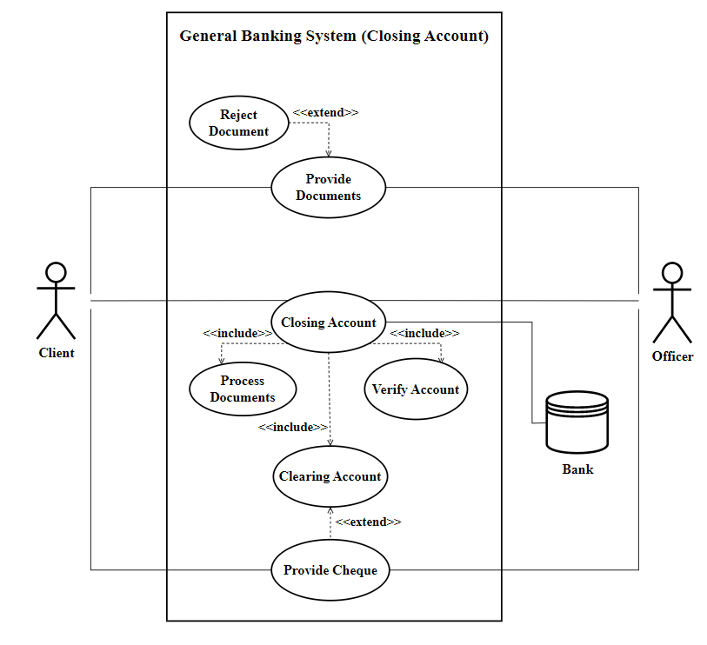
Use Case Diagrams (contd.)
..
Figure 1: Use Case Diagram for General Banking (Closing Account)

Slide 7
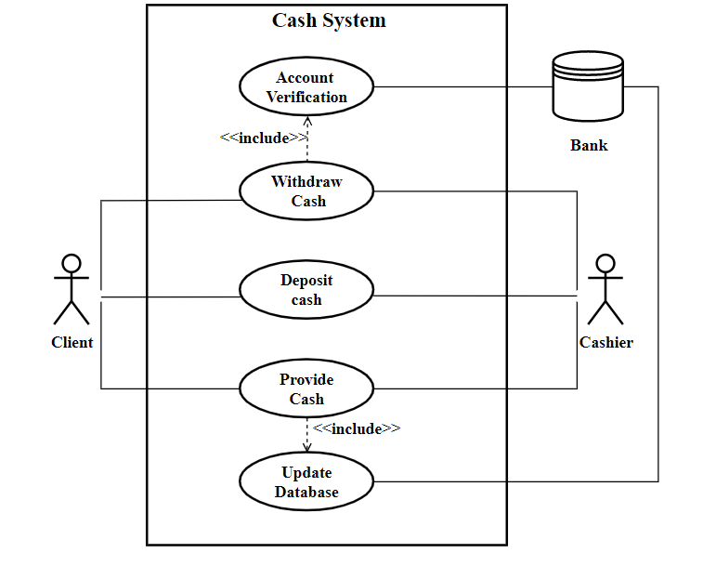
Use Case Diagrams (contd.)
ii) Cash:
Figure 3: Use Case Diagram for Cash section

Slide 8
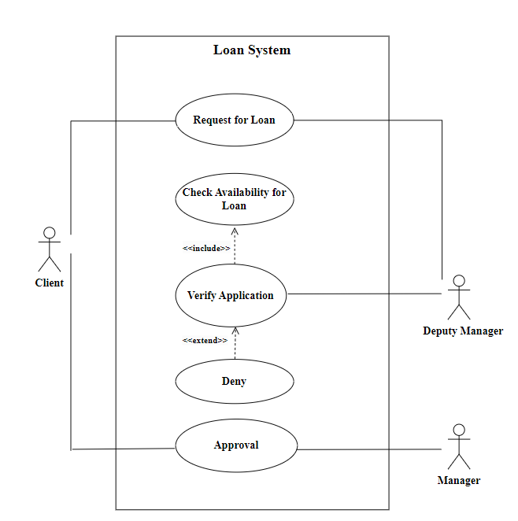
Use Case Diagrams (contd.)
iii) Loan:
Figure 4: Use Case Diagram for Loan system

Slide 9
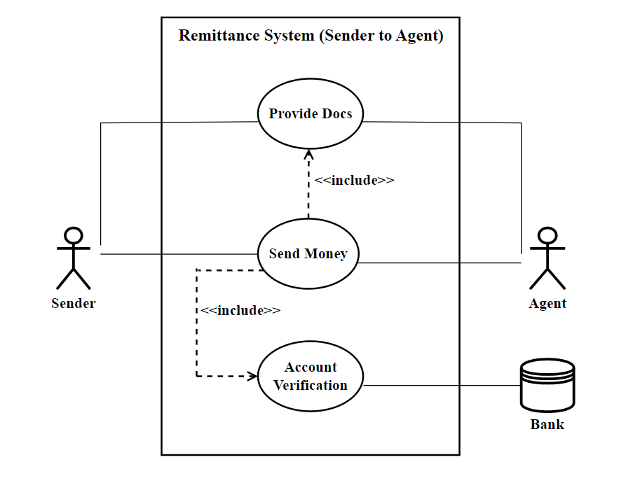
Use Case Diagrams (contd.)
Figure 5: Use Case Diagram for Remittance (Sender to Agent)
iv) Remittance:

Slide 10
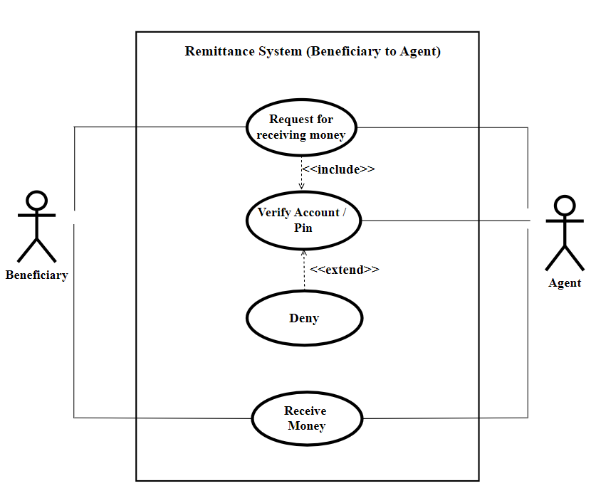
Use Case Diagrams (contd.)
Figure 6: Use Case Diagram for Remittance (Beneficiary to Agent)

Slide 11
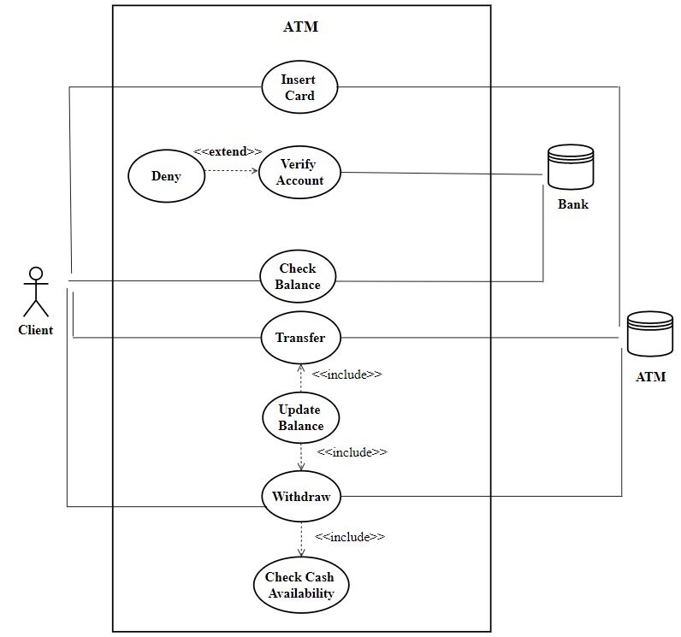
Use Case Diagrams (contd.)
v) ATM:
Figure 7: Use Case Diagram for ATM System

Slide 12
Conclusion
UML diagram is used to describe the object and
the information structure of the system.
It shows how the users and the system are
communicating
It helps us to visualize different sections of Dutch
Bangla Bank Ltd. (Noapara Branch)

Slide 13
Thank You!
☺

