Slide 1

Project 3: Soccer Mania
By: Pedro Gomez, Bose Babu Ravula, Tabassum Choudhury, Tanner Hunter and Antara Choudhury.
Dataset:https://www.kaggle.com/datasets/abecklas/fifa-world-cup

Slide 2
Theme
Aim of our Project: to uncover patterns in World Cup Data
We will examine:
Relationships between matches (stage, home team and away team), year, and attendance.
Relationships between Total # of Goals (Home Team Goals and Away Team Goals), Year and City.
Comparison of winning countries.

Slide 3
Coding Approach
Created data visualizations to tell a story by:
Creating a Python Flask-powered API with different routes,
Creating HTML templates and CSS files,
Creating a Postgresql database.
Writing JavaScript for each visualization
Created dashboard page with multiple charts that update from same data.
Used JavaScript library chart.JS.

Slide 4
Data Wrangling Techniques
After reading WorldCupMatches.csv into Pandas, we took following actions to remove errors:
Dropped Datetime column,
Created a dataframe that shows the Year, Stage, Home Team, Away Team, Attendance and MatchID,
Renamed columns,
Grouped data by MatchID,

Slide 5
Data Wrangling Techniques
After reading WorldCupPlayers.csv into Pandas, we:
Created dataframe that shows the Year, Home Team Goals, Away Team,
Goals and City, and also dropped missing values
Renamed columns and grouped data by year and city
After reading WorldCups.csv into Pandas, we:
Created a dataframe that shows the Winning Country, Year and Goals Scored

Slide 6
Final Visualization 1
In the first visualization we wanted to showcase attendance to world cup matches based on years. Users can choose a year from the dropdown list and view top ten matches with highest attendance for that year.

Slide 7
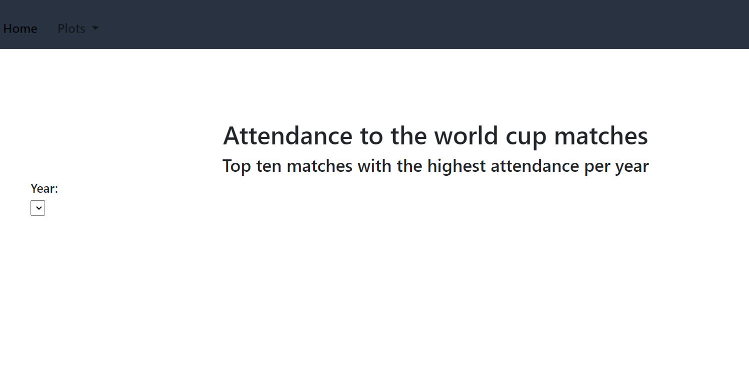

Slide 8
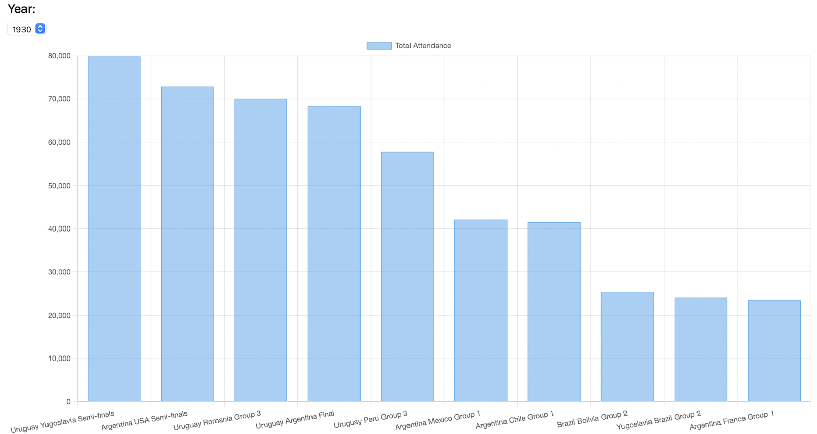


Slide 9
Final Visualization 2
On the 2nd part of the visualization, we tried to demonstrate distribution of goals across cities through a heatmap.
Final Visualization 2

Slide 10
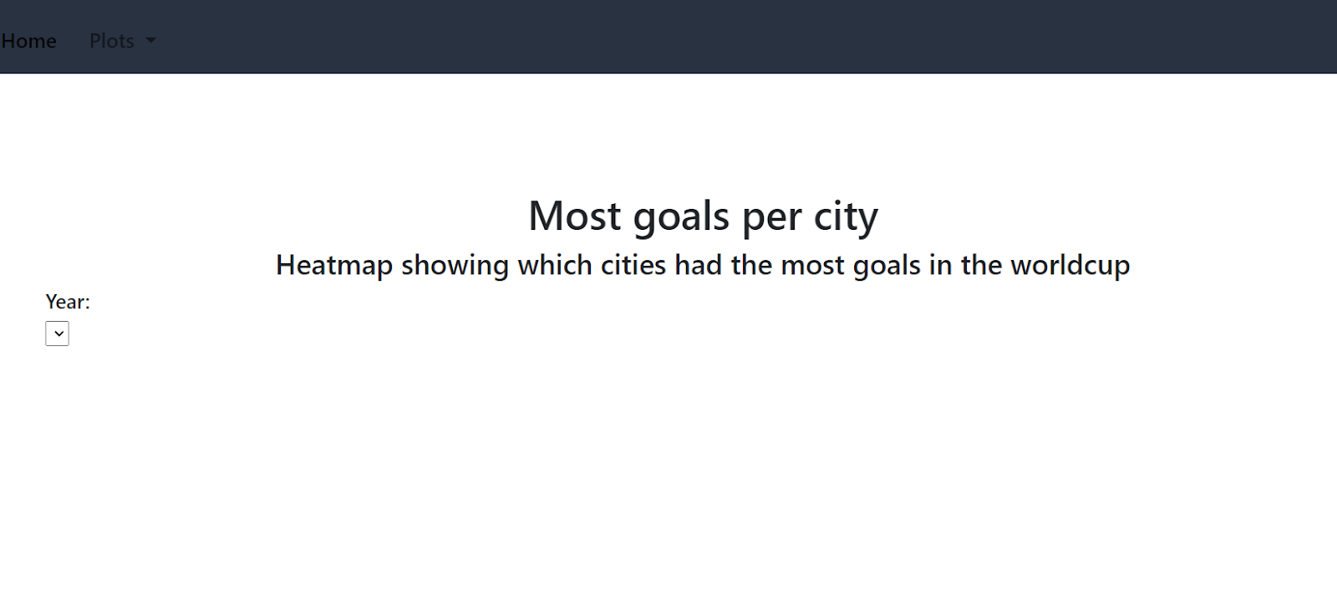

Slide 11
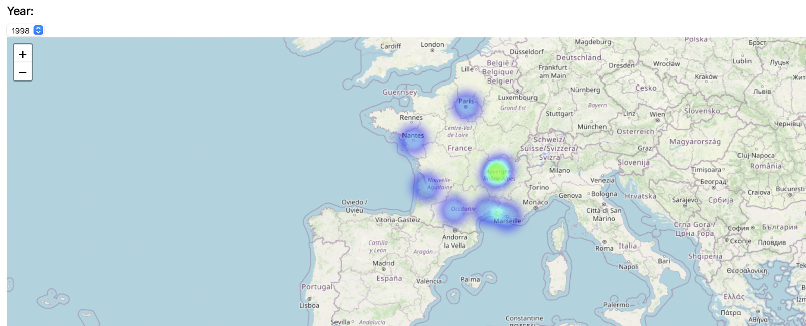

Slide 12
Final Visualization 3
In this part we tried to create a visualization based on the winners of FIFA world cup from 1930 – 2014,
We also tried to demonstrate comparison between two countries chosen by the user based on following factors:
  Winner
  Year of winning
  No.of goals

Slide 13
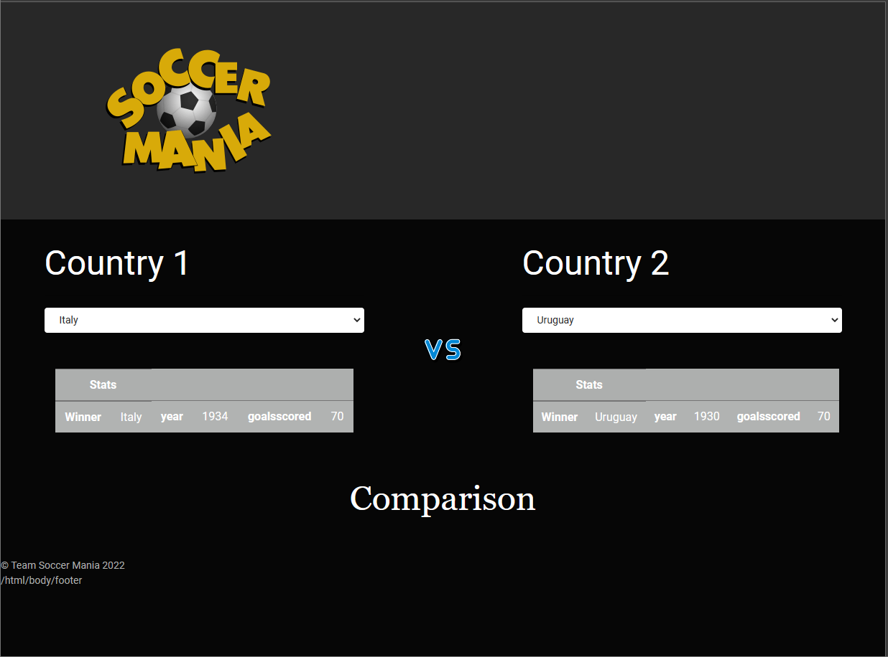

Slide 14
Conclusion
Overall, our intention was to showcase information with trends on soccer world cup matches over the years based on parameters that deemed necessary and also was available. That was all from us! Signing off team Soccer Mania.

